Slide 1
Control Synthesis for the Flow-Based Microfluidic Large-Scale Integration Biochips
Wajid Minhass, Paul Pop, Jan Madsen, Tsung-Yi Ho* Technical University of Denmark
*National Cheng Kung University, Taiwan

Slide 2

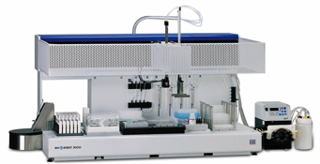
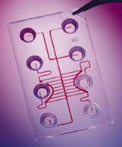

Motivation for biochips
Automation
Test tubes
Integration
Miniaturization
⬇
Automation
Robotics
Integration
Miniaturization
⬇
Microfluidic Biochips
Automation
Integration
Miniaturization
Slide source: Krishneddu Chakrabarty, Duke Universtiy

Slide 3

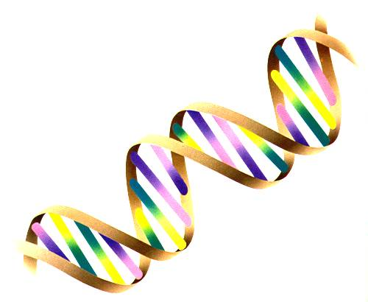
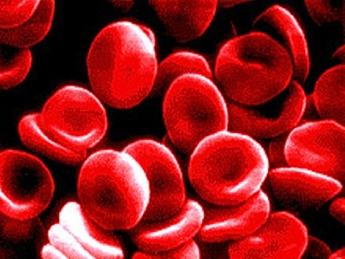
Applications
  Cell culturing
  Clinical diagnostics
  DNA sequencing
  Protein analysis
  Molecular biology
  …

Slide 4
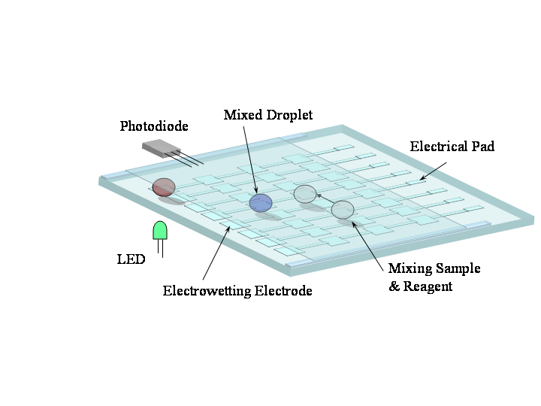
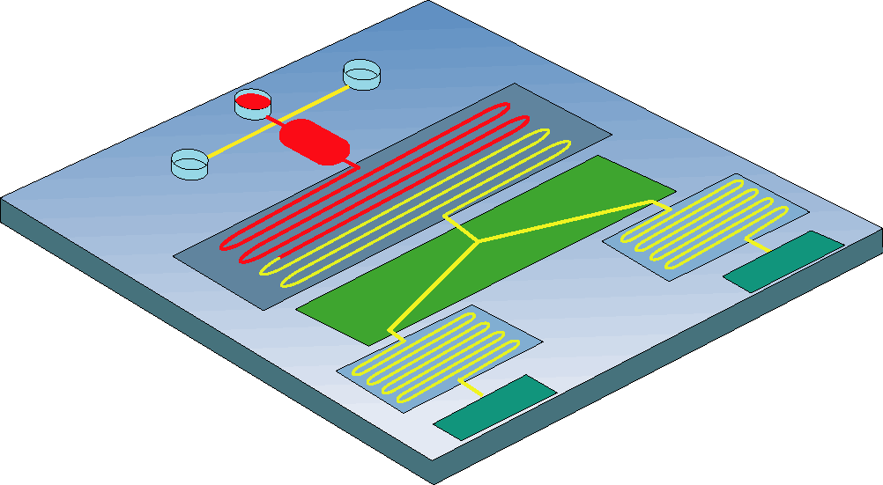
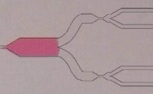
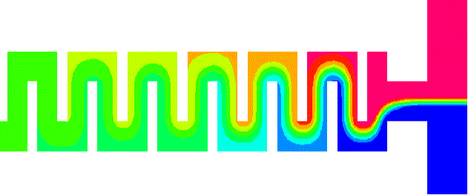
Microfluidics
Continuous-flow biochips: Permanently-etched microchannels, micropumps and microvalves, electrokinetics, etc.
Digital microfluidic biochips: Manipulation of liquids
as discrete droplets
Multiplexing
Mixing: Static or Dynamic
Biosensors:
Optical: SPR, Fluorescence etc.
Electrochemical: Amperometric, Potentiometric etc.
Slide source: Krishneddu Chakrabarty, Duke Universtiy

Slide 5
Continuous flow microfluidic biochips
Technology:
  Multi-layer soft lithography
  Fabrication substrate:
  elastomers (e.g., PDMS)
    Good biocompatibility
    Optical transparency
Microfluidic VLSI, or mVLSI
  Valve size: 6 × 6 µm²
    possible to have 1 million valves/ cm²
    advancing faster than Moore’s law
  Increasing design complexity
  (commercial chip with 25,000 valves
  performing 9,216 PCRs in parallel)

Slide 6
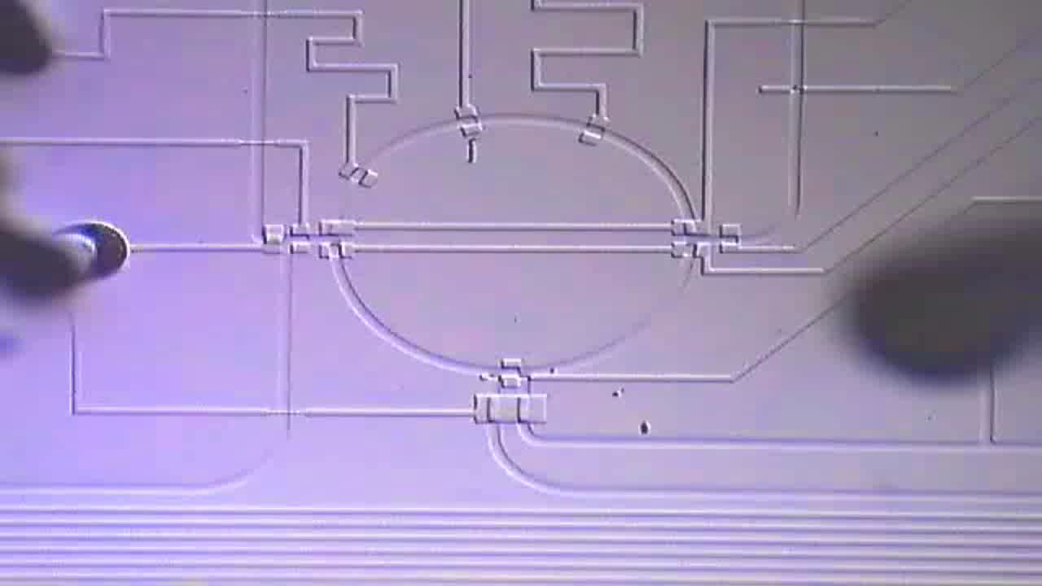
Components
Microfluidic mixer
http://groups.csail.mit.edu/cag/biostream
10x real-time

Slide 7
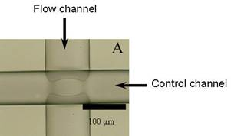
Basic building block: microfluidic valve

Slide 8
Component model: flow layer
Microfluidic mixer
Flow layer model:
Operational phases + Execution time
Five phases:
Ip1
Ip2
Mix
Op1
Op2
Ip1

Slide 9
Component model: control layer
Input
Waste
Input
Waste
Ip2
Mix
Input
Waste
Input
Waste
open
Op1
closed
Op2
mixing state

Slide 10
Components
Many types of components can be integrated:
  switches, mixers, multiplexers, micropumps, detectors, filters, heaters, separators, storage units, etc.
Microfluidic switch

Slide 11
Motivation for CAD
Current methodologies
  Manual: drawing in AutoCAD
  Full-custom
  Bottom-up
New top-down synthesis methodologies are needed

Slide 12
Design tasks: VLSI vs mVLSI
We have proposed models and algorithms for all the mVLSI tasks:
Wajid Minhass, System-Level Modeling and Synthesis Techniques for Flow-Based Microfluidic Very Large Scale Integration Biochips, PhD thesis, Technical University of Denmark, 2013

Slide 13
System Model
Architecture model
Application model
Component model, e.g., mixer

Slide 14
Problem Formulation
Given
  A biochip architecture A
  Component model library L
  A biochemical application G
Perform control synthesis
  Generate the control logic
    Deciding which valves need to be opened or closed, in what sequence and for how long, in order to execute the application on the chip
    Current practice: manual—tedious and error-prone
  Minimize the chip pin count
    Share control pins between valves
    Minimizes macro-assembly around the chip and increases scalability
  such that the application completion time is minimized and
  all constraints (resource, dependency, routing) are satisfied

Slide 15
1. Control Logic Generation
Given the application and architecture models, we perform binding and scheduling to obtain the schedule
Notes:
Schedule

Slide 16
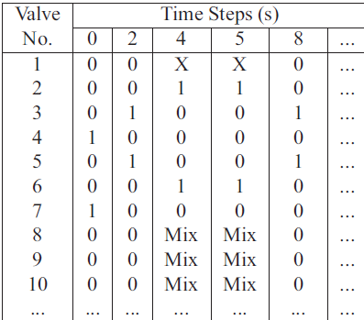
1. Control Logic Generation
Given the schedule and the component model,
we generate the control logic (we also remove redundant valves)
Notes:
Control logic table

Slide 17
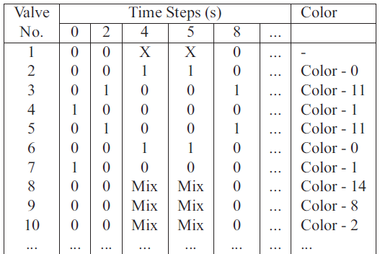
2. Control Pin Count Minimization
Control pin sharing: reduced to a graph coloring problem
  Finding the chromatic number: NP-hard problem
  Many heuristic solutions exist, we use a Tabu Search approach
2
3
8
5
4
6
7

Slide 18
Experimental Results
PCR: Polymerase Chain Reaction mixing stage
IVD: In-vitro diagnostics
Allocated units: (Mixers, Heaters, Filters, Detectors)
NR: non-redundant
In all cases, pin count reduced by more than 70%

Slide 19
Contributions and message
Message
  Biochips have the potential to revolutionize life sciences
  They are getting very complex
  Top-down CAD tools are needed to support the designer
Contribution:
  Top-down control synthesis framework
  Models and problem formulation
Limitations:
  Only one control layer (both push-up and push-down valves exist)
  Only one valve size (valves can be of different sizes,
  closing at different pressures)
  The control synthesis problem was considered in isolation

Slide 20
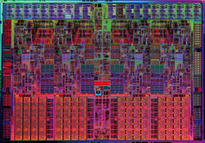
Motivation: revolutionize life sciences
Biological systems are incredibly complex
  Biologists have to run an immense number of experiments
  to understand what a biological system does
  Example: how would you find out
  what this microprocessor is doing?
    Just taking pictures and checking voltages?
    Millions of input-output experiments,
    to identify patterns
    Alter components and see how they affect the functionality
What is needed: Moore’s law for experimental biology
  From 100 experiments a day, to 10,000,000 experiments a day
  Double the number of experiments per researcher per day
  every 18 months

Slide 21
Biochips CAD group at DTU
  We started in 2009
  Leader: Assoc. prof. Paul Pop
  Members
  Prof. Jan Madsen
  Wajid Hassan Minhass, PhD student (this work)
  Mirela Alistar, PhD student (see her paper now at ASP DAC)
  Elena Maftei, PhD (graduated 2011)
  3 MSc students (graduated)
  3 BSc students (one graduated)

Slide 22
Build your own biochip: microfluidic foundries
Foundries
  Stanford Microfluidic Foundry
  Caltech Microfluidic Foundry
Services
  Fabricate a mVLSI biochip based on your design
  Fabrication: approx. $500 for a new biochip, $25 for an existing chip
Tools provided by the foundries
  AutoCAD drawing files, to draw your chip’s masks
  List of parts to build the control

Slide 23
Open source CAD tools for mVLSI

Slide 24
Outline
Flow-based microfluidic biochips
System model
  Basic building block: valve
  Biochip architecture model: component model
  Biochemical application model
Synthesis tasks: the need for CAD tools
Problem formulation: control synthesis
  Control logic generation
  Control pin count minimization
Experimental evaluation
Contributions and message

