Slide 1
Feedback Control for the
Programmable Cell Culture Chip “ProCell”
Felician Ștefan Blaga
Supervisor: Paul Pop (DTU Informatics)
Co-supervisors: Wajid Minhass (DTU Informatics) and Martin Dufva (DTU Nanotech)

Slide 2
Outline
Early design phases
  Design decisions and uncertainties
Modeling uncertainties
  Worst-case execution time
  Functionality requirements
Problem formulation: mapping optimization
  Motivational examples
Multi-objective optimization strategy
  Robustness vs. flexibility
  Genetic Algorithm approach
  Experimental results
Conclusions and message

Slide 3
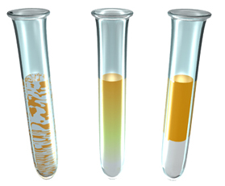
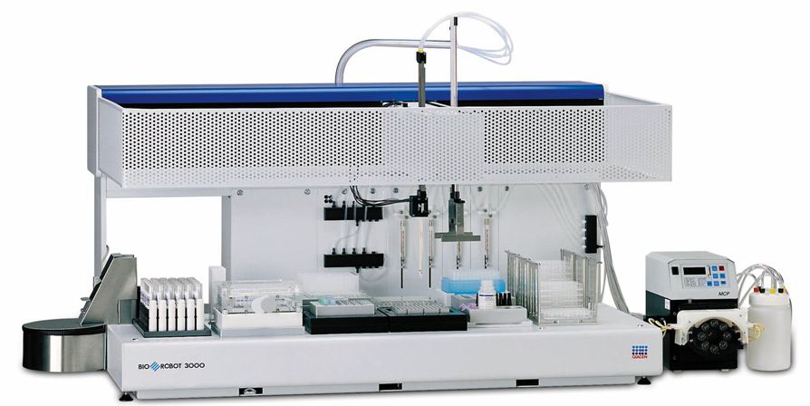

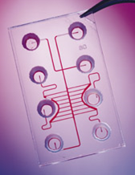
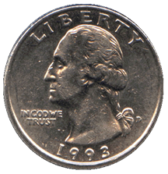
Motivation for Biochips
Automation
Test tubes
Integration
Miniaturization
⬇
Automation
Robotics
Integration
Miniaturization
⬇
Automation
Microfluidics
Integration
Miniaturization

Slide 4
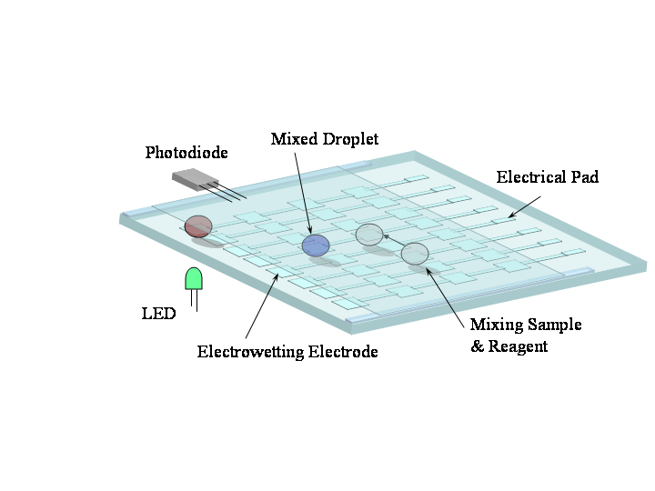
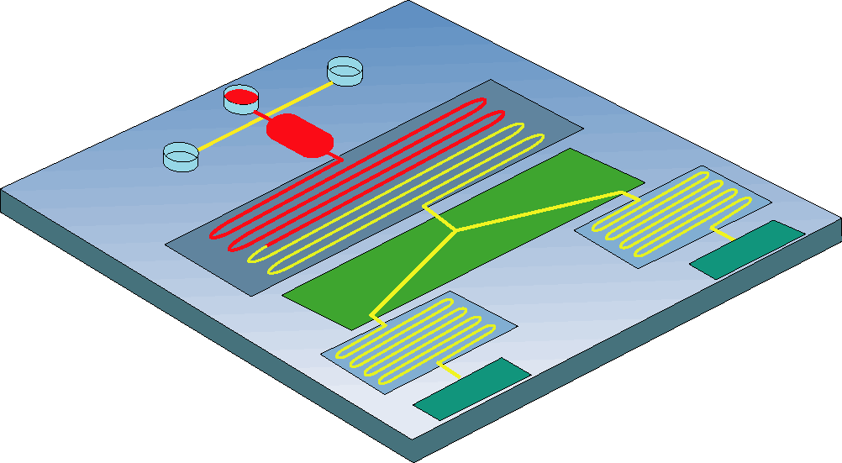
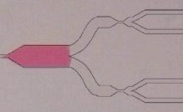
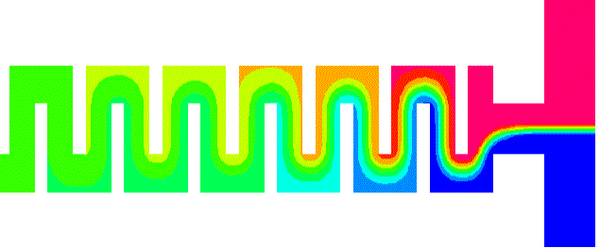
Two types of microfluidic biochips
Continuous-flow biochips: Permanently-etched microchannels, micropumps and microvalves, electrokinetics, etc.
Digital microfluidic biochips: Manipulation of liquids as discrete droplets
Multiplexing
Mixing: Static,
Diffusion Limited
Biosensors:
Optical: SPR, Fluorescence etc.
Electrochemical: Amperometric, Potentiometric etc.
Notes:
There are two different generations of microfluidics. The first one is continuous-flow biochips. They consist of microchannels, micropumps and microvalves, and they are etched on a silicon, glass or plastic substrate. This figure shows an example of such biochip developed by university of Michigan. The second generation is digital microfluidic biochips. They manipulate the liquid as droplets. Compared to continuous flow systems, they have high reconfigurability and scalable architectures.

Slide 5
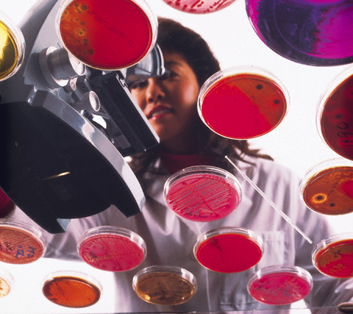
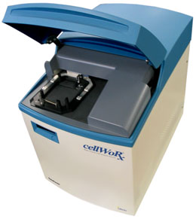
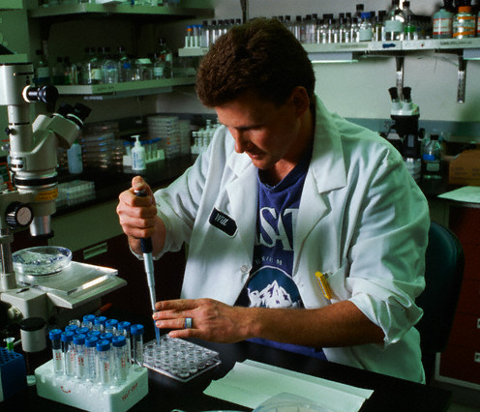
Application area: cell culturing
TODO Some text about cell culturing

Slide 6
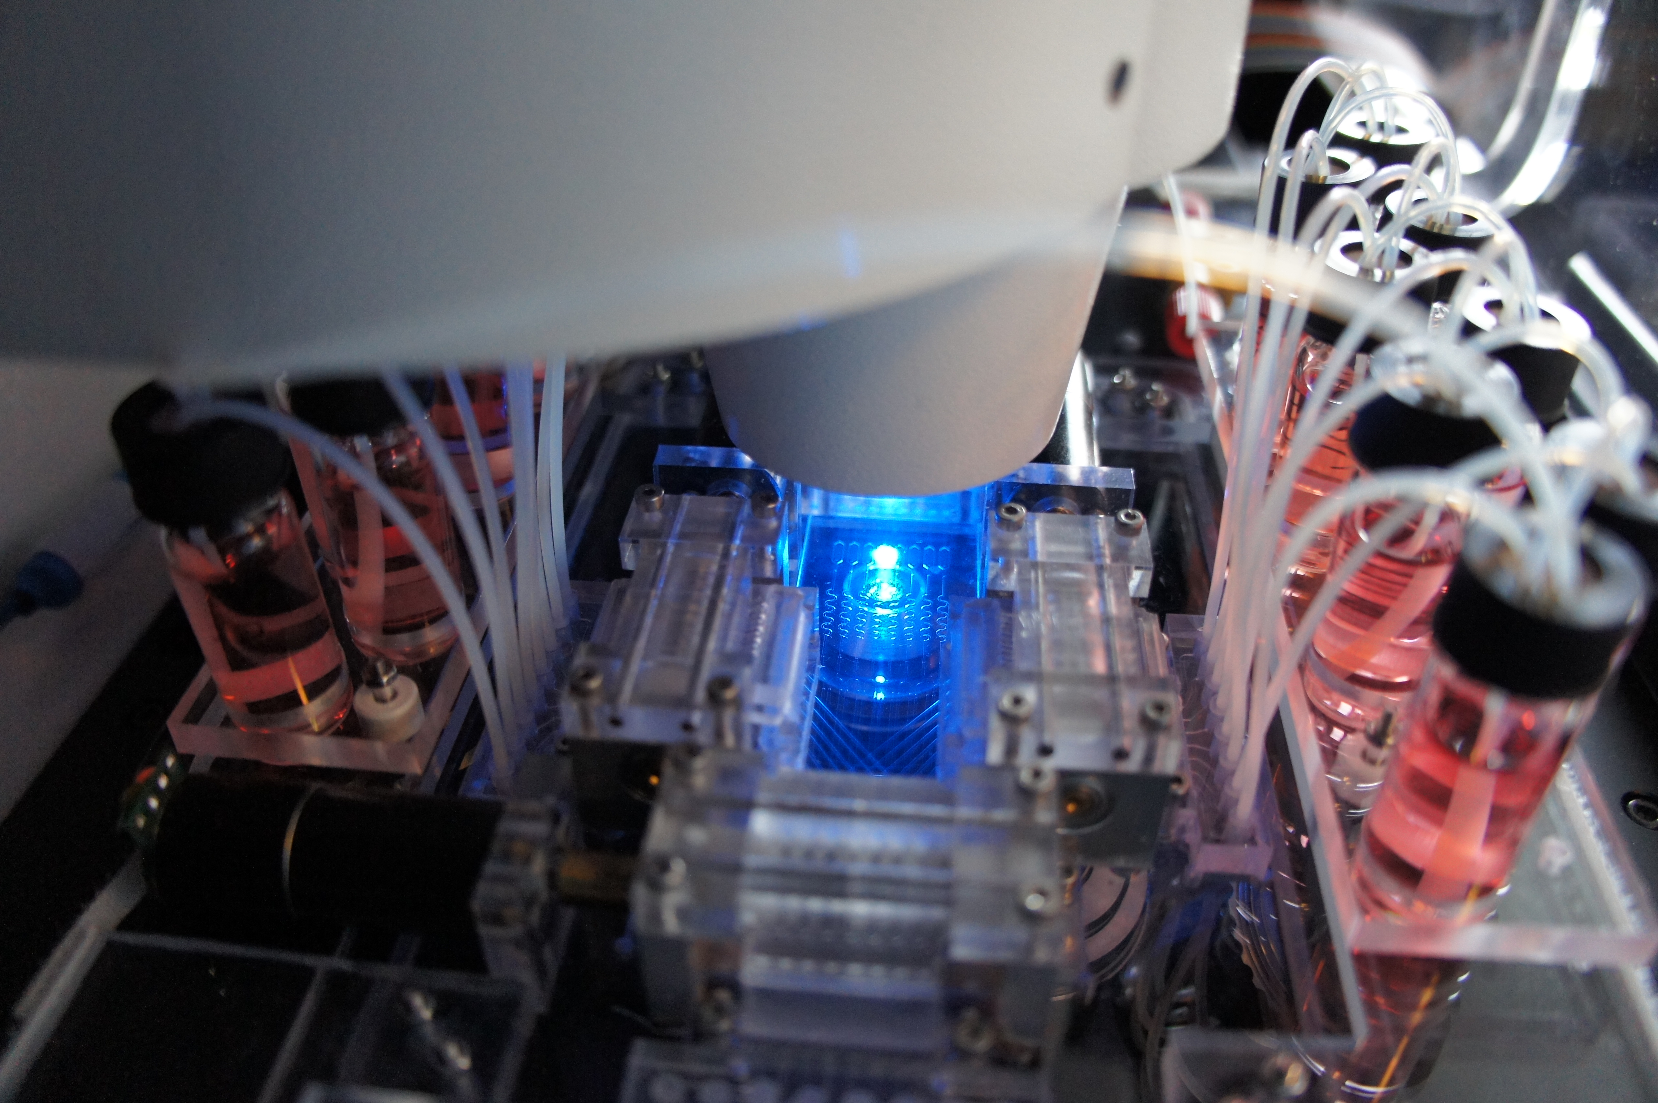
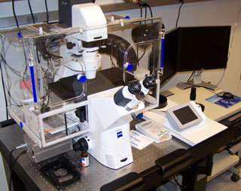
ProCell setup
Requirements:
  1
  2
Components
  1
  2

Slide 7
ProCell control diagram
Explanations, color change…
PC
Microscope
Procell Prototype
Motors controlling the pumps
Signal adaptor
LabJack
Explanations
Explanations

Slide 8
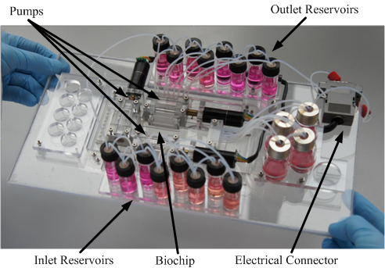
ProCell prototype
The biochip is fabricated using micro-milling prototyping

Slide 9
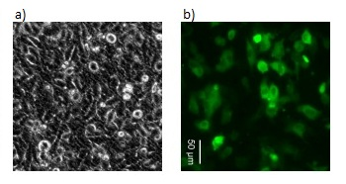
Zeiss Microscope
Something about the microscope and the AxioVision Software
Something about fluorescence

Slide 10
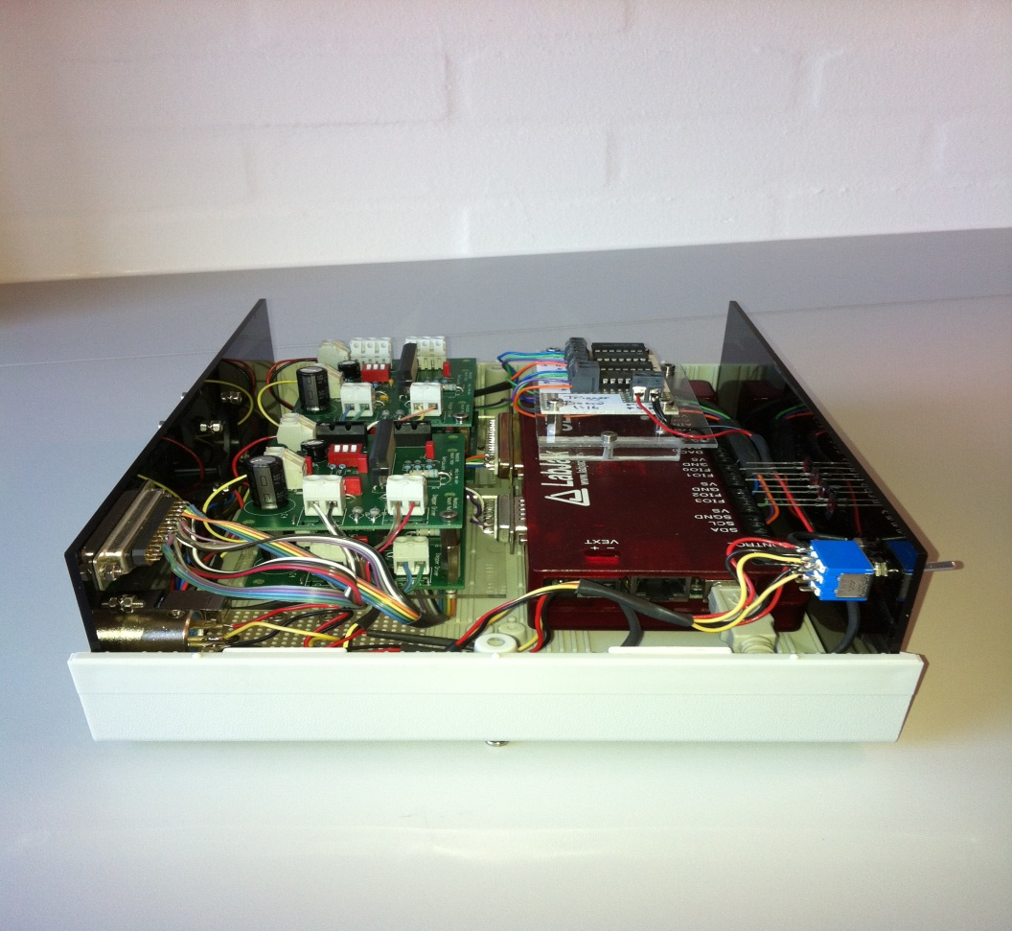
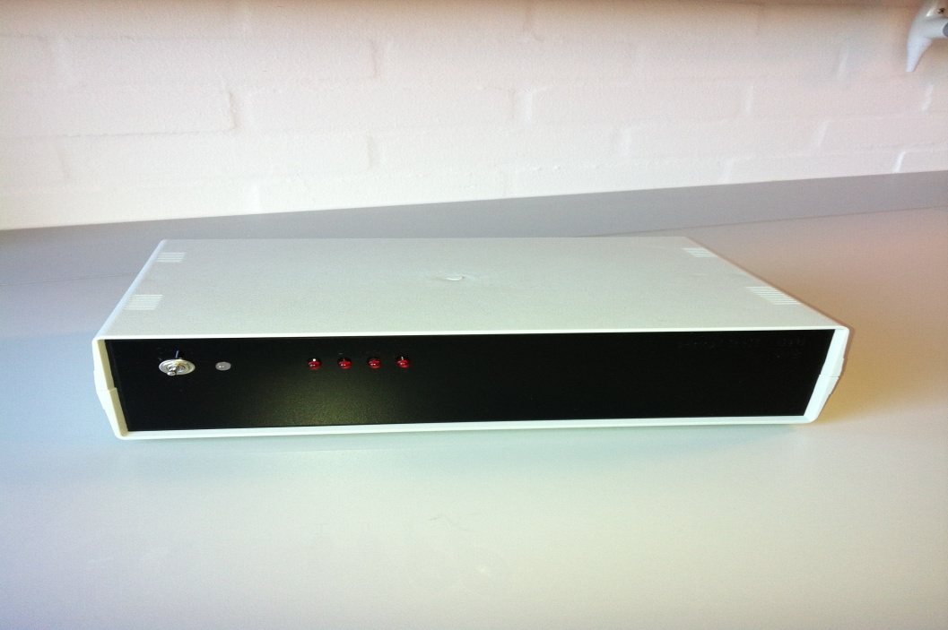
Control box
Something about the control box, and difficulties in putting everything together (you had to order the box, etc.)
What you will cover next:
  LabJack
  Signal adapter board

Slide 11
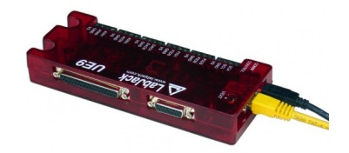
LabJack
What is a LabJack? (copy paste from the thesis)
How is it controlled?

Slide 12
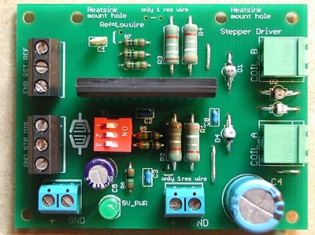
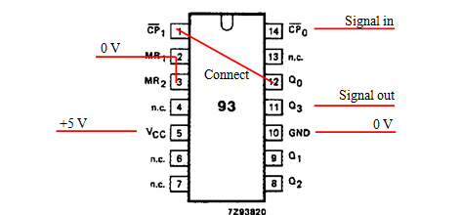
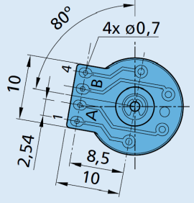
Signal adapter board
Some explanations about the motors
  Use sub-bullets if needed
Something about the board and why you needed the counter
Step motor
Faulhaber AM1524
Ripple counter

Slide 13
Three types of control
Direct control
  Short text about it—take it from the thesis and be succinct
Scenario-based control
  Short text about it
Feedback control
  Short text about it

Slide 14
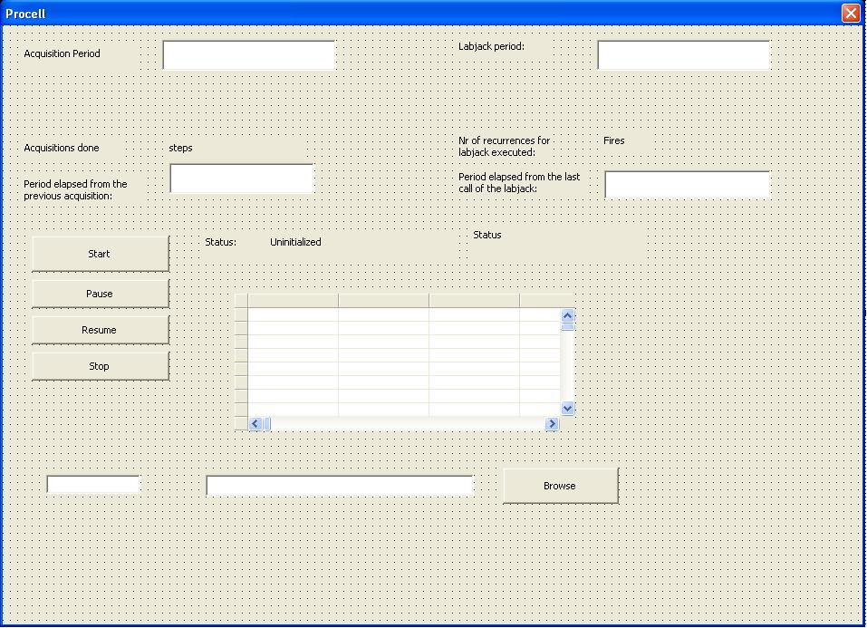
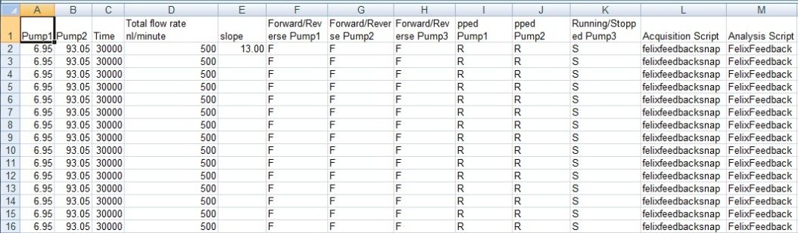
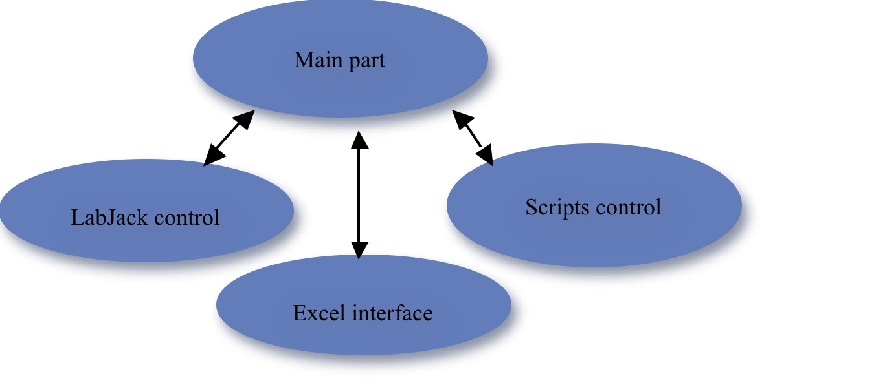
Scenario-based control
Focus on VBA
  Tell us what is on the left
  Tell us what you did with VBA

Slide 15
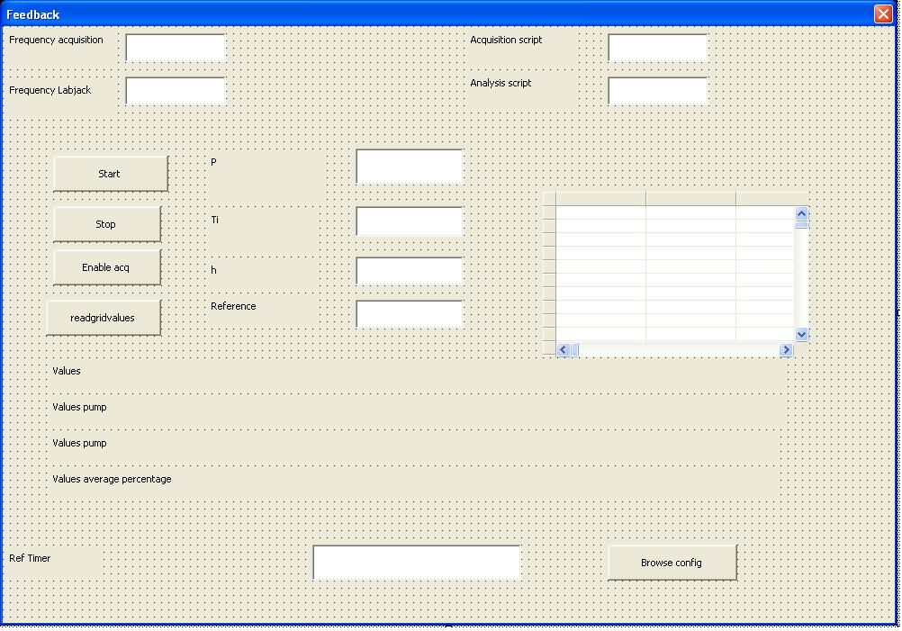
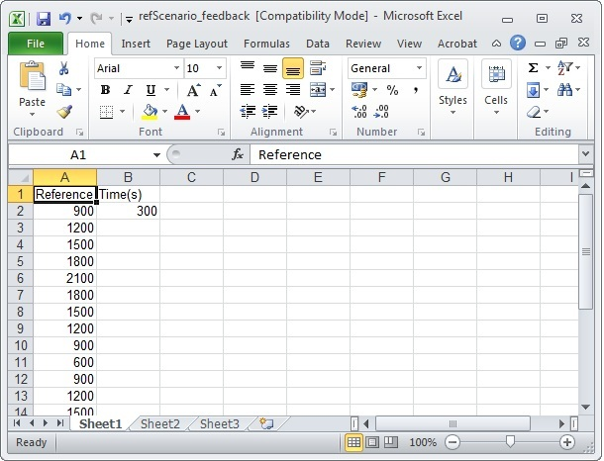
Feedback control
Main part
Explain the feedback control
Tell us about VBA
Maybe we need two slides?
LabJack control
Scripts control
Excel interface
Ref
R
P
M
-

Slide 16
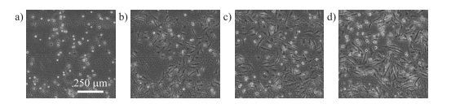
Evaluation: direct control
What do we see in the picture
How is the control achieved

Slide 17
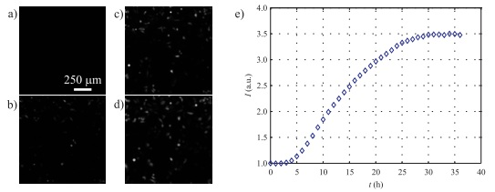
Evaluation: scenario-based control
What do we see in the picture
How is the control achieved

Slide 18
Evaluation: feedback control
No Feedback
  What do we see in the picture
  How is the control done
With feedback
  What do we see in the picture
  How is the control done
What is the conclusion

Slide 19
Evaluation: feedback control
Remind what is fluorescence
What do we see in the picture
How was the control done
Conclusion: why is it good

Slide 20
Conclusions
ProCell setup: cell culturing biochip, microscope, proposed control box
Several control approaches, using VBA and the control box
  Direct control
  Scenario-based control
  Feedback control
  The control solution has been systematically evaluated and tested
The solution is successfully used in the field
  DTU Nanotech
  Danish Cancer Society
  University of Oslo
  Bioneer
The work done in the thesis has been partly reported in two scientific papers

