Slide 1



Software Reliability
Engineering
Florin POPENTIU
University Politehnica of Bucharest
popentiu@imm.dtu.dk
Fl.Popentiu@city.ac.uk

Slide 2
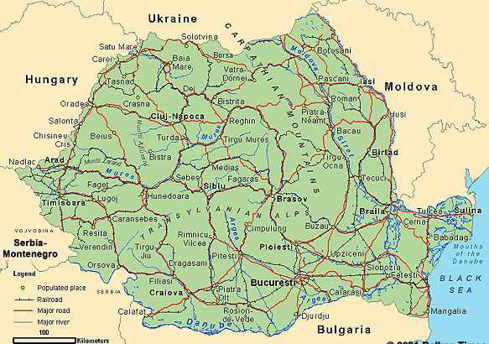



Slide 3





Slide 4
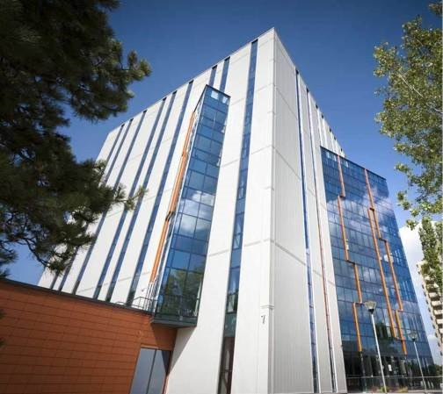

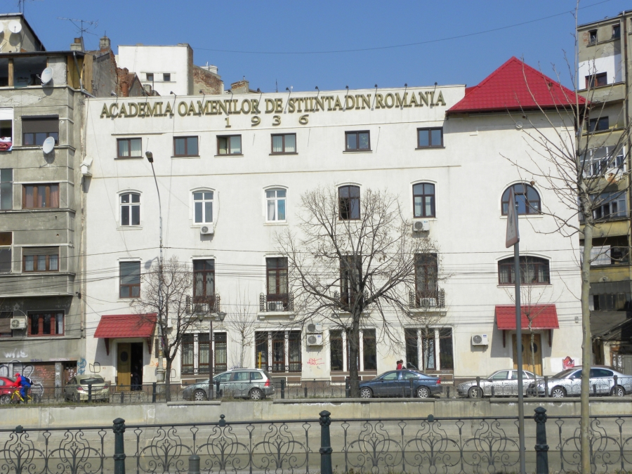



Slide 6


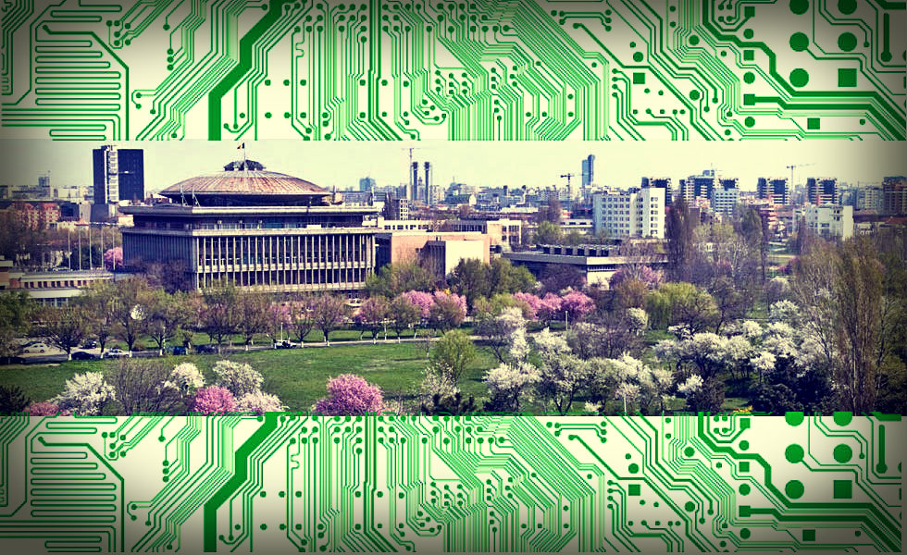
University “Politehnica” of BUCHAREST

Slide 7
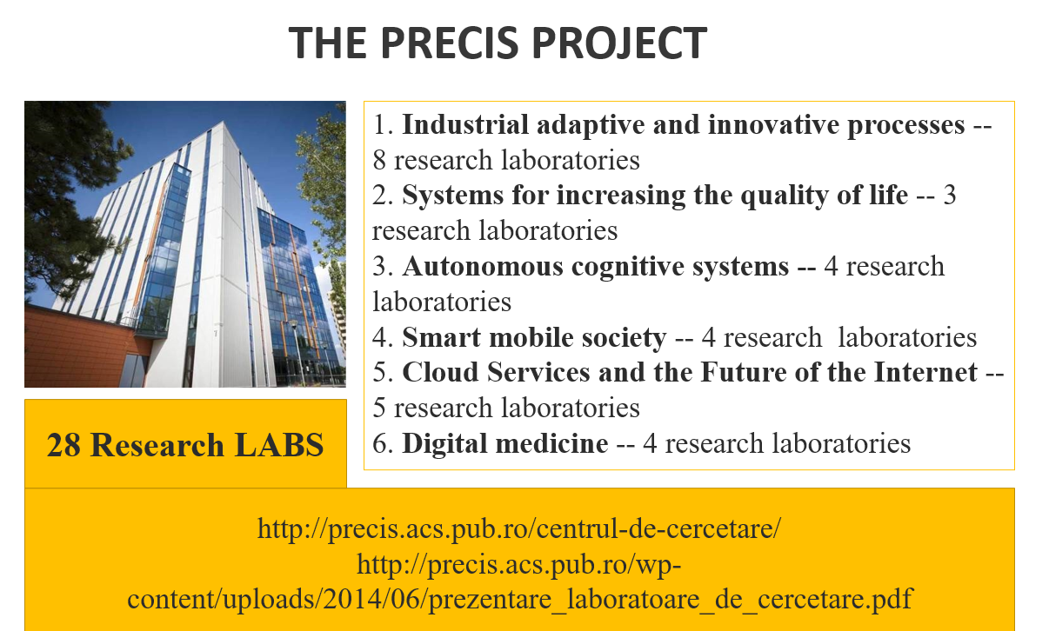
The PRECIS PROJECT

Slide 8
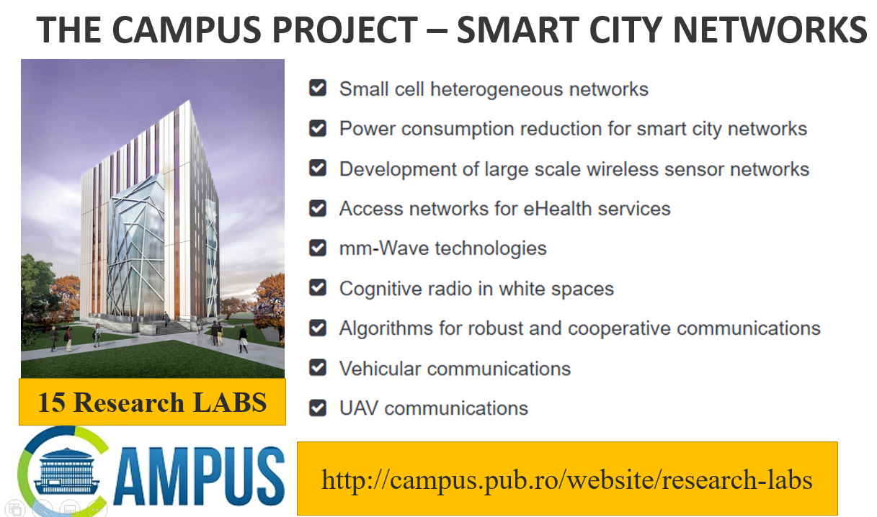
The CAMPUS PROJECT – SMART CITY NETWORKS

Slide 9
Software Reliability - Course Objectives
Measuring software reliability
Generic approach and specific models
Evaluating predictions
Capabilities and limitations
Reliability assessment in the life-cycle
Data collection
Unanswered questions

Slide 10
Software Reliability Course - Agenda
Motivation
Introduction to Software Engineering
Measuring Software Reliability
Software Reliability Techniques and Tools
Experiences in Software Reliability
Software Reliability Engineering Practice
Lessons Learned
Background Literature

Slide 11
1. Motivation
Introduction
Errors, faults and failures
Faults and failures: examples
Actual software disasters
The relationship between faults and failures
Case Study – Therac 25
When are software faults introduced?
What is reliability?
What is dependability?
Dependable systems
Hancock’s Half Hour!

Slide 12
What is “Software”?
An abstract digital definition of system behaviour.
Made concrete by compilation and loading.
Defines much of system internal state.
Includes interfaces (H/W-s/W, HCI, etc.).
Includes documentation.
May be firmware, microcode, operating system, application.
System may consist of H/W, S/W, or both.

Slide 13


How Hard is Software ?
Software is so hard that –
£1billion is spent annually in the UK on software
Over half this is wasted!
“Waste” includes:
Cost of overruns
Cost of correcting errors
Penalty due to not using quality assurance procedures
“unnecessary” expenditure on maintenance.

Slide 14
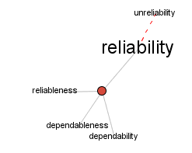
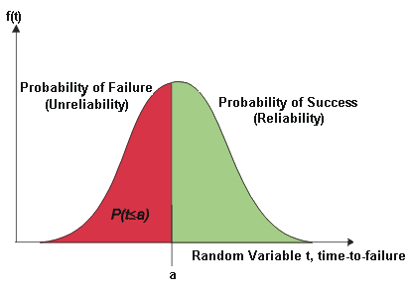
What is reliability?
Two senses:
General: The ability of a system to perform a required function under given conditions for a specific time interval.
Precise: The probability that a system will operate without failure under given conditions for a specific time interval.

Slide 15

Software reliability is rarely of concern to most people until something goes wrong.
Physical system components deteriorate over time, while software does not.
However, unlike a human operator, software does not adapt well to situations which were not anticipated by its designers, and such failures can prove enormously costly.

Slide 16
Does Software Reliability Make Sense?
Developers, users and military organizations are often concerned about the reliability of systems that include software.
Over the years, reliability engineers have developed detailed and elaborated methods of estimating the reliability of hardware systems based on an estimate of the reliability of their components.
Software can be viewed as one of those components, and an estimate of the reliability of software is considered essential to estimating the reliability of the overall system.

Slide 17
Hardware/Software differences
Hardware is manufactured
- Designed once
- Many imperfect copies
Software is “all design”
- Design transformed into code
- Many perfect copies
Every software product is a “prototype”

Slide 18
Hardware/Software maintenance
Hardware maintenance
- System “down” until repaired
- Corrective maintenance restores system to “good as old”
- Design change difficult
- Requires movement of men and material
Software maintenance
- “Transient” failures
- Corrective maintenance improves system design
- Design change easy
- Requires movement of information

Slide 19
Identify the software LRUs in the system
A software line replacement unit (LRU) is the lowest level of architecture for which the software can be compiled and object code generated.
Software configuration items are commonly referred to a computer software configuration item (CSCI). However, a CSCI may be composed of more than one LRU.
While hardware components are replaced with identical hardware components, software
components are updated whenever software defects are corrected.
The lowest replacement unit for software will be either a dynamically linked library (DLL) or an executable.
In even a small system there will be usually more than one software LRU.
Source: IEEE Recommended Practice on Software Reliability, IEEE Std 1633™-2016

Slide 20

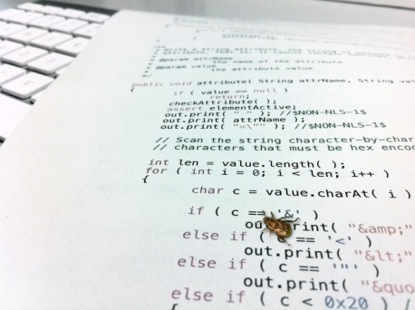
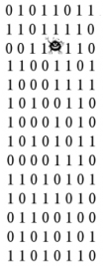

Errors, faults, and failures
can lead to
can lead to
Error Fault Failure
Error: Designer’s mistake
e.g. failure to distinguish signed and absolute value numbers in an algorithm
Fault: Encoding of an error into software
e.g. ‘X:=Y’ is coded instead of ‘X:=ABS(Y)’
Failure: Deviation of the software from its specified delivery or service (incorrect output or timing of output)
e.g. nuclear reactor exhibits behaviour likely to be an earthquake hazard.

Slide 21
Failures of Complex Systems
“Physical” failure:
  Hardware component breaks.
  Cause is physical (e.g., wear-out, overload, corrosion).
  “fault” appears in system at that point in time.
  Fault may cause failures unless “masked” by “redundancy”.
  System repaired by replacement of broken component.
  System is thereby restored to its previous good state.

Slide 22
Failures of Complex Systems (Cont’)
Design failure:
  defect in design
  cause is intellectual (bad requirement, careless design)
  fault is present in system, but “latent”
  may cause failure with some inputs or internal states
  repair by changing design
  system is different from its previous “bad” state

Slide 23
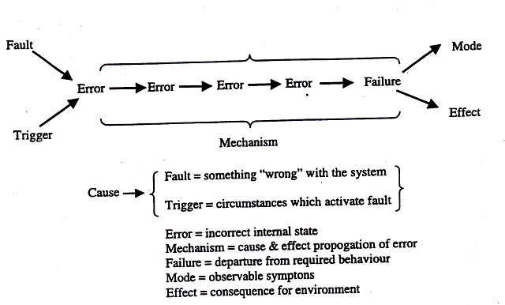
System Failure

Slide 24
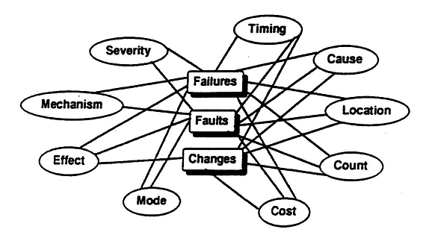
Attributes of failures, faults and changes

Slide 26
Categories that partition all software defects (Cont’)
Heisenbug: a defect that seems to disappear or alter its behavior when one attempts to probe or isolate it
Aging-related defect: a defect that is able to cause an increasing failure rate and/or a degrading performance while the software is running continuously.
Software-hardware interface defects: software can fail due to a lack of robust interface with the hardware
Source: IEEE Standard 1633-2016

Slide 27
Failures and faults
A failure corresponds to unexpected run-time behaviour observed by a user of the software.
A fault is a static software characteristic which causes a failure to occur.
Faults need not necessarily cause failures. They only do so if the faulty part of the software is used.
If a user does not notice a failure, is it a failure? Remember most users don’t know the software specification.

Slide 28

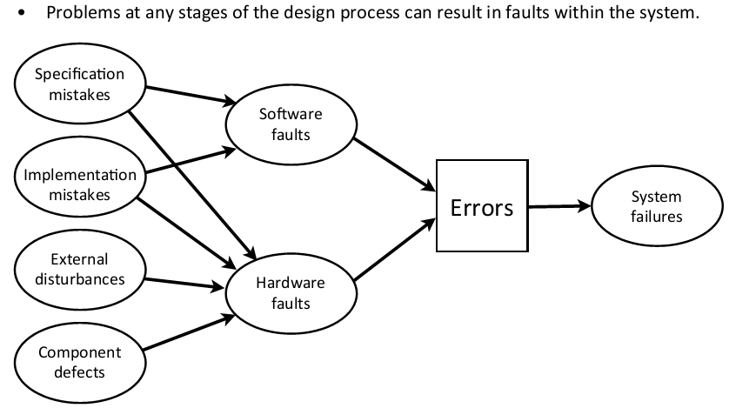
http://www.imm.dtu.dk/English/Teaching/IMM%20Courses.aspx?coursecode=02228

Slide 29

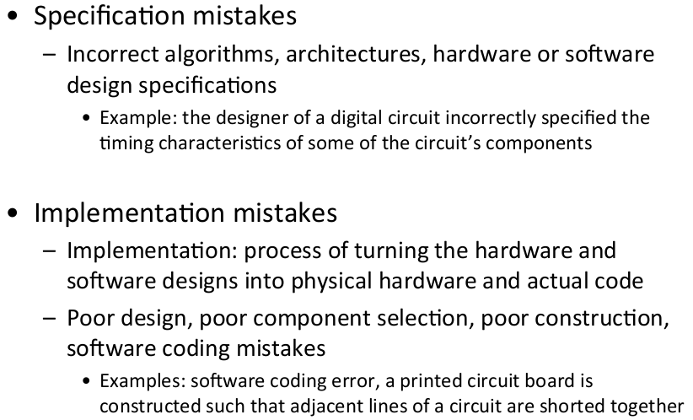
http://www.imm.dtu.dk/English/Teaching/IMM%20Courses.aspx?coursecode=02228

Slide 30
Failure classification
Failure class | Description
Transient | Occurs only with certain inputs
Permanent | Occurs with all inputs
Recoverable | System can recover without operator intervention
Unrecoverable | Operator intervention needed to recover from failure
Non-corrupting | Failure does not corrupt system state or data
Corrupting | Failure corrupts system state or data

Slide 31
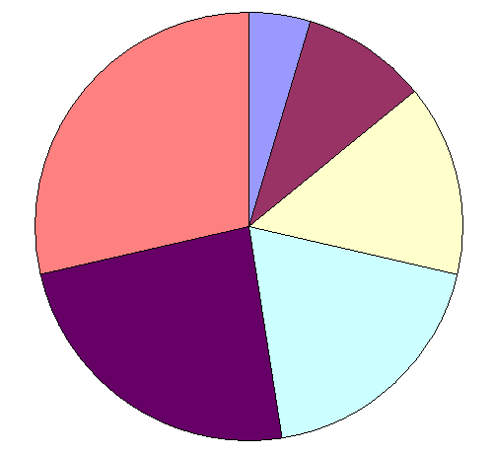
The relationship between faults and failures
Common faults: MTTF < 50 years
Faults with 50<MTTF<160 years
Very rare faults MTTF > 5000 years
Faults with 160 < MTTF < 500 years
Rare faults
1600 < MTTF < 5000 years
Fairly rare faults 500 < MTTF < 1600 years
(MTTF = Mean Time To Failure)
Sample from 9 major software products, each with many thousands of years logged use world-wide.
Ref: Adams E., Optimizing preventive service of software products”, IBM J Research & Development.

Slide 32
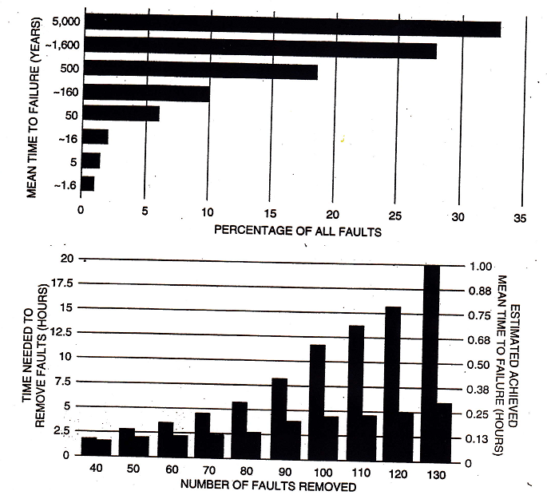
Diminishing returns
Software faults persist even in well-debugged programs. Edward N. Adams of IBM found that bugs that remained in a system were primarily “5000-year” bugs – that is, each of them would produce a failure only once in 5000 years (top). Such faults make debugging an exercise in diminishing returns: in the test of a military command-and-control system (bottom), the time needed to remove the bugs begins to outpace by far the resulting improvement in the estimated reliability, measured in terms of estimated achieved MTTF.
For visual clarity, the graphs have been plotted on different time scales.
Source: Littlewood B., Strigini L., The Risks of Software, Scientific American, Nov., 1992, 62-75.

Slide 34
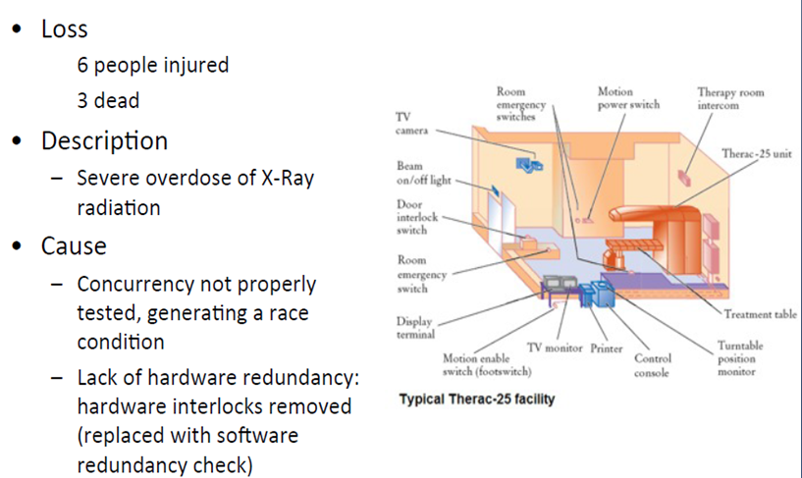
Case study: Therac 25 – 1986

Slide 35
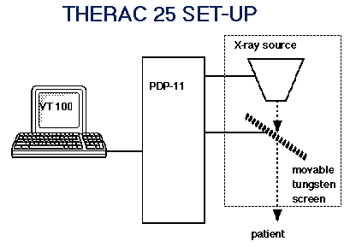
Therac 25 Failure
Location: East Texas Cancer Center
Timing: 21 March 1986 (#treatment hours unknown)
Mode: ‘Malfunction 54’on operator screen
Effect: Beam strength too great by factor of 100
Mechanism: Use of up arrow key corrupted internal software variable
Cause: Unintentional design fault
Severity: Critical (loss of life)
Cost: Financial loss in
litigation/investigation
You cannot predict what you cannot measure!

Slide 36

Case study: Therac 25
Radiotherapy machine failure
- 2 deaths, several injuries
2 modes of operation
- X-ray: high-intensity beam strikes tungsten target
- electron: low-intensity beam with target retracted
- treatment programmed using monitor and keyboard
The accidents
- high-intensity beam, with target retracted
- “Malfunction 54”
The trigger
- use of to correct a typing error

Slide 37
Software disasters
Therac 25
  Software controlled radiation therapy.
  Software interlock governed high/low beam strength.
  Interaction of operator error and software fault -> high strenth beam. without shield in place
  Killed 2, injured others.
Citibank (1990)
  Electronic funds transfer through CHAPS.
  Lost : 2 billions pounds in 30 minutes
  Interaction of operator error and design fault -> wrong date supplied.
  Repeated previous day’s transfers.
  Money recovered within 2 days!

Slide 38
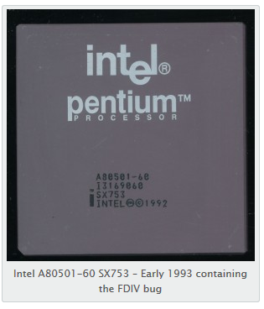
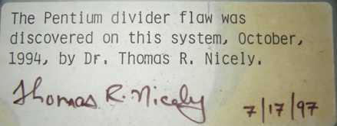
Intel Pentium FDIV Bug (1993)
The FDIV instructions on the Pentium used a lookup table (Programmable Logic Array) to speed calculation. This PLA had 1066 entries, which were mostly correct except 5 out of the 1066 did not get written to the PLA due to a programming error, so any calculation that hit one of those 5 cells, would result in an erroneous result.
http://www.cpushack.com/tag/intel/

Slide 39

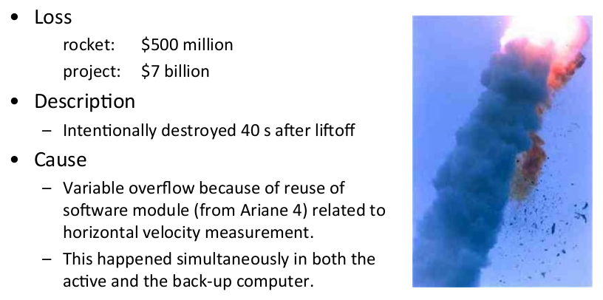

Slide 40
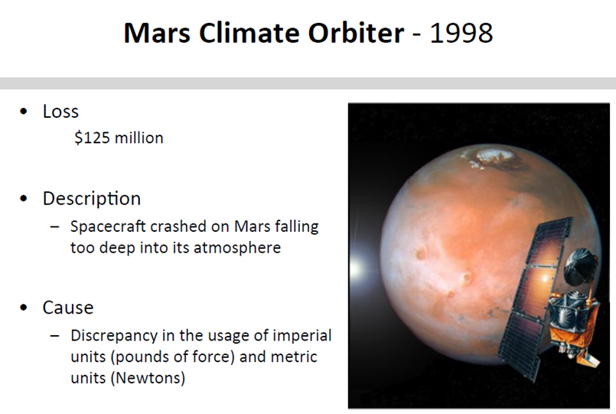
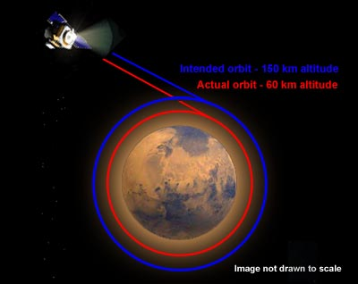


Slide 41
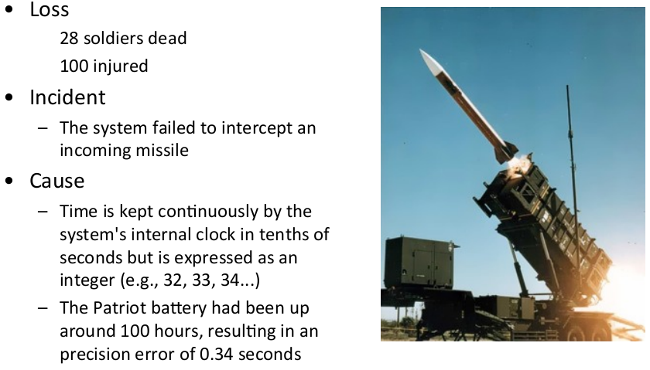
http://www.imm.dtu.dk/English/Teaching/IMM%20Courses.aspx?coursecode=02228

Slide 42
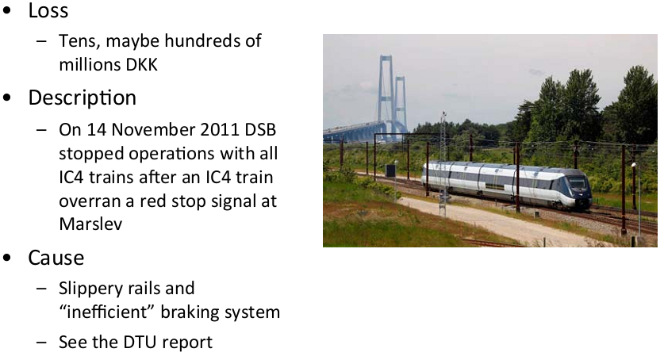


Slide 43
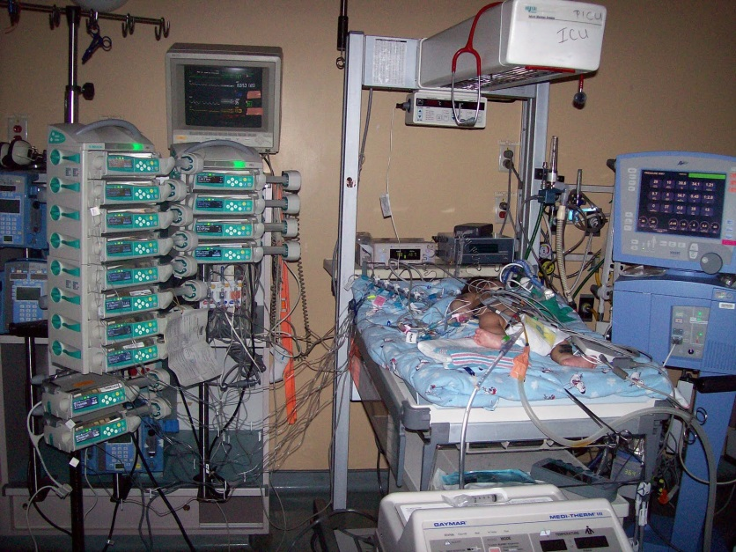
Infusion Pumps 2005-2009
Many of the problems that have been reported are related to software malfunctions. For example, some pumps fail to activate pre-programmed alarms when problems occur, while others activate an alarm in the absence of a problem.
According to the FDA, in five years it has received 56,000 reports of problems caused by drug infusion pumps, including 500 deaths. Between 2005 and 2009, 87 drug infusion pumps have been recalled because of safety issues.

Slide 44
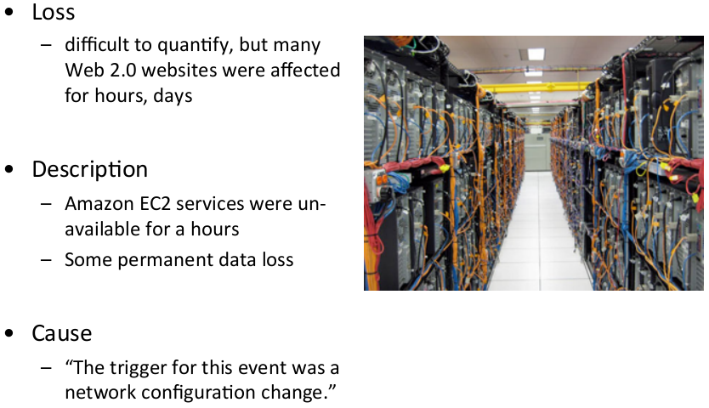

Amazon Cloud Outage 2011

Slide 46



RELIABILITY DOES MATTER (cont)
The combination of slow lift-off speed and the extreme angle of attack resulted in an unrecoverable stall, yaw, and descent.
B-2’s crash
https://youtu.be/YNnM_8WahcQ

Slide 47

RELIABILITY DOES MATTER (cont)
The angle of attack (AOA) sensor was replaced after a flight from Manado, in North Sulawesi to Denpasar, Bali on October 28, 2018.
The new Boeing 737 MAX 8 crashed into the sea on October 29, 13 minutes after taking off from Jakarta.
Boeing Company … published an update to the flight crew operations manual for its 737 Max 8, warning of a possible fault in the aircraft’s angle of attack system that could cause the aircraft to violently pitch nose down.
The crash killed all on board: 181 passengers (178 adults and three children), as well as six cabin crew and two pilots.

Slide 48


RELIABILITY DOES MATTER (cont)
On 10 March 2019, the Boeing 737 MAX 8 aircraft which operated the Ethiopian Airlines Flight 302 crashed near the town of Bishoftu six minutes after takeoff. All passengers and crew on board, 157 in total, were killed in the accident.
in both flights the Maneuvering Characteristics Augmentation System, known as MCAS, activated in response to erroneous angle of attack information.
https://www.youtube.com/watch?v=0kgG03pVQRg

Slide 49
When are software faults introduced?
Requirements: | Gripen: “control laws”, ICL (Fujitsu Service) “usability problems”
System design: | Therac: no fault-tolerance (H/W interlock)
Software specification: | Mariner: missing “bar” in mathematical formula
Coding: | Mercury orbiter: “dot for comma”
Compilation: | Pascal compilers: -ve exponential, floating point I/P
Maintenance: | LAS(2): London Ambulance Service “memory leak”
Requirements faults give most serious failures but …
… can we ensure against failures that are “deliberate”?

Slide 50
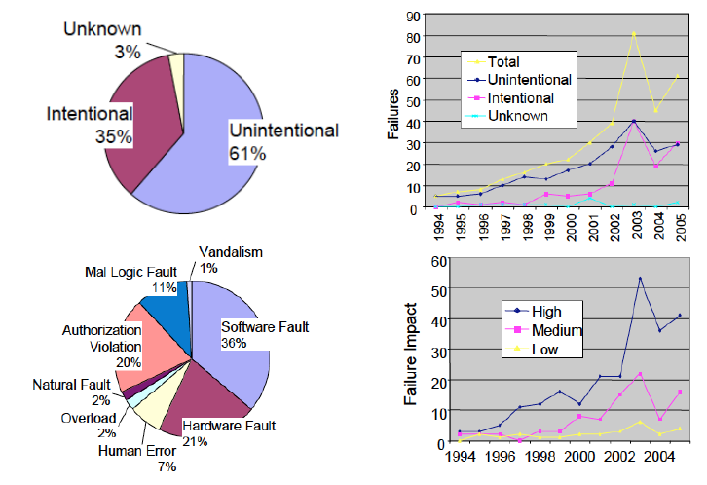

Slide 51
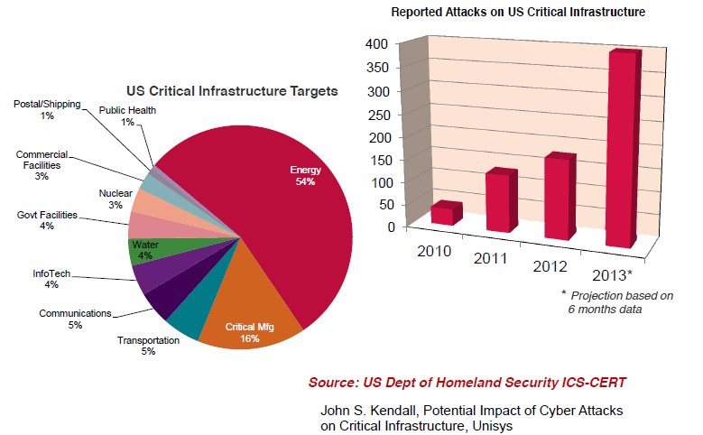

Slide 52
What is “dependability”?
Defined as:
“The extent to which the user can justifiably depend on the service delivered by a system.”
J-C. Laprie: Dependability: basic concepts and terminology
Important concepts: “required service”, “user”, “system”
“Umbrella” term: not measurable attributes
Different authors use different sets of attributes (Laprie, BS5760)

Slide 53
Definitions of dependability attributes “RAMURSES”
Attribute … | … defined as ability of a system to …
Reliability: | … deliver required service
Availability: | … be in an “up” state
Maintainability: | Corrective… be repaired to remove faults Adaptive … be modified for new environment Perfective … be enhanced to improve service
Usability: | … provide ease of access for user
Recoverability: | … resume service after failure
Safety: | … be used without accident
Efficiency: | … complete task within given resources
Security: | … resist unauthorised interference

Slide 54
Dependable systems
We need depend on systems. They must be:
Reliable: | Deliver the required service under given time.
Safe: | Must not kill people.
Secure: | Must not allow unauthorised access.
Usable: | Must be “friendly”: easy to learn and use.
Maintainable: | Must be quick to recover after failure, and easy to repair so that they do not fail again.
Available: | Must be ready for use a high proportion of time.
Extendable: | Must be easy to enhance to perform new functions.

Slide 55
How to make software-based systems more dependable
Fault avoidance: | Good management Disciplined process Careful requirements capture & design
Fault removal: | Design and code inspection Static analysis Testing
Fault tolerance: | Defensive design: “belt & braces” Diverse redundant modules Manual back-up
Dependability measurement: | Realistic trial Collect data (failures, faults, operating time) Analyse data to evaluate “RAMURSES”

Slide 56

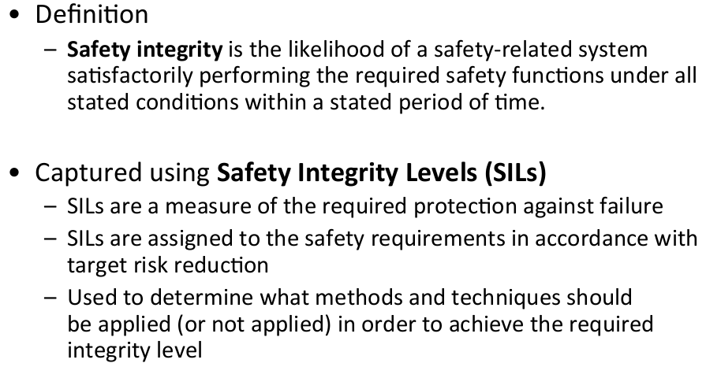
http://www.imm.dtu.dk/English/Teaching/IMM%20Courses.aspx?coursecode=02228

Slide 57
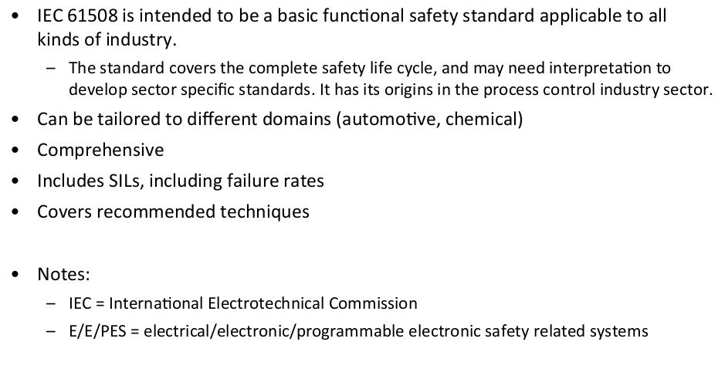
IEC 61508 Standard
http://www.imm.dtu.dk/English/Teaching/IMM%20Courses.aspx?coursecode=02228

Slide 58
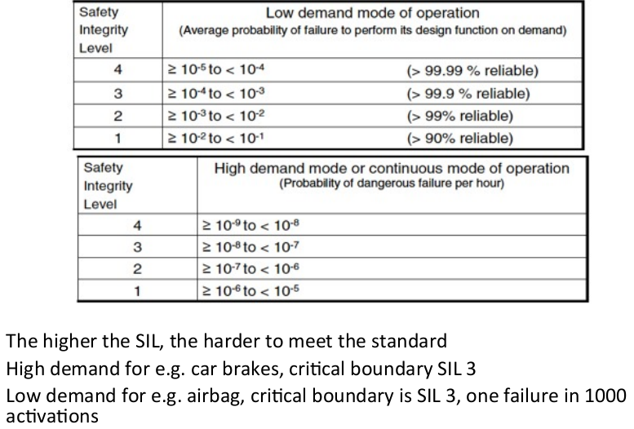
http://www.imm.dtu.dk/English/Teaching/IMM%20Courses.aspx?coursecode=02228

Slide 59


Hancock’s Half Hour
Tony Hancock: “But I’ve just been throttled half to death by a flamin’ python! Why won’t the insurance company pay out?”
Sid James: “Well, you see, they only insured you against accident, but the snake meant it!”

Slide 60
Software Reliability Course - Agenda
Motivation
Introduction to Software Engineering
Measuring Software Reliability
Software Reliability Techniques and Tools
Experiences in Software Reliability
Software Reliability Engineering Practice
Lessons Learned
Background Literature

Slide 61
2. Introduction to Software Engineering
The phases of a software project
Types of software
Achieving software reliability: diverse sources of information
Products, processes, and resources
Achieving software reliability: diverse approaches

Slide 62
What is “Software Engineering”
Application of mathematical, scientific, organisational principles
Concept, design, implementation, maintenance
Achieve adequate quality with given time and resources
Large projects

Slide 63
The Phases of a Software Project
Enthusiasm
Disillusionment
Panic
Collapse
Search for the guilty
Punishment of the innocent
Rewards and honours for those not involved

Slide 66
Types of software
Games
Working machine programs
Operating systems
Commercial applications
Process control
Embedded military & nuclear
Flight-critical (‘Fly-by-wire’, e.g. A330-340)
What is ‘quality’ in each case?
‘Quality is conformance to requirements’. Philip B. Crosby
‘Quality is free, but only to those who are willing to pay heavily for it’ T. DeMarco and T. Lister , Peopleware : Productive Projects and Teams, 2nd Ed. by Tom Demarco, Timothy R. Lister , ISBN: 0932633439
So what are the requirements?
‘Horses for courses!’

Slide 67
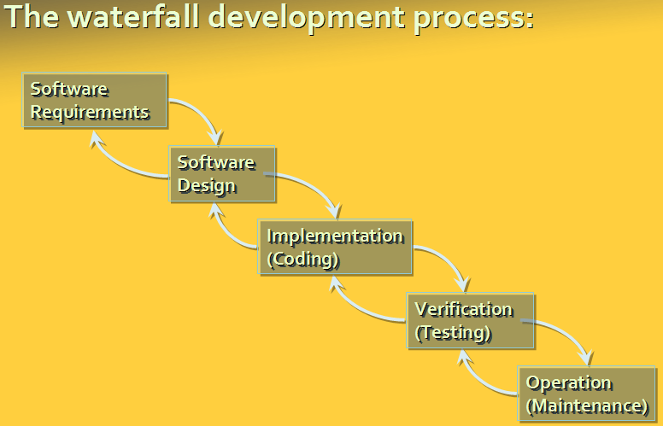
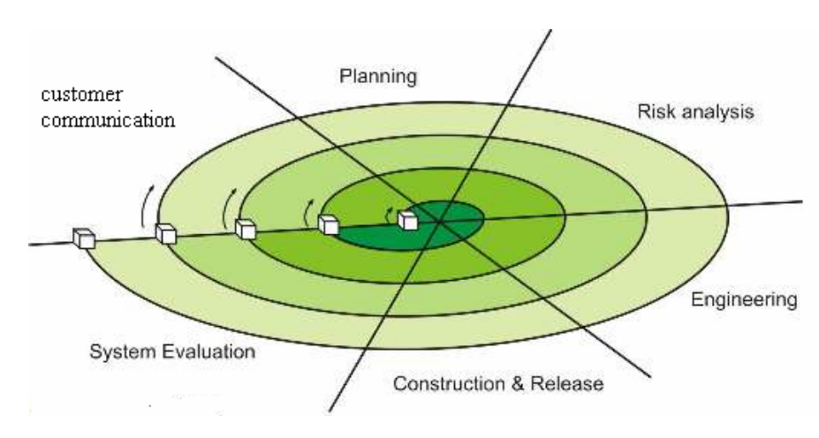
Software Development Phases
Concept
Software Requirements
Top Level Design
Detailed Design
Code/implementation
Unit/development Test
System/verification/validation Test
Operational Test
Operation

Slide 68
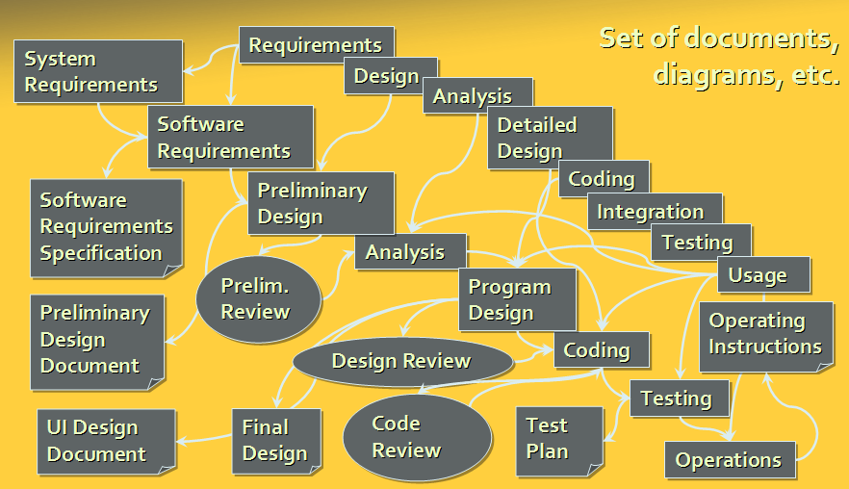
Software Development Overview

Slide 69
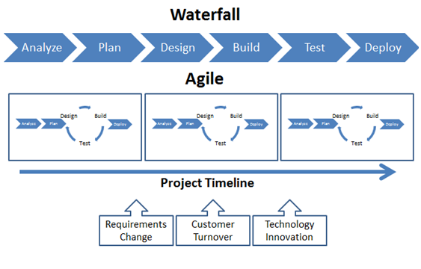
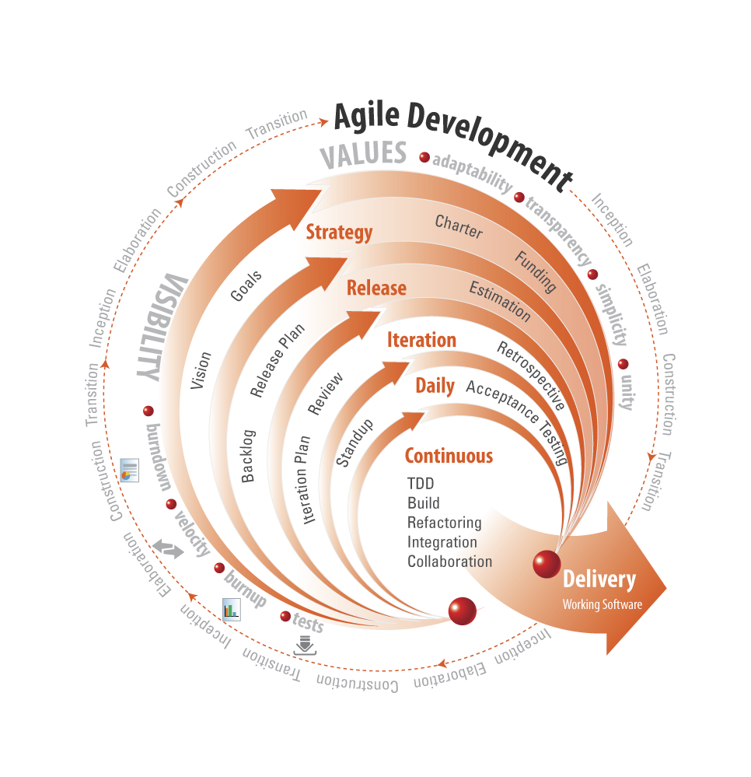

Slide 70
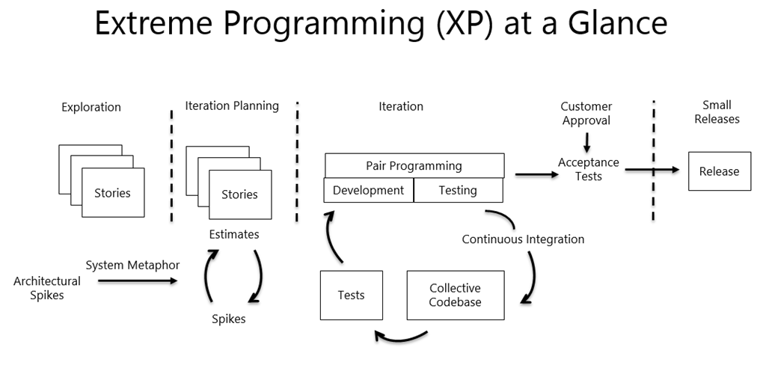
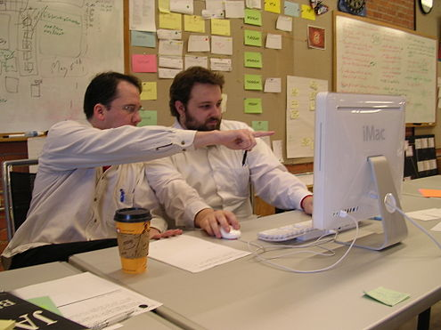
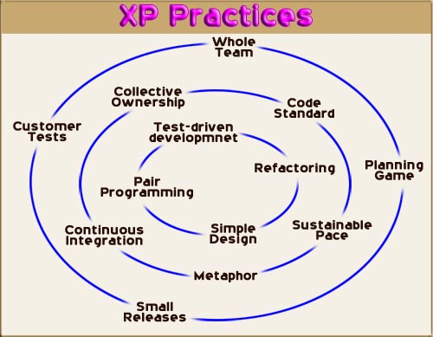

Slide 71
DevOps - Overview
DevOps (a clipped compound of "software DEVelopment" and "information technology OPerationS") is a term used to refer to a set of practices that emphasize the collaboration and communication of both software developers and information technology (IT) professionals while automating the process of software delivery and infrastructure changes.
Because DevOps is a cultural shift and collaboration (between development, operations and testing), there is no single
"DevOps tool": it is rather a set (or "DevOps toolchain"), consisting of multiple tools. Generally, DevOps tools fit into one or more of these categories, which is reflective of key aspects of the software development and delivery process

Slide 72
DevOps toolchain (Cont`)
  Code — Code development and review, version control tools, code merging;
  Build — Continuous integration tools, build status;
  Test — Test and results determine performance;
  Package — Artifact repository, application pre-deployment staging;
  5. Release — Change management, release approvals, release automation;
  6. Configure — Infrastructure configuration and management, Infrastructure as Code tools;
  7. Monitor — Applications performance monitoring, end–user experience.

Slide 73
DevOps toolchain (Cont1`)
It aims at establishing a culture and environment where building, testing, and releasing software can happen rapidly, frequently, and more reliably.
Though there are many tools available, certain categories of them are essential in the DevOps toolchain setup for use in an organization. Some attempts to identify those basic tools can be found in the existing literature.
Tools such as Docker (containerization), Jenkins (continuous integration), Puppet (Infrastructure as Code) and Vagrant (virtualization platform)—among many others—are often used and frequently referenced in DevOps tooling discussions

Slide 74
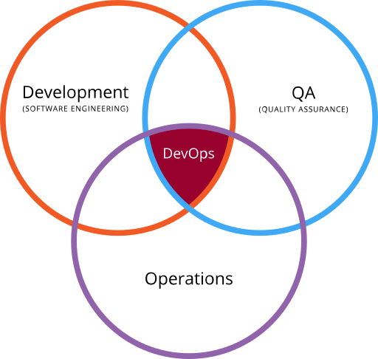
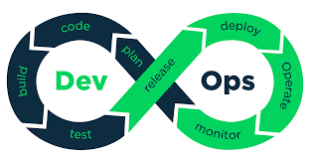
Venn diagram showing DevOps as the intersection of development (software engineering), operations and quality assurance (QA)
Illustration showing stages in a DevOps toolchain

Slide 75
System Requirements Analysis
Establish need and feasibility
  Overall functional requirements
  Dependability requirements
  Cost and schedule constraints
Subsystem/component breakdown
  Identify system elements
  Define the process carried out by each
  Define interfaces
  Apportion dependability among elements
Identify software elements
  Define software FRs and NFRs
  Initial statement of software requirements
  Develop software requirements specification

Slide 76
Reliability specification
Reliability requirements are only rarely expressed in a quantitative, verifiable way.
To verify reliability metrics, an operational profile must be specified as part of the test plan.
Reliability is dynamic – reliability specifications related to the source code are meaningless.
  No more than N faults/1000 lines
  This is only useful for a post-delivery process analysis

Slide 77
Specification validation
It is impossible to empirically validate very high reliability specifications.
No database corruption means PODOF of less than 1 in 200 million.
If a transaction takes 1 second, then simulating one day’s transaction takes 3.5 days.
It would take longer than the system’s lifetime to test for reliability.

Slide 78
Steps to reliability specification
For each sub-system, analyse the consequences of possible system failures.
From the system failure analysis, partition failures into appropriate classes.
For each failure class identified, set out the reliability using an appropriate metric. Different metrics may be used for different reliability requirements.

Slide 79
Examples of a reliable specification
Failure class | Example | Reliability metric
Permanent, Non-corrupting | The system fails to operate with any card which is input. Software must be restarted to correct failures. | ROCOF 1 occurrence/1000 days
Transient, Non-corrupting | The magnetic stripe data cannot be read on an undamaged card which is input | PODOF 1 in 1000 transactions
Transient, corrupting | A pattern of transactions across the network causes database corruption | Unquantifiable! Should never happen in the lifetime of the system

Slide 82
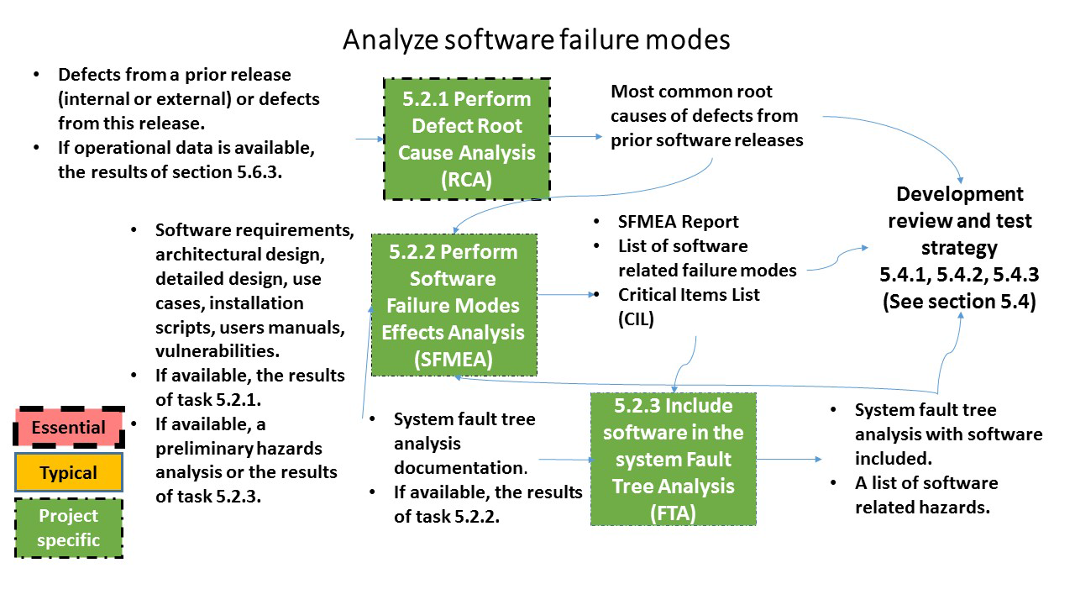
Develop failure modes model
Source: IEEE Recommended Practice on Software Reliability, IEEE Std 1633™-2016

Slide 84
Reliability and formal methods
The use of formal methods of development may lead to more reliable systems as it can be proved that the system conforms to its specification.
The development of a formal specification forces a detailed analysis of the system which discovers anomalies and omissions in the specification.
However, formal methods may not actually improve reliability.

Slide 85
Reliability and formal methods (Cont’)
The specification may not reflect the real requirements of system users.
A formal specification may hide problems because users don’t understand it.
Program proofs usually contain errors.
The proof may make assumptions about the system’s environment and use which are incorrect.

Slide 86
IV & V
Independent Verification and Validation
  Two contractors: developer and monitor
  Commercially independent
  Monitor has no vested interest in delivery
  Access points contractually defined
Advantages
  Checker is well-motivated
  Diversity of approach
Disadvantages
  - Expensive (up to 60% on contract)

Slide 87
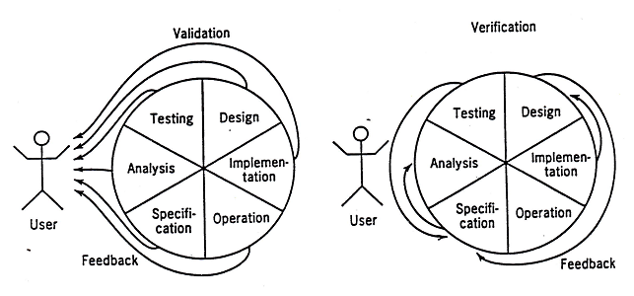
VALIDATION AND VERIFICATION
Verification: Are we building the product right?
Validation: Are we building the right product?

Slide 88
Verification & Validation
The System may have been verified;
Have we built the system “correctly”?
But inadequately validated?
Have we built the “correct” system?
This is often satirised by customer’s remark:
It’s just what I asked for, but not what I want!

Slide 89
Testing Strategies
Dynamic testing Vs Static testing (static analysis)
  -in dynamic testing, the test data is executed on real machine
Black Box Testing Vs White Box Testing
  in black box testing, test cases are derived from the specification or requirements without reference to the code itself or its structure
  in white box testing, test data are derived from the internal program structure
Testing Random
  -using test cases in which all the test data are random

Slide 90
Testing has many purposes…
Reliability testing – measuring reliability
Acceptance testing – fit for delivery?
Unit testing – modules working on isolation?
Integration testing – modules working as a system?
Etc…

Slide 91
… but only one goal
To discover faults
A successful test is one which establishes the presence of one or more faults in the software being tested.

Slide 92
Remember …
… testing aims to find faults.
… testing is finished when the acceptance criteria have been met – not when the time runs out.
… the importance of test specification and planning.

Slide 93
Testing after development
Acceptance testing
  - Completed system Vs requirements of real user
Alpha test
  - User and developer test system using real data
Beta test
  - Release of product to a section of the market for real use
Installation testing
  - Tests to check on the installation process
During use
  Using spare capacity to do additional automatic testing

Slide 94
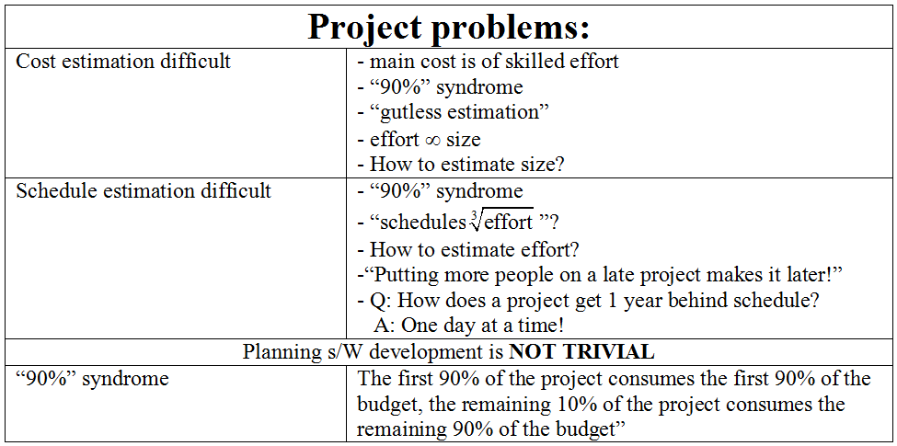
SOFTWARE COST AND SCHEDULE

Slide 95
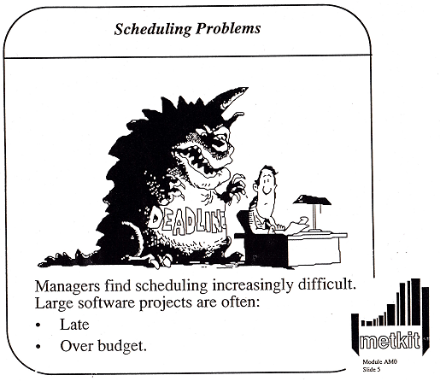

Slide 96
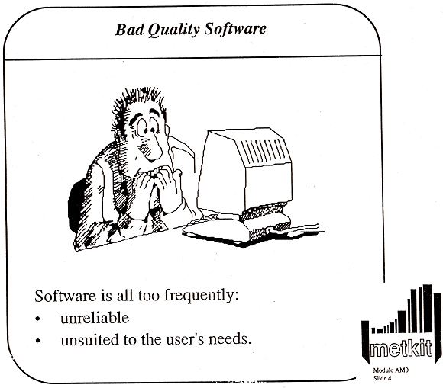

Slide 97
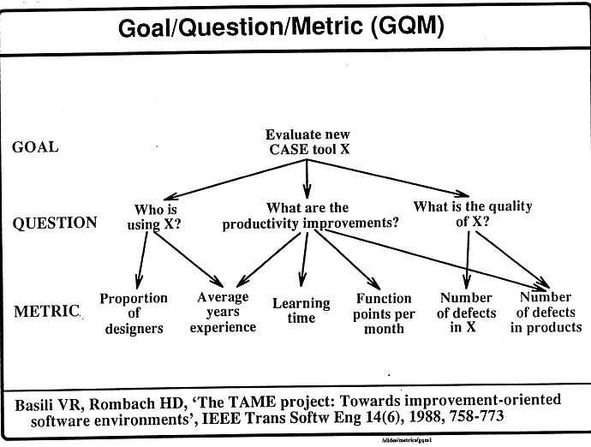

Slide 98
SEI – Capability Maturity Model
CMM was developed by Software Engineering Institute and it is a strategy to improve software quality by improving the process by which software is developed. The five levels of CMM and their characteristics are given below:
Maturity Level | Characterization
Maturity Level 1 (Initial) | Adhoc process: Cost, schedule and quality are unpredictable
Maturity Level 2 (Repeatable) | Basic Project Management: Planning and tracking can be repeated
Maturity Level 3 (Defined) | Process Definition: The process is stable and repeatable
Maturity Level 4 (Managed) | Process measurement: The process is measured and operates within measured limits
Maturity Level 5 (Optimizing) | Process Control: The focus is on continuous process improvement

Slide 99
The Cleanroom Approach
The Cleanroom process was originally developed by Harlan Mills from IBM Fellow Department.
The name Cleanroom was chosen to evoke the cleanrooms used in the electronics industry to prevent the introduction of defects during the fabrication of semiconductors.

Slide 100
The Cleanroom Approach (Cont’)
The Cleanroom software engineering process is a software development process intended to produce software with a certifiable level of reliability.
The focus of the Cleanroom process is on defect prevention, rather than defect removal.

Slide 101
The Cleanroom Approach (Cont1’)
The first two principles of the Cleanroom process are:
  Software development based on formal methods
  Incremental implementation under statistical quality control: The quality of each increment is measured against pre-established standards to verify that the development process is proceeding acceptably.

Slide 102
The Cleanroom Approach (Cont’2)
The third principle of the Cleanroom process is:
  Statistically sound testing: Based on the formal specification, a representative subset of software input/output trajectories is selected and tested. This sample is then statistically analyzed to produce an estimate of the reliability of the software, and a level of confidence in that estimate.

Slide 103
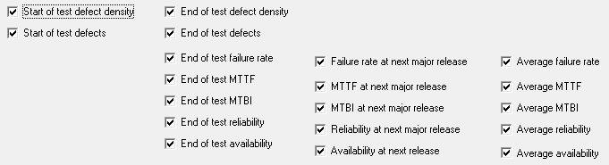
Software Engineering Assessment
“You can’t control what you can’t measure.”
Tom De Marco: “Controlling Software Projects”
“If You Can't Measure It, You Can't Manage It”
Peter Drucker !

Slide 104
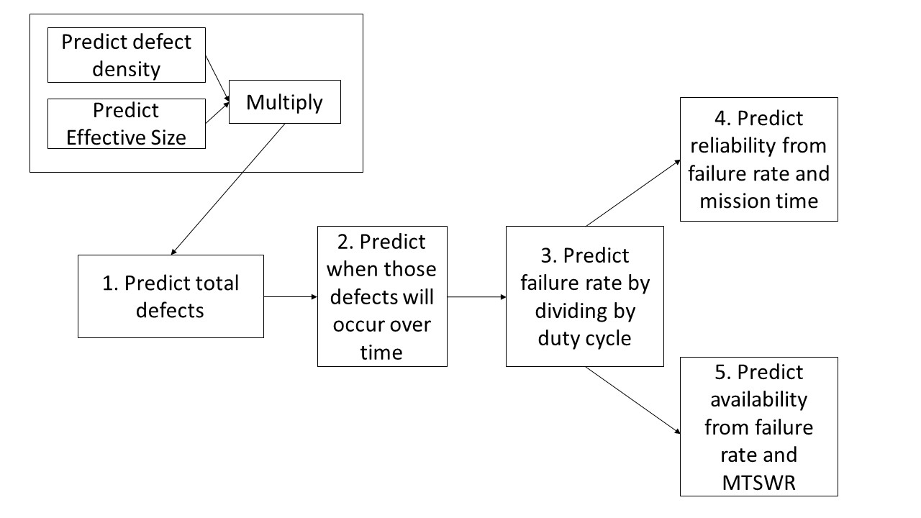
Process for predicting reliability Figures of Merit early in development
Source: IEEE Recommended Practice on Software Reliability, IEEE Std 1633™-2016

Slide 105

Software Reliability Engineering
A reliability objective is the specification of the reliability goal of a product from the customer viewpoint.
The operational profile is a set of disjoint alternatives of system operational scenarios and their associated probabilities of occurrence.
Reliability modeling is an essential element of the reliability estimation process.

Slide 106
Developing an operational profile
Developing an operational profile for a system involves one or more of the following five steps:
  Find the customer profile
  Establish the user profile
  Define the system-mode profile
  Determine the functional profile
  Determine the operational profile itself

Slide 107
Operational profile generation
Should be generated automatically whenever possible.
Automatic profile generation is difficult for interactive systems.
May be straightforward for ‘normal’ input but it is difficult to predict ‘unlikely’ inputs and to create test data for them.

Slide 109

Predict software reliability during development
Source: IEEE Recommended Practice on Software Reliability, IEEE Std 1633™-2016

Slide 110
Statistical testing
Testing software for reliability rather than fault detection.
Test data selection should follow the predicted usage profile for the software.
Measuring the number of errors allows the reliability of the software to be predicted.
An acceptable level of reliability should be specified and the software tested and amended until that level of reliability is reached.

Slide 111
Statistical testing procedure
Determine operational profile of the software.
Generate a set of data corresponding to this profile.
Apply tests, measuring amount of execution time between each failure.
After a statistically valid number of tests have been executed, reliability can be measured.

Slide 112
Statistical testing difficulties
Uncertainty in the operational profile
  This is a particular problem for new systems with no operational history. Less of a problem for replacement systems.
High costs of generating the operational profile
  Costs are very dependent on what usage information is collected by the organisation which requires the profile .
Statistical uncertainty when high reliability is specified
  Difficult to estimate level of confidence in operational profile
  Usage pattern of software may change with time.

Slide 113

Overview of software metrics used in
SRE during testing

Slide 114

Overview of software metrics used in
SRE during testing (Cont’)
Source: IEEE Recommended Practice on Software Reliability, IEEE Std 1633™-2016

Slide 115

Components of a reliability test suite
Source: IEEE Recommended Practice on Software Reliability, IEEE Std 1633™-2016

Slide 116

Apply software reliability during testing
Source: IEEE Recommended Practice on Software Reliability, IEEE Std 1633™-2016

Slide 117

Support release decision
Source: IEEE Recommended Practice on Software Reliability, IEEE Std 1633™-2016

Slide 118

Deployment acceptance process
Source: IEEE Recommended Practice on Software Reliability, IEEE Std 1633™-2016

Slide 119


Achieving Software Reliability: diverse sources of information
High quality software
Personnel experience/skill
Quality of tools/techniques
…
Structural information
Measures
…
Verification arguments
Use of certain techniques
…
Test results …
Resources | Processes | Products
PEOPLE | FORMAL DEVELOPMENT | DOCUMENTS
TOOLS | DESIGN | TEST PLANS
TECHNIQUES | TEST | PROOFS
STANDARDS | REVIEW MEETINGS | MEETING MINUTES
QUALITY PLANS | … | …
…

Slide 120
Products, Processes, and Resources
Resources
Processes
Products
Resource: an item which is input to a process
- people, hardware, software, etc.
Process: a software related activity or event
- testing, designing, coding,
Product: an object which results from a process
- test plane, specification and design documents, source and object code, minutes of meetings, etc.

Slide 121
Achieving software reliability: diverse approaches
High quality software
Fault
avoidance
Fault
removal
Fault
tolerance
Formal methods
Object oriented design
Structured design/analysis
Structured programming
…
N-version programming
Recovery blocks
Error masking
…
Black box testing
White box testing
…
Reviews/inspections
Statistical QC
Measurement
…

Slide 122


Slide 123
WHY USE FAULT TOLERANCE
Avoidance and Removal never perfect
Residual faults always possible
Must prevent residual faults causing failure
Only way to achieve ultra-reliability(?)

Slide 124

SOFTWARE FAULT TOLERANCE PROBLEMS

Slide 125

http://www.imm.dtu.dk/English/Teaching/IMM%20Courses.aspx?coursecode=02228

Slide 126

Block diagram configurations
Source: IEEE Recommended Practice on Software Reliability, IEEE Std 1633™-2016

Slide 127

http://www.imm.dtu.dk/English/Teaching/IMM%20Courses.aspx?coursecode=02228

Slide 128



Slide 129


http://www.imm.dtu.dk/English/Teaching/IMM%20Courses.aspx?coursecode=02228

Slide 130


http://www.imm.dtu.dk/English/Teaching/IMM%20Courses.aspx?coursecode=02228

Slide 131


http://www.imm.dtu.dk/English/Teaching/IMM%20Courses.aspx?coursecode=02228

Slide 132

Reliability considerations
Source: IEEE Recommended Practice on Software Reliability, IEEE Std 1633™-2016

Slide 133

Reliability considerations (Cont’)
Source: IEEE Standard 1633-2016

Slide 136
Software Reliability Course - Agenda
Motivation
Introduction to Software Engineering
Measuring Software Reliability
Software Reliability Techniques and Tools
Experiences in Software Reliability
Software Reliability Engineering Practice
Lessons Learned
Background Literature

Slide 137
3. Measuring Software Reliability
Measures of software reliability
Software measurement
Software engineering assessment
Definition of software reliability
Software reliability: measurement
Predictive measures
Reliability models

Slide 138
Key points
Reliability is usually the most important dynamic software characteristic.
Professionals should aim to produce reliable software.
Reliability depends on the pattern of usage of the software. Faulty software can be reliable.
Reliability requirements should be defined quantitatively whenever possible.

Slide 139
Key points (Cont’)
There are many different reliability metrics. The metric chosen should reflect the type of system and the application domain.
Statistical testing is used for reliability assessments. Depends on using a test data set which reflect the use of the software.
Reliability growth models may be used to predict when a required level of reliability will be achieved.

Slide 140
The predictor distribution of time to failure (TTF).
Software reliability growth models yield predictor distribution of time to failure (TTF). From this we can derive:
- Probability of mission success
- Median TTF (sometimes Mean)
- Hazard rate (ROCOF)
- Expected no. of faults detected
- Expected further execution time required to achieve the above.

Slide 141
Software Measurement
Perfection cannot be guaranteed
- Proof is fallible
- “Good practice” may not be good enough
- “No faults found” does not mean “No faults left”
Must measure quality
- measure dependability dynamically
- under realistic conditions
- collect data

Slide 142
Definition of software reliability
The reliability of a software item is the probability that the system of which it is part will operate, without failure due to the activation of a fault in the software, under given conditions for a given time interval.
Probability: Subjective degree of belief
Failure: Departure of system behaviour from what is required
Fault: Design defect due to human error
Conditions: Defines “mode of use” of software
Time: “Execution time” (measure of software use)

Slide 143
Software reliability measurement
Software reliability measurement is always a prediction problem: how is the software likely to behave from now given its past record of failures.
We can predict future failures well if we have observed past failures frequently.
This does not help us with high reliability requirements. How reliable is a system which has not failed for 10,000 hours of use?
The system requirement for the A330 is MTTF of 10⁹ flying hours. The software requirement is higher. How can we certify this system?

Slide 144
Prediction versus estimation
The major difference between software reliability prediction and software reliability estimation is that predictions are performed based on historical data while estimations are based on collected data.
Predictions, by their nature, will almost certainly be less accurate than estimations. However, they are useful for improving the software reliability during the development process.

Slide 145
Prediction versus estimation (Cont’)
If the organization waits until collected data is available (normally during testing), it will generally be too late to make substantial improvements in software reliability.
The predictions should be performed iteratively during each phase of the life cycle and as collected data becomes available the predictions should be refined to represent the software product at hand.

Slide 146
Predictive measures
Predictive measures invariably require a prediction system.
A prediction system consists of a mathematical model, together with a set of procedures for determining unknown parameters, and interpreting results. The procedures are stochastic.
The model alone is insufficient; using the same model will yield different results if we use different prediction procedures.

Slide 147
Reliability Measurement Goal
Reliability measurement is a set of mathematical techniques that can be used to estimate and predict the reliability behavior of software during its development and operation.
The primary goal of software reliability modeling is to answer the following question:
“Given a system, what is the probability that it will fail in a given time interval, or, what is the expected duration between successive failures?”

Slide 148

Software reliability predictions
Software reliability prediction is performed at each phase of the software development process up to software system test.
Software reliability predictions are made during the software development phases that precede software system test, and are available in time to feed back into the software development process. The predictions are based on measurable characteristics of the software development process and the products produced by that process.

Slide 149
Probabilistic modelling
Why are statistical methods necessary?
Why reliability?
What is the nature of the failure process?
… of the debugging process?
How can we measure, predict?
Why do we want to measure it anyway? Some potential benefits:
- some software is safety-critical (A330-340, Sizewell B)
- all software needs to be sufficiently reliable (warranties? support costs? etc)
- methodology for a rational choice between SE technologies (eg are formal methods the most cost-effective way of achieving R?)
- management tool for scheduling and monitoring software development (is project on time?)

Slide 150

Finding errors: does it increase or decrease your confidence in the software reliability?
“The number of errors detected by the verification process attest to the effectiveness of the software development principles ... Significantly enhance the probability of achieving essentially error-free software.”
(Westinghouse commenting on their work on the Sizewell B nuclear protection system.)

Slide 151
Refined data for software reliability models
Failure time data
- List of interfailure times
* execution time between activation of successive new faults
Failure count data
- Count of new faults activated, and total execution time accumulated, in successive calendar periods

Slide 152



Why probability?
A computer is a deterministic machine – why don’t we know when it will fail next?
There is intrinsic uncertainty
- about the sequence of inputs it will receive
- about where faults lie
- about the effect of attempts to remove faults
We need probability to describe such uncertainty

Slide 153

Uncertainty Modelling
Modelling type 1 uncertainty is easiest. Seems plausible to assume I_{F} encountered purely randomly:
  Time to failure is exponential
  F(t) = Pr (T<t) = 1-e^{-λt}
  f(t) = F’(t) = λe^{-λt}
  R(t) = e^{-λt}
How to model type 2 uncertainty: the way in which the value of λ changes as debugging proceeds.

Slide 154
Types of uncertainty
There is intrinsic uncertainty about future failure behaviour because of:
  Uncertainty about the operational environment: even if we knew I_{F} we would not know when it would be encountered next.
  Uncertainty about the effect of fault-removal:
  - we never know whether a fix is successful
  - even if it is successful, we do not know how much it improves overall reliability.
Models must be judged by their ability to capture both sources of uncertainty
Frequentist for 1, but not for 2?

Slide 155
A conceptual model of the software failure process
In summary:
- debugging creates a sequence of programs p(1), p(2), …
- there is a sequence of failure subsets I_{F}(1), I_{F}(2), …
- these have ‘sizes’ represented by random variables λ(1), λ(2), …
- distribution of T_{i} is exponential with rate λ(i).

Slide 156
Software reliability metrics
Metric | Definition | Formula
Reliability R(t) | The probability that a given piece of software will execute without failure in a given environment for a given period of time
Mean time to failure (MTTF) | The time which is expected to elapse between the current time and the next failure
Median m | This term implies the point of statistical distribution that a given quantity is equally likely to fall either side of | F(m) = 1/2
Rate of occurrence of failures ROCOF λ(t) | The current rate at which failures are occurring | λ(t)=f(t)/R(t)
Note: F(t) is called distribution function of the random variable T;
its probability density function is f(t)=F’(t)

Slide 157
Reliability metrics
Mean time to failure
  Measure of the time between observed failures
  MTTF of 500 means that the time between failures is 500 time units
  Relevant for system with long transactions e.g. CAD systems
Availability
  Measure of how likely the system is available for use. Takes repair/restart time into account
  Availability of 0.998 means software is available for 998 out of 1000 time units
  Relevant for continuously running systems e.g. telephone switching systems

Slide 158
Reliability measurement
Measure the number of system failure for a given number of system inputs
  Used to compute POFOD
Measure the time (or number of transactions) between system failures
  Used to compute ROCOF and MTTF
Measure the time to restart after failure
  Used to compute AVAIL

Slide 159
Software reliability
Cannot be defined objectively
  Reliability measurements which are quoted out of context are not meaningful
Requires operational profile for its definitions
  Requires operational profile defines the expected pattern of software usage
Must consider fault consequences
  Not all faults are equally serious. System is perceived as more unreliable if there are more serious faults.

Slide 160
Reliability economics
Because of very high costs of reliability achievement, it may be more cost effective to accept unreliability and pay for failure cost.
However, this depends on social and political factors. A reputation for unreliable products may lose future business.
Depends on system type – for business systems in particular, modest reliability may be adequate.

Slide 161

Example of primitive data
Source: IEEE Recommended Practice on Software Reliability, IEEE Std 1633™-2016

Slide 162

Reliability growth (faults found, failure rate)

Slide 163

Reliability growth (failure rate)

Slide 164

Random-step reliability growth

Slide 167

Same data plotted differently
Source: IEEE Recommended Practice on Software Reliability, IEEE Std 1633™-2016

Slide 168

Increasing and decreasing fault rate
Source: IEEE Recommended Practice on Software Reliability, IEEE Std 1633™-2016

Slide 169

Various fault rate trends
Source: IEEE Recommended Practice on Software Reliability, IEEE Std 1633™-2016

Slide 170

Increasing fault rate trend
Source: IEEE Recommended Practice on Software Reliability, IEEE Std 1633™-2016

Slide 171

Bathtub curve

Slide 172

Reliability prediction

Slide 173

Software failure rate - example
http://www.ece.cmu.edu/~koopman/des_s99/sw_reliability/

Slide 174
Reliability improvement
Reliability is improved when software faults which occur in the most frequently used parts of the software are removed.
Removing x% of software faults will not necessarily lead to an x% reliability improvement.
In a study, removing 60% of software defects actually led to a 3% reliability improvement.
Removing faults with serious consequences is the most important objective.

Slide 175
Some parametric software reliability models
! Remember that the problem is one of prediction. This entails the following triad:
  The model itself, which gives a complete probability specification of the process (eg the joint distribution of {T_{i}}, with unknown parameters, say β)
  An inference procedure for the unknown parameters of 1 based on realisations (data) t₁, t₂, …, t_{n}
  A prediction procedure which combines 1 and 2 to make predictions about future behaviour
Notice that:
Disaster can strike at
any (or all) of these
stages!
A “good” model seems
necessary for good
prediction, but is not
sufficient
All models are “wrong”
(but some are more
wrong than others!)
Various solutions to 2,
eg ML estimation, eg
Bayesian posterior
distribution
ditto for 3, eg
substitution of ML ests.,
eg Bayesian predictive
Distributions.

Slide 176

Jelinski-Moranda [JM] model
This assumes:
t₁, t₂, t₃ ,… are independent random variables
Type 1 uncertainty: t_{i} is exponentially distributed, parameter λ_{i}
Type 2 uncertainty: λ_{i}=(N-i+1)φ, where N is the initial number of faults (finite) and φ is contribution to overall failure rate of each fault.
No fault introduction while correcting detected faults: each activated fault is corrected before new executions
Inference by ML, prediction via ‘plug-in’ rule.
R(t_{i})=exp(-λ_{i}t_{i}) is the reliability function

Slide 177

Jelinski-Moranda [JM] model (Cont’)

Slide 178

Jelinski-Moranda [JM] model (Cont1’)

Slide 179

Jelinski-Moranda [JM] model (Cont2’)

Slide 180

Jelinski-Moranda [JM] model (Cont3’)

Slide 181

Why is JM always optimistic ?

Slide 182

Why is JM always optimistic ? (Cont’)

Slide 183

Why is JM always optimistic ? (Cont1’)

Slide 184
Criticisms of [JM] model
Foundational assumptions unrealistic: true fault rates differ by orders of magnitude.
Parameter estimates of N (by ML) have poor properties:
  often seriously underestimate N (even N! – factorial!)
  sometimes goes to infinite (essentially) when no evidence of reliability growth in the data)
Shall show reliability predictions are poor: usually grossly “optimistic”.

Slide 185
Musa model [M]
Assumptions similar to the Jelinski-Moranda model.
Parameters definition: M₀ = number of faults in the software; N₀ = number of failures; B = fault reduction factor: number of faults / number of failures; C = compression factor (execution time in operation / in test); φ = fault manifestation rate.
λ(i) = B C φ (N₀-i+1)
N(t) = N₀[1 - exp (-B C φ t) ] = number of failures observed at t ( execution time)

Slide 186
Littlewood [L] Model
The main hypotheses are the following:
  At a failure, the fault is removed with certainty
  Faults manifest themselves at times that are independently exponentially distributed
  The rates of these faults come from Γ(α, β) distribution
Notations and relations:
  N is the initial number of faults
  φ_{i} represents the (random variable) rate associated with fault i (in arbitrary labelling).
  λ_{i} = φ₁ + φ₂ + … + φ_{N-i+1}

Slide 187


Slide 188


Slide 189


Slide 190


Slide 191
[L] - LS Estimates
The LSE are those N, α, β chosen to minimize
The system of equations to be solved in order to find
LS estimates is:

Slide 192


Slide 193

Littlewood-Verrall [LV] Model
Stochastic relationship between the successive failure rates. During correction it is possible to remove a fault or to introduce a new one.
Randomness of inputs: f(t_{i}| λ_{i}) = λ_{i} exp(- λ_{i}t_{i}), the probability density function for λ_{i} is Γ(α, Ψ(i)), where Ψ(i) captures the programming difficulty and the programmer skills. Usually, Ψ(i) = β₁+β₂ i.
Parameters: α, β₁, β₂
Relations:
λ_{i}(t) = α/(t+Ψ(i)),
MTTF_{i} = Ψ(i)/(α-1).

Slide 194
[LV] – LS estimates
The LSE’s are obtained by the minimization of:
In the case of linear assumptions for ψ(i), the following system of equations is necessary to be solved:

Slide 195


Keiller-Littlewood [KL]
[KL] is similar to [LV], except that reliability growth is induced via the shape parameter of gamma distribution for the rates:
Predictions of the unknown parameters can be obtained by Maximum Likelihood approach.

Slide 196
The Poisson model (time related)
The main hypotheses are the following:
  N(0) = 0
  The occurrence of an fault is independent of previous faults; the future is independent of the past
  Not more than one fault can occur in the time interval (t, t+dt); simultaneous events are ‘impossible’
  The rate of occurrence of failures (ROCOF) is

Slide 197
The NHPP distribution
The occurrence of faults are described by the non-homogeneous (NHPP) distribution:
where m(t) is the mean (expected) number of faults occurring in the interval (0, t):

Slide 198

Goel and Okumoto [GO]
GO model is a NHPP variant of JM model.
ROCOF is
λ(t) = μφ exp(-φt),
where t is total elapsed time since debugging began, μ is the final number of faults that can be detected by the testing process, and φ is a constant of proportionality, can be interpreted as the failure occurrence rate per fault.
Prediction involves ML estimation of μ and φ, then substitution.

Slide 199
Goel-Okumoto [GO]–Assumptions (Cont’)
The software is operated in a similar manner as the anticipated operational usage.
The number of errors (f₁, f₂, …, f_{m}) detected in each of the respective time intervals (0, t₁), (t₁, t₂), …(t_{m-1}, t_{m}) are independent for any finite collection of increasing sequence of times.
Every error has the same chance of being detected and is of the same severity as any other error.

Slide 200
Goel-Okumoto [GO]–Assumptions(Cont1’)
The cumulative number of errors detected at any time t, N(t), follows a Poisson distribution with mean m(t). The mean m(t) is such that the expected number of error occurrences for any time (t, t+Δt) is proportional to the expected number of undetected errors at time t.
The expected cumulative number of errors function m(t) is assumed to be a bounded, nondecreasing function of t with m(t)=0, t=0; m(t) = a, t goes to infinity: m(t)=a(1-exp(-bt)), b is a constant of proportionality.

Slide 201


Slide 202
[GO] – ML estimates
Let f_{i}=N(t_{i})-N(t_{i-1}), Pr{N(t)=n}=m(t)^{n}exp(-m(t))/n!. The likelihood function is:
The MLEs are the solutions of a system based on the following relations:

Slide 203


Slide 204


Slide 205


Slide 206


NHPP – S Shaped Model
Failure intensity:
λ(t) = a b² t exp(-bt)
Parameters to be estimated: a, b
Cumulative number of failures:
M(t)=a[1-(1+bt)exp(-bt)]

Slide 207
Software Reliability Course - Agenda
Motivation
Introduction to Software Engineering
Measuring Software Reliability
Software Reliability Techniques and Tools
Experiences in Software Reliability
Software Reliability Engineering Practice
Lessons Learnt
Background Literature

Slide 208
4. Software Reliability Techniques and Tools
Kolmogorov-Smirnov (KS) Test
The U-plot
The Y-plot
The Prequential Likelihood Ratio
The Laplace test, Running Average, TTT, MIL HD Test, Noise
Recalibration
Combination of predictions

Slide 209
Kolmogorov-Smirnov (KS) Statistics
Uses the absolute vertical distance between two CDFs to measure goodness of fit.
Depends on the fact that:
where F₀ is a known, continuous CDF, and
is the sample CDF, is distribution free.
(CDF – Cumulative Distribution Function)
D_{n} is independent on

Slide 210

Critical Values for KS-test:
If D_{n} is less than the established criteria, the model fits the data adequately.

Slide 211
The u-plot
The “u-plot” can be used to assess the predictive quality of a model
Given a predictor, , that estimates the probability that the time to the next failure is less than t. Consider the sequence
where each u_{i} is a probability integral transform of the observed t_{i} using the previously calculated predictor based upon t₁, t₂, …, t_{i-1}.

Slide 212
The u-plot (Cont’)
If each were identical to the true F_{i} then the u_{i} would be realizations of independent random variables with a uniform distribution in [0,1].
The simplest question to answer is whether their distribution is close to U by plotting their sample cdf: we call this the u-plot.

Slide 213

How to draw a u-plot

Slide 214

Y-plot

Slide 215

The y-Plot for the LV and JM models (Littlewood, 1981)

Slide 216

Detecting consistent ‘bias’ and inappropriate ‘noisiness’ in a prediction system

Slide 217

Detecting consistent ‘bias’ and inappropriate ‘noisiness’ in a prediction system (Cont’)

Slide 218
Prequential Likelihood Ratio
The pdf for for T_{i} is based on observations t₁, t₂, …, t_{i-1}.
For one-step ahead predictions of T_{j+1}, T_{j+2}, …, T_{j+n} , the prequential likelihood is:
Two prediction systems, A and B, can be evaluated by computing the prequential likelihood ratio:
If PLR_{n} approaches infinity as n approaches infinity, B is discarded in favor of A.

Slide 219

Using PLR as a device for comparing two prediction systems, A and B

Slide 220


Reliability trend analysis – Laplace test

Slide 221
Laplace test - Interpretation
This test analyses the trend of the failures. One can extract two types of information from such a graph : local and global changes.
When the values are positive (resp. negative), the reliability is globally increasing (resp. decreasing). On the other side, when the values are increasing (resp. decreasing), we have local variations of the reliability.
If U is approximately equal to zero, it indicates a lack of trend,
If U is greater than zero, the TBFs are decreasing,
If U is less than zero, the TBFs are increasing.

Slide 222

General trend – Local trend

Slide 223



Slide 224
TTT plot – Total Time on Test
The TTT plot is basically a scaled version of the graph consisting of the points (i, T_{i}).
Is defined as a plot of the points (i/n, T_{i}/T_{n}), for i=1, 2, …, n.
A necessary but not sufficient condition for this notion of reliability growth is that the graph of the TTT plot should be below the diagonal.

Slide 225
The MIL-HDBK-189 Test
The MIL-HDBK-189 trend test is a conditional statistical test based on the power-law process:
where a and b are the model parameters which are positive.
If b<1 then μ(t) decreases, meaning that the failures tend to occur less frequently (and the system shows reliability growth).
If b>1, then the system shows reliability decrease. When b=1 the homogeneous Poisson process case is obtained.

Slide 226
The MIL-HDBK-189 Test (Cont’)
Considering the event {T_{n} = t_{n}}, the MLE of b of a failure truncated power-law process is given by
Under the null hypothesis of b=1 it follows that 2n/b ∼χ2(2(n-1)). If the alternative hypothesis is two-sided, then the null hypothesis is rejected if
or
where denotes the γ-percentile of the chi-squared distribution with ν degrees of freedom. For large values of the null hypothesis is rejected in favor of reliability growth.

Slide 227

Model noise

Slide 228
Recalibrating Software Reliability Models
This method was introduced by Brocklehurst, Chan, Littlewood & Snell (NASA-CR-166407), and can be summarized as follows.
The relation between true distribution F_{i}(t) of the random variable T_{i}, and the predicted one, , can be represented through a relation function G_{i} as F_{i}(t) = G_{i}( ), where G_{i} is only slowly changing function with i. Since G_{i} is not known, it will be approximated with an estimate G* which will lead to a new prediction:
This technique recalibrates the raw model output related to the accuracy of past predictions.

Slide 229


Slide 230


Slide 231

Combination of predictions
Our previous recommendation was: ‘pick the model which had performed best in the past, and use it for the next prediction’.
This seems unduly ‘rejecting’ of models which are only slightly inferior to ‘the best’.
Why not combine predictions from different models in some optimal way? cf pooling of ‘expert opinion’.
For two candidate models, A and B, could take
as a ‘meta-predictor’; similarly for more than two.

Slide 232

How should the weights be selected ‘optimally’?
For a prediction at stage i, i.e. of t_{i}, let {w_{k}} take values that maximise the PL of the combined predictor over previous predictions
in the case of two prediction systems.
This is computationally intensive, but seems to work quite well.

Slide 233
How well do these work?
Sometimes dramatic disagreement between model predictions on the same data source.
No universally accurate model.
No way of selecting a model a priori and being confident that it will be accurate on a particular data source.
Remember we have a prediction triad: in principle we could separately examine models and inference procedures.
In fact this is too difficult: we are forced to examine directly the accuracy of the different available models on each data source and somehow decide which, if any, is giving accurate results.

Slide 234


Reliability models in practice - examples

Slide 235

Data set: Sys1

Slide 236


Slide 237


Slide 238


Slide 239


Slide 240


Slide 241



Slide 242
Optimistic/pessimistic
If u-plot is everywhere above the line of unit slope the predictions are ‘too optimistic’; if they are everywhere below the line, ‘too pessimistic’.
Here JM is far too optimistic, which confirms suspicion from median plot; LV is slightly too pessimistic.
This poor u-plot performance for JM probably explains the poor PLR performance versus LM, LV.
The median plot, and PLR, seem to show that there is little to choose between the three in the early stages, but u-plot aggregates over the whole sequence of predictions.

Slide 243
Summary
These models seem to perform almost as well as the best parametric models for most data sets.
They seem robust: whilst the performance of the parametric models varies considerably from one data set to another, these seem fairly consistent.
In most cases the best performing model is usually a parametric one.
Since we can select the best model via analysis of predictive accuracy, it is still best to be eclectic in model choice and ‘let the data decide’.
Some of these models are very computationally intensive (but who cares?!).
‘Prediction is very difficult, especially of the future’
(Niels Bohr)

Slide 244
Software Reliability Course - Agenda
Motivation
Introduction to Software Engineering
Measuring Software Reliability
Software Reliability Techniques and Tools
Experiences in Software Reliability
Software Reliability Engineering Practice
Lessons Learnt
Background Literature

Slide 245
5. Experiences in Software Reliability
SRGM in opensource software (OSS)
Limits in software reliability
Reliability & Availability Guidelines
A Case Study from the Nuclear Industry
How might we gain confidence in ultrahigh reliability?
The law of diminishing returns: ‘Heroic debugging’ does not work
Adams effect
Exercises

Slide 246
Limits to reliability measurement
The dependence upon computers in safety-critical applications is accelerating:
  A330-340 flight control: 10⁻⁹ failures per hour stated requirement
  Sizewell B reactor protection: 10⁻⁴ prob of failure on demand
  Air traffic control: 3 seconds per annum
  Chemical plant: risks comparable to nuclear
  Robotics (e.g. surgical assistance): surprisingly modest requirements
  Automobiles (engine management, ABS, 4WS)
  Railway signalling and control (TGV): 10⁻¹² prob of fail per hour

Slide 247
Limits to reliability measurement (Cont’)
Can we build these to the reliability levels needed?
How do we convince ourselves that the reliability targets have been achieved when software plays a critical role?
What are the limits to the levels of reliability we can measure? Are these just limits to the current measurement techniques, or are they intrinsic?

Slide 252
VALIDATION
For validation, the remaining third of the release interval, we measured each model’s prediction capability using prediction relative error (PRE):
PRE = Predicted - Actual number of defects
_______________________________
Predicted,
where Predicted is the total number of defects a model predicted at two-thirds of the time interval,
and Actual is the number of defects at the end of the time interval.
Source: IEEE Standard 1633-2016

Slide 255

Source: Selecting the Best Reliability Model to Predict Residual Defects in Open Source Software, Najeeb Ullah and Maurizio Morisio, Polytechnic University of Turin , Antonio Vetrò, Technical University of Munich

Slide 257
How much confidence should we place in a system that has not failed at all?
(1)
Let the random variable T represents the time to next failure, and let us assume that this program has been on test for a period t₀, during no failures have occurred.
T is exponential with rate λ
And mean θ = λ⁻¹
Assume, in general, x failures of the program during the period of testing t₀.
http://openaccess.city.ac.uk/1251/1/CACMnov93.pdf

Slide 258
How much confidence should we place in a system that has not failed at all?
(2)
Bayes theorem states
p(λ | data) ∝ p(λ) p(data | λ),
where the distribution p(λ) represents the prior belief on occurrence of the failures, λ, and p(λ| data) represent the posterior belief after seeing the data.
Assuming the sequence of failures as a Poisson process, then p(data | λ) is proportional to λ^{x} . exp(-λt₀).

Slide 259
How much confidence should we place in a system that has not failed at all?
(3)
The form of p(λ) (a conjugate family of distributions, like Gamma) permits some homogeneity.
The prior belief - Gamma (a, b), for some suitable choice of a and b.
p(λ | x, t₀) is represented by Gamma (a+x, b+t₀).
Under conjugacy both posterior distribution and prior will be a member of the same family: for example the expected value, E(λ), changes from a/b to (a+x)/(b+t₀), so that observing a small number of failures, x, in a long time time t₀, will cause the posterior expected value to be smaller than the prior.

Slide 260


How much confidence should we place in a system that has not failed at all?
3)
http://openaccess.city.ac.uk/1251/1/CACMnov93.pdf

Slide 261
How much confidence should we place in a system that has not failed at all?
Ignoring prior distribution ?! (1)
Modelling “total ignorance” is difficult.
To represent initial ignorance, we should take a and b as small as possible.
The posterior distribution is approximately Gamma (x, t₀), with the approximation improving a, b → 0.
We could informally think of Gamma (x, t₀) as the posterior in which the data “speak for themselves”.
When x=0 the posterior distribution for the rate is proportional to λ⁻¹, and is thus improper (i.e., it yields a total probability mass greater than 1).
Worse, the predictive distribution for T is also improper, and is thus useless for prediction.

Slide 262

How much confidence should we place in a system that has not failed at all?
Ignoring prior distribution ?! (2)

Slide 263
How much confidence should we place in a system that has not failed at all?
What prior belief is needed to arrive at a
posterior belief in ultra-high reliability?
Is such belief reasonable? (1)
The conclusion here is that observing a long period of failure-free working does not in itself allow us to conclude that a system is ultra-reliable. It must be admitted that the prior distribution here is rather unrealistic.
Let us consider the case where the observer has genuine prior beliefs about λ.
Example: the reliability requirement is that the median time to failure is 10⁶ hours, and the trust has shown failure-free working for 10³ hours, what prior belief would the observer have needed in order to conclude that the requirement had been met?

Slide 264
How much confidence should we place in a system that has not failed at all?
What prior belief is needed to arrive at a
posterior belief in ultra-high reliability?
Is such belief reasonable? (2)
From above, (a, b) must satisfy
which implies, since b>0, that a>0.1003288.
It is instructive to examine what is implied by prior beliefs in this solution set.

Slide 265
How much confidence should we place in a system that has not failed at all?
What prior belief is needed to arrive at a
posterior belief in ultra-high reliability?
Is such belief reasonable? (3)
Consider, for example, a=0.11, b=837.2.
Is this a “reasonable” prior belief? Not, since the prior probability that T>10⁶ is 0.458.
The observer must believe a priori that there is almost 50:50 chance by surviving for 10⁶ hours.
If a = 0.50, b=332333, the prior P(T>10⁶) is 0.499. As a increases this problem becomes worse.
To believe that “this is a 10⁶ system” after seeing only 10³ hours of
failure-free working, we must initially believe it was a 10⁶ system.
To end up with a very high confidence in a system, when we can see
only a modest amount of testing, we must bring to the problem the
relevant degree of belief.

Slide 266
Orders of magnitude less than …
You can argue with the details of all this, but I think you are struck with the ball-park order-of-magnitude representing by this argument:
For the amounts of testing that are practically feasible, the confidence to be gained solely from such information is orders of magnitude less than is represented by, for example, 10⁻⁹ failures/hr.
Are there other sources of information, in addition to testing, that could allow us to gain higher confidence? (e.g. by allowing us to justifiably have strong prior beliefs)

Slide 267
Reliability Guidelines
Typical ROCOF (Failures/Hr) | Time Between Failures
10⁻⁹h⁻¹ | 114,000 years
10⁻⁶h⁻¹ | 114 years
10⁻³h⁻¹ | 6 weeks
10⁻²h⁻¹ | 100 hours
10⁻¹h⁻¹ | 10 hours

Slide 268
Use Availability Guidelines
Acceptable Down Time | Availability
5 minutes/year | 5 nines (0.99999)
5 minutes/month or 1hour/year | 4 nines (0.9999)
10 minutes/week or 1 shift/year | 3 nines (0.999)

Slide 269
Software Reliability in Safety Critical Applications: A Case Study from the Nuclear Industry
Software is being widely used in various safety critical industries such as automobile, medical, petrochemical, nuclear, railways, etc.
The increase in software-based systems for safety functions requires systematic evaluation of software reliability. Software reliability estimation is still an unresolved issue and existing approaches have limitations and assumptions that are not acceptable for safety applications.
http://www.arsymposium.org/india/2012/abstracts/t2s2.htm

Slide 270
Software Reliability in Safety Critical Applications: A Case Study from the Nuclear Industry (Cont’)
Existing reliability estimation techniques require a sufficient and accurate history of software failures, which is not available for new software products. A novel idea uses mutation testing and software verification. The approach has been demonstrated through a case study from the nuclear industry (specifically, the core temperature monitoring system of a nuclear reactor).
http://www.arsymposium.org/india/2012/abstracts/t2s2.htm

Slide 277

Relative culture change, effort, calendar time, and automation required to implement the SRE tasks (Cont’)

Slide 278

Relative culture change, effort, calendar time, and automation required to implement the SRE tasks (Cont1’)
Key:
L—Low
M—Medium
H—High
V—Varies depending on the scope selected
*The same tools used for hardware reliability can be used for SR.
B—Basic tools such as spreadsheets, etc.
Source: IEEE Recommended Practice on Software Reliability, IEEE Std 1633™-2016

Slide 279
It need to …
Firstly it needs to be emphasised that we do need to express our dependability requirements in the language of probability.
  The sources of uncertainty we have met earlier are still present:
    Operational environment
    Incomplete knowledge of possible behaviour
  Informally we need to have sufficient confidence that the system will fail sufficiently infrequently (or, for a one-shot system, with sufficiently low probability, etc).

Slide 280
How might we gain confidence in ultrahigh reliability?
Direct observation of operational behaviour of the system (e.g. in test or simulation) is not going to give assurance of ultra-high reliability:
  The problem of ‘representativeness’ of input cases
  The law of diminishing returns …
Aids to be used to obtain confidence in software designs:
  Past experience with similar products, or products of the same process
  Structural reliability modelling
  Proofs and formal methods
  Combination of different kinds of evidence
  Validation by stepwise improvement of a product

Slide 281

‘Heroic debugging’ does not work
Later improvements in the MTTF require proportionally longer testing.

Slide 282

Adams effect
Field data on many copies of a system undergoing failures as a result of both software and hardware design faults; points are ‘current rate’ estimates from LV, curve fitted by eye.
Again a strong law of diminishing returns
To get very low rate will take extremely long time even if achievable (what is asymptote?)
Adams effect: rates of faults differ by order of magnitude; system eventually is depleted of the ‘large’ ones; unreliability then comes from many small faults; fixes have little effect upon unreliability.

Slide 283



Slide 284



Slide 285


Slide 286


Slide 287


Slide 288


Slide 289


Slide 290


Slide 291


Slide 292


Slide 293


Slide 294


Slide 295


Slide 296


Slide 297


Slide 298


Slide 299


Slide 300


Slide 301


Slide 302


Slide 303


Slide 304


Slide 305


Slide 306


Slide 307


Slide 308


Slide 309


Slide 310


Slide 311


Slide 312


Slide 313


Slide 314


Slide 315


Slide 316


Slide 317



Slide 318


Slide 319


Slide 320


Slide 321


Slide 322


Slide 323


Slide 324


Slide 325


Slide 326


Slide 327


Slide 328


Slide 329
Software Reliability Course - Agenda
Motivation
Introduction to Software Engineering
Measuring Software Reliability
Software Reliability Techniques and Tools
Experiences in Software Reliability
Software Reliability Engineering Practice
Lessons Learned
Background Literature

Slide 330
6. Software Reliability Engineering Practice
Software Reliability Tools
SMERFS Main Features
SREPT Main Features
CASRE Main Features
Frestimate Main Features
CASRE in large
Frestimate in large
Examples
Conclusions

Slide 331
Software Reliability Tools
Statistical Modelling and Estimation of Reliability Functions for Software (SMERFS) [William Farr of Naval Surface Warfare Center]
SREPT (Software Reliability Estimation and Prediction Tool) [Center for Advanced Computing and Communication Department of Electrical and Computer Engineering Duke University]
Computer-Aided Software Reliability Estimation Tool (CASRE) [Allen Nikora, JPL & Michael Lyu, Chinese University of Hong Kong]
Frestimate [SoftRel, Ann Marie Neufelder, http://www.softrel.com/prod01.htm
etc.

Slide 332
SMERFS Main Features
Multiple Models (12)
Model Application Scheme: Single Execution
Data Format: Failure-Counts and Time-Between Failures
On-line Model Description Manual
Two parameter Estimation Methods
Least Square Method
Maximum Likelihood Method
Goodness-of-fit Criteria: Chi-Square Test, KS Test
Model Applicability - Prequential Likelihood, Bias, Bias Trend, Model Noise
Simple Plots

Slide 333


SREPT

Slide 334
CASRE Main Features
Multiple Models (12)
Model Application Scheme: Multiple Iterations
Goodness-of-Fit Criteria - Chi-Square Test, KS Test
Multiple Evaluation Criteria - Prequential Likelihood, Bias, Bias Trend, Model Noise
Conversions between Failure-Counts Data and Time-Between-Failures Data
Menu-Driven, High-Resolution Graphical User Interface
Capability to Make Linear Combination Models

Slide 335

CASRE High-Level Architecture

Slide 336

CASRE Screen Shot

Slide 337


CASRE – Running average Trend Test

Slide 338

CASRE – Laplace Test

Slide 339


CASRE – Select and Run Models

Slide 340

CASRE – Display modelling results

Slide 341

CASRE – Ranking Models

Slide 342


Frestimate Main Features
Frestimate is a software reliability tool providing basic software prediction capabilities.

Slide 343

FRESTIMATE - topics
Frestimate – prediction/estimation models
Frestimate versus CASRE/SMERFS

Slide 344
Frestimate: prediction models
Prediction models - regardless of whether they are for software reliability or any other application - are developed by collecting trained data and observing relationships in that features and some outcome. In the case of software reliability the outcome is delivered defects normalized by code size.
The features vary from model to model and are generally related to development practices. Some models have only one feature. Some models have many features. The model is the mathematical expression that determines some outcome given some set of features.

Slide 345
Frestimate: prediction models (Cont1’)
Predictors are used early in the development lifecycle to:
  Determine whether the current capabilities/development practices are suitable for meeting a system reliability objective
  Select the development practices that would allow the system reliability objective to be met
  Determine whether vendor supplied software will meet a system objective

Slide 346
Frestimate: prediction models (Cont2’)
Predictors are used early in the development lifecycle to:
  Determine suitable quality and reliability objectives for the software
  Determine staffing requirements for maintenance and testing
  Predict the inherent number of defects in the software at the start and end of testing

Slide 347
Frestimate: estimation
Estimation models - are models that project the future based on what has happened in the immediate past - on this project.
Estimators do not use trained data like predictors, they use data collecting only from the project in which we are interested in measuring.

Slide 348
Frestimate: estimation (Cont1’)
Estimators have a variety of purposes including:
  Projecting how many more hours of testing are needed to reach some reliability objective
  Projecting how many more defects must be detected and then fixed to reach some reliability objective.
  Validating a reliability prediction

Slide 349
Frestimate / trained data
Because the actual fielded defect density is known for the sample, it is called trained data.
By exploring relationships between the development practices and observed defect density in trained data, we can develop mathematical models to predict defect density for organizations in which the development practices are known but the defect density is not known.

Slide 350

Rome Laboratory Model
The Air Force's Rome Laboratory developed predictions of fault density that could be transformed into other reliability measures such as failure rates.

Slide 351
Rome Laboratory Model (Cont1’)
A number of factors were selected:
A - Application type (e.g., real-time control systems, scientific, information management),
D - Development environment (methodology, tools, languages),
Requirements and design representation metrics (AM - anomaly management, ST - traceability, QR - incorporation of quality review results),
Software implementation metrics (SL - language type [assembly, high-order, object-oriented, etc.), SS - program size, SM - modularity, SU - extent of reuse, SX - complexity, SR - incorporation of standards review results into the software).
The initial fault density prediction is given by the product
δ₀ = A*D*(AM*ST*QR)*(SL*SS*SM*SU*SX*SR).

Slide 352
Rome Laboratory Model (Cont2’)
A prediction of the initial failure rate is made as [Musa] λ₀=F*K*δ₀*number of lines of source code = F*K*W₀, where:
  W₀ is called also ‘The number of inherent faults’
  F is the linear execution frequency of the program
  K is the fault expose ratio (1.4E-7<=K<=10.6E-7). The fault exposure ratio, K, is an important factor that controls the per-fault hazard rate, and hence, the effectiveness of the testing of software.

Slide 353
Rome Laboratory Model (Cont3’)
The initial failure rate can be expressed also by letting F=R/I, where :
R is the average instruction rate and
I is the number of object instructions in the program,
and then further rewriting I as I_{s}*Q_{x}, where
I_{s} is the number of source instructions and
Q_{x} is the code expansion ratio (the ratio of machine instructions to source instructions - an average value of 4 is indicated).

Slide 354


Rome Laboratory Model @Frestimate

Slide 355

FRESTIMATE ‘against’ CASRE and SMERFS

Slide 356
Software Reliability Course - Agenda
Motivation
Introduction to Software Engineering
Measuring Software Reliability
Software Reliability Techniques and Tools
Experiences in Software Reliability
Software Reliability Engineering Practice
Lessons Learned
Background Literature

Slide 357
7. Lessons learned
The increase in software-based systems for safety functions requires systematic evaluation of software reliability.
Software reliability estimation is still an unresolved issue and existing approaches have limitations and assumptions that are not acceptable for safety applications.
Direct observation of operational behaviour of the system (e.g. in test or simulation) is not going to give assurance of ultra-high reliability

Slide 358
Tentative summary of the story so far:
Lots of models but no single “best buy”
The bad news: some models almost universally bad, all models occasionally bad!
The good news: some models OK sometimes
Cannot select a model a priori and trust it to work (even if it worked well on a previous project, and you think the current project is ‘similar’)
Be eclectic: try many models on your data and check for accuracy of predictions
It is USUALLY possible to predict software reliability with
REASONABLE accuracy and have SOME CONFIDENCE you have done so.

Slide 359
General conclusions
The bad news …
  No perfect model
  No way of selecting the best models a priori
  All models sometimes inaccurate
… the good news …
  Can analyse predictive accuracy dynamically
  Recalibration often improve accuracy
  Can usually obtain accurate reliability estimates and know they are accurate
… and the warning …
  These techniques only work for modest reliability levels
  They are essential no way assuring that ultrahigh reliability has been achieved

Slide 360

BE CLEVER WHILE DESIGN, IMPLEMENT, TEST, AND VALIDATE
Software, the Invisible Technology. By G. Pascal Zachary, Oct., 2016
http://spectrum.ieee.org/computing/software/software-the-invisible-technology

Slide 361

Be clever while programming!
“Everyone knows that debugging is twice as hard as writing a program in the first place.
So if you're as clever as you can be when you write it, how will you ever debug it?”
Brian W. Kernighan

Slide 362

Why Such Inactivity?
There are a number of reasons for this inactivity:
Lack of awareness/training
Disillusionment following “false starts” with immature measures and models. “All Models are Wrong - Some are Useful” (George E. P. Box)
Too busy grappling with the current crisis to see long term

Slide 363
Software Reliability Course - Agenda
Motivation
Introduction to Software Engineering
Measuring Software Reliability
Software Reliability Techniques and Tools
Experiences in Software Reliability
Software Reliability Engineering Practice
Lessons Learned
Background Literature

Slide 364







References
http://www.cse.cuhk.edu.hk/~lyu/book/reliability/

Slide 365
Appendix

Slide 366


Slide 367


Slide 368


Slide 369


Slide 370


Slide 371


Slide 372


Slide 373


Slide 374


Slide 375


Slide 376


Slide 377


Slide 378


Slide 379


Slide 380


Slide 381


Slide 382


Slide 383


Slide 384


Slide 385


Slide 386


Slide 387


Slide 388


Slide 389


Slide 390


Slide 391


Slide 392


Slide 393


Slide 394


Slide 395


Slide 396


Slide 397


Slide 398


Slide 399


Slide 400


Slide 401


Slide 402


Slide 403


Slide 404


Slide 405


Slide 406


Slide 407


Slide 408


Slide 409


Slide 410


Slide 411


Slide 412


Slide 413
DOF – Degrees Of Freedom
In statistics, the number of degrees of freedom is the number of values in the final calculation of a statistic that are free to vary.
A data set contains a number of observations, say, n. They constitute n individual pieces of information. These pieces of information can be used either to estimate parameters or variability. In general, each item being estimated costs one degree of freedom. The remaining degrees of freedom are used to estimate variability.
A single sample: There are n observations. There's one parameter (the mean) that needs to be estimated. That leaves n-1 degrees of freedom for estimating variability.
Two samples: There are n₁+n₂ observations. There are two means to be estimated. That leaves n₁+n₂-2 degrees of freedom for estimating variability.
http://en.wikipedia.org/wiki/Degrees_of_freedom_%28statistics%29

Slide 414
EOC – End Of Course!
http://www2.imm.dtu.dk/~popen/pec/pec.html/
http://www2.imm.dtu.dk/~popen/pec/pec.html/
https://www.cs.drexel.edu/~spiros/teaching/CS576/slides/9.reliability.pdf

