Slide 1


IMPROVING THE DEPENDABILITY OF IoT – Towards A SAFER WORLD
E Summit: Entrepreneurial Opportunities and Challenges in VUCA World,
6-7 May 2020, I.T.S, Ghaziabad, Delhi(NCR), India
Prof.Popențiu-Vlădicescu Florin
University “Politehnica”of Bucharest Romania
popentiu@imm.dtu.dk
http://www.staff.city.ac.uk/~pop/
Prof. Grigore Albeanu,
University ”SpiruHaret,” Bucharest, Romania

Slide 2



BEFORE
COVID19

Slide 3
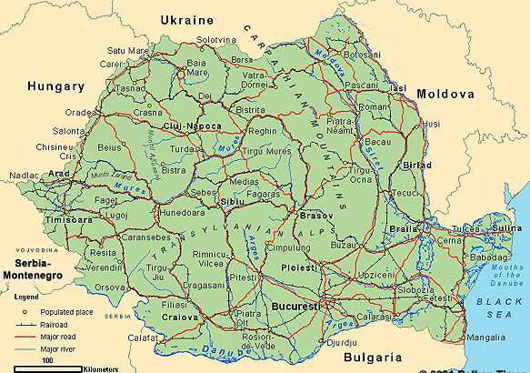


E Summit: Entrepreneurial Opportunities and Challenges in VUCA World,
6-7 May 2020, I.T.S, Ghaziabad, Delhi(NCR), India

Slide 4




E Summit: Entrepreneurial Opportunities and Challenges in VUCA World,
6-7 May 2020, I.T.S, Ghaziabad, Delhi(NCR), India

Slide 5

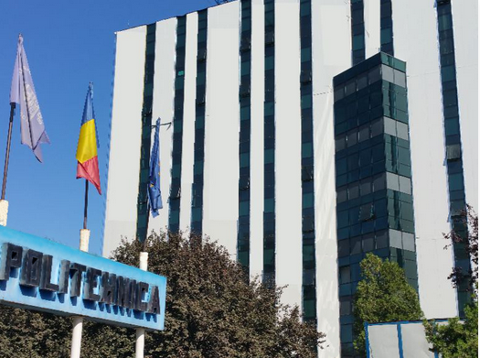

University “Politehnica” of BUCHAREST

Slide 6

The PRECIS PROJECT
1. Industrial adaptive and innovative processes -- 8 research laboratories
2. Systems for increasing the quality of life -- 3 research laboratories
3. Autonomous cognitive systems -- 4 research laboratories
4. Smart mobile society -- 4 research laboratories
5. Cloud Services and the Future of the Internet -- 5 research laboratories
6. Digital medicine -- 4 research laboratories
E Summit: Entrepreneurial Opportunities and Challenges in VUCA World,
6-7 May 2020, I.T.S, Ghaziabad, Delhi(NCR), India
28 Research LABS
http://precis.acs.pub.ro/centrul-de-cercetare/
http://precis.acs.pub.ro/wp-content/uploads/2014/06/prezentare_laboratoare_de_cercetare.pdf

Slide 7

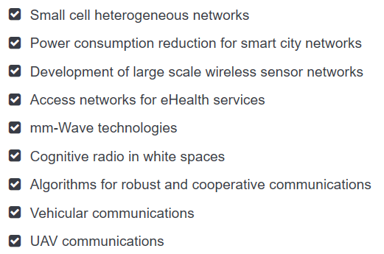

The CAMPUS PROJECT – SMART CITY NETWORKS
E Summit: Entrepreneurial Opportunities and Challenges in VUCA World,
6-7 May 2020, I.T.S, Ghaziabad, Delhi(NCR), India
15 Research LABS
http://campus.pub.ro/website/research-labs

Slide 8
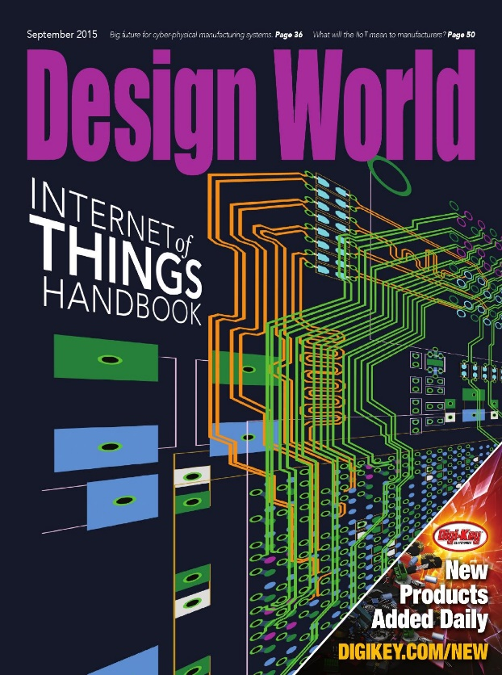

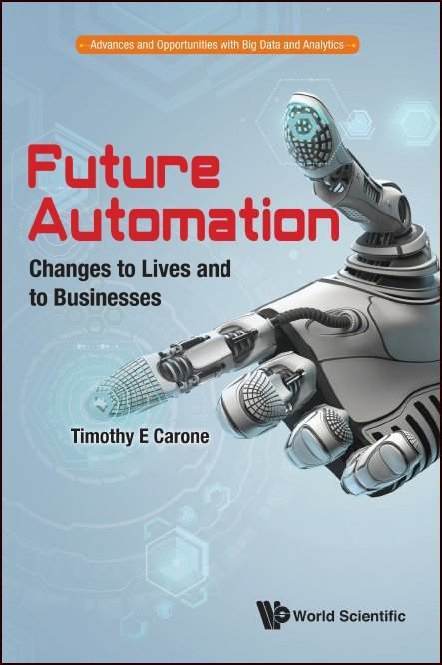

AGENDA
Current and Future IoT Systems, Reliability Solutions, Dependability, IoT Vulnerabilities

Slide 9
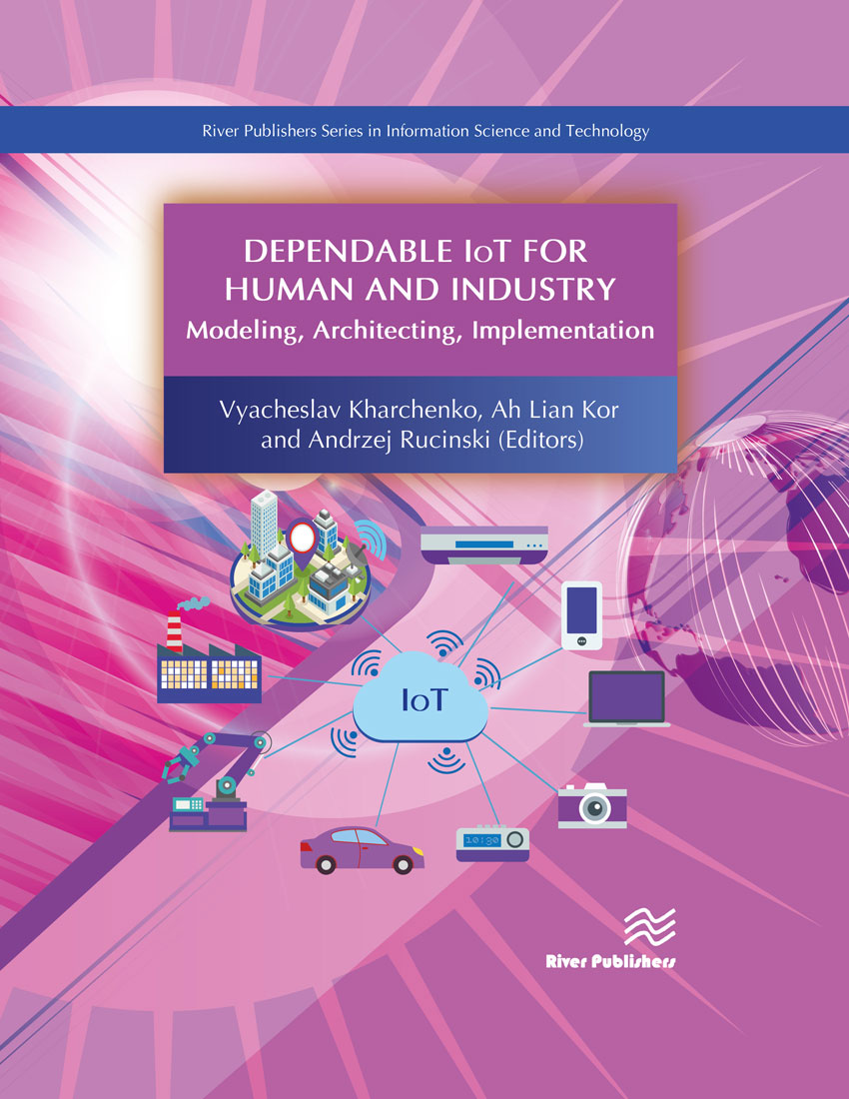
ADVANCED DEPENDABLE Systems – ADS
Characteristics:
Devices are the main PARTS in a ADS (SoC, NoC, IoT…).
An increased degree of interoperability (Human Computer Interfaces, Systems of Systems, Systems operating on the field etc.)
The levels of dependability of ADS, and Quality of Service are important attributes

Slide 10
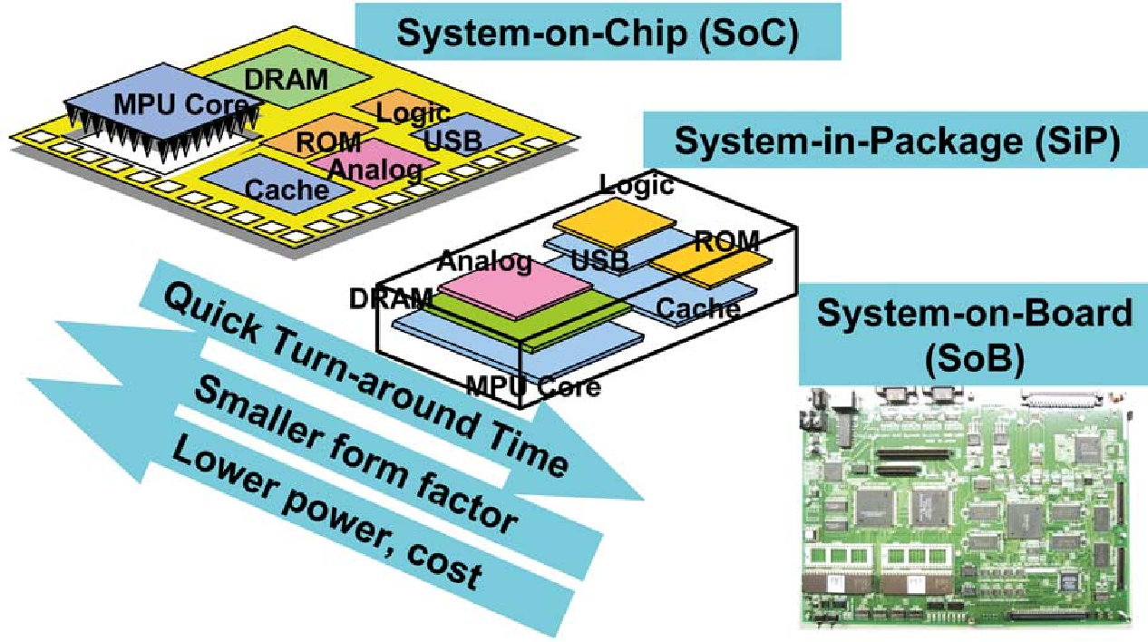
ADS – DEVICES: SoC, SIP, SOB
A system on a chip (SoC) is an integrated circuit (IC) that integrates all components of a computer or other electronic system into a single chip.

Slide 11
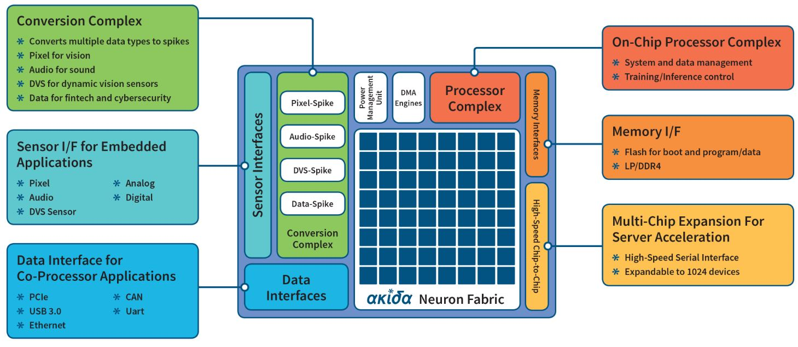
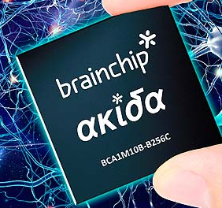
The Akida Neuromorphic SoC
Characteristics:
- small, low cost and low power, making it ideal for edge applications such as Advanced Driver Assistance Systems (ADAS), autonomous vehicles, drones, vision-guided robotics, surveillance and machine vision systems;
has effectively 1.2 million neurons and 10 billion synapses
Source: https://www.brainchipinc.com/products/akida-neuromorphic-system-on-chip

Slide 12
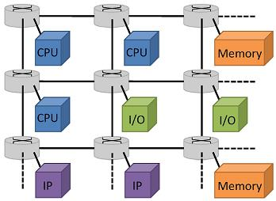
ADS – DEVICES: Networks on CHIP
On-chip networks (NoC) are communication networks, which provide predominantly packet-switch communication between processing elements of an embedded system.

Slide 13

Networks on CHIP RELIABILITY –
Fault tolerance techniques
One of the most popular generic fault tolerance techniques is n-modular redundancy (NMR) that consists of n identical components and a voter to detect and mask failures. This structure is capable of masking (n - 1)/2 errors having n identical components. The most common values for n are three (triple modular redundancy, TMR), five and seven capable of masking one, two and three errors, respectively.

Slide 14
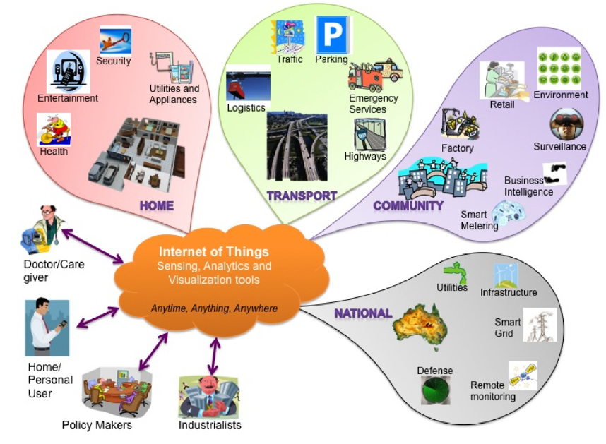
IoT Based ADS
FOR
SOCIETY
AND
LIFE
Future Generation Computer Systems 29 (2013) 1645–1660

Slide 15
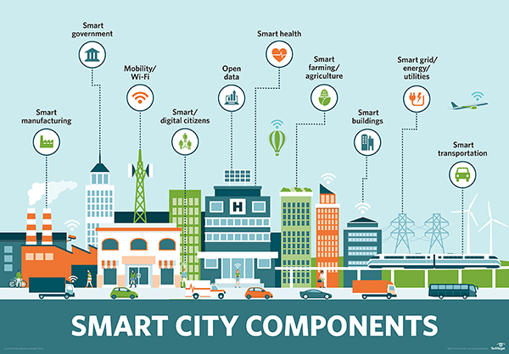
ADS and SMART CITIES
E Summit: Entrepreneurial Opportunities and Challenges in VUCA World,
6-7 May 2020, I.T.S, Ghaziabad, Delhi(NCR), India
http://internetofthingsagenda.techtarget.com/definition/smart-city

Slide 16

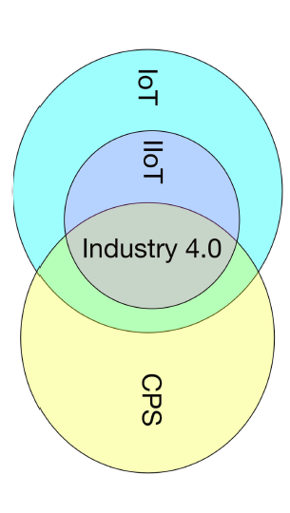
IoT Based MES AND INDUSTRY 4.0
IIOT - Industrial IoT
CPS – Cyber Physical System
IEEE TRANSACTIONS ON INDUSTRIAL INFORMATICS, VOL. 14, NO. 11, NOVEMBER 2018

Slide 17


SMART Buildings
E Summit: Entrepreneurial Opportunities and Challenges in VUCA World,
6-7 May 2020, I.T.S, Ghaziabad, Delhi(NCR), India
‘Different City – Smart City’ Conference, 1st edition, Bucharest, 2016

Slide 18
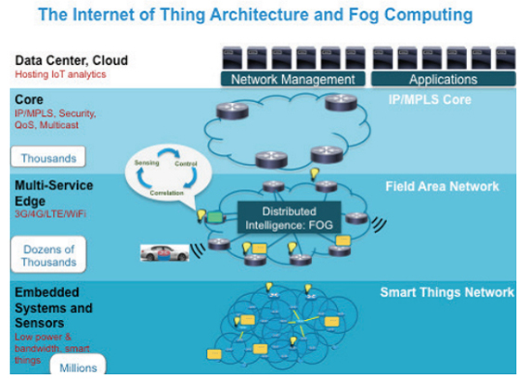
THE FOG AT THE EDGE OF THE NETWORK
Fog computing is a paradigm that “extends cloud computing and services to the edge of the network”, and it provides “low latency, location awareness, and improves quality-of-services (QoS) for streaming and real time applications” using IP or Multiprotocol Label Switching (MPLS).
https://www.cisco.com/c/en/us/products/cloud-systems-management/fog-data-services/index.html

Slide 19
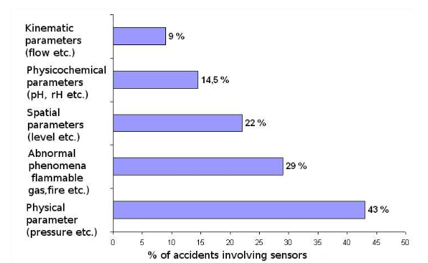
RELIABILITY DOES MATTER
“Processes, servers, NICs, switches, and local and wide area networks can all fail, with real economic consequences.”
Also, IOT devices!
The percentage of accidents caused by a critical sensor malfunction is, in reality, small (less than 3%) when compare against other causes (Bailis, 2014).
However, the report highlights “a doubling in the average annual number of sensor accidents between the periods 1992-1999 and 2000-2008” for the following fields: Metallurgy, Refining, Food Processing, and Chemicals-Pharmaceuticals.
P. Bailis, K. Kingsbury, “The network is reliable. An informal survey of real-world communications failures,” ACM Queue, 12(7), 2014

Slide 22
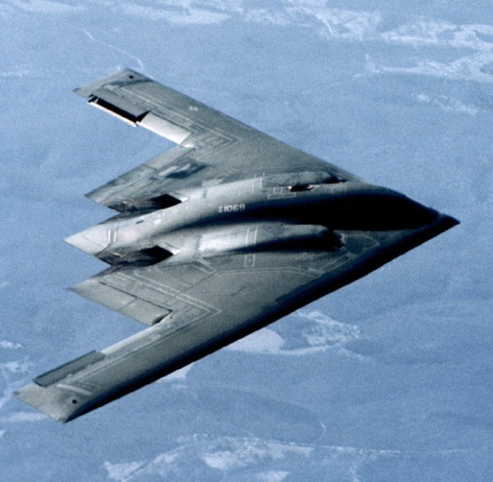
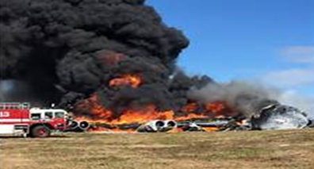
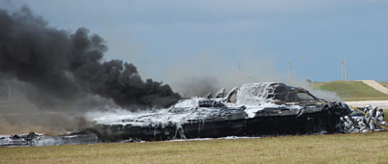
RELIABILITY DOES MATTER (cont)
The combination of slow lift-off speed and the extreme angle of attack resulted in an unrecoverable stall, yaw, and descent.
B-2’s crash
E Summit: Entrepreneurial Opportunities and Challenges in VUCA World,
6-7 May 2020, I.T.S, Ghaziabad, Delhi(NCR), India
https://youtu.be/YNnM_8WahcQ

Slide 23

RELIABILITY DOES MATTER (cont)
The angle of attack (AOA) sensor was replaced after a flight from Manado, in North Sulawesi to Denpasar, Bali on October 28, 2018.
The new Boeing 737 MAX 8 crashed into the sea on October 29, 13 minutes after taking off from Jakarta.
Boeing Company … published an update to the flight crew operations manual for its 737 Max 8, warning of a possible fault in the aircraft’s angle of attack system that could cause the aircraft to violently pitch nose down.
E Summit: Entrepreneurial Opportunities and Challenges in VUCA World,
6-7 May 2020, I.T.S, Ghaziabad, Delhi(NCR), India
The crash killed all on board: 181 passengers (178 adults and three children), as well as six cabin crew and two pilots.

Slide 24


RELIABILITY DOES MATTER (cont)
E Summit: Entrepreneurial Opportunities and Challenges in VUCA World,
6-7 May 2020, I.T.S, Ghaziabad, Delhi(NCR), India
On 10 March 2019, the Boeing 737 MAX 8 aircraft which operated the Ethiopian Airlines Flight 302 crashed near the town of Bishoftu six minutes after takeoff. All passengers and crew on board, 157 in total, were killed in the accident.
in both flights the Maneuvering Characteristics Augmentation System, known as MCAS, activated in response to erroneous angle of attack information.
https://www.youtube.com/watch?v=0kgG03pVQRg

Slide 25
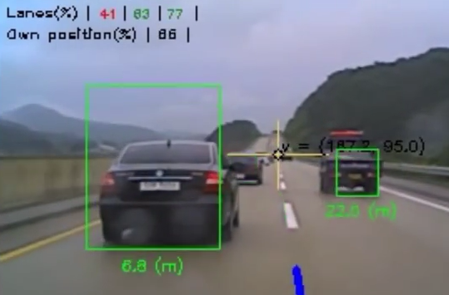
RELIABILITY DOES MATTER (cont)
Vehicle detection and tracking is becoming a reality using only vision sensors, which can be installed onboard vehicles due to their low weight and cost, and the increased capabilities of embedded processors.
(see AKIDA NoC processor)
E Summit: Entrepreneurial Opportunities and Challenges in VUCA World,
6-7 May 2020, I.T.S, Ghaziabad, Delhi(NCR), India
https://www.youtube.com/watch?v=LRnQUncmZEo

Slide 26
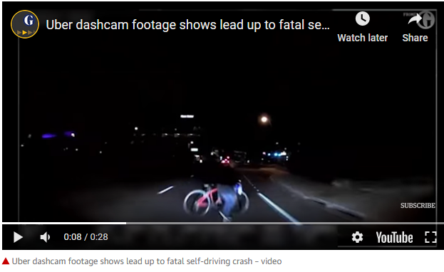
RELIABILITY DOES MATTER (cont)
Why the
self-driving
car
did not
stop ?
E Summit: Entrepreneurial Opportunities and Challenges in VUCA World,
6-7 May 2020, I.T.S, Ghaziabad, Delhi(NCR), India
https://www.digitaltrends.com/cool-tech/most-significant-self-driving-car-crashes/
https://www.youtube.com/watch?time_continue=8&v=RASBcc4yOOo

Slide 27
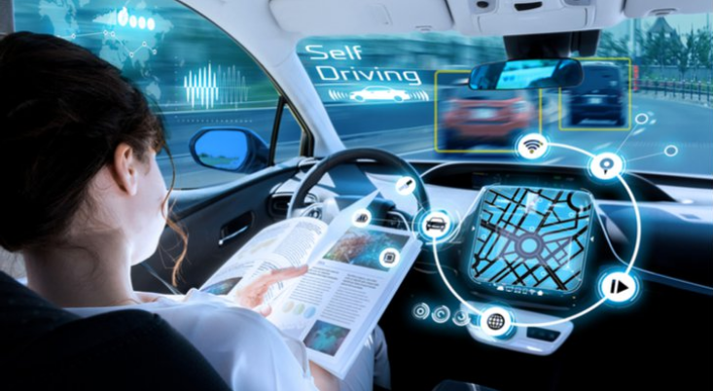
AUTONOMOUS DRIVING –
RELIABILITY DOES MATTER (cont)
A self-driving car, also known as a robot car, autonomous car, or driverless car, is a vehicle that is capable of sensing its environment and moving with little or no human input.
E Summit: Entrepreneurial Opportunities and Challenges in VUCA World,
6-7 May 2020, I.T.S, Ghaziabad, Delhi(NCR), India
Source: Shutterstock

Slide 28
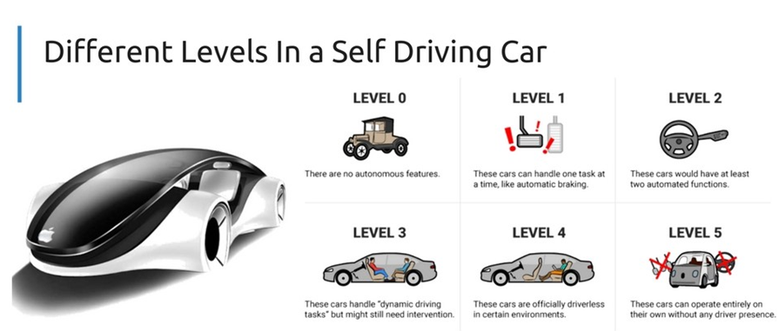
AUTONOMOUS DRIVING –
RELIABILITY DOES MATTER (cont)
There are currently 5 levels of automated driving, of which two are considered autonomous (or self-driving) driving (Level 4 and Level 5).
(https://en.wikipedia.org/wiki/List_of_self-driving_car_fatalities)
E Summit: Entrepreneurial Opportunities and Challenges in VUCA World,
6-7 May 2020, I.T.S, Ghaziabad, Delhi(NCR), India

Slide 29
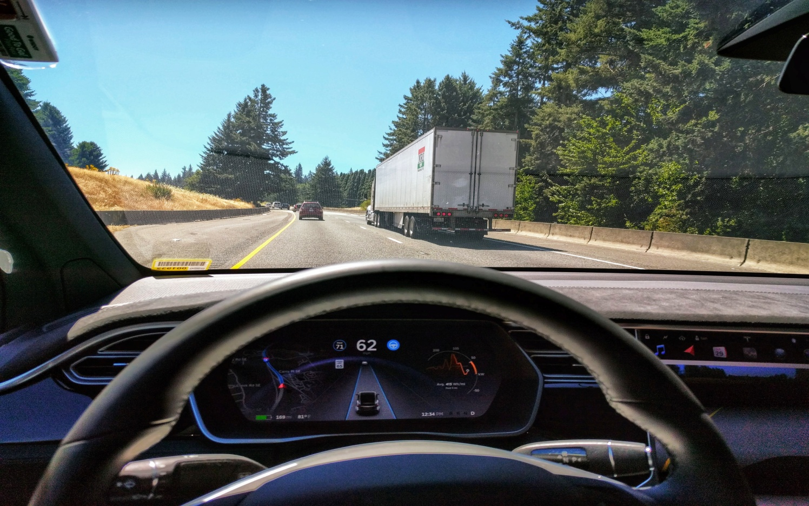
AUTONOMOUS DRIVING –
RELIABILITY DOES MATTER (cont)
There are currently 5 levels of automated driving, of which two are considered autonomous (or self-driving) driving (Level 4 and Level 5).
Tesla Autopilot is a Level 2 automated driving system.
Level 2 is considered automated driving, but not autonomous driving. A Level 2 driving system expects a driver to be fully aware at any time of the driving and traffic situation and be able to take over any moment.
E Summit: Entrepreneurial Opportunities and Challenges in VUCA World,
6-7 May 2020, I.T.S, Ghaziabad, Delhi(NCR), India
Source: https://upload.wikimedia.org/wikipedia/commons/e/e7/Tesla_Autopilot_Engaged_in_Model_X.jpg

Slide 30
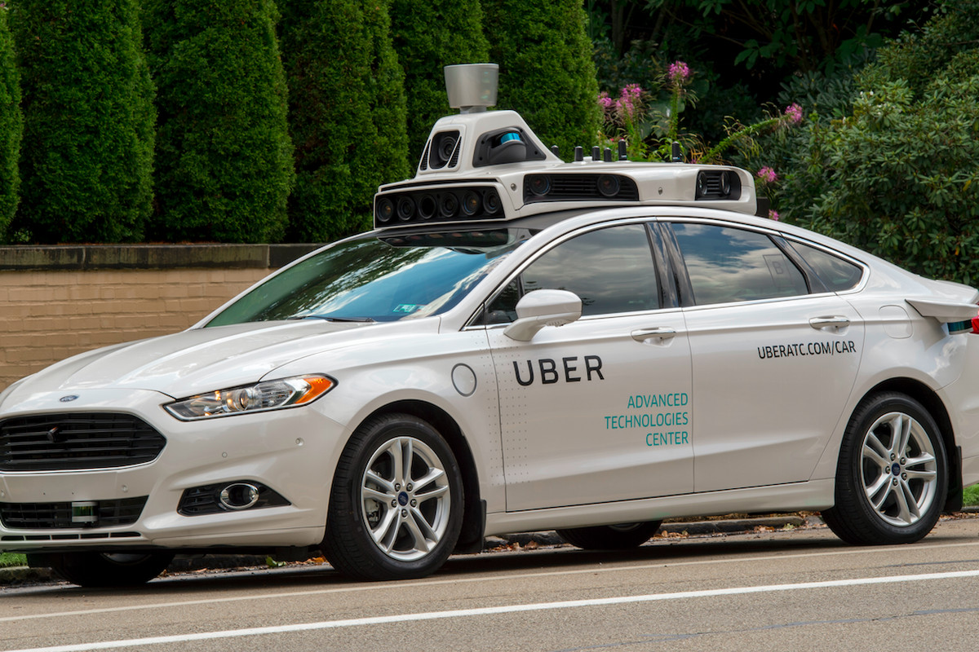
AUTONOMOUS DRIVING –
RELIABILITY DOES MATTER (cont)
There are currently 5 levels of automated driving, of which two are considered autonomous (or self-driving) driving (Level 4 and Level 5).
A Level 3 autonomous driving system would occasionally expect a driver to take over control (as Uber!)
E Summit: Entrepreneurial Opportunities and Challenges in VUCA World,
6-7 May 2020, I.T.S, Ghaziabad, Delhi(NCR), India
Uber has resumed tests of its self-driving cars after the crash.

Slide 31
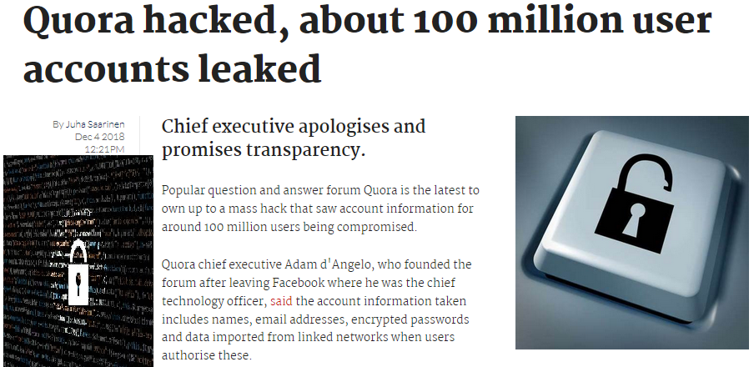
SECURITY DOES MATTER!
November 30, 2018
SECURITY, is the ANSWER!

Slide 32


Major Third-party Breaches Revealed in May 2019
A database of a huge number of Instagram influencers, big names, and brand records containing their own data including contact subtleties was found openly available on the web.
Cyber criminals leaked credit-card data from a third-party data-management firm. City Bank, Axis, ICICI, IndusInd, RBL, and others’ confidential customer data were exposed.
The money was sent on online wallets like PayTM and Mobikwik, which were opened using fake details and SIM.
Magecart attackers inserted card-skimming scripts into the subscription website for the Forbes print magazine.
Websites using Alpaca Forms
http://blog.asuswebstorage.com/2019/05/15/asus-webstorage-security-incident-update/
Companies Using Asus’s Webstorage
https://www.normshield.com/major-third-party-breaches-revealed-in-may-2019/

Slide 33
MORE Breaches - July 2019
The credit bureau Equifax will pay about $650 million — and perhaps much more — to resolve most claims stemming from a 2017 data breach that exposed sensitive information on more than 147 million consumers and demonstrated how little control Americans have over their personal data.
5 Million Bulgarians Have Their Personal Data Stolen in Hack:
Bulgaria has suffered what has been described as the biggest data leak in its history. The stolen data, which hackers emailed to local media on July 15, originates from the country’s tax reporting service – the National Revenue Agency (NRA).
https://thenextweb.com/security/2019/07/16/bulgaria-tax-agency-data-leak-hack/
https://www.nytimes.com/2019/07/22/business/equifax-settlement.html

Slide 34
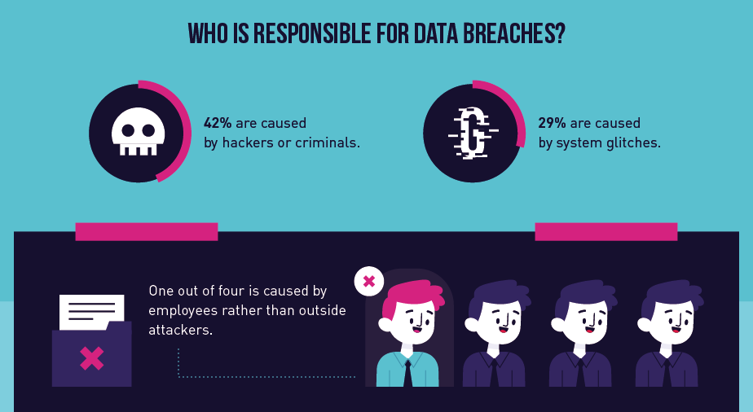
https://hostingtribunal.com/blog/biggest-data-breach-statistics/

Slide 35
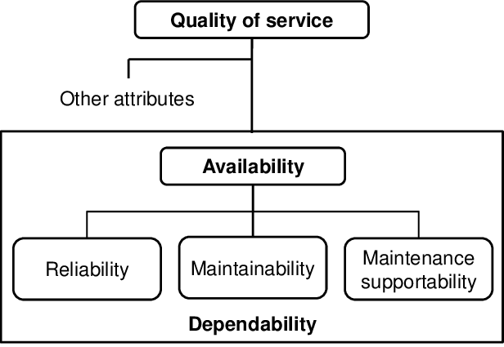
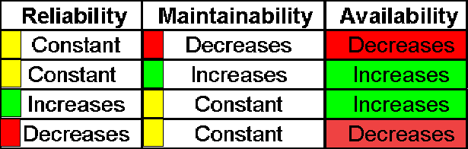
AVAILABILITY DOES MATTER
Along the whole chain of sensor-based modern engineering system, from sensing and measuring, to interpreting and connecting the data, the robustness and the reliability are important factors to assure improved experience with IoT and Fog.
E Summit: Entrepreneurial Opportunities and Challenges in VUCA World,
6-7 May 2020, I.T.S, Ghaziabad, Delhi(NCR), India

Slide 36
ADVANCE SYSTEMS Dependability
Dependability
Reliability
Availability
Security
Safety
The ability of the system to deliver services as specified
The ability of the system to deliver services when requested
The ability of system to protect itself against intrusion
The ability of the system to operate without catastrophic failure

Slide 37
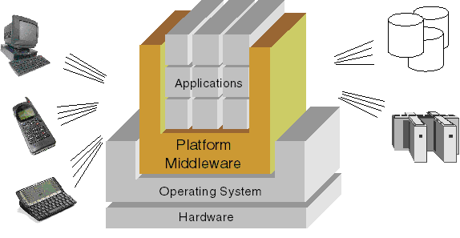
Dependability Optimization
E Summit: Entrepreneurial Opportunities and Challenges in VUCA World,
6-7 May 2020, I.T.S, Ghaziabad, Delhi(NCR), India
HARDWARE DEPENDABILITY
http://www-01.ibm.com/software/info/websphere/partners4/articles/images/garwho-fig3.gif

Slide 38
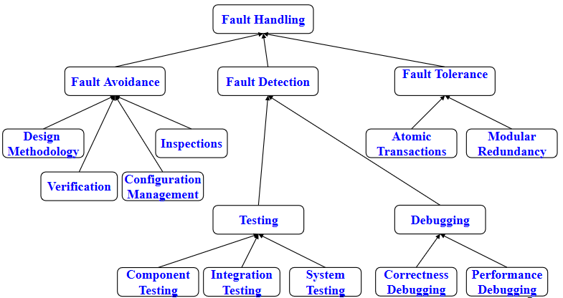
Dependability Optimization
E Summit: Entrepreneurial Opportunities and Challenges in VUCA World,
6-7 May 2020, I.T.S, Ghaziabad, Delhi(NCR), India
SOFTWARE DEPENDABILITY
http://slideplayer.com/slide/6762/

Slide 39
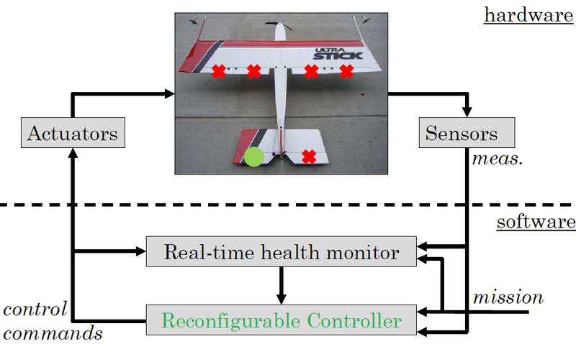
RELIABILITY SOLUTIONS – Fault tolerance
The reliability can be assured by “enhanced hardware, software, and network designs”, including fault tolerant approaches.
Fault tolerance is the ability of a system to continue functioning in the event of a partial failure.
E Summit: Entrepreneurial Opportunities and Challenges in VUCA World,
6-7 May 2020, I.T.S, Ghaziabad, Delhi(NCR), India

Slide 40
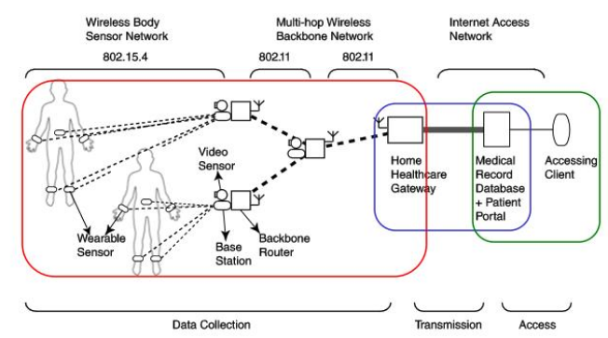
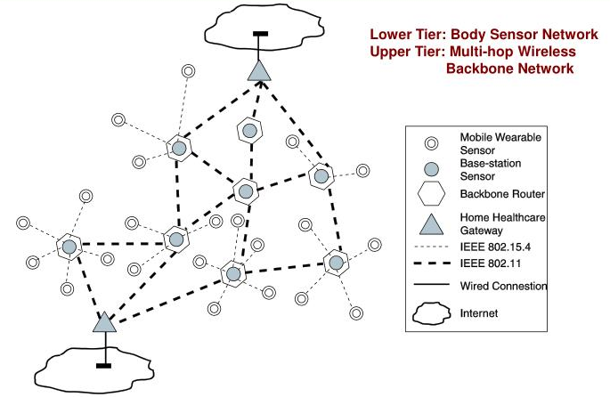
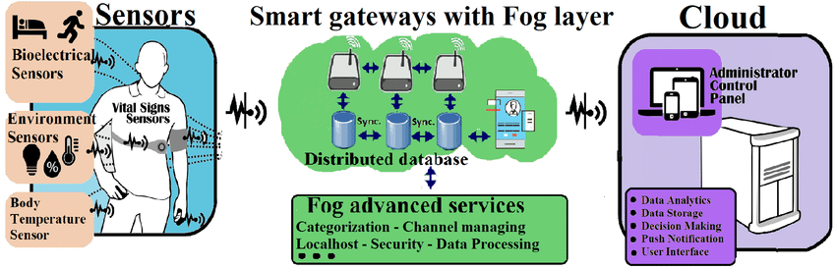
RELIABILITY SOLUTIONS - Fault Tolerant Sensor Network Routing for Patient Monitoring
https://www.researchgate.net/figure/A-IoT-based-e-health-monitoring-system-architecture_fig1_315665270 (2017)

Slide 41
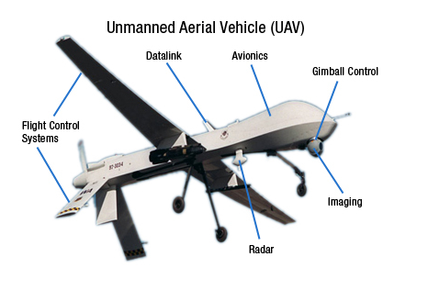
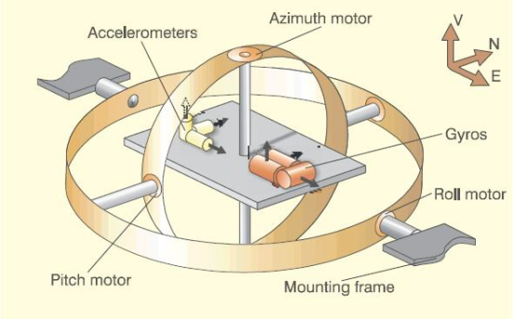
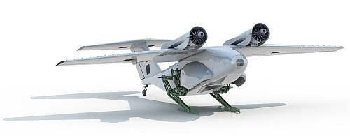
RELIABILITY SOLUTIONS – integration of multiple devices for “similar service”
E Summit: Entrepreneurial Opportunities and Challenges in VUCA World,
6-7 May 2020, I.T.S, Ghaziabad, Delhi(NCR), India
Replace Gimball by SINS !

Slide 42
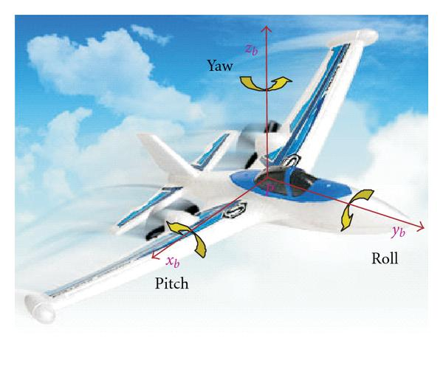
MULTIPLE INTEGRATION OF Strap down Inertial Navigation Systems
Strap down Inertial Navigation Systems (SINS)
Celestial Navigation System (CNS),
Global Positioning System (GPS),
Doppler radar.
E Summit: Entrepreneurial Opportunities and Challenges in VUCA World,
6-7 May 2020, I.T.S, Ghaziabad, Delhi(NCR), India
Sensors
M. Ushaq and F. J. Cheng, A Reliable Multi-Sensor Navigation System for an Unmanned Aerial Vehicle Realized through Integration of SINS with GPS, CNS and Doppler Radar, Applied Mechanics and Materials (Volume 392) , 2013.

Slide 43
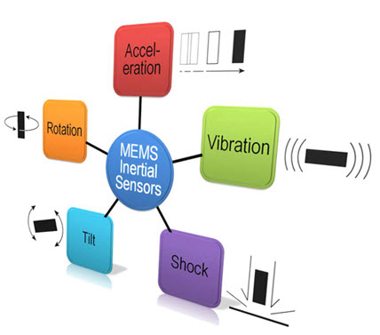
RELIABILITY SOLUTIONS – by proper configuration/calibration
Sensors proper configuration/calibration is important. The calibration of MEMS sensors, for instance, encompassed calculation of the scale and offset coefficients to be recorded into sensor’s settings. [J. Bakunowicz and P. Rzucidło: Measurement and analysis of certain flight parameters, J. Sens. Sens. Syst., 6, 211–222, 2017]
E Summit: Entrepreneurial Opportunities and Challenges in VUCA World,
6-7 May 2020, I.T.S, Ghaziabad, Delhi(NCR), India
MEMS (Microelectromechanical systems ) Sensors Based Hands Gesture Controlled Robot

Slide 44

RELIABILITY SOLUTIONS – Listen to STANDARDS
MIL-STD-785 (Reliability Program for Systems and Equipment) and
MIL-HDBK-217 (Reliability Prediction of Electronic Equipment)
MIL-STD-883 (Test Methods and Procedures for Microelectronics)
E Summit: Entrepreneurial Opportunities and Challenges in VUCA World,
6-7 May 2020, I.T.S, Ghaziabad, Delhi(NCR), India
https://www.weibull.com/knowledge/milhdbk.htm

Slide 45

RELIABILITY SOLUTIONS – Computer Aided Reliability Engineering
E Summit: Entrepreneurial Opportunities and Challenges in VUCA World,
6-7 May 2020, I.T.S, Ghaziabad, Delhi(NCR), India

Slide 46
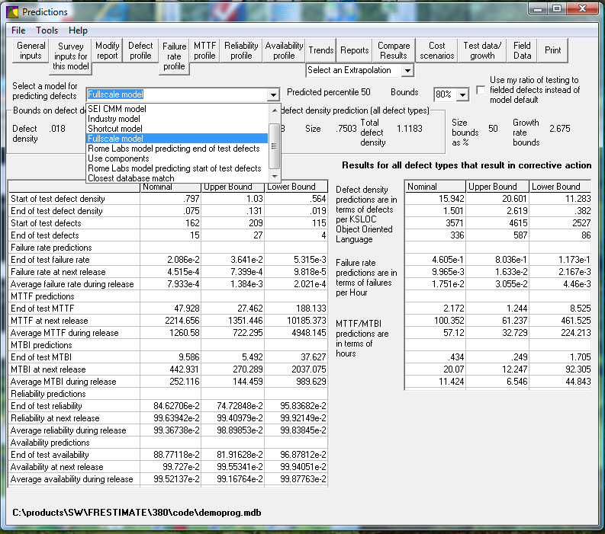
RELIABILITY SOLUTIONS – Computer Aided Software Reliability - FRESTIMATE
Predict BEFORE coding and/or testing begins:
- Software defects during testing and after delivery
- Testing effort required to meet a desired/required objective
- Software failure rate, MTTF, MTTCF, availability, reliability
E Summit: Entrepreneurial Opportunities and Challenges in VUCA World,
6-7 May 2020, I.T.S, Ghaziabad, Delhi(NCR), India
Ann Marie Neufelder; http://www.softrel.com/index.html

Slide 47
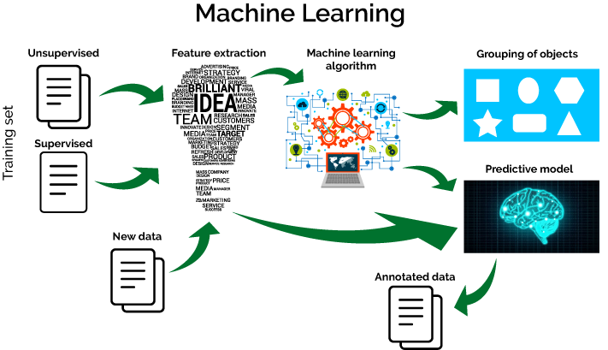
AVAILABILITY SOLUTIONS by MACHINE LEARNING
Machine Learning could help in fault isolation and fault detection of machines and thus improve Mean Time To Repair (MTTR) of a failed system to achieve higher availability.
E Summit: Entrepreneurial Opportunities and Challenges in VUCA World,
6-7 May 2020, I.T.S, Ghaziabad, Delhi(NCR), India
Rajkumar Buyya, Satish Narayana, Fog and Edge Computing: Principles and Paradigms, Ch 10, pp. 249, 2019.

Slide 48

AVAILABILITY SOLUTIONS by MACHINE LEARNING (cont.)
Machine learning could be used to optimize operations by monitoring occupancy, movement, and overall system usage and over time (the case of a train station in a smart city).
E Summit: Entrepreneurial Opportunities and Challenges in VUCA World,
6-7 May 2020, I.T.S, Ghaziabad, Delhi(NCR), India
Intelligent transportation: https://www.information-age.com/intelligent-transportation-smart-cities-123473979/
Rajkumar Buyya, Satish Narayana, Fog and Edge Computing: Principles and Paradigms, Ch 10, pp. 249, 2019.

Slide 49
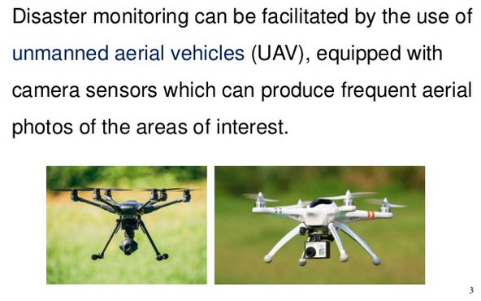
AVAILABILITY SOLUTIONS by MACHINE LEARNING (cont.)
Machine learning can be used with Self-Driving Cars and Unmanned Aerial Vehicles to understand images, or to detect anomalies.
E Summit: Entrepreneurial Opportunities and Challenges in VUCA World,
6-7 May 2020, I.T.S, Ghaziabad, Delhi(NCR), India
EnviroInfo Conference 2017 Disaster Management for Resilience and Public Safety.

Slide 50

IoT IS IN NO WAY SECURE FOR SURE!
Many smart devices currently available on the market are vulnerable to third-party intrusions. Vulnerabilities have been detected on multiple occasions in medical devices, pacemakers, security cameras, smart doorbells, baby monitors and connected cars.
E Summit: Entrepreneurial Opportunities and Challenges in VUCA World,
6-7 May 2020, I.T.S, Ghaziabad, Delhi(NCR), India
https://www.bitdefender.com/files/News/CaseStudies/study/229/Bitdefender-Whitepaper-The-IoT-Threat-Landscape-and-Top-Smart-Home-Vulnerabilities-in-2018.pdf

Slide 51

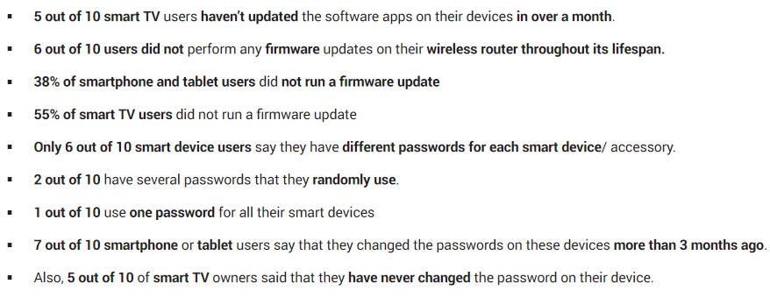
Key Facts 2018
E Summit: Entrepreneurial Opportunities and Challenges in VUCA World,
6-7 May 2020, I.T.S, Ghaziabad, Delhi(NCR), India
https://www.bitdefender.com/files/News/CaseStudies/study/229/Bitdefender-Whitepaper-The-IoT-Threat-Landscape-and-Top-Smart-Home-Vulnerabilities-in-2018.pdf

Slide 52

IoT IS IN NO WAY IMMUNE TO HACKING
Back in October of 2016, the largest Distributed Denial of Service(DDoS )attack ever was launched on service provider Dyn using an IoT botnet.
This IoT botnet was made possible by malware called Mirai. Once infected with Mirai, computers continually search the internet for vulnerable IoT devices and then use known default usernames and passwords to log in, infecting them with malware. These devices were things like digital cameras and DVR players.
2018
E Summit: Entrepreneurial Opportunities and Challenges in VUCA World,
6-7 May 2020, I.T.S, Ghaziabad, Delhi(NCR), India
https://blog.avast.com/hacker-creates-seven-new-variants-of-the-mirai-botnet (October 25, 2018)

Slide 53
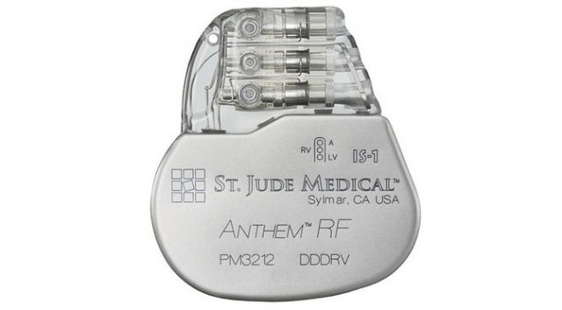
IoT IS IN NO WAY IMMUNE TO HACKING (cont.)
Hackable Cardiac Devices from St. Jude: Medical’s implantable cardiac devices have vulnerabilities that could allow a hacker to access a device.
The devices, like pacemakers and defibrillators, are used to monitor and control patients’ heart functions and prevent heart attacks.
The vulnerability occurred in the transmitter that reads the device’s data and remotely shares it with physicians.
E Summit: Entrepreneurial Opportunities and Challenges in VUCA World,
6-7 May 2020, I.T.S, Ghaziabad, Delhi(NCR), India
https://www.extremetech.com/extreme/238161-security-firm-claims-implantable-cardiac-devices-can-be-hacked (October 24, 2016)

Slide 54

IoT IS IN NO WAY IMMUNE TO HACKING (cont.)
The Jeep Hack
In July [2015], a team of researchers was able to take total control of a Jeep SUV using the vehicle’s CAN bus. By exploiting a firmware update vulnerability, they hijacked the vehicle over the Sprint cellular network and discovered they could make it speed up, slow down and even veer off the road.
E Summit: Entrepreneurial Opportunities and Challenges in VUCA World,
6-7 May 2020, I.T.S, Ghaziabad, Delhi(NCR), India
https://www.cnbc.com/2015/07/21/hackers-remotely-kill-jeep-engine-on-highway.html (July 25, 2015)

Slide 55

IoT IS IN NO WAY IMMUNE TO HACKING (cont.)
Numerous gadgets and devices have a built-in web server that hosts a web application for managing them (vulnerable to a Cyber based attack).
There are flaws in the implementation of the authorization/authentication mechanisms.
E Summit: Entrepreneurial Opportunities and Challenges in VUCA World,
6-7 May 2020, I.T.S, Ghaziabad, Delhi(NCR), India
https://resources.infosecinstitute.com/the-top-ten-iot-vulnerabilities/

Slide 56
IoT IS IN NO WAY IMMUNE TO HACKING (cont.)
3. Insecure network services. IoT devices have tools for diagnostics and testing along with services like debugging. These “maintenance” services have possibly been lightly tested, which thus make them likely to have exploitable source code behind them.
4. An absence of transport layer encryption.
5. If the data on the IoT device is not encrypted, and other individuals have access to it, this makes data vulnerable to covert hijacking and theft.
E Summit: Entrepreneurial Opportunities and Challenges in VUCA World,
6-7 May 2020, I.T.S, Ghaziabad, Delhi(NCR), India
https://www.nsslabs.com/company/news/media-resources/iot-insecurity-pinpointing-the-problems/
https://resources.infosecinstitute.com/the-top-ten-iot-vulnerabilities/

Slide 57
IoT IS IN NO WAY IMMUNE TO HACKING (cont.)
6. Numerous IoT devices can connect to the Cloud. Therefore, having a Cloud-based management interface represents yet another potential security vulnerability.
7. Unreliable mobile interface.
8. Inadequate security features. There are no encryption options or features to detect and monitor any potential Cyber-attacks.
9. Unprotected patches and upgrades.
10. Erasing personal data.
E Summit: Entrepreneurial Opportunities and Challenges in VUCA World,
6-7 May 2020, I.T.S, Ghaziabad, Delhi(NCR), India
https://resources.infosecinstitute.com/the-top-ten-iot-vulnerabilities/

Slide 58

BE CLEVER WHILE DESIGN, IMPLEMENT, TEST, AND VALIDATE
E Summit: Entrepreneurial Opportunities and Challenges in VUCA World,
6-7 May 2020, I.T.S, Ghaziabad, Delhi(NCR), India
Software, the Invisible Technology. By G. Pascal Zachary, Oct., 2016
http://spectrum.ieee.org/computing/software/software-the-invisible-technology

Slide 59

How To “Solve” It?
Everyone knows that debugging is twice as hard as writing a program in the first place.
E Summit: Entrepreneurial Opportunities and Challenges in VUCA World,
6-7 May 2020, I.T.S, Ghaziabad, Delhi(NCR), India
“So if you're as clever as you can be when you write it, how will you ever debug it?”
Writing a program ---- Product design and implementation
Debug ---- Testing, Repairing, Validation

Slide 60
Conclusions
Efforts are made to design, implement, and test modern IoT based systems to offer high standards of quality related to reliability, availability and security.
However, due to the novelty of developments, the increased complexity of processes, many devices can be subject to failures or cyber attacks.
Our expectations are positive based on experience gained through PRECIS and CAMPUS projects on developing new IoT systems as listed above.
E Summit: Entrepreneurial Opportunities and Challenges in VUCA World,
6-7 May 2020, I.T.S, Ghaziabad, Delhi(NCR), India

Slide 61

Thank You!

