Slide 1

Architecture Synthesis for
Cost Constrained Fault Tolerant Biochips
M. C. Eskesen, P. Pop and S. Potluri
Department of Applied Mathematics and Computer Science,
Technical University of Denmark

Slide 2
Outline
Introduction to mVLSI
Flow-based biochips
Defects and need for reliability
Fault model and fault tolerant components
Motivational example
Problem formulation and objective
Optimization strategy
Experimental results
Conclusions

Slide 3

Introduction to mVLSI
Source: W. Grover, “Designing, fabricating and using flow-based microfluidics:
Past successes and future challenges”, Tutorial, VLSI Design 2015

Slide 4
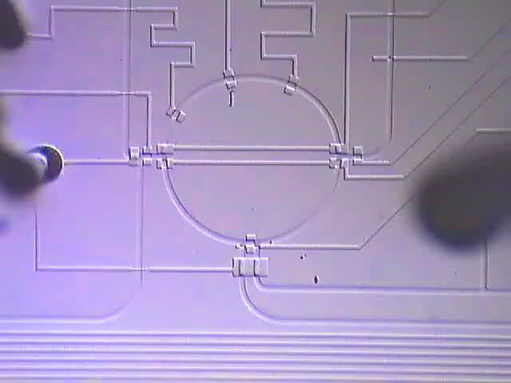
Flow-based (FB) Biochips
Source: http://groups.csail.mit.edu/cag/biostream/

Slide 5
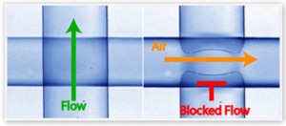
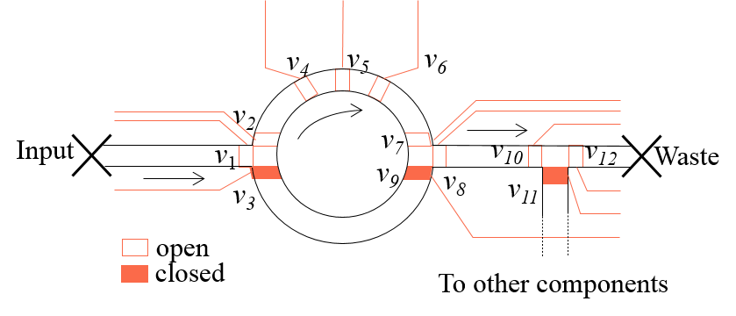
Technology and high level abstraction
Technology:
  Multi-layer soft lithography
  Fabrication substrate –
  elastomers (PDMS)
  Source: S. R. Quake et al, “From micro- to
  nanofabrication using soft materials”, Science 2000
Pressure
Source
Control Layer
Valve
v_{a}
Valve
v_{a}
Control Pin z₁
a
Flow Layer
Fluidic Input
Glass Plate
3D View
Top View

Slide 6
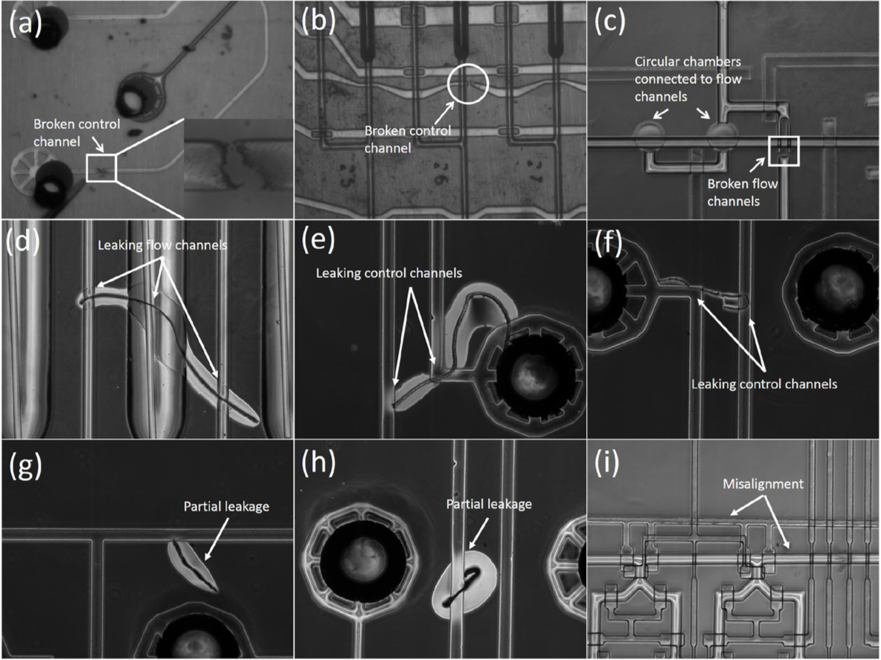
Defects in microfabrication of FB biochips
Source: K. Hu et.al, “Testing of Flow-based Microfluidic Biochips:
Fault Modeling, Test Generation and Experimental Demonstration”, IEEE TCAD, 2014

Slide 7
Need for Reliability
Sensitivity= positivity in disease, expressed as a % = TP/ (TP+FN) × 100
Specificity = absence of a particular disease, expressed as % = TN/ (FP+TN)× 100
TP = True Positives, the number of diseased patients correctly classified by the test
TN = True Negatives, number of non-diseased patients correctly classified by the test
FP = False Positives, the number of non-diseased patients misclassified by the test
FN = False Negatives, the number of diseased patients misclassified by the test

Slide 8
The big picture
VLSI
mVLSI
System Specifications
System Specifications
Architectural Design
Schematic Design
Functional Design
Physical Design
(Flow Layer)
X = (AB + CD)
Y= (A(B+C))
Logic Design
Application Mapping
t1
t2
t3
...
Circuit Design
Control Synthesis
v1
0
1
0
...
v2
1
0
0
...
...
...
...
...
...
Physical Design
Physical Design
(Control Layer)
Fabrication
Fabrication

Slide 9
The big picture
Biochip synthesis
Recompile biochemical application
Original netlist
Fault locations
Add redundancy
Diagnosis
Fault tolerant netlist
Defective biochip
Fabrication
Testing
Fabricated biochip

Slide 10
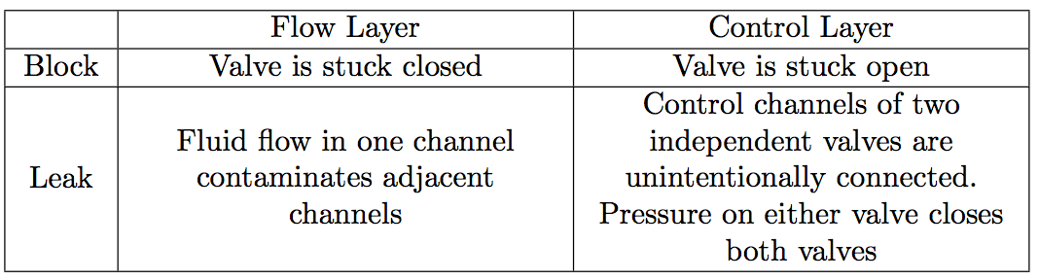

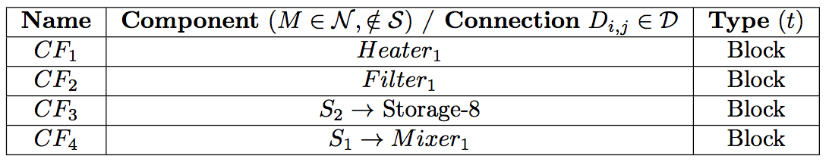
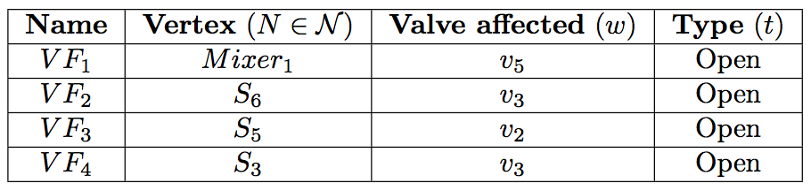
Fault model

Slide 11
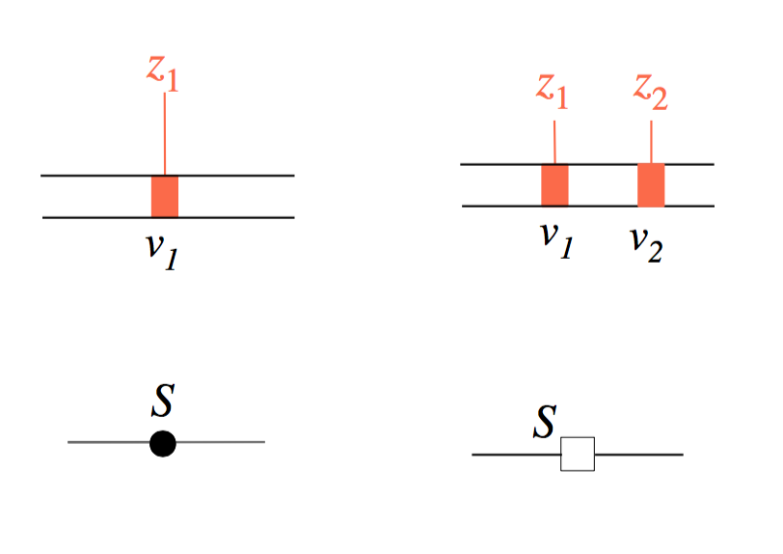
Fault-tolerant switch design
Cost overhead: 1 extra valve per switch

Slide 12
Fault-tolerant pump/mixer design
Cost overhead: 1 extra valve per pump

Slide 13
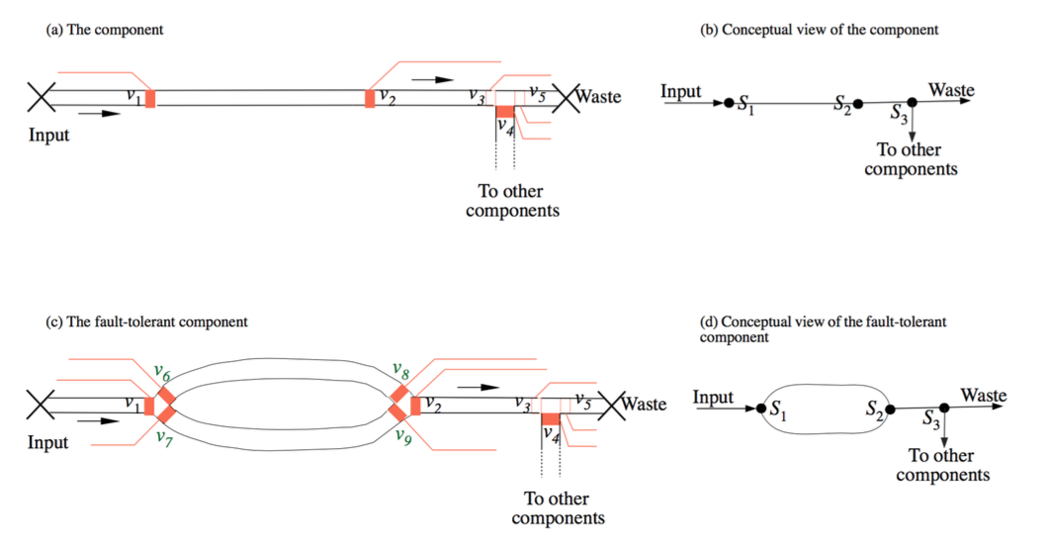

Fault-tolerant channels
Cost overhead: 4 extra valves and 3 extra channels

Slide 14
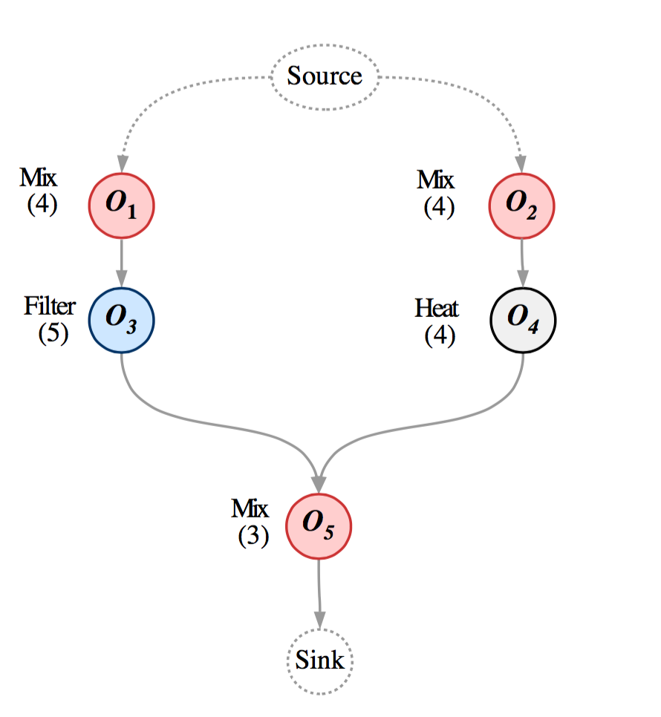
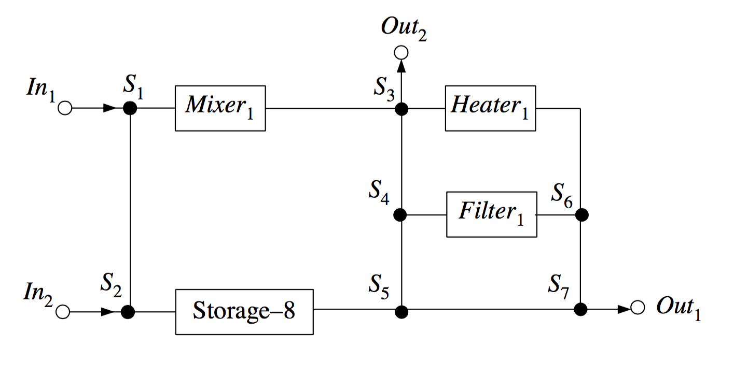
Motivational example

Slide 15
Straightforward vs. optimized synthesis
Straightforward solution: redundancy not optimized;
biochip architecture cost: 129
Optimized solution: optimal addition of redundancy
biochip architecture cost: 96

Slide 16
Problem formulation
Fault Tolerant Architecture Synthesis (FTAS)
Given
  A biochemical application and a fault model
  Characterized component model library
  (including fault-tolerant components)
Synthesize
  A biochip architecture
  Deciding on:
    Component allocation
    Fault-tolerant netlist generation
    Schedule for routing of fluids through the microfluidic channels
  Such that
    the cost of the architecture is minimized
    Satisfying the fault-tolerance, dependency and resource constraints
Cost = total number of valves + total number of channels in the architecture
Notes:
Facilitates programmability and automation

Slide 17
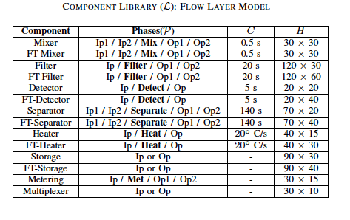

Problem formulation
Application model
Component library&
Design constraints
Initial architecture
Fault model
Fault Tolerant Architecture Synthesis (FTAS)
Fault tolerant architecture
Cost = total number of valves + total number of channels in the architecture

Slide 18
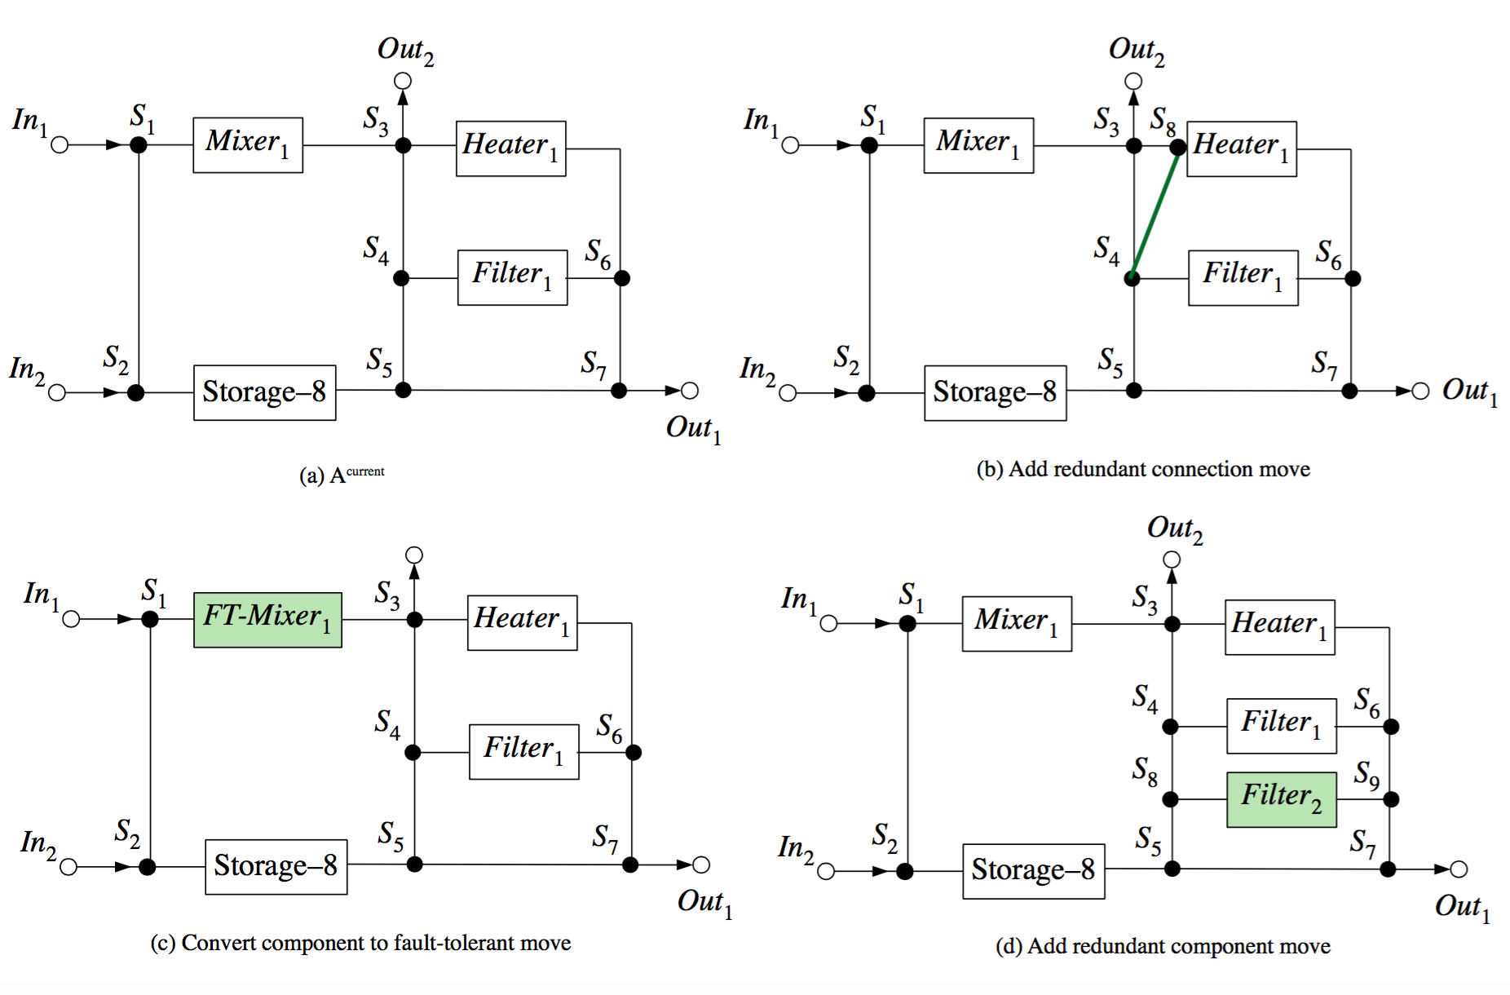
Optimization strategy (FTAS)
Design transformations
Add redundant component
Make component fault-tolerant
Add redundant connection
Remove redundant component
Make component non fault-tolerant
Remove redundant connection

Slide 19
Optimization strategy (FTAS)
Metaheuristic optimization: Greedily Randomized Adaptive Search Procedure (GRASP)
  Searches the solution space to minimize the objective function
  Fault scenario generation: subset of all the possible scenarios
    Each iteration applies design transformations visits a neighboring solution
      Applies a fault scenario: injects the faults in the scenario
      Determines connectivity: can I still move fluids around?
      Finish time of the application: will the application finish correctly?
      Evaluates them based on the objective, to pick or drop the neighboring solution.

Slide 20
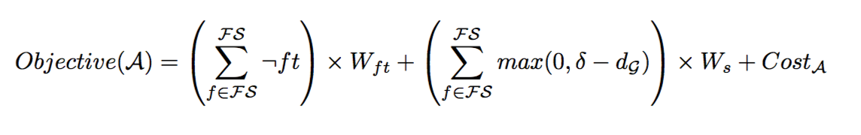
Optimization strategy (FTAS)
Connectivity
  1 if connected, 0 otherwise
  Determined by Breadth First Search
  Considers blocked route and valve faults on switches
Physical constraints
  Sum of
    Total number of valves
    Total number of connections
Scheduling
  Maximum of 0 or δ - application deadline
  Determined by List Scheduling
  Routes determined by Breadth First Search
Notes:
Facilitates programmability and automation

Slide 21
Optimization strategy (FTAS)
Notes:
Facilitates programmability and automation

Slide 22
Experimental Results
A: Original biochip architecture
A_{SFS}⁺ : Biochip architecture obtained using straightforward fault solution
A_{FTAS}⁺: Biochip architecture obtained using proposed FTAS approach
N : Set of all microfluidic components in the biochip
D : Set of all microfluidic channels in the biochip
Name | A |  |  | |FS| | |FS⁻| | A_{SFS}⁺ |  |  | A_{FTAS}⁺
 | |N| | |D| | Cost |  |  | |N| | |D| | Cost | |N| | |D| | Cost
S-1 | 15 | 17 | 84 | 121 | 100 | 20 | 27 | 133 | 15 | 20 | 102
PCR | 14 | 16 | 88 | 77 | 50 | 18 | 25 | 135 | 14 | 17 | 92
IVD | 52 | 78 | 274 | 841 | 100 | 57 | 92 | 379 | 52 | 78 | 279

Slide 23
Yield Results for S-1 benchmark
FS : Exhaustive set of fault scenarios based on the fault model
FS ⁻ : Chosen fraction of fault scenarios
FST : Set of fault scenarios tolerated by the architecture
|FS⁻| | A_{FTAS}⁺ |  |  | |FST| | %Yield
25 | 16 | 20 | 98 | 105 | 86.8%
50 | 15 | 19 | 99 | 117 | 96.7%
121 | 15 | 19 | 102 | 121 | 100%

Slide 24
Thank you!

Slide 25
Microfluidic Large Scale Integration
VLSI
mVLSI
System Specifications
System Specifications
Architectural Design
Schematic Design
Functional Design
Physical Design
(Flow Layer)
X = (AB + CD)
Y= (A(B+C))
Logic Design
Application Mapping
t1
t2
t3
...
Circuit Design
Control Synthesis
v1
0
1
0
...
v2
1
0
0
...
...
...
...
...
...
Physical Design
Physical Design
(Control Layer)
Fabrication
Fabrication

Slide 26
Component library

Slide 27
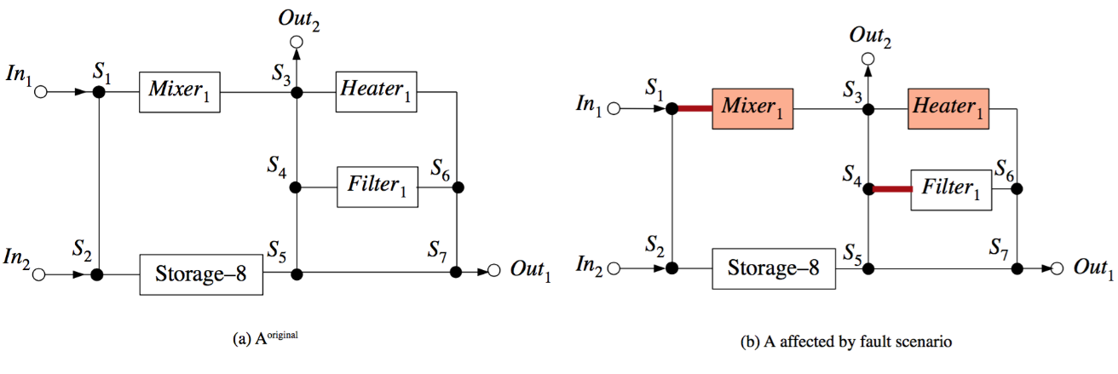
Optimization strategy
Fault scenario generation
  Each iteration
    Applies a fault scenario
    Determines connectivity
    Finish time, δ, of the application
Channel S₁ → Mixer₁ is blocked, Channel of Heater₁ suffers from a block defect.
A valve in the pump of Mixer₁ and the valves controlling the channel towards S₃ and the channel towards S₅ of S₄ are stuck open
Connectivity
  1 if connected, 0 otherwise
  Determined by Breadth First Search
  Considers blocked route and valve faults on switches
Scheduling
  Maximum of 0 or δ - application deadline
  Determined by List Scheduling
  Routes determined by Breadth First Search
Physical constraints
  Sum of
    Total number of valves
    Total number of connections

Slide 28
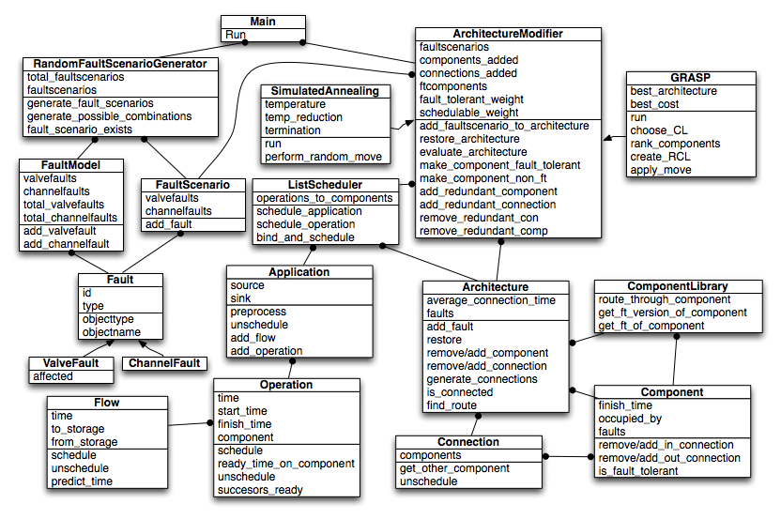
Implementation

Slide 29
Experimental Setup
Implemented in
Python 3.4
Intel Xeon X5550 processor
Running at 2.65 GHz, with 24 GB RAM
One synthetic benchmark S-1
Two real-life benchmarks
IVD (In-Vitro-Diagnostics)
PCR (Polymerase-Chain-Reaction)

Slide 30
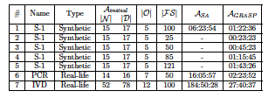
Experimental Results

