Slide 1

Modeling and Simulation
of TTEthernet
Master Thesis By Alexander Zafirov
Supervisor: Paul Pop

Slide 2

Overview
Introduction
TTEthernet
Simulator
Evaluation

Slide 3
Overview
Introduction
TTEthernet
Simulator
Evaluation
Thesis Objectives

Slide 4
Introduction
Hard-real systems
  Distributed systems
  Safety-critical demands
    Event-Triggered approach - depend on particular event
    Time-Triggered approach - predetermined
Mixed-criticality systems

Slide 5
Thesis Objectives
The goal of the master thesis project is to develop a fast and accurate simulator based on the TTEthernet protocol
The requirements for the simulator:
model the two simulation paradigms - action- and event-oriented
model all the three integration policies
determine the average end-to-end delays for all BE and RC messages
determine the worst-case end-to-end communication delays for the RC messages
compare and evaluate results from simulation to TTEthernet analysis
simulator should be designed and implemented so that it can be used inside an optimization loop
Notes:
bullets
more text

Slide 6
Overview
Introduction
TTEthernet
Simulator
Evaluation
Description
Architecture
Virtual Links
Traffic Classes
Integration Policies

Slide 7
TTEthernet
deterministic
synchronized
congestion free
based on ARINC 664p7 and Ethernet
fault-tolerant

Slide 8
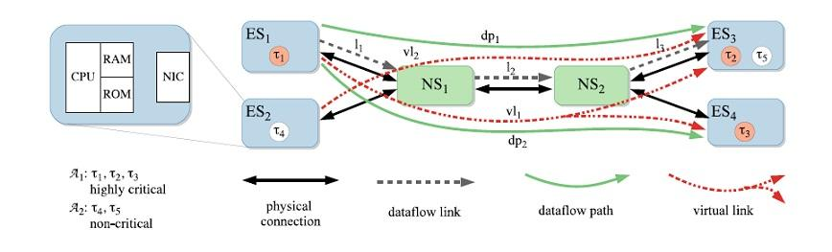
Architecture
End System(ES)
Network Switch(NS)
physical connection - full-duplex and multi-hop
dataflow links
virtual links

Slide 9
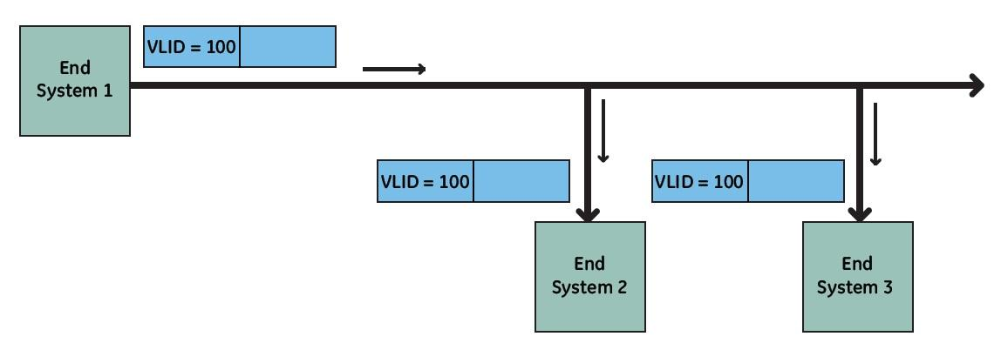
Virtual Links
logical point-to-point connections in the network
"tree" structures with an ES as the root node and a set of ES as leaf nodes
used to route frames
each virtual link carries a single message

Slide 10
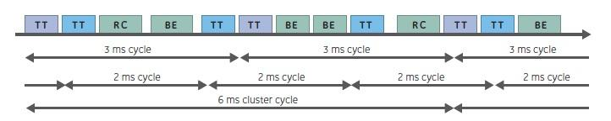
Traffic Classes
Time-Triggered (TT)
  offline static scheduled tables
  highest priority
Rate Constrained (RC)
  bounded end-to-end latencies
  lower priority - transmitted when no TT
Best Effort (BE)
  no time guarantees
  lowest priority

Slide 11
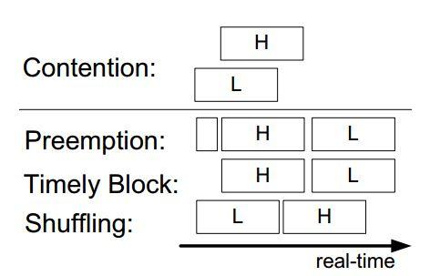
Integration Policies
1) The relay process of the L is stopped; the switch establishes the minimum time of silence
on the channel and relays the H message an a priori specified duration later.
2) The switch will not forward messages at those times when a TT message is expected
3) The H message is delayed until the relay process of the L message is finished

Slide 12
Overview
Introduction
TTEthernet
Simulator
Evaluation
Simulator Design
Simulator Output
Main Simulation Loop
Steady-state Simulation
Stepwise Simulation
Action-oriented Simulation
Event-oriented Simulation

Slide 13
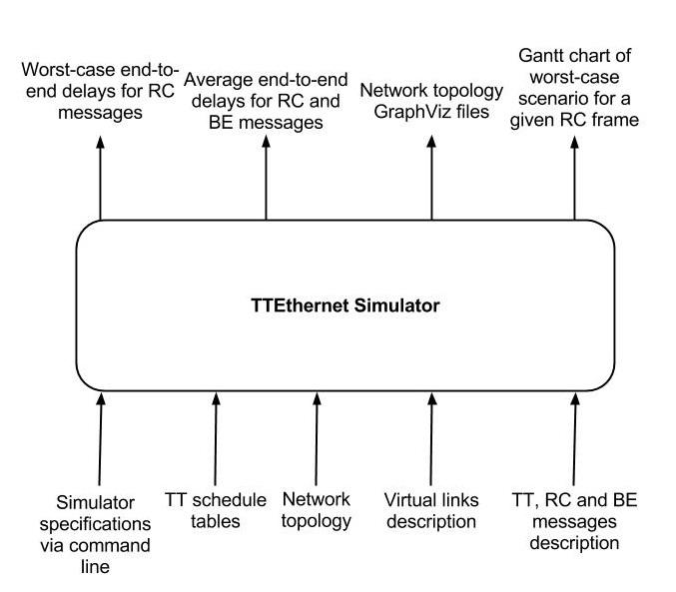
Simulator

Slide 14
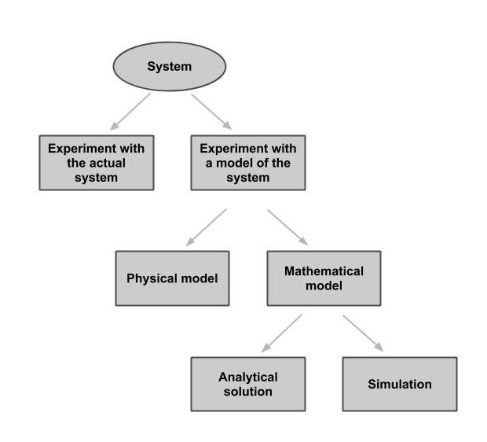
Simulator Design
The TTEthernet model is:
  discrete
  dynamic
  stochastic
Two simulators of the TTEthernet protocol:
  fixed-increment time advance approach (action-oriented paradigm)
  next-event time advance (event-oriented paradigm)

Slide 15
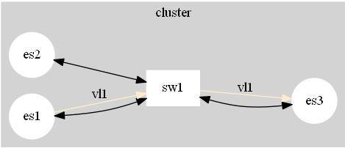
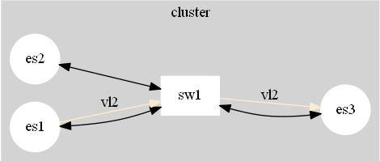
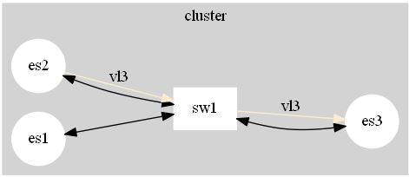
Simulator Output
Virtual Link | Dataflow Link | Dataflow Link
vl1 | es1,sw1 | sw1,es3
vl2 | es1,sw1 | sw1,es3
vl3 | es2,sw1 | sw1,es3

Slide 16
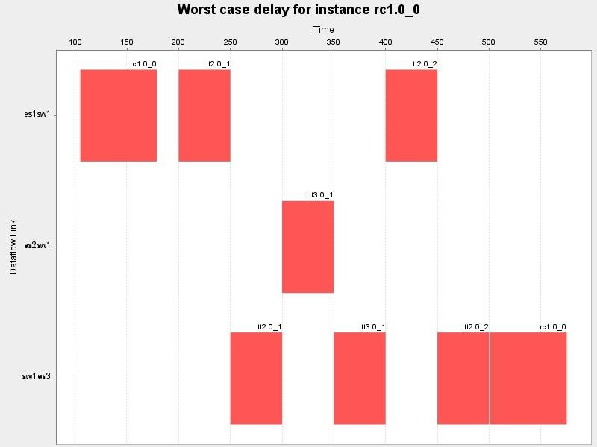
Simulator Output

Slide 17
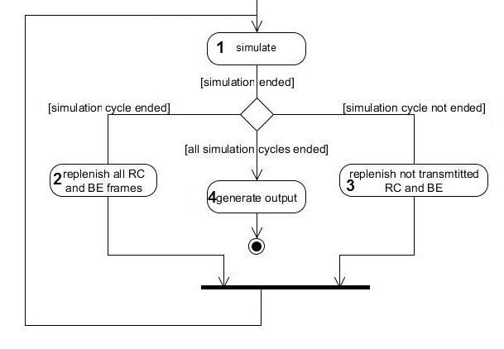
Main Simulation Loop

Slide 18
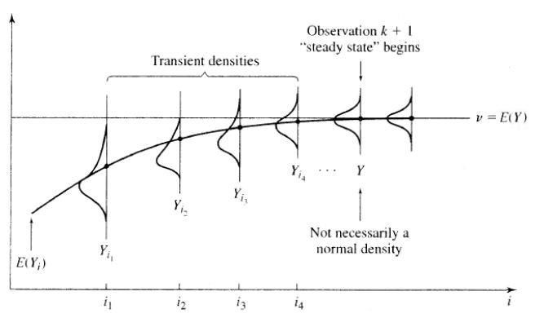

Steady-state Simulation

Slide 19
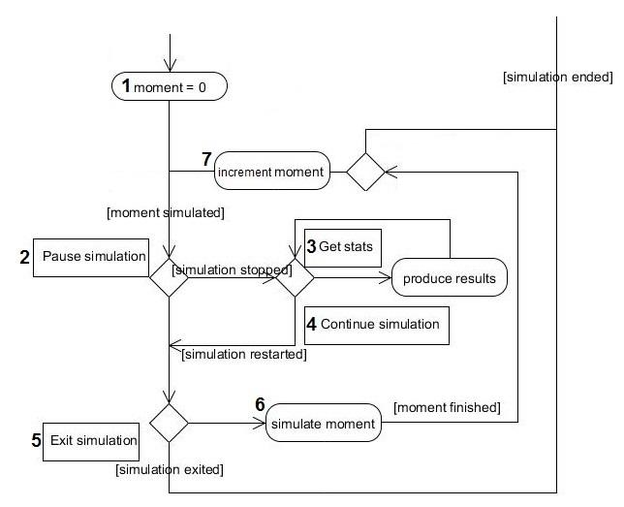
Stepwise Simulation
Command | Action
begin | start the stepwise simulation
pause | pause the stepwise simulation
continue | resume the stepwise simulation
stats | produce csv file and gantt chart
exit | permanently stop the simulation

Slide 20
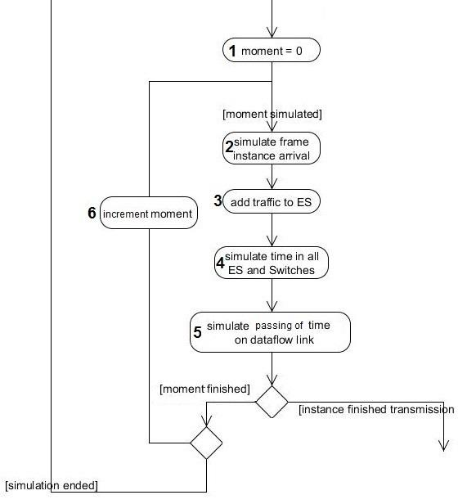
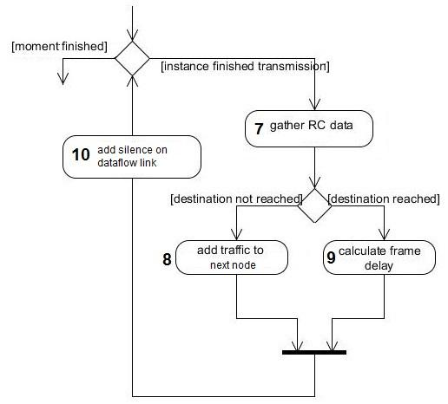
Action-oriented Simulator

Slide 21
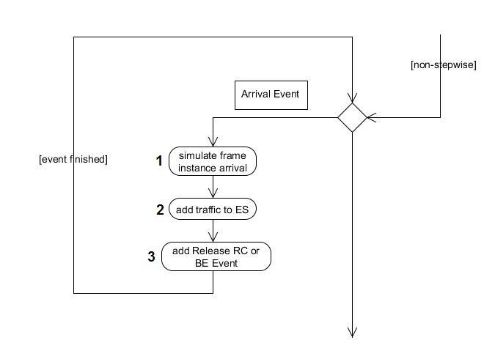
Event-oriented Simulator
Events:
ARRIVAL_RC_BE
RELEASE_RC_BE
RELEASE_TT
FINISH_TT
FINISH_RC_BE
SILENCE

Slide 22
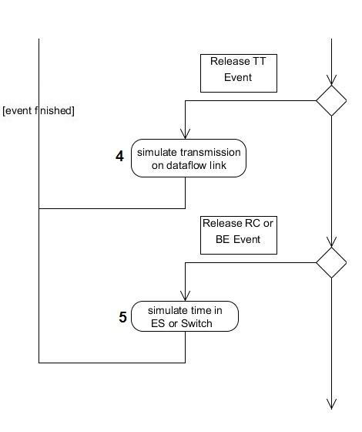
Event-oriented Simulator

Slide 23
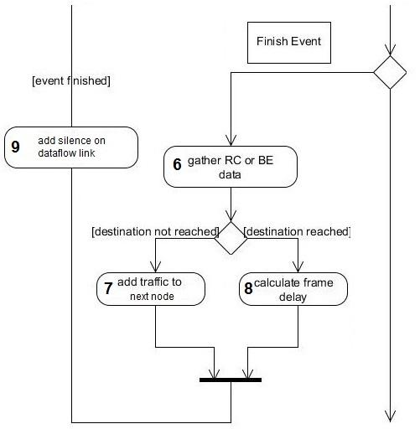
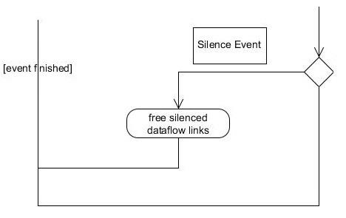
Event-oriented Simulator

Slide 24
Overview
Introduction
TTEthernet
Simulator
Evaluation
Integration Policy Comparison
Action- vs Event-Driven Simulation
Orion Topology Comparison
Steady-state Simulation
Analysis vs Simulation

Slide 25
Evaluation
all three traffic classes with all integration policies run for 10 simulation cycles of the action-oriented simulator
two simulators run for 10, 100 and 1000 simulation cycles with the Timely Block integration policy with a single test case
from 10 to 4000 simulation cycles of the action-oriented simulator with the Timely Block integration policy of a single test case
action-based simulator run for 500 simulation cycles with two real world test cases based on the NASA's Orion Crew Exploration Vehicle
TTEthernet analysis and 1000 simulation cycles of action-oriented simulator with 10 test cases

Slide 26
Integration policy comparison
Frame | Timely Block [s] | Shuffling [s] | Preemption [s]
tt1.0 | 118 | 300 | 150
tt7.0 | 113 | 261 | 160
tt35.0 | 118 | 192 | 140
rc7.0 | 1126 | 547 | 252481
rc22.0 | 149 | 252149 | 214
rc28.0 | 200 | 252137 | 261
be11 | 769 | 289 | 300
be13 | 885 | 446 | 467
be20 | 965 | 292 | 252321

Slide 27
Action- vs Event-Driven Simulation
Simulator runs | Activity-oriented [s] | Event-oriented [s]
10 | 232 | 2
100 | 1887 | 18
1000 | 24189 | 180
Event-driven simulation advandates:
TT frame's sending and receiving times are initially inserted sorted into the queue - saves time on inserting and sorting the queue for each TT instances
local sorting - includes only the events that come before the event causing the sorting and the event itself

Slide 28
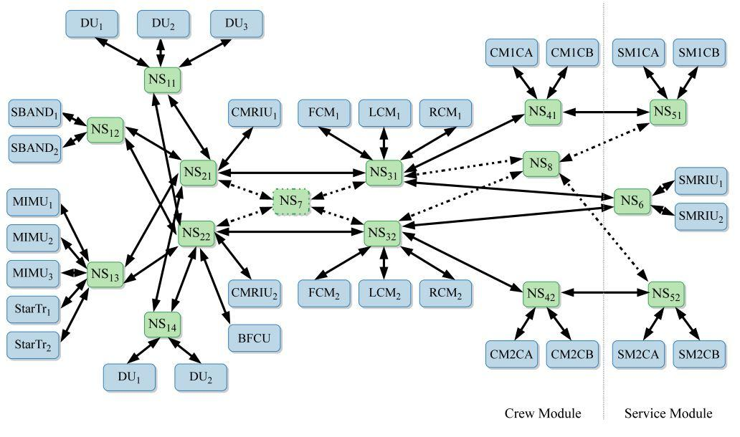
Orion Crew Exploration Vehicle
Potential Orion mission objectives (1) delivering a crew to and providing emergency return capability from the International Space Station, and (2) transporting a crew to near-Earth objects
Orion utilizes TTEthernet Onboard Data Network as a priority-based network communications via traffic classes

Slide 29
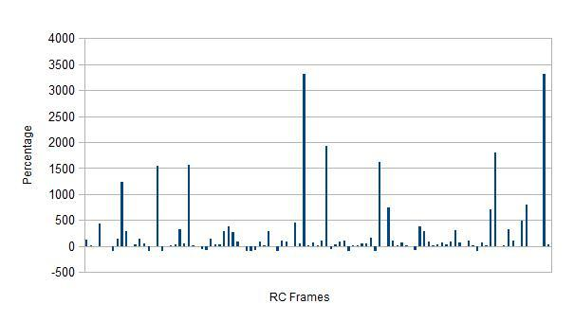
Orion Topology Comparison
Test case | ES | SW | Frames | Frame instances | Average run-time[s] | Total run-time[s]
Orion 1 | 31 | 13 | 180 | 5438 | 501 | 250572
Orion 2 | 31 | 14 | 180 | 5438 | 602 | 301008

Slide 30
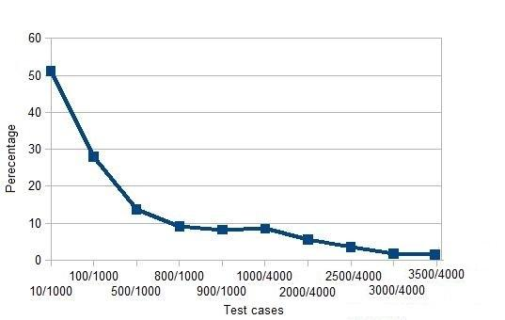
Steady-state Simulation
 | 1000/4000 | 1500/4000 | 2000/4000 | 2500/4000 | 3000/4000 | 3500/4000
Percentile difference | 8.55 | 5.61 | 3.49 | 1.75 | 1.44 | 0.96

Slide 31
Analysis vs Simulation
Test case | ▲delay[%]
1 | 21388.23
2 | 22101.10
3 | 40357.05
4 | 66831.41
5 | 50209.40
6 | 109484.76
7 | 156453.61
8 | 24770.09
9 | 167413.91
10 | 116517.49
analysis - very pessimistic WCD for RC frames due to the lack of execution time
simulation - relatively optimistic due to small number of simulation cycles performed

Slide 32
Thank you
for the attention

