Slide 1
Analysis and Optimization of TTEthernet-based Safety Critical Embedded Systems
MSc Thesis Presentation
Radoslav Hristov Todorov
s080990

Slide 2
Content
Project Backlog
Basics
  IMA, TTEthernet, AFDX
Motivation
  Architectures, Constraints, Problem Definition
End-to-end Analysis
  Prelimenary Analysis
Approaches
Trajectory Approach
  Formula
  (II) Indirect Influence and Time-Triggered (TT) influence
Case Studies
  Results
Implementation
  Algorithm explanation
Directions for further development
Notes:
Hello everybody!
This is my presentation for my master thesis project – ”Analysis and Optimization of TTEthernet-based Safety Critical Embedded Systems”
Here on the very first slide you can see the agenda for this presentation.
We will go through the several steps involved in the creation of the master thesis product.
First, I will present some basic ”grammar” related to my project
Afterwards, I will motivate my thesis with explanations about the architectures and the constraints used in my project.
As next step, I am talking about some prelimenary analysis related to the outlined problem in my thesis.
I introduce the approaches related to the solving of my problem.
I choosed the Trajectory Approach as basis of the solution. Related to this approach I will explain the formula, and the following extenssions II and TT influence.
The content of the presentation continues with summary of all found approaches.
Note: I will go through all of them without to get into details.
As last approch in the survey is pointed the ”Trajectory approach”...
BASICS, MOTIVATION, END-TO-END DELAYS, TRAJECTORY APPROACH, ENHANCEMENTS, CASE STUDIES, IMPLEMENTATION, CONCLUSION

Slide 3
Project Backlog
1st step
In this period were researched the technologies: TTEthernet, AFDX
Some general knowledge about the avionics industry was gained
2nd step
At this stage was developed a mock-up of the problem formulation
Some sample configurations were sugested for input of the problem
3rd step
It was made a complete research of similar problematic
All possible methods for solution were evaluated
4th step
5th step
A first version of the prototype software was developed
6th step
The software was extended
Some experiments were tested
The proper test cases were chosen for the project
The report work was done; Results were observed
Final corrections were implemented
Notes:
The project was held in DTU IMM
The duration was 6 months
(15 February 2010 – 15 August 2010)
There was not any previous knowledge
about the these topic; Everything
was researched and done
”from scratch”
The process of work was
through ”waterfall”
development
1)BASICS, 2) MOCKUP PROBLEM FORMULATION, 3)RESEARCH, 4) INITIAL SOFTWARE 5) ENHANCEMENTS 6) REPORT

Slide 4
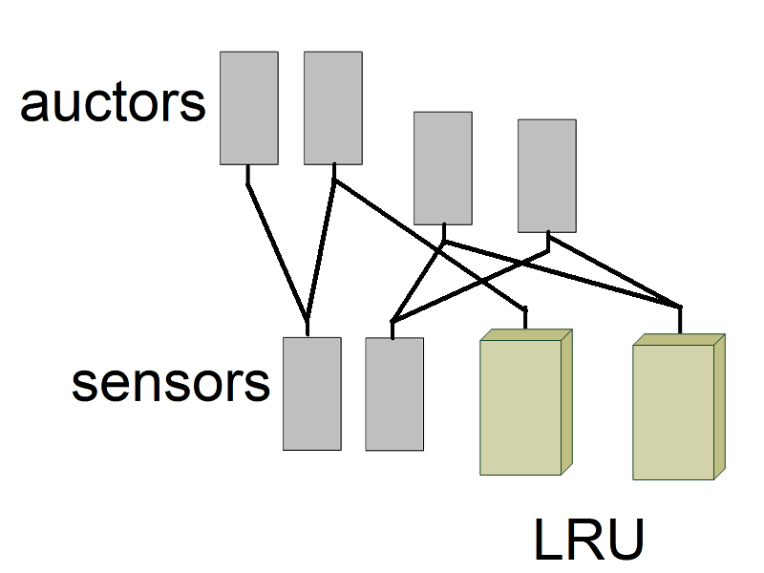
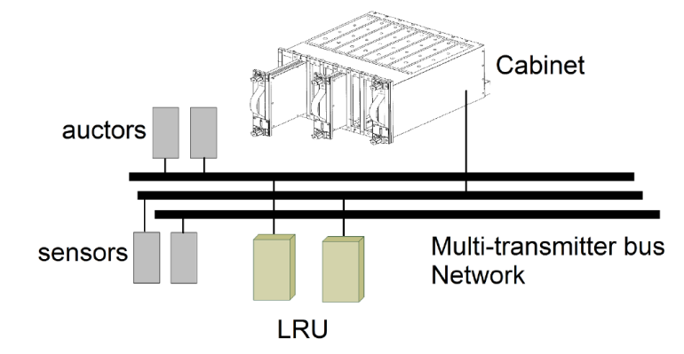
Project Research –
From federated approach to IMA, AFDX and TTEthernet
Federated approach
Integrate several
software functions
Non-transparent
fault propagation
Hard maintenance
IMA approach
Integrated Modular Avionics (IMA)
Functional modules
Cabinet equipment
“virtual backplane"
1st step
2nd step
3rd step
4th step
5th step
6th step
Notes:
DRAWBACKS OF THE FEDERATED APPROACH
IMA FEATURES
Core Processing and Input/Output Module
Line Replacement Unit
Input Output Modules

Slide 5
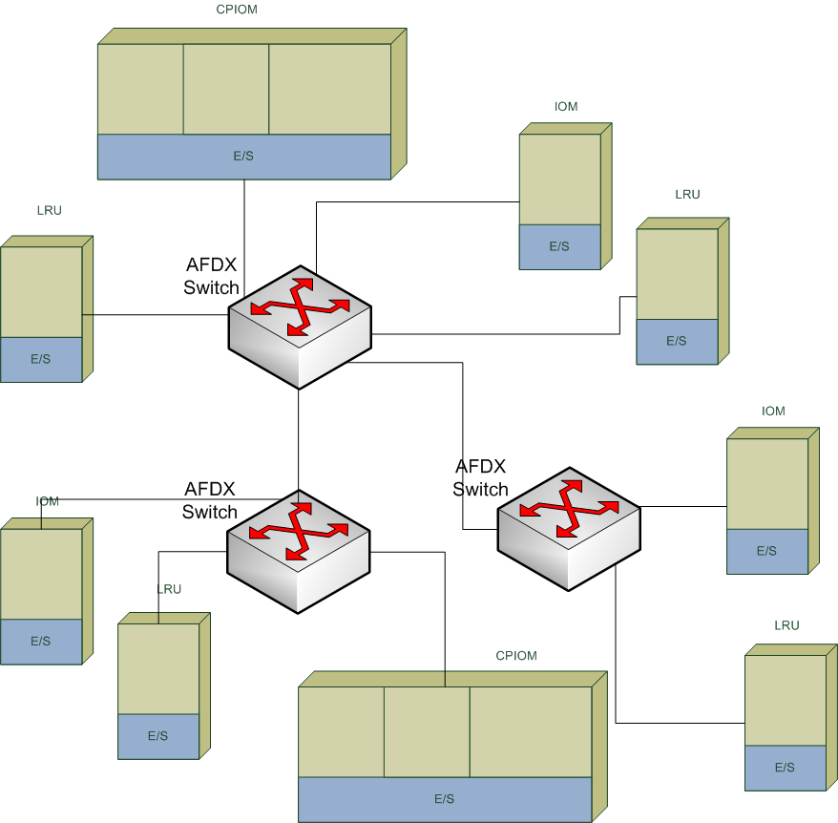
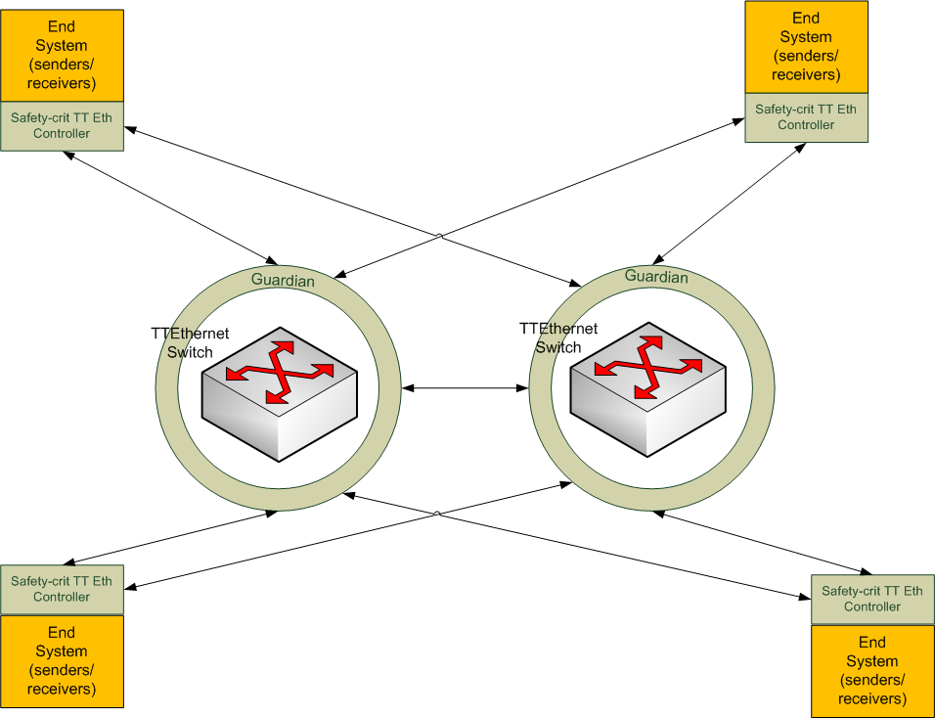

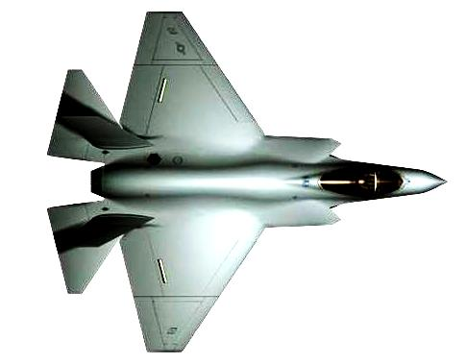
Project Research –
From federated approach to IMA, AFDX and TTEthernet
AFDX Networks
TTEthernet Networks
TT Capabilities
1st step
2nd step
3rd step
4th step
5th step
6th step

Slide 6
Project Research –
From federated approach to IMA, AFDX and TTEthernet
AFDX Networks
TTEthernet Netwokrs
Connect different equipment
Allows different design topologies
Based on well-known Ethernet technology
Rate-Constrained (RC) messages communication
The same as AFDX newtorks plus Time-Triggered (TT)
and Best-effort (BE) messages /traffic classes
Utilize asynchronous and synchronous communication
Fault-tolerant capabilities
Global time
Special Time-Triggered (TT) Ethernet switches
Capabilities for system-level partitioning and distributed computing
1st step
2nd step
3rd step
4th step
5th step
6th step
Notes:
TOPLOGY, EQUIPMENT, RC
TT, RC, BE, FAULT-TOLERANT, GLOBAL TIME, PARTITIONS AND DISTRIBUTED COMPUTING

Slide 7

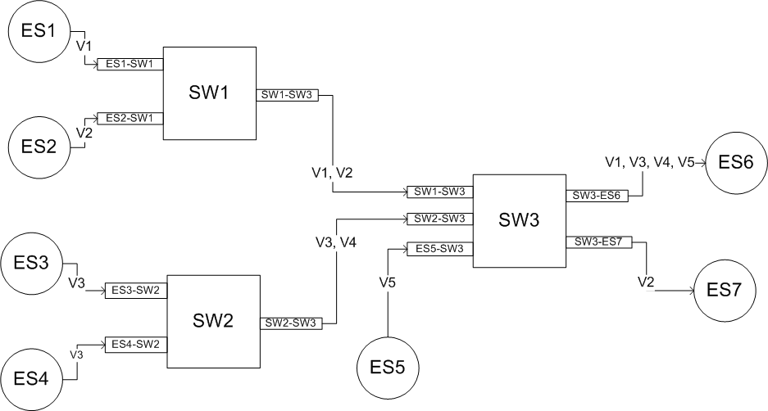
Problem Formulation –
Hardware architecture
CPIOM Module
/LRU/ IOM
are presented by End Systems
1st step
2nd step
3rd step
4th step
5th step
6th step
Notes:
REPRESENTATION OF AFDX NETWORK TO A GRAPHIC/ARCHITECTURE

Slide 8
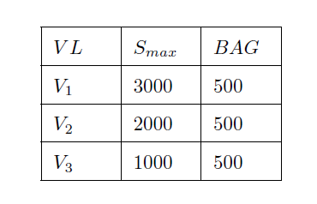
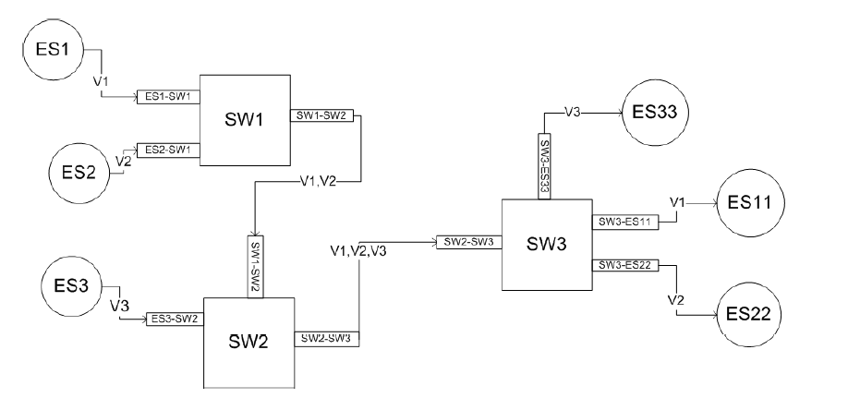
Problem Formulation –
Basic Notations
BAG
Media
Smax
Virtual link
Sender End System
Output Port
Switch
Input Port
Receiver End System
1st step
2nd step
3rd step
4th step
5th step
6th step
Notes:
NOTATIONS USED IN THE ARCHITECTURE REPRESENTATION

Slide 9
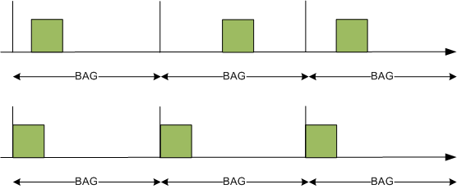
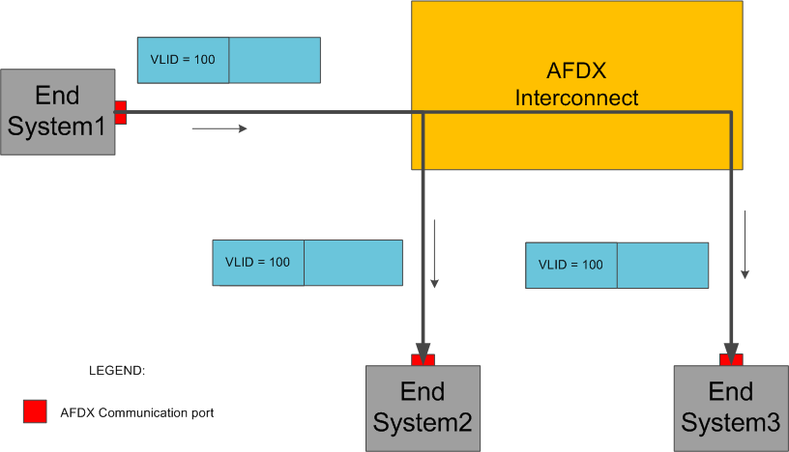
Problem Formulation –
Design Considerations
BAG (Bandwidth Allocation Gap)–
minimum interval between two frames
Smax - maximum allowed length of a frame
BAG
Smax
Virtual Link
1st step
2nd step
3rd step
4th step
5th step
6th step

Slide 10
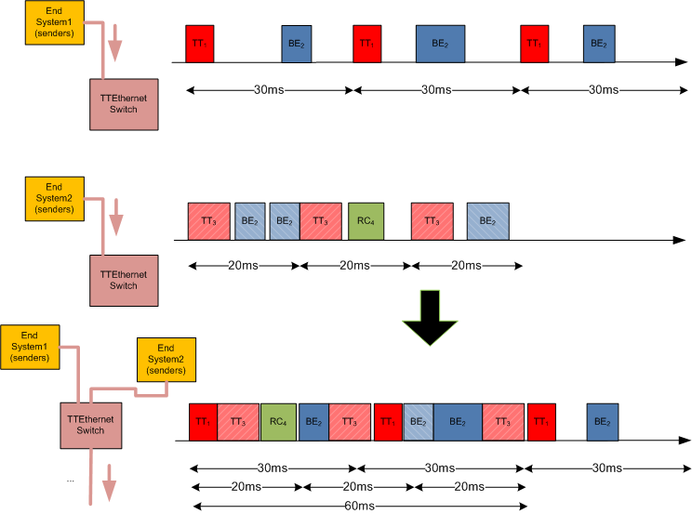
Problem Formulation –
Traffic Integration
Traffic from first End System
Traffic from second End System
Integrated Traffic
1st step
2nd step
3rd step
4th step
5th step
6th step

Slide 11
Problem Formulation –
Given
Given:
  The described architectures so far
  An application that has:
    Time-Triggered (TT) messages
    Rate-Constrained (RC) messages
Given Constraints:
  Time-Triggered (TT) /static/ messages take precedence
  Time-Triggered (TT) traffic is set offline
  Time-Triggered (TT) messages setup consists from:
< T;D; S_{max}; S_{min}; start-uptime >
  Rate-Constrained (RC) messages setup consists from
        < T = BAG; S_{max}; S_{min} >
Input
1st step
2nd step
3rd step
4th step
5th step
6th step

Slide 12
Problem Formulation –
Determinate
Additional aspects:
- it could be an AFDX network (only RC mesages)
We are interested in the produced ”end-to-end” delays
We define Scenario I and II for the problem formulation:
  Scenario I is related to a case where the Time-Triggered (TT) messages are already defined (the problem is how to define them as a table of Time-Triggered constraints) and is required to be done optimizations for the Rate-Constrained (RC) messages.
  Scenario II is related again to optimization of Rate-Constrained (RC) traffic but in this case the parameters related to them are optimized
1st step
2nd step
3rd step
4th step
5th step
6th step
Notes:
With the term ”end-to-end delay” time for a given message we define the time needed for crossing the message's own ingress node, all links and switches in the network exactly, before the message is delivered to the destination node of the network

Slide 13
Problem Formulation –
Goals
To avoid packet loss i.e. none of the switches buffers will overflow
To minimize the end-to-end delay messages, which is necessary to maintain the deterministic nature of the AFDX networks
To integrate and test the results with networks carrying mixed traffic (Rate-Constrained (RC) and Time-Triggered (TT) messages).
Even the hardware design allows enormous buffering, the second problem still has to be solved
1st step
2nd step
3rd step
4th step
5th step
6th step

Slide 14
Methods for calculations of
End-to-end delays
Method name | Advantages | Disadvantages | References
Network calculus | Conventional and well known | Leads to impossible scenarios and higher values than the real bounds | [31]
Grouping technique | Decreases the end-to-end delays for specific scenarios | Covers only dedicated scenarios depending on the configuration | Private case in [26]
Simulation approach | Easy to implement and understand | Covers only specific scenarios; could not be used to give guarantees for the results | [20], [24]
1st step
2nd step
3rd step
4th step
5th step
6th step

Slide 15
Methods for calculations of
End-to-end delays (2)
Method name | Advantages | Disadvantages | References
Time automata modelling | Exact calculation of the modelled configurations | Can be applied only to scenarios with a limited number of nodes | -
Stochastic network calculus | Improves some of the disadvantages of the Network Calculus approach | Considered as hard to understand due the complexity of the theory | [23], [24]
Heuristic optimization methods over network calculus* | Tighter experimental results for the bounds compared to the Network Calculus method | Requires a lot of experimental work | [25]
1st step
2nd step
3rd step
4th step
5th step
6th step
* Optimization approach

Slide 16
Methods for calculations of
End-to-end delays (3)
Method name | Advantages | Disadvantages | References
Heuristic optimization methods over network calculus with priority assignments* | Tighter experimental results for the bounds compared to the network calculus method | Requires a lot of experimental work and the results are not comparable with whose any other approach | [25]
Stochastic network calculus with priority assignments* | Enables priorities to be set for the traffic flows | The results are not comparable with those of any other method | [18]
Trajectory approach | Easy to understand and to implement; Shows tighter bounds than the network calculus approach | Analysis includes pessimism which cannot be avoided owing to the nature of the method | [26]
1st step
2nd step
3rd step
4th step
5th step
6th step
* Optimization approach
Selected approach

Slide 17
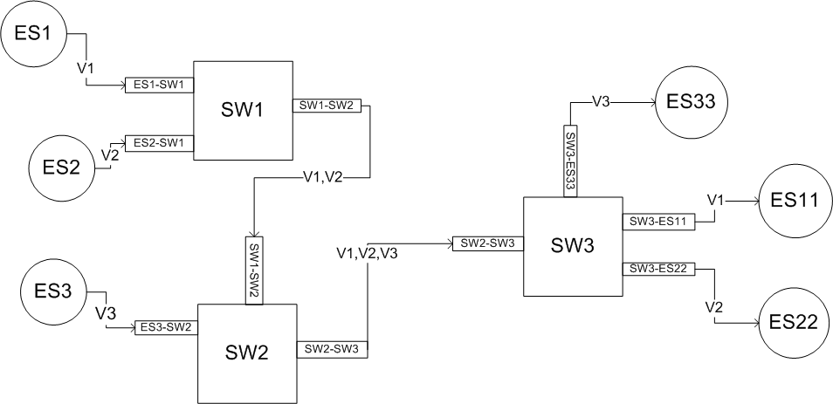
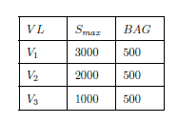
Trajectory Approach
What the approach is calculating?
Input
The approach is based on the analysis of the worst-case scenario for a packet on the basis of its trajectory through the nodes in the network.
It considers the longest calculated busy period of a message
(i.e. all other possible transmissions before the current one or in other words a period of time in which there is at least one message for transmission before the current one in the output buffer of a switch.).
1st step
2nd step
3rd step
4th step
5th step
6th step

Slide 18
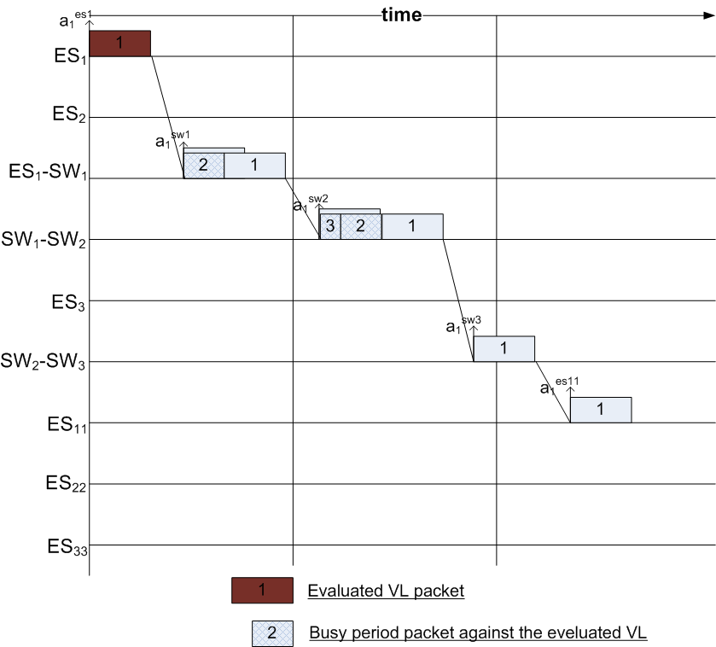
Trajectory Approach
What the approach is calculating?
In the terms of the example the situation can be presented as the following:
Busy Period
1st month
2nd month
3rd month
4th month
5th month
6th month
1st step
2nd step
3rd step
4th step
5th step
6th step

Slide 19
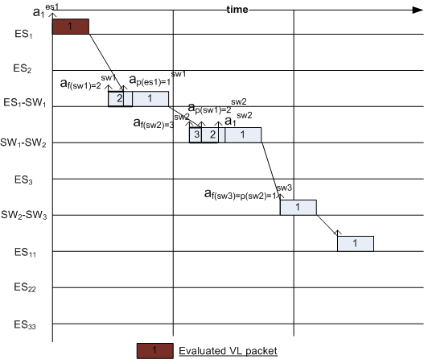
Trajectory Approach
What the approach is calculating?
Actually, in real the delays are smaller values and almost never reach their peaks:
Shorter Busy Period
1st month
2nd month
3rd month
4th month
5th month
6th month
1st step
2nd step
3rd step
4th step
5th step
6th step

Slide 20
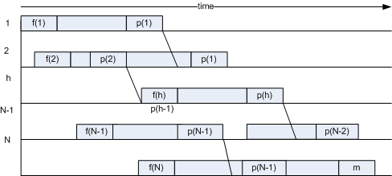
Trajectory Approach
What the approach is calculating?
The approach is called “Trajectory” because describes the delay of the messages per its trajectory according the figure:
Where f(N)- the first packet processed in the busy period in node N and p(N-1) the first packet processed between f(N) and the packet in which we are interested
Shorter Busy Period
1st month
2nd month
3rd month
4th month
5th month
6th month
1st step
2nd step
3rd step
4th step
5th step
6th step

Slide 21
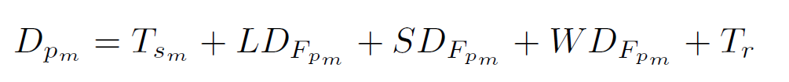



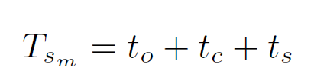

Prelimenary Formula for calculation of the Rate-Constrained (RC) message delays
Latency
in the destination
system
Transportation costs. More specifically:
Total end-to-end delay of message F_{pm}
Transmission delay
in switches output ports. Mores specifically:
Latency of the source end system. More specifically:
is the delay in
the output port buffer S_{k}
Transmission delay
in switches. More
specifically:
T_{sm} contains time for obtaining data, fragmentation of it and sending costs
Where S_{Fpm} is the size of the message and R the capacity of the link
1st month
2nd month
3rd month
4th month
5th month
6th month
The real
problem
1st step
2nd step
3rd step
4th step
5th step
6th step

Slide 22
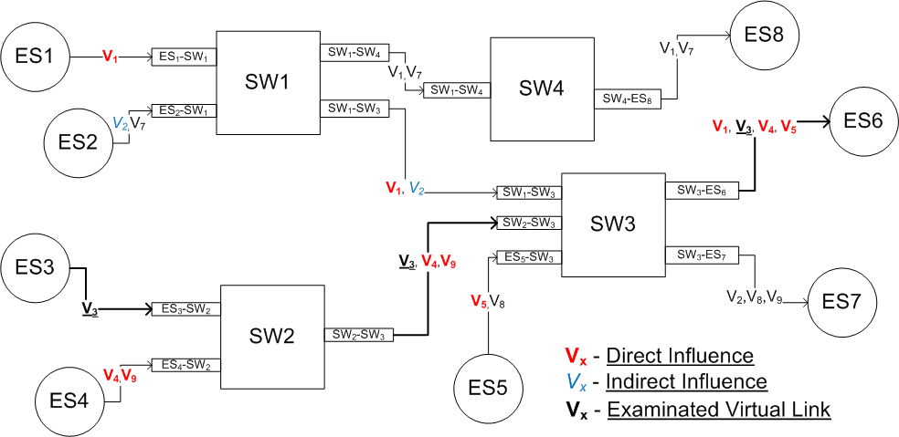
Classification of the virtual links in the system
Example system:
How V_{x} is influenced by the rest of the the virtual links in terms of the end-to-end delay?
Virtual Link that is examinated
Output port that has contention problem
Indirect influence by V₂
1st month
2nd month
3rd month
4th month
5th month
6th month
1st step
2nd step
3rd step
4th step
5th step
6th step

Slide 23
Classification of the virtual links in the system
There are 2(or 3) classes of virtual links:
  Direct Influence (DI) virtual links – paths or partial paths which share at least one output buffer
  Indirect Influence (II) virtual links – paths or partial path which do not share output buffers with but share at least one output buffer with a Direct Influence (DI)or Indirect Influence (II) path.
  No Influence – paths or partial paths which cannot be classified as either Direct Influence (DI) or Indirect Influence paths.
Our next task is to research how far Indirect Influence (II) is important for the analysis and how much impact it has on the end-to-end delays.
1st month
2nd month
3rd month
4th month
5th month
6th month
1st step
2nd step
3rd step
4th step
5th step
6th step

Slide 24
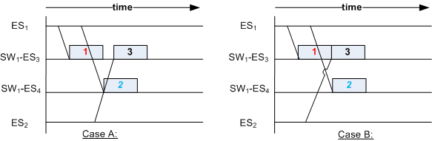
Classification of the virtual links in the system
Virtual link V₁ has the first message from all virtual links ready for transmission
Virtual Link V₁ is the first emited one. V₃ simply depends on the arrival of the message
1st month
2nd month
3rd month
4th month
5th month
6th month
1st step
2nd step
3rd step
4th step
5th step
6th step

Slide 25
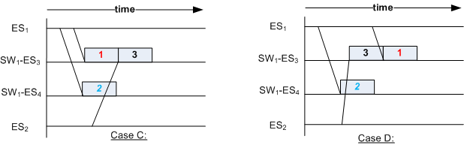
Classification of the virtual links in the system
Virtual link V₂ has the first message from all virtual links ready for transmission
Virtual Link V₂ is the first emited one. V₃ depends on the arrival of the message from V₁ in Case C
1st month
2nd month
3rd month
4th month
5th month
6th month
1st step
2nd step
3rd step
4th step
5th step
6th step

Slide 26
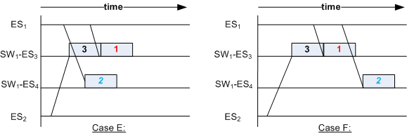
Classification of the virtual links in the system
Virtual link V₃ has the first message from all virtual links ready for transmission
Virtual Link V₃ is the first emited one and any firther investigation is not required
1st month
2nd month
3rd month
4th month
5th month
6th month
1st step
2nd step
3rd step
4th step
5th step
6th step

Slide 27
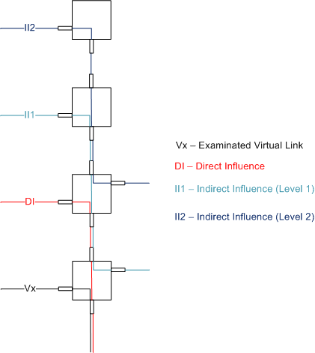
Classification of the virtual links in the system
The Indirect Influence (II) can exist on multiple levels
Indirect Influence (II2)
Indirect Influence (II1)
Direct Influence (DI)
1st month
2nd month
3rd month
4th month
5th month
6th month
1st step
2nd step
3rd step
4th step
5th step
6th step

Slide 28
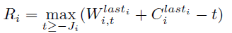
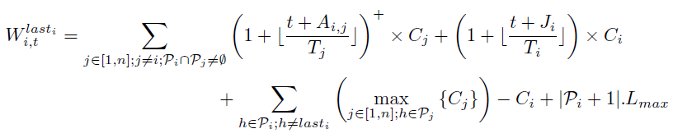

Trajectory Approach
Short description of the formula in one slide
Processing time from packets crossing virtual link i
Processing time from packets of virtual link V_{i}
Worst case end-to-end response time of any message from virtual link i
Processing time for longest packet of virtual links V_{j}
Processing time for virtual link V_{i} packet
1st month
2nd month
3rd month
4th month
5th month
6th month
1st step
2nd step
3rd step
4th step
5th step
6th step
Delays from path

Slide 29
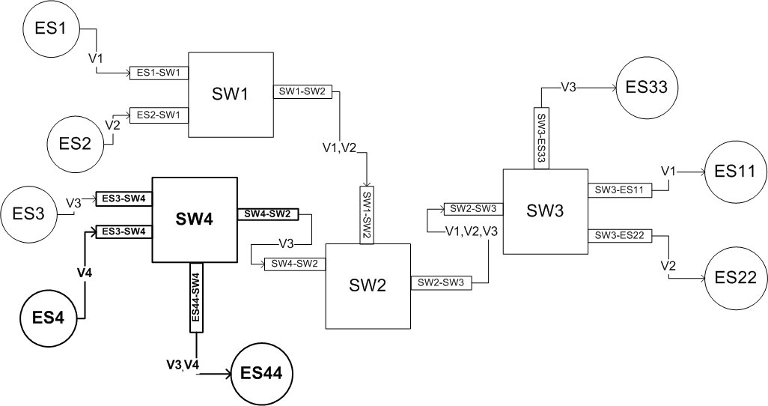
Enhancement to the Trajectory Approach
Including of Indirect Influence (II) virtual links
Until now all the experiments were conducted with virtual links that have only Direct Influence (DI) crossing virtual links:
V₁ and V₂ are influenced indirectly by V₄
1st month
2nd month
3rd month
4th month
5th month
6th month
1st step
2nd step
3rd step
4th step
5th step
6th step

Slide 30
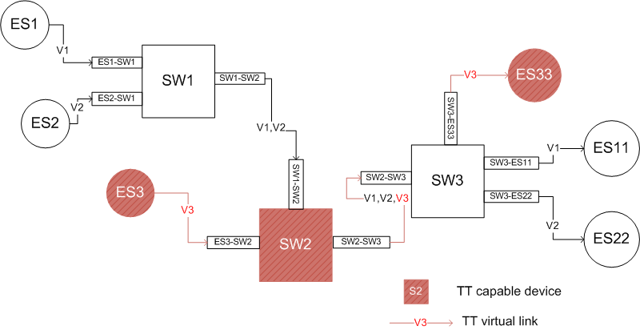
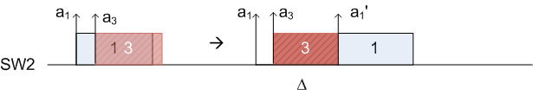
Enhancement to the Trajectory Approach
Including of Time-Triggered (TT) messages
Until now all the experiments were conducted with virtual links that have only Rate-Constrained (RC) messages:
3 – Time-Triggered (TT) message is predefined and 1 – Rate-Constrained (RC) message has to wait
1st month
2nd month
3rd month
4th month
5th month
6th month
V₃ – Time-Triggered (TT) messages
1st step
2nd step
3rd step
4th step
5th step
6th step

Slide 31
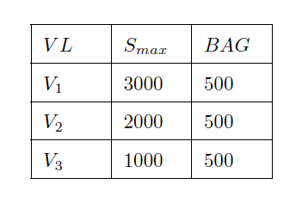
Results
Trajectory Approach
Input
Several tests were conductuted
In the report are presented two test cases
  Case Study 1:
1st month
2nd month
3rd month
4th month
5th month
6th month
1st step
2nd step
3rd step
4th step
5th step
6th step

Slide 32
Results
Trajectory Approach –
Extenstion with Time-Triggered (TT) messages
Input
  Case Study 1A:
1st month
2nd month
3rd month
4th month
5th month
6th month
1st step
2nd step
3rd step
4th step
5th step
6th step
Predefined time slots

Slide 33
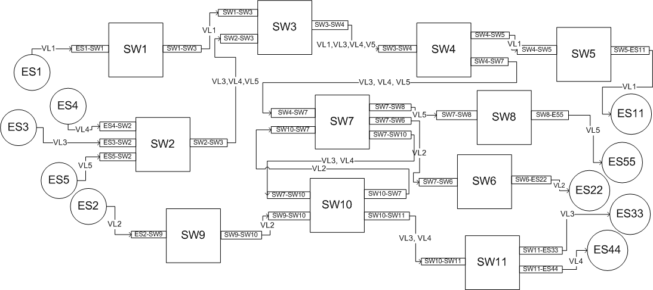
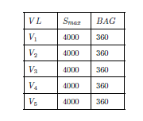
Results
Trajectory Approach
  Case Study 2:
1st month
2nd month
3rd month
4th month
5th month
6th month
1st step
2nd step
3rd step
4th step
5th step
6th step
Input

Slide 34
Implementation of the Trajectory Approach based on the formula and case study 1
A_{i,j} V₁ | V₂ | V₃
SW₁ | x | x
SW₂ | x | x
SW₃
Smax | V₁ | V₂ | V₃
ES | x
SW₁ | x
SW₂ | x
SW₃ | x
A_{i,j} V₂ | V₁ | V₃
SW₁
SW₂
SW₃
A_{i,j} V₃ | V₁ | V₂
SW₁
SW₂
SW₃
Time-Triggered Message calculations follow the same formula
1st month
2nd month
3rd month
4th month
5th month
6th month
1st step
2nd step
3rd step
4th step
5th step
6th step

Slide 35
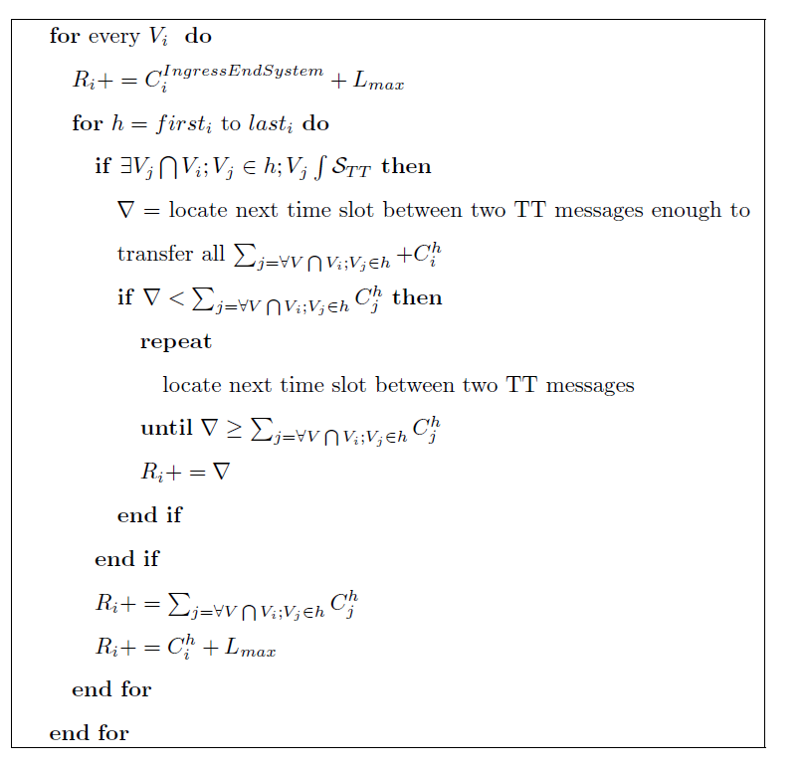
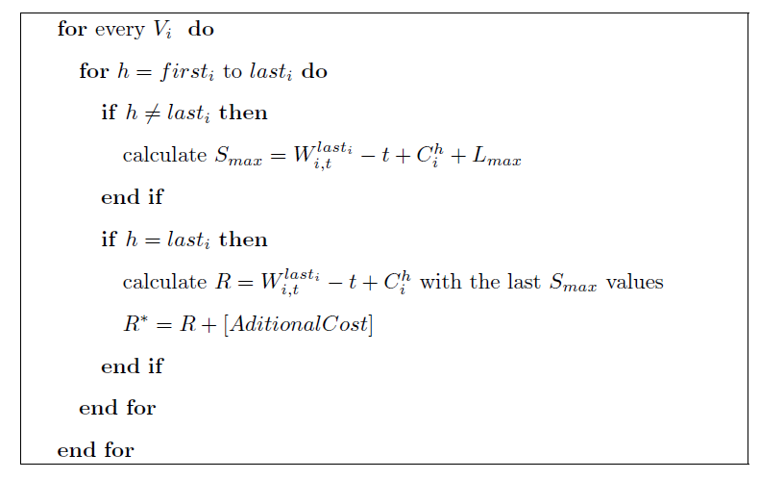
Implementation of the Trajectory Approach next to the Holistic
1st month
2nd month
3rd month
4th month
5th month
6th month
1st step
2nd step
3rd step
4th step
5th step
6th step

Slide 36
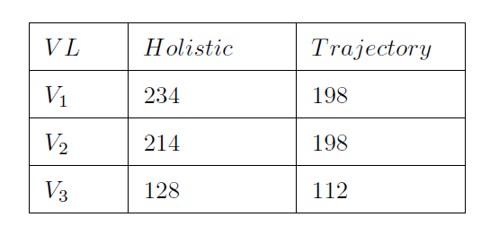
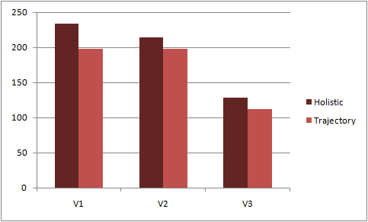
Results
Trajectory Approach
  Case Study 1:
With the term “holistic" we refer to a method for calculating the entire worst-case response times incurred in transmission of a message from a virtual link assuming the worst-case
1st month
2nd month
3rd month
4th month
5th month
6th month
1st step
2nd step
3rd step
4th step
5th step
6th step

Slide 37
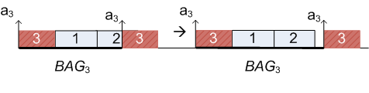
Results
Trajectory Approach
Extenstion with Time-Triggered (TT) messages
  Case Study 1A:
The same results were achieved.
There is no t which can change the results
1st month
2nd month
3rd month
4th month
5th month
6th month
1st step
2nd step
3rd step
4th step
5th step
6th step
Additionaly:

Slide 38
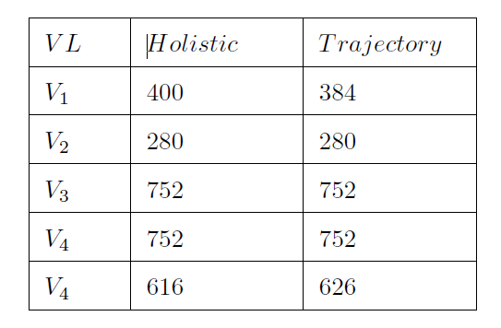
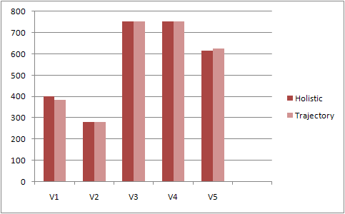
Results
Trajectory Approach
  Case Study 2:
With the term “holistic" we refer to a method for calculating the entire worst-case response times incurred in transmission of a message from a virtual link assuming the worst-case
1st month
2nd month
3rd month
4th month
5th month
6th month
1st step
2nd step
3rd step
4th step
5th step
6th step

Slide 39
Conclusion
Possible extensions
Influence of the computation time inside the end nodes. An end node is usually subject to contention from several logical partitions that have to cooperate over the usage of the single resource CPU
Intercommunication between different synchronization domains in these networks. As previously explained, the topology could be complex, and this calls for additional assumptions for the calculations of the worst-case response times
Best-Effort (BE) traffic with the rest of the ongoing traffic (Rate-Constrained (RC) and Time-Triggered (TT) traffic). A quantitative or quality method should be developed which can show or predict the trends of the behaviour of this traffic class.
1st month
2nd month
3rd month
4th month
5th month
6th month
1st step
2nd step
3rd step
4th step
5th step
6th month

Slide 40
Thank you for your time!
Radoslav Todorov
1st month
2nd month
3rd month
4th month
5th month
6th month
1st step
2nd step
3rd step
4th step
5th step
6th step

