Slide 1


Timing Analysis of Rate Constrained Traffic for the TTEthernet Communication Protocol
Domițian Tămaș-Selicean¹, Paul Pop¹ and Wilfried Steiner²
¹Technical University of Denmark
²TTTech Computertechnik AG

Slide 2
Motivation
Real time applications implemented using distributed systems
Point-to-point connection
Bus connection
PE
Application A ₁ -- highly critical
Reduces wiring and weight
Mixed-criticality applications share the same network
Application A ₂ -- critical
Application A ₃ -- non-critical
Notes:
Example of point-to-point connection is the ARINC 429 data transfer standard for avionics, with a transfer rate of up to 100 kbit/s.
One option would be an Ethernet-based network, since it can achieves speeds up to 1 Gbit/s. But Ethernet is known to be unsuitable for real-time or safety-critical applications, as it is inherently a non-deterministic network.

Slide 3
ARINC 664 p7 “Aircraft Data Network”
ES₁
ES₃
NS₁
NS₂
ES₂
ES₄
Network Switch
End System
Full-Duplex Ethernet-based data network for safety-critical applications
Notes:
ARINC 664 p7 specifies a full-duplex Ethernet network for aircraft data networks.
It is composed of End – Systems connected by Network Switches and physical connections.

Slide 4
ARINC 664 p7 “Aircraft Data Network”
ES₁
ES₃
NS₁
NS₂
ES₂
ES₄
RAM
CPU
NIC
ROM
Notes:
Each End Systems consists of a Processing Element PE, containing a CPU, a a RAM and non-volatile memory, and a Network Interface Card

Slide 5
ARINC 664 p7 “Aircraft Data Network”
ES₁
NS₁ to ES₁
ES₃
NS₁
NS₂
ES₁ to NS₁
ES₂
ES₄
dataflow link
Notes:
In half-duplex implementations, frame collision is unavoidable, leading to unbounded transmission times.
ARIC 664p7 is a full-duplex network, thus allows simultaneous communication in both directions, collisions-free.

Slide 6
ARINC 664 p7 “Aircraft Data Network”
ES₁
ES₃
τ₁
vl₂
τ₂
τ₅
NS₁
NS₂
ES₂
ES₄
vl₁
τ₄
virtual link
τ₃
Highly critical application A ₁: τ₁, τ₂ and τ₃
  τ₁ sends message m₁ to τ₂ and τ₃
Non-critical application A ₂: τ₄ and τ₅
  τ₄ sends message m₂ to τ₅
Notes:
The Ethernet protocol does not offer separation between messages of different criticalities. ARINC 664p7 manages this through the concept of Virtual Links, by emulating point-to-point connectivity over the network. The virtual link is defined as the “logical unidirectional connection from one source system to one or more destination end systems”. Thus the virtual link is a directed tree, with the sender as a root, and the receivers as leaf. Each virtual link is composed of a set of dataflow paths, one such dataflow path for each root-leaf connection.
One virtual link is assigned to one message only.
By using virtual links, the highly critical message m1 is separated from the non-critical message m2.
Let’s assume we have 2 applications, A1 and A2.

Slide 7
ARINC 664 p7 “Aircraft Data Network”
ES₁
ES₃
τ₁
dp₁
τ₂
τ₅
l₁
l₃
NS₁
l₂
NS₂
l₄
ES₂
dp₂
ES₄
vl₁
τ₄
τ₃
dataflow path
Highly critical application A ₁: τ₁, τ₂ and τ₃
  τ₁ sends message m₁ to τ₂ and τ₃
Non-critical application A ₂: τ₄ and τ₅
  τ₄ sends message m₂ to τ₅
Notes:
T1 of A1 sends m1 to T2 and T3 on vl1.
vl1 is composed of dataflow paths dp1 and dp2, where dp1 is connecting ES1 to ES3 and dp2 is connecting ES1 to ES4.

Slide 8
ARINC 664 p7 “Aircraft Data Network”
Deterministic Event Triggered communication
Separation of traffic enforced through “bandwidth allocation”
Bandwidth Allocation Gap (BAG) – minimum time interval between two consecutive instances of a frame on a virtual link
BAG_{x}
f_{x,1}
f_{x,2}
Maximum bandwidth assigned to virtual link vl_{i}
BW (vl_{i}) = f_{i} .size/BAG_{i}

Slide 9
TTEthernet
ARINC 664p7 compliant
Traffic classes:
  synchronized communication
    Time Triggered (TT)
  unsynchronized communication
    Rate Constrained (RC) – ARINC 664p7 traffic class
    Best Effort (BE) – no timing guarantees
Standardized as SAE AS 6802
Marketed by TTTech Computertechnik AG
Implemented by Honeywell on the NASA Orion Constellation
Notes:
When talking about traffic classes, also mention integration policies:
timely block – the transmission of an RC frame is postponed if it will not terminate before the transmission of a scheduled TT frame
pre-emption – the transmission of an RC frame is pre-empted if a TT frame is scheduled for tranmission
shuffling – if an RC frame is transmitting, the TT frame will be sent only after the transmission finished

Slide 10
TTEthernet
Composed of clusters
Each cluster has a clock synchronization domain
Inter-cluster communication using RC traffic
ES₁
ES₃
ES₅
ES₇
NS₁
NS₂
ES₂
ES₈
ES₄
ES₆
Cluster 1
Cluster 2

Slide 11
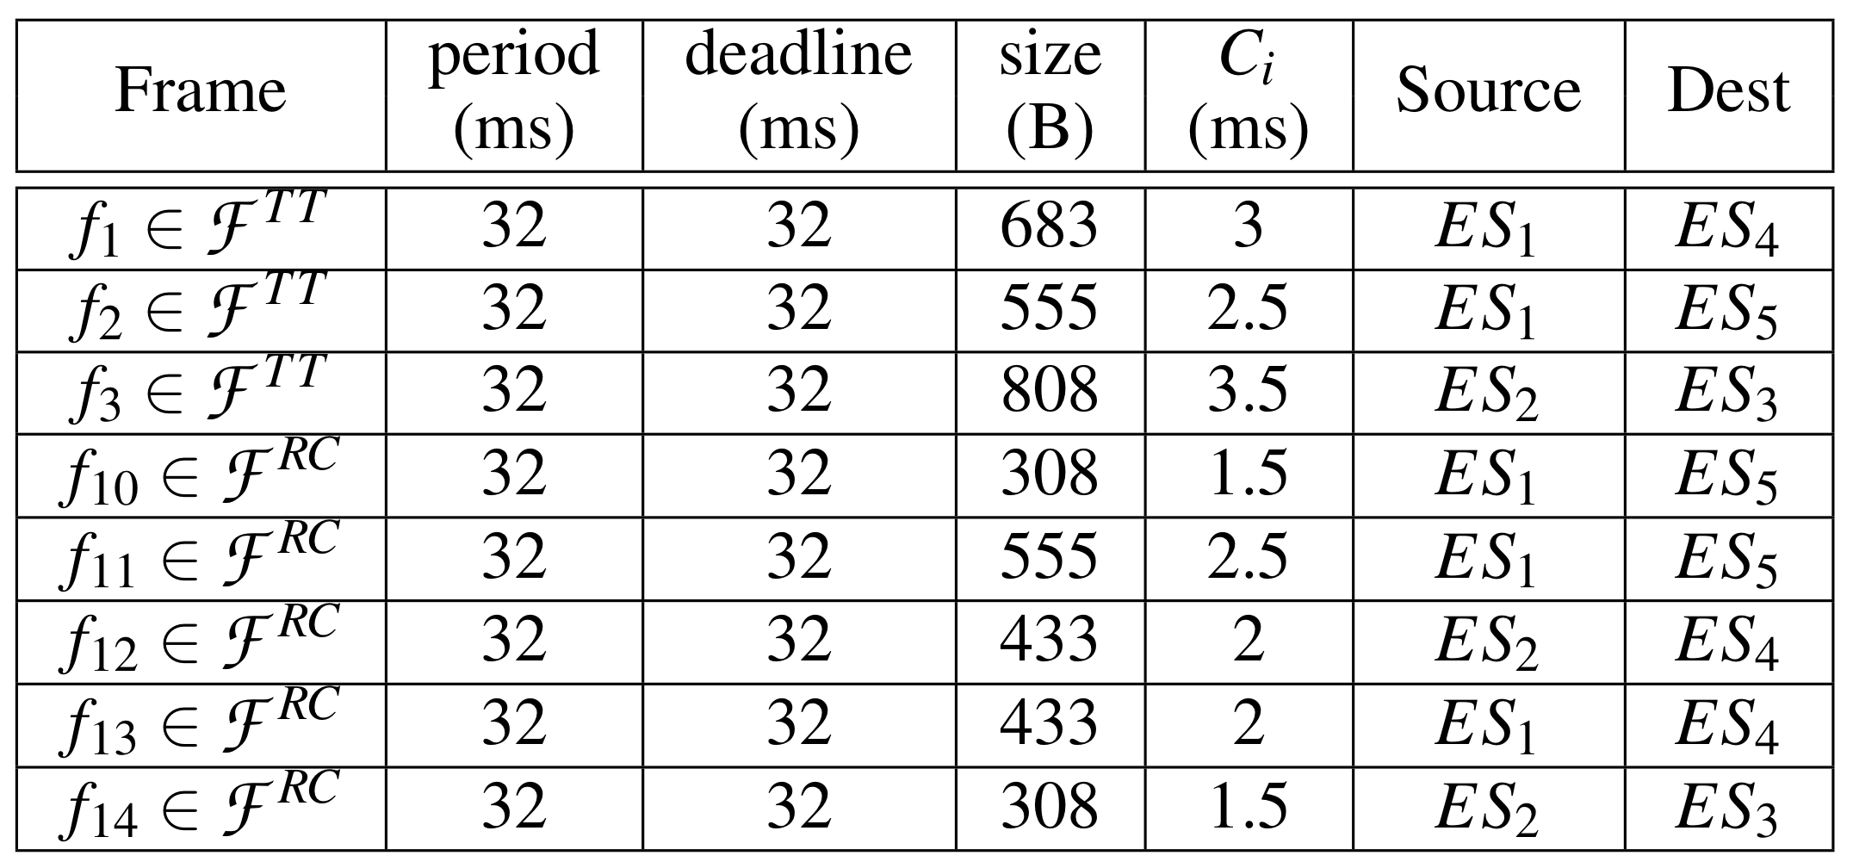
Motivation

Slide 12
Motivation
Notes:
Upper: how the related work computes the WCD, by adding the worst-case latencies on each dataflow link, resulting in unlikely cases.
Lower: the exact WCD for this scenario.

Slide 13
Sources of delay
Delays from scheduled TT frames on dl_{j}
Delays from other RC frames transmitted on dl_{j}
TT and RC traffic integration-induced delays
Technical latencies introduced by the network nodes

Slide 14
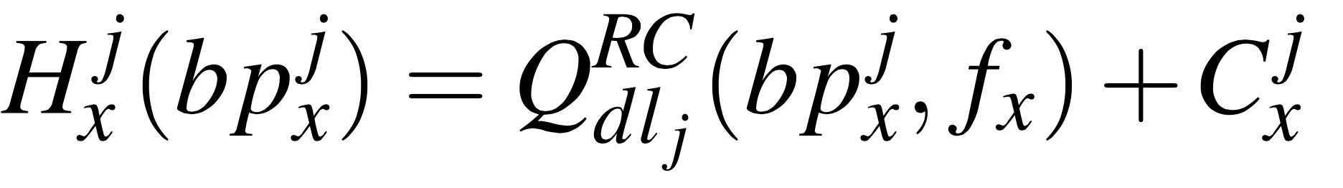
Busy Period
To compute the size:
  Demand
  Availability
Notes:
Analysis based on busy period – the time interval [t_c^j, t^j] within which the RC frames arrived before f_x in the outgoing queue are transmitted.
! The size of the busy period depends on the number of frames arrived, and the number of frames depends on the size of the busy period.
To compute, use availability and demand, and compute iteratively until the

Slide 15
Worst-case end-to-end delay
For each dataflow path dp_{i}, the end-to-end delay is the time difference between start of the busy period on the first dl₀ and the end of the busy period on the last dl_{n}
  The start of the busy period on dl_{j} is obtained by subtracting from the end of the busy period on dl_{j-1} all the RC frames transmitted on both dl_{j} and dl_{j-1}
The longest delay among all the dp_{i} is the WCD
Notes:
As mentioned, the related work sums up the worst-case delays on each dataflow link a frame is transmitted on, leading to pessimistic results.

Slide 16
Worst-case end-to-end delay
ES₁
ES₃
dp₁
l₁
l₃
NS₁
l₂
NS₂
l₄
ES₂
dp₂
ES₄
vl₁
WCD: the longest end-to-end delay for all dp_{i}
The end-to-end delay on dp_{i}: t^{n} – t_{c}⁰
Consider only possible scenarios: t_{c}^{j} depends on t^{j-1}
Notes:
A VL can be composed of se veral DPs, so the worst-case end-to-end is the longest end-to-end delay among all DPs
The end-to-end delay on a DP = t^n – t_c^0.
We consider only possible scenarios, so we compute the bp on l2 based on when the bp on l1 finished.
Down side: to determine the WCD, we have to consider each time instant on l1 as the starting time.

Slide 17
Example

Slide 18
Example
Exact WCD:

Slide 19
Experimental Results
3 synthetic benchmarks:
  12 ESes and 4 NSes, 20 TT and 26 RC
  10 ESes and 5 NSes, 58 TT and 51 RC
  35 ESes and 8 NSes, 91 TT and 81 RC
The analysis is compared to the analysis from:
  W. Steiner. Synthesis of Static Communication Schedules for Mixed- Criticality Systems. In Proceedings of the International Symposium on Object/Component/Service-Oriented Real-Time Distributed Computing Workshops, pages 11–18, 2011.

Slide 20
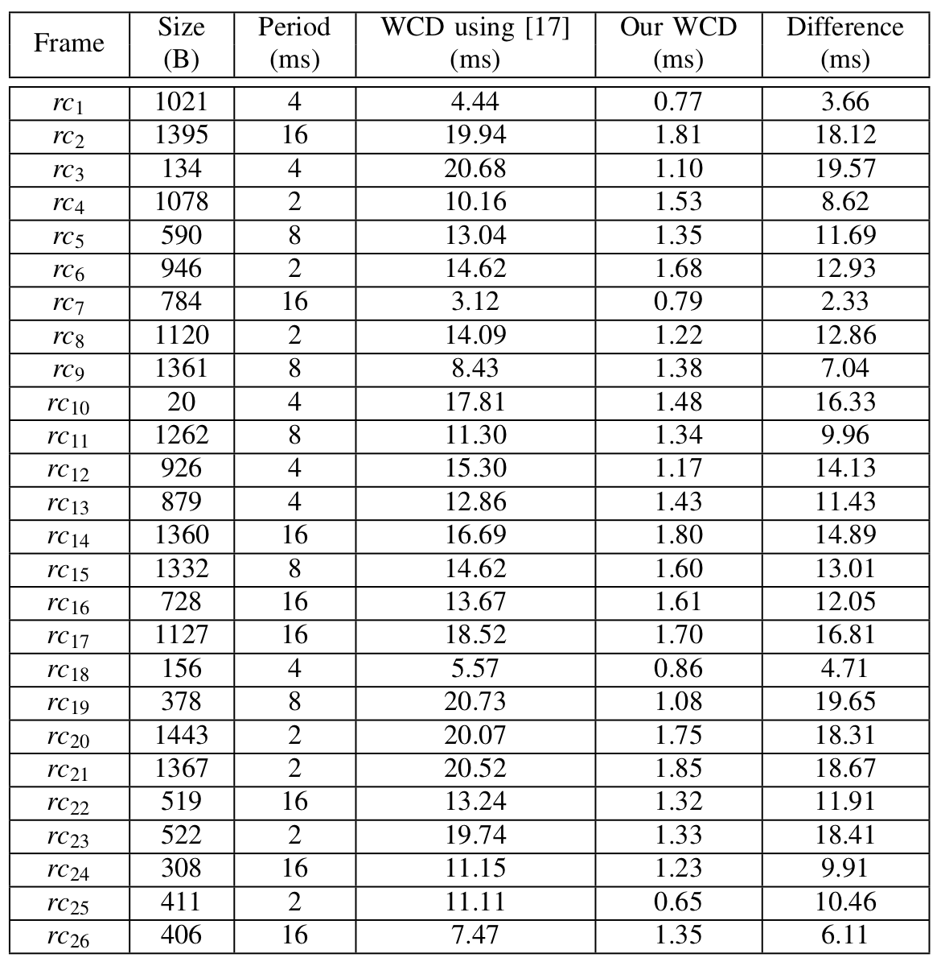
Experimental Results

Slide 21
Conclusions
TTEthernet is very well suited for mixed-criticality applications
  Predictability is achieved using three classes of traffic: TT, RC and BE
  Spatial separation is achieved trough virtual links
  Temporal separation is enforced by schedule tables for TT traffic and bandwidth allocation for RC traffic
We proposed a timing analysis for the TTEthernet protocol
  Compared to other analyses, our analysis is much closer to the exact worst-case end-to-end delay, while requiring more time to obtain a result
Future work:
  Optimize the analysis to reduce the computation time
  Provide a more formal complexity analysis
Notes:
To make more concise!

