Slide 1

Task Mapping and Partition Allocation for
Mixed-Criticality Real-Time Systems
Domițian Tămaș-Selicean and Paul Pop
Technical University of Denmark

Slide 2
Outline
Motivation
System and application models
Problem formulation and example
Optimization strategy
Experimental results
Conclusions

Slide 3
Motivation
Safety is the property of a system that will not endanger human life or the environment
A safety-related system needs to be certified
A Safety Integrity Level (SIL) is assigned to each safety related function, depending on the required level of risk reduction
There are 4 SILs:
  SIL4 (most critical)
  SIL1 (least critical)
  SIL0 (non-critical) – not covered by standards
SILs dictate the development process and certification procedures

Slide 4
Motivation
Real time applications implemented using distributed systems
Mixed-criticality applications share the same architecture
Federated Architecture
Integrated Architecture
SIL4
SIL1
SIL3
SIL3
SIL2
SIL4
SIL4
SIL1
PE
Application A ₁
Application A ₂
Application A ₃
Solution: partitioned architecture

Slide 5
System Model
Partition = virtual dedicated machine
Partitioned architecture
  Spatial partitioning
    protects one application’s memory and access to resources from another application
  Temporal partitioning
    partitions the CPU time among applications

Slide 6
System Model
PE 1
PE 2
PE 1
PE 2
PE 3
Partition
Partition
slice
Major Frame
Temporal partitioning
  Static partition table
    Repeated with a period MF
    Partition switch overhead
    Each partition can have its own scheduling policy
    A partition has a certain SIL
Problem: optimize task mapping
and allocation of partitions
PE 3

Slide 7
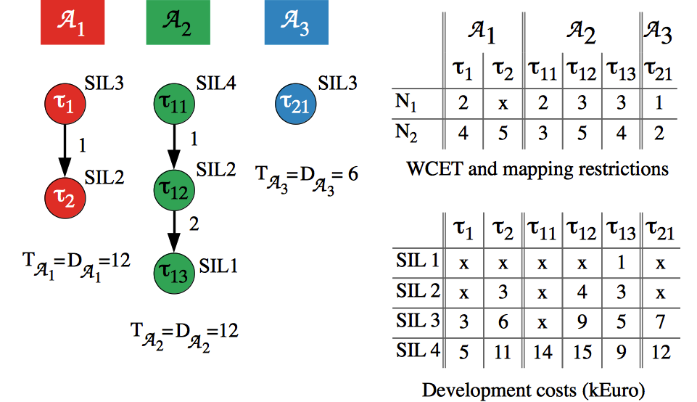
Application Model
Static Cyclic Scheduling

Slide 8
Problem formulation
Given
    A set of applications
    The criticality level (or SIL) for each task
    A set of N processing elements (PEs)
    The size of the Major Frame and of the Application Cycle
Determine
    The mapping of tasks to PEs
    The sequence and length of partition slices on each processor
    The assignment of tasks to partitions
    The schedule for all the tasks in the system
Such that
    All applications meet their deadline

Slide 9
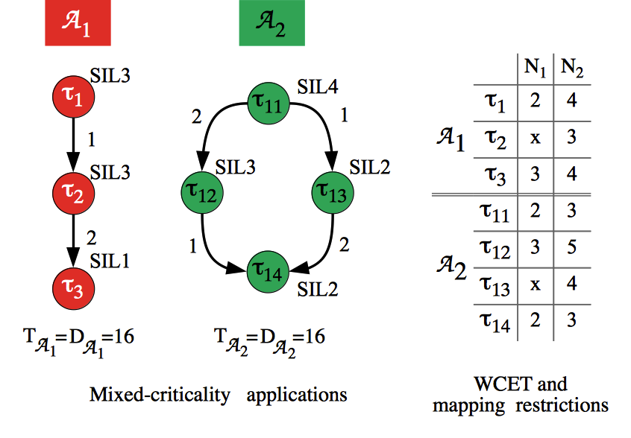
Motivational Example
Notes:
Use the motivational example from Journal!

Slide 10
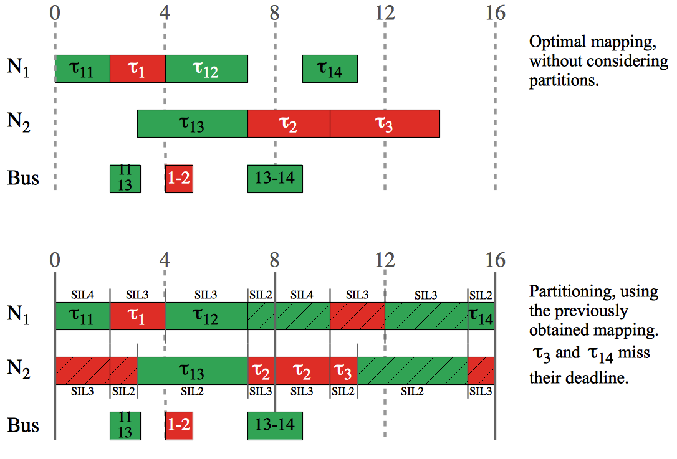
Motivational Example

Slide 11
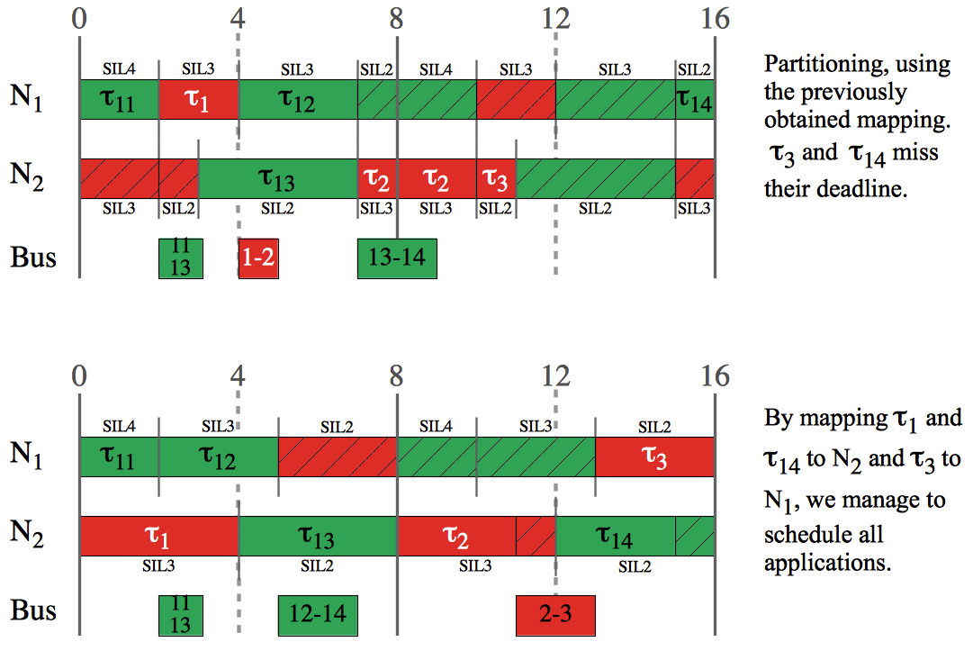
Motivational Example

Slide 12
Optimization Strategy
Mapping and Time-Partitioning Optimization (MTPO) strategy:
  Tabu Search meta-heuristic
    The mapping of tasks to processors
    The sequence and length of partition slices on each PE
    The assignment of tasks to partitions
  List scheduling
    The schedule for the applications
Tabu Search
  Minimizes the cost function
  Explores the solution space using design transformations

Slide 13
Optimization Strategy
Degree of schedulability
  Captures the difference between the worst-case response time and the deadline
Cost Function

Slide 14
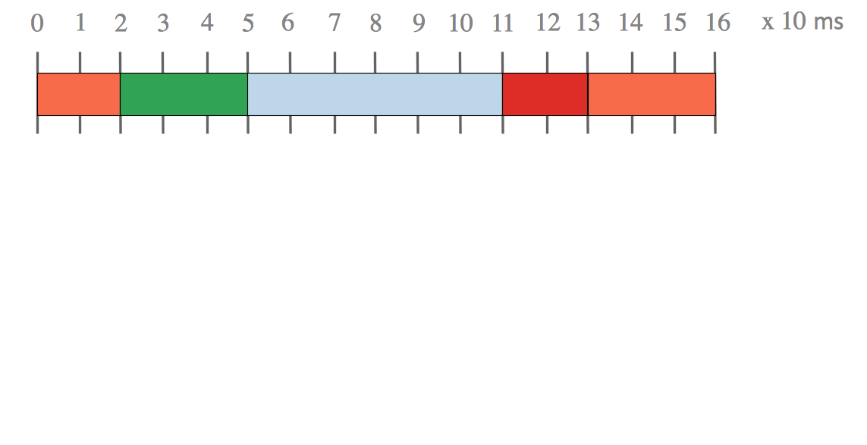
Optimization Strategy: Design Transformations

Slide 15
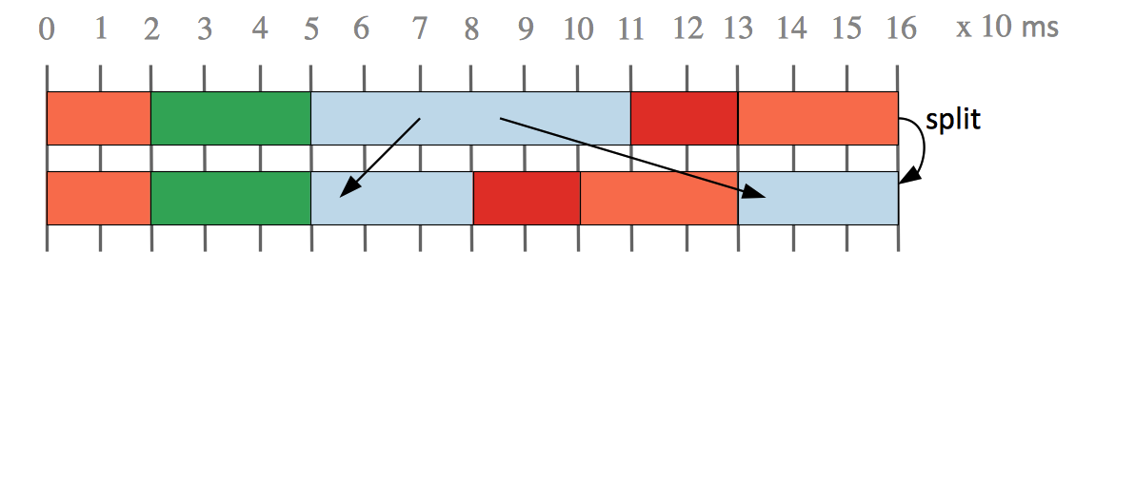
Optimization Strategy: Design Transformations

Slide 16
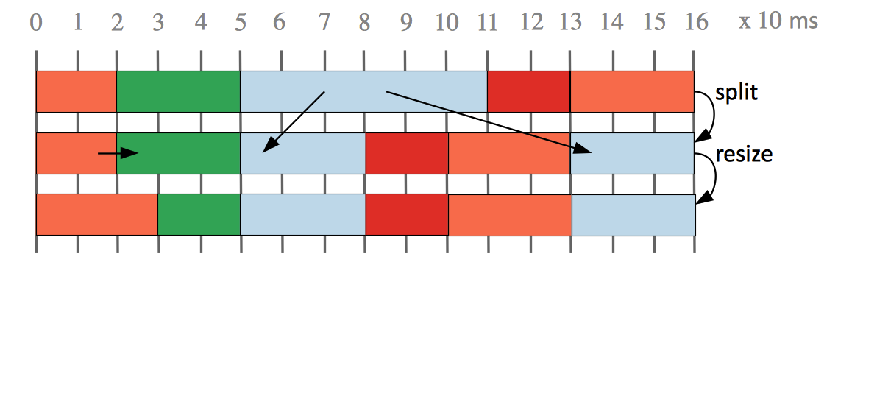
Optimization Strategy: Design Transformations

Slide 17
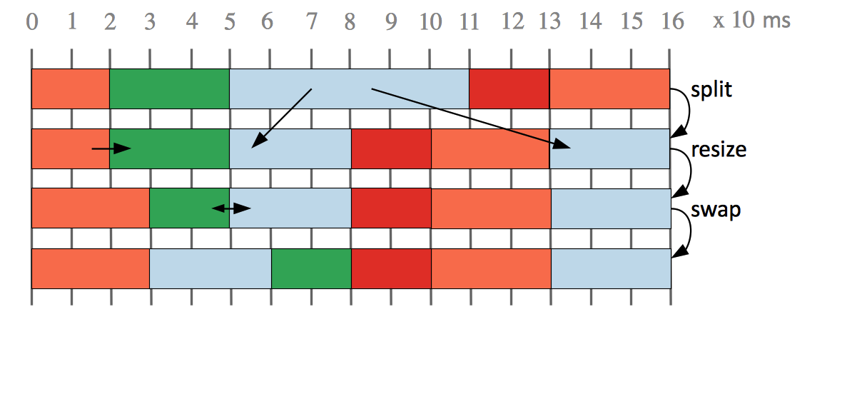
Optimization Strategy: Design Transformations

Slide 18
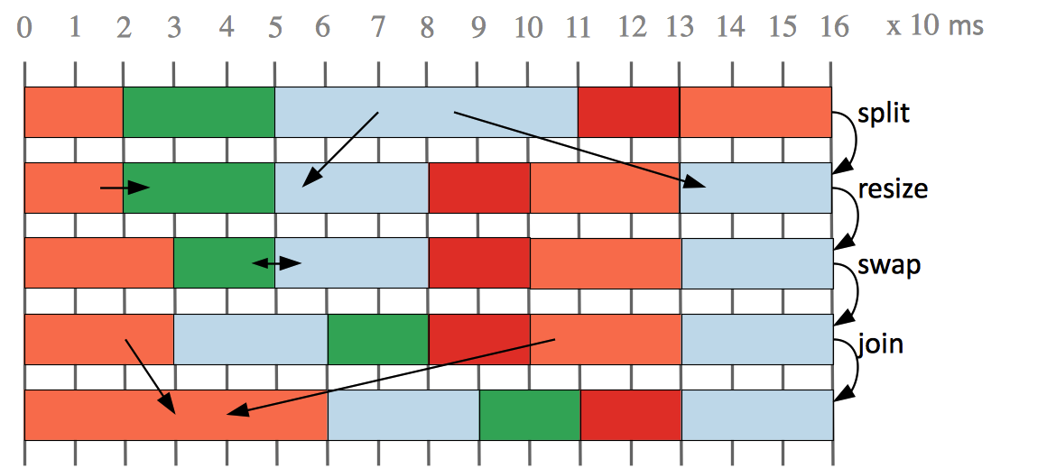
Optimization Strategy: Design Transformations
Task re-assignment

Slide 19
Experimental Results
Benchmarks
  5 synthetic
  3 real life test cases from E3S
MTPO compared to:
  MO+TPO
    Optimization where first we do a mapping optimization,
    without considering partitioning (MO), and then we perform
    a partitioning optimization, considering the mapping
    obtained previously as fixed (TPO)

Slide 20
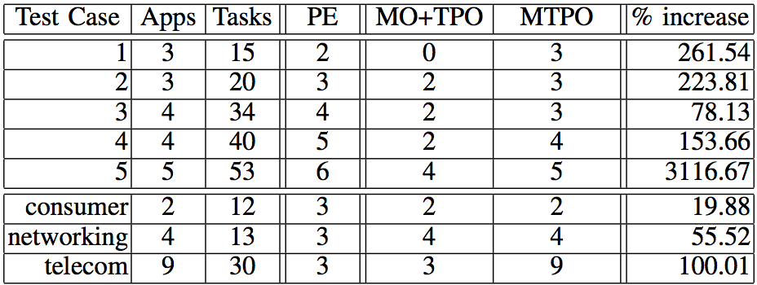
Experimental Results

Slide 21
Conclusions
Mixed-criticality systems, with applications of different
criticalities running on the same processors, are implemented using a partitioned architecture.
Optimizing the time partitions and the task allocation to partitions leads to schedulable solutions with improved resource utilization.
We proposed a Tabu Search based optimization algorithm.
Notes:
To make more concise!

Slide 22
Thank you!
Domițian Tămaș-Selicean
dota@imm.dtu.dk

