Slide 1


Synthesis of Communication Schedules for
TTEthernet-based Mixed-Criticality Systems
Domițian Tămaș-Selicean¹, Paul Pop¹ and Wilfried Steiner²
¹Technical University of Denmark
²TTTech Computertechnik AG

Slide 2
Outline
Motivation
TTEthernet
  ARINC 664p7 “Aircraft Data Network”
  TT and RC Traffic Transmission
Problem Formulation
  Motivational Example
Optimization Strategy
  RC End-to-End Analysis
Experimental results
Conclusions

Slide 3
Motivation
Real time applications implemented using distributed systems
Point-to-point connection
Bus connection
PE
Application A ₁ -- highly critical
Reduces wiring and weight
Mixed-criticality applications share the same network
Application A ₂ -- critical
Application A ₃ -- non-critical
Notes:
Example of point-to-point connection is the ARINC 429 data transfer standard for avionics, with a transfer rate of up to 100 kbit/s.
One option would be an Ethernet-based network, since it can achieves speeds up to 1 Gbit/s. But Ethernet is known to be unsuitable for real-time or safety-critical applications, as it is inherently a non-deterministic network.

Slide 4
ARINC 664 p7 “Aircraft Data Network”
ES₁
ES₃
NS₁
NS₂
ES₂
ES₄
Network Switch
End System
Full-Duplex Ethernet-based data network for safety-critical applications
Notes:
ARINC 664 p7 specifies a full-duplex Ethernet network for aircraft data networks.
It is composed of End – Systems connected by Network Switches and physical connections.

Slide 5
ARINC 664 p7 “Aircraft Data Network”
ES₁
ES₃
NS₁
NS₂
ES₂
ES₄
RAM
CPU
NIC
ROM
Notes:
Each End Systems consists of a Processing Element PE, containing a CPU, a a RAM and non-volatile memory, and a Network Interface Card

Slide 6
ARINC 664 p7 “Aircraft Data Network”
ES₁
NS₁ to ES₁
ES₃
NS₁
NS₂
ES₁ to NS₁
ES₂
ES₄
dataflow link
Notes:
In half-duplex implementations, frame collision is unavoidable, leading to unbounded transmission times.
ARIC 664p7 is a full-duplex network, thus allows simultaneous communication in both directions, collisions-free.

Slide 7
ARINC 664 p7 “Aircraft Data Network”
ES₁
ES₃
τ₁
vl₂
τ₂
τ₅
NS₁
NS₂
ES₂
ES₄
vl₁
τ₄
virtual link
τ₃
Highly critical application A ₁: τ₁, τ₂ and τ₃
  τ₁ sends message m₁ to τ₂ and τ₃
Non-critical application A ₂: τ₄ and τ₅
  τ₄ sends message m₂ to τ₅
Notes:
The Ethernet protocol does not offer separation between messages of different criticalities. ARINC 664p7 manages this through the concept of Virtual Links, by emulating point-to-point connectivity over the network. The virtual link is defined as the “logical unidirectional connection from one source system to one or more destination end systems”. Thus the virtual link is a directed tree, with the sender as a root, and the receivers as leaf. Each virtual link is composed of a set of dataflow paths, one such dataflow path for each root-leaf connection.
One virtual link is assigned to one message only.
By using virtual links, the highly critical message m1 is separated from the non-critical message m2.
Let’s assume we have 2 applications, A1 and A2.

Slide 8
ARINC 664 p7 “Aircraft Data Network”
ES₁
ES₃
τ₁
dp₁
τ₂
τ₅
l₁
l₃
NS₁
l₂
NS₂
l₄
ES₂
dp₂
ES₄
vl₁
τ₄
τ₃
dataflow path
Highly critical application A ₁: τ₁, τ₂ and τ₃
  τ₁ sends message m₁ to τ₂ and τ₃
Non-critical application A ₂: τ₄ and τ₅
  τ₄ sends message m₂ to τ₅
Notes:
T1 of A1 sends m1 to T2 and T3 on vl1.
vl1 is composed of dataflow paths dp1 and dp2, where dp1 is connecting ES1 to ES3 and dp2 is connecting ES1 to ES4.

Slide 9
ARINC 664 p7 “Aircraft Data Network”
Deterministic Event Triggered communication
Separation of traffic enforced through “bandwidth allocation”
Bandwidth Allocation Gap (BAG) – minimum time interval between two consecutive instances of a frame on a virtual link
BAG_{x}
f_{x,1}
f_{x,2}
Maximum bandwidth assigned to virtual link vl_{i}
BW (vl_{i}) = f_{i} .size/BAG_{i}

Slide 10
TTEthernet
ARINC 664p7 compliant
Traffic classes:
  synchronized communication
    Time Triggered (TT)
  unsynchronized communication
    Rate Constrained (RC) – ARINC 664p7 traffic class
    Best Effort (BE) – no timing guarantees
Standardized as SAE AS 6802
Marketed by TTTech Computertechnik AG
Implemented by Honeywell on the NASA Orion Constellation
Notes:
When talking about traffic classes, also mention integration policies:
timely block – the transmission of an RC frame is postponed if it will not terminate before the transmission of a scheduled TT frame
pre-emption – the transmission of an RC frame is pre-empted if a TT frame is scheduled for tranmission
shuffling – if an RC frame is transmitting, the TT frame will be sent only after the transmission finished

Slide 11
TTEthernet
Composed of clusters
Each cluster has a clock synchronization domain
Inter-cluster communication using RC traffic
ES₁
ES₃
ES₅
ES₇
NS₁
NS₂
ES₂
ES₈
ES₄
ES₆
Cluster 1
Cluster 2

Slide 12
TT Transmission
ES₁
NS₁
ES₂
CPU
k
l
CPU
P_{1,1}
P_{2,1}
FU
f
FU
B_{2,Rx}
m
τ₁
e
TT
h
τ₄
b
d
TT_{R}
B_{1,Tx}
i
TT_{S}
B_{1,Rx}
P_{1,2}
b
TT_{S}
P_{2,2}
τ₂
a
B_{1,Tx}
B_{2,Tx}
j
τ₃
P_{1,3}
f₂
B_{2,Tx}
g
P_{2,3}
S_{S}
c
S_{R}
S_{S}
f₃
NS₂
f₄
A₁: τ₁ à m₁ à τ₃, RC
NS₃
A₂: τ₂ à m₂ à τ₄, TT

Slide 13
TT Transmission
ES₁
NS₁
ES₂
CPU
k
l
CPU
P_{1,1}
P_{2,1}
FU
f
FU
B_{2,Rx}
m
τ₁
e
TT
h
τ₄
b
d
TT_{R}
B_{1,Tx}
i
TT_{S}
B_{1,Rx}
P_{1,2}
b
TT_{S}
P_{2,2}
τ₂
a
B_{1,Tx}
B_{2,Tx}
j
τ₃
P_{1,3}
f₂
B_{2,Tx}
g
P_{2,3}
S_{S}
c
S_{R}
S_{S}
f₃
NS₂
f₄
A₁: τ₁ à m₁ à τ₃, RC
NS₃
A₂: τ₂ à m₂ à τ₄, TT
a
Packing message m₂ into frame f₂
h
TT_{R} checks if f₂ arrives according to schedule
b
Place f₂ in buffer B_{1,Tx} for transmission
i
Place f₂ in buffer B_{1,Tx} for transmission
c
Send time specified in send schedule S_{S}
j
Send time specified in send schedule S_{S}
d
TT_{S} sends f₂ to NS₁
k
FU checks f₂
e
f₂ is sent on the dataflow link to NS₁
l
Store the frame into receive buffer B_{2,Rx}
f
The Filtering Unit (FU) checks the frame f₂
m
Task τ₄ reads f₂ from buffer
g
Expected receive time specified in receive schedule S_{R}

Slide 14
TT Transmission
ES₁
NS₁
ES₂
CPU
k
l
CPU
P_{1,1}
P_{2,1}
FU
f
FU
B_{2,Rx}
m
τ₁
e
TT
h
τ₄
b
d
TT_{R}
B_{1,Tx}
i
TT_{S}
B_{1,Rx}
P_{1,2}
b
TT_{S}
P_{2,2}
τ₂
a
B_{1,Tx}
B_{2,Tx}
j
τ₃
P_{1,3}
f₂
B_{2,Tx}
g
P_{2,3}
S_{S}
c
S_{R}
S_{S}
f₃
NS₂
f₄
A₁: τ₁ à m₁ à τ₃, RC
NS₃
A₂: τ₂ à m₂ à τ₄, TT
a
Packing message m₂ into frame f₂
h
TT_{R} checks if f₂ arrives according to schedule
b
Place f₂ in buffer B_{1,Tx} for transmission
i
Place f₂ in buffer B_{1,Tx} for transmission
c
Send time specified in send schedule S_{S}
j
Send time specified in send schedule S_{S}
d
TT_{S} sends f₂ to NS₁
k
FU checks f₂
e
f₂ is sent on the dataflow link to NS₁
l
Store the frame into receive buffer B_{2,Rx}
f
The Filtering Unit (FU) checks the frame f₂
m
Task τ₄ reads f₂ from buffer
g
Expected receive time specified in receive schedule S_{R}

Slide 15
TT Transmission
ES₁
NS₁
ES₂
CPU
k
l
CPU
P_{1,1}
P_{2,1}
FU
f
FU
B_{2,Rx}
m
τ₁
e
TT
h
τ₄
b
d
TT_{R}
B_{1,Tx}
i
TT_{S}
B_{1,Rx}
P_{1,2}
b
TT_{S}
P_{2,2}
τ₂
a
B_{1,Tx}
B_{2,Tx}
j
τ₃
P_{1,3}
f₂
B_{2,Tx}
g
P_{2,3}
S_{S}
c
S_{R}
S_{S}
f₃
NS₂
f₄
A₁: τ₁ à m₁ à τ₃, RC
NS₃
A₂: τ₂ à m₂ à τ₄, TT
a
Packing message m₂ into frame f₂
h
TT_{R} checks if f₂ arrives according to schedule
b
Place f₂ in buffer B_{1,Tx} for transmission
i
Place f₂ in buffer B_{1,Tx} for transmission
c
Send time specified in send schedule S_{S}
j
Send time specified in send schedule S_{S}
d
TT_{S} sends f₂ to NS₁
k
FU checks f₂
e
f₂ is sent on the dataflow link to NS₁
l
Store the frame into receive buffer B_{2,Rx}
f
The Filtering Unit (FU) checks the frame f₂
m
Task τ₄ reads f₂ from buffer
g
Expected receive time specified in receive schedule S_{R}

Slide 16
TT Transmission
ES₁
NS₁
ES₂
CPU
k
l
CPU
P_{1,1}
P_{2,1}
FU
f
FU
B_{2,Rx}
m
τ₁
e
TT
h
τ₄
b
d
TT_{R}
B_{1,Tx}
i
TT_{S}
B_{1,Rx}
P_{1,2}
b
TT_{S}
P_{2,2}
τ₂
a
B_{1,Tx}
B_{2,Tx}
j
τ₃
P_{1,3}
f₂
B_{2,Tx}
g
P_{2,3}
S_{S}
c
S_{R}
S_{S}
f₃
NS₂
f₄
A₁: τ₁ à m₁ à τ₃, RC
NS₃
A₂: τ₂ à m₂ à τ₄, TT
a
Packing message m₂ into frame f₂
h
TT_{R} checks if f₂ arrives according to schedule
b
Place f₂ in buffer B_{1,Tx} for transmission
i
Place f₂ in buffer B_{1,Tx} for transmission
c
Send time specified in send schedule S_{S}
j
Send time specified in send schedule S_{S}
d
TT_{S} sends f₂ to NS₁
k
FU checks f₂
e
f₂ is sent on the dataflow link to NS₁
l
Store the frame into receive buffer B_{2,Rx}
f
The Filtering Unit (FU) checks the frame f₂
m
Task τ₄ reads f₂ from buffer
g
Expected receive time specified in receive schedule S_{R}

Slide 17
TT Transmission
ES₁
NS₁
ES₂
CPU
k
l
CPU
P_{1,1}
P_{2,1}
FU
f
FU
B_{2,Rx}
m
τ₁
e
TT
h
τ₄
b
d
TT_{R}
B_{1,Tx}
i
TT_{S}
B_{1,Rx}
P_{1,2}
b
TT_{S}
P_{2,2}
τ₂
a
B_{1,Tx}
B_{2,Tx}
j
τ₃
P_{1,3}
f₂
B_{2,Tx}
g
P_{2,3}
S_{S}
c
S_{R}
S_{S}
f₃
NS₂
f₄
A₁: τ₁ à m₁ à τ₃, RC
NS₃
A₂: τ₂ à m₂ à τ₄, TT
a
Packing message m₂ into frame f₂
h
TT_{R} checks if f₂ arrives according to schedule
b
Place f₂ in buffer B_{1,Tx} for transmission
i
Place f₂ in buffer B_{1,Tx} for transmission
c
Send time specified in send schedule S_{S}
j
Send time specified in send schedule S_{S}
d
TT_{S} sends f₂ to NS₁
k
FU checks f₂
e
f₂ is sent on the dataflow link to NS₁
l
Store the frame into receive buffer B_{2,Rx}
f
The Filtering Unit (FU) checks the frame f₂
m
Task τ₄ reads f₂ from buffer
g
Expected receive time specified in receive schedule S_{R}

Slide 18
TT Transmission
ES₁
NS₁
ES₂
CPU
k
l
CPU
P_{1,1}
P_{2,1}
FU
f
FU
B_{2,Rx}
m
τ₁
e
TT
h
τ₄
b
d
TT_{R}
B_{1,Tx}
i
TT_{S}
B_{1,Rx}
P_{1,2}
b
TT_{S}
P_{2,2}
τ₂
a
B_{1,Tx}
B_{2,Tx}
j
τ₃
P_{1,3}
f₂
B_{2,Tx}
g
P_{2,3}
S_{S}
c
S_{R}
S_{S}
f₃
NS₂
f₄
A₁: τ₁ à m₁ à τ₃, RC
NS₃
A₂: τ₂ à m₂ à τ₄, TT
a
Packing message m₂ into frame f₂
h
TT_{R} checks if f₂ arrives according to schedule
b
Place f₂ in buffer B_{1,Tx} for transmission
i
Place f₂ in buffer B_{1,Tx} for transmission
c
Send time specified in send schedule S_{S}
j
Send time specified in send schedule S_{S}
d
TT_{S} sends f₂ to NS₁
k
FU checks f₂
e
f₂ is sent on the dataflow link to NS₁
l
Store the frame into receive buffer B_{2,Rx}
f
The Filtering Unit (FU) checks the frame f₂
m
Task τ₄ reads f₂ from buffer
g
Expected receive time specified in receive schedule S_{R}

Slide 19
TT Transmission
ES₁
NS₁
ES₂
CPU
k
l
CPU
P_{1,1}
P_{2,1}
FU
f
FU
B_{2,Rx}
m
τ₁
e
TT
h
τ₄
b
d
TT_{R}
B_{1,Tx}
i
TT_{S}
B_{1,Rx}
P_{1,2}
b
TT_{S}
P_{2,2}
τ₂
a
B_{1,Tx}
B_{2,Tx}
j
τ₃
P_{1,3}
f₂
B_{2,Tx}
g
P_{2,3}
S_{S}
c
S_{R}
S_{S}
f₃
NS₂
f₄
A₁: τ₁ à m₁ à τ₃, RC
NS₃
A₂: τ₂ à m₂ à τ₄, TT
a
Packing message m₂ into frame f₂
h
TT_{R} checks if f₂ arrives according to schedule
b
Place f₂ in buffer B_{1,Tx} for transmission
i
Place f₂ in buffer B_{1,Tx} for transmission
c
Send time specified in send schedule S_{S}
j
Send time specified in send schedule S_{S}
d
TT_{S} sends f₂ to NS₁
k
FU checks f₂
e
f₂ is sent on the dataflow link to NS₁
l
Store the frame into receive buffer B_{2,Rx}
f
The Filtering Unit (FU) checks the frame f₂
m
Task τ₄ reads f₂ from buffer
g
Expected receive time specified in receive schedule S_{R}

Slide 20
TT Transmission
ES₁
NS₁
ES₂
CPU
k
l
CPU
P_{1,1}
P_{2,1}
FU
f
FU
B_{2,Rx}
m
τ₁
e
TT
h
τ₄
b
d
TT_{R}
B_{1,Tx}
i
TT_{S}
B_{1,Rx}
P_{1,2}
b
TT_{S}
P_{2,2}
τ₂
a
B_{1,Tx}
B_{2,Tx}
j
τ₃
P_{1,3}
f₂
B_{2,Tx}
g
P_{2,3}
S_{S}
c
S_{R}
S_{S}
f₃
NS₂
f₄
A₁: τ₁ à m₁ à τ₃, RC
NS₃
A₂: τ₂ à m₂ à τ₄, TT
a
Packing message m₂ into frame f₂
h
TT_{R} checks if f₂ arrives according to schedule
b
Place f₂ in buffer B_{1,Tx} for transmission
i
Place f₂ in buffer B_{1,Tx} for transmission
c
Send time specified in send schedule S_{S}
j
Send time specified in send schedule S_{S}
d
TT_{S} sends f₂ to NS₁
k
FU checks f₂
e
f₂ is sent on the dataflow link to NS₁
l
Store the frame into receive buffer B_{2,Rx}
f
The Filtering Unit (FU) checks the frame f₂
m
Task τ₄ reads f₂ from buffer
g
Expected receive time specified in receive schedule S_{R}

Slide 21
TT Transmission
ES₁
NS₁
ES₂
CPU
k
l
CPU
P_{1,1}
P_{2,1}
FU
f
FU
B_{2,Rx}
m
τ₁
e
TT
h
τ₄
b
d
TT_{R}
B_{1,Tx}
i
TT_{S}
B_{1,Rx}
P_{1,2}
b
TT_{S}
P_{2,2}
τ₂
a
B_{1,Tx}
B_{2,Tx}
j
τ₃
P_{1,3}
f₂
B_{2,Tx}
g
P_{2,3}
S_{S}
c
S_{R}
S_{S}
f₃
NS₂
f₄
A₁: τ₁ à m₁ à τ₃, RC
NS₃
A₂: τ₂ à m₂ à τ₄, TT
a
Packing message m₂ into frame f₂
h
TT_{R} checks if f₂ arrives according to schedule
b
Place f₂ in buffer B_{1,Tx} for transmission
i
Place f₂ in buffer B_{1,Tx} for transmission
c
Send time specified in send schedule S_{S}
j
Send time specified in send schedule S_{S}
d
TT_{S} sends f₂ to NS₁
k
FU checks f₂
e
f₂ is sent on the dataflow link to NS₁
l
Store the frame into receive buffer B_{2,Rx}
f
The Filtering Unit (FU) checks the frame f₂
m
Task τ₄ reads f₂ from buffer
g
Expected receive time specified in receive schedule S_{R}

Slide 22
TT Transmission
ES₁
NS₁
ES₂
CPU
k
l
CPU
P_{1,1}
P_{2,1}
FU
f
FU
B_{2,Rx}
m
τ₁
e
TT
h
τ₄
b
d
TT_{R}
B_{1,Tx}
i
TT_{S}
B_{1,Rx}
P_{1,2}
b
TT_{S}
P_{2,2}
τ₂
a
B_{1,Tx}
B_{2,Tx}
j
τ₃
P_{1,3}
f₂
B_{2,Tx}
g
P_{2,3}
S_{S}
c
S_{R}
S_{S}
f₃
NS₂
f₄
A₁: τ₁ à m₁ à τ₃, RC
NS₃
A₂: τ₂ à m₂ à τ₄, TT
a
Packing message m₂ into frame f₂
h
TT_{R} checks if f₂ arrives according to schedule
b
Place f₂ in buffer B_{1,Tx} for transmission
i
Place f₂ in buffer B_{1,Tx} for transmission
c
Send time specified in send schedule S_{S}
j
Send time specified in send schedule S_{S}
d
TT_{S} sends f₂ to NS₁
k
FU checks f₂
e
f₂ is sent on the dataflow link to NS₁
l
Store the frame into receive buffer B_{2,Rx}
f
The Filtering Unit (FU) checks the frame f₂
m
Task τ₄ reads f₂ from buffer
g
Expected receive time specified in receive schedule S_{R}

Slide 23
TT Transmission
ES₁
NS₁
ES₂
CPU
k
l
CPU
P_{1,1}
P_{2,1}
FU
f
FU
B_{2,Rx}
m
τ₁
e
TT
h
τ₄
b
d
TT_{R}
B_{1,Tx}
i
TT_{S}
B_{1,Rx}
P_{1,2}
b
TT_{S}
P_{2,2}
τ₂
a
B_{1,Tx}
B_{2,Tx}
j
τ₃
P_{1,3}
f₂
B_{2,Tx}
g
P_{2,3}
S_{S}
c
S_{R}
S_{S}
f₃
NS₂
f₄
A₁: τ₁ à m₁ à τ₃, RC
NS₃
A₂: τ₂ à m₂ à τ₄, TT
a
Packing message m₂ into frame f₂
h
TT_{R} checks if f₂ arrives according to schedule
b
Place f₂ in buffer B_{1,Tx} for transmission
i
Place f₂ in buffer B_{1,Tx} for transmission
c
Send time specified in send schedule S_{S}
j
Send time specified in send schedule S_{S}
d
TT_{S} sends f₂ to NS₁
k
FU checks f₂
e
f₂ is sent on the dataflow link to NS₁
l
Store the frame into receive buffer B_{2,Rx}
f
The Filtering Unit (FU) checks the frame f₂
m
Task τ₄ reads f₂ from buffer
g
Expected receive time specified in receive schedule S_{R}

Slide 24
TT Transmission
ES₁
NS₁
ES₂
CPU
k
l
CPU
P_{1,1}
P_{2,1}
FU
f
FU
B_{2,Rx}
m
τ₁
e
TT
h
τ₄
b
d
TT_{R}
B_{1,Tx}
i
TT_{S}
B_{1,Rx}
P_{1,2}
b
TT_{S}
P_{2,2}
τ₂
a
B_{1,Tx}
B_{2,Tx}
j
τ₃
P_{1,3}
f₂
B_{2,Tx}
g
P_{2,3}
S_{S}
c
S_{R}
S_{S}
f₃
NS₂
f₄
A₁: τ₁ à m₁ à τ₃, RC
NS₃
A₂: τ₂ à m₂ à τ₄, TT
a
Packing message m₂ into frame f₂
h
TT_{R} checks if f₂ arrives according to schedule
b
Place f₂ in buffer B_{1,Tx} for transmission
i
Place f₂ in buffer B_{1,Tx} for transmission
c
Send time specified in send schedule S_{S}
j
Send time specified in send schedule S_{S}
d
TT_{S} sends f₂ to NS₁
k
FU checks f₂
e
f₂ is sent on the dataflow link to NS₁
l
Store the frame into receive buffer B_{2,Rx}
f
The Filtering Unit (FU) checks the frame f₂
m
Task τ₄ reads f₂ from buffer
g
Expected receive time specified in receive schedule S_{R}

Slide 25
TT Transmission
ES₁
NS₁
ES₂
CPU
k
l
CPU
P_{1,1}
P_{2,1}
FU
f
FU
B_{2,Rx}
m
τ₁
e
TT
h
τ₄
b
d
TT_{R}
B_{1,Tx}
i
TT_{S}
B_{1,Rx}
P_{1,2}
b
TT_{S}
P_{2,2}
τ₂
a
B_{1,Tx}
B_{2,Tx}
j
τ₃
P_{1,3}
f₂
B_{2,Tx}
g
P_{2,3}
S_{S}
c
S_{R}
S_{S}
f₃
NS₂
f₄
A₁: τ₁ à m₁ à τ₃, RC
NS₃
A₂: τ₂ à m₂ à τ₄, TT
a
Packing message m₂ into frame f₂
h
TT_{R} checks if f₂ arrives according to schedule
b
Place f₂ in buffer B_{1,Tx} for transmission
i
Place f₂ in buffer B_{1,Tx} for transmission
c
Send time specified in send schedule S_{S}
j
Send time specified in send schedule S_{S}
d
TT_{S} sends f₂ to NS₁
k
FU checks f₂
e
f₂ is sent on the dataflow link to NS₁
l
Store the frame into receive buffer B_{2,Rx}
f
The Filtering Unit (FU) checks the frame f₂
m
Task τ₄ reads f₂ from buffer
g
Expected receive time specified in receive schedule S_{R}

Slide 26
RC Transmission
ES₁
f₁
NS₁
8
9
ES₂
CPU
2
3
RC
TP
Q_{Tx}
11
CPU
P_{1,1}
Q_{1,Tx}
TR₁
4
7
P_{2,1}
τ₁
1
TR₂
RC_{S}
6
FU
FU
B_{2,Rx}
τ₄
Q_{2,Tx}
5
TT
10
P_{1,2}
TT_{R}
B_{1,Tx}
TT_{S}
12
B_{1,Rx}
P_{2,2}
B_{1,Tx}
TT_{S}
Q_{2,Rx}
13
τ₂
B_{2,Tx}
τ₃
P_{1,3}
f₂
B_{2,Tx}
Q_{1,Rx}
P_{2,3}
S_{S}
S_{R}
S_{S}
f₃
NS₂
f₄
A₁: τ₁ à m₁ à τ₃, RC
NS₃
A₂: τ₂ à m₂ à τ₄, TT
1
Packing message m₁ into frame f₁
8
Traffic Policing (TP) checks that f2 arrives
according to the BAG
2
Insert it in queue Q_{1,Tx}
3
Traffic Regulator (TR) ensures bandwidth for each VL
9
Copy f₁ to outgoing queue Q_{Tx}
4
RC scheduler RC multiplexes frames coming from TRs
10
Send f₁ when there is no TT traffic
5
TT_{S} transmits f₁ when there is no TT traffic
11
FU checks f₁
6
f₁ is sent on the dataflow link to NS₁
12
Copy to receiving Q_{2,Rx}
7
FU checks the validity of the frame
13
Task τ₃ reads f₁ from the queue

Slide 27
RC Transmission
ES₁
f₁
NS₁
8
9
ES₂
CPU
2
3
RC
TP
Q_{Tx}
11
CPU
P_{1,1}
Q_{1,Tx}
TR₁
4
7
P_{2,1}
τ₁
1
TR₂
RC_{S}
6
FU
FU
B_{2,Rx}
τ₄
Q_{2,Tx}
5
TT
10
P_{1,2}
TT_{R}
B_{1,Tx}
TT_{S}
12
B_{1,Rx}
P_{2,2}
B_{1,Tx}
TT_{S}
Q_{2,Rx}
13
τ₂
B_{2,Tx}
τ₃
P_{1,3}
f₂
B_{2,Tx}
Q_{1,Rx}
P_{2,3}
S_{S}
S_{R}
S_{S}
f₃
NS₂
f₄
A₁: τ₁ à m₁ à τ₃, RC
NS₃
A₂: τ₂ à m₂ à τ₄, TT
1
Packing message m₁ into frame f₁
8
Traffic Policing (TP) checks that f2 arrives
according to the BAG
2
Insert it in queue Q_{1,Tx}
3
Traffic Regulator (TR) ensures bandwidth for each VL
9
Copy f₁ to outgoing queue Q_{Tx}
4
RC scheduler RC multiplexes frames coming from TRs
10
Send f₁ when there is no TT traffic
5
TT_{S} transmits f₁ when there is no TT traffic
11
FU checks f₁
6
f₁ is sent on the dataflow link to NS₁
12
Copy to receiving Q_{2,Rx}
7
FU checks the validity of the frame
13
Task τ₃ reads f₁ from the queue

Slide 28
RC Transmission
ES₁
f₁
NS₁
8
9
ES₂
CPU
2
3
RC
TP
Q_{Tx}
11
CPU
P_{1,1}
Q_{1,Tx}
TR₁
4
7
P_{2,1}
τ₁
1
TR₂
RC_{S}
6
FU
FU
B_{2,Rx}
τ₄
Q_{2,Tx}
5
TT
10
P_{1,2}
TT_{R}
B_{1,Tx}
TT_{S}
12
B_{1,Rx}
P_{2,2}
B_{1,Tx}
TT_{S}
Q_{2,Rx}
13
τ₂
B_{2,Tx}
τ₃
P_{1,3}
f₂
B_{2,Tx}
Q_{1,Rx}
P_{2,3}
S_{S}
S_{R}
S_{S}
f₃
NS₂
f₄
A₁: τ₁ à m₁ à τ₃, RC
NS₃
A₂: τ₂ à m₂ à τ₄, TT
1
Packing message m₁ into frame f₁
8
Traffic Policing (TP) checks that f2 arrives
according to the BAG
2
Insert it in queue Q_{1,Tx}
3
Traffic Regulator (TR) ensures bandwidth for each VL
9
Copy f₁ to outgoing queue Q_{Tx}
4
RC scheduler RC multiplexes frames coming from TRs
10
Send f₁ when there is no TT traffic
5
TT_{S} transmits f₁ when there is no TT traffic
11
FU checks f₁
6
f₁ is sent on the dataflow link to NS₁
12
Copy to receiving Q_{2,Rx}
7
FU checks the validity of the frame
13
Task τ₃ reads f₁ from the queue

Slide 29
RC Transmission
ES₁
f₁
NS₁
8
9
ES₂
CPU
2
3
RC
TP
Q_{Tx}
11
CPU
P_{1,1}
Q_{1,Tx}
TR₁
4
7
P_{2,1}
τ₁
1
TR₂
RC_{S}
6
FU
FU
B_{2,Rx}
τ₄
Q_{2,Tx}
5
TT
10
P_{1,2}
TT_{R}
B_{1,Tx}
TT_{S}
12
B_{1,Rx}
P_{2,2}
B_{1,Tx}
TT_{S}
Q_{2,Rx}
13
τ₂
B_{2,Tx}
τ₃
P_{1,3}
f₂
B_{2,Tx}
Q_{1,Rx}
P_{2,3}
S_{S}
S_{R}
S_{S}
f₃
NS₂
f₄
A₁: τ₁ à m₁ à τ₃, RC
NS₃
A₂: τ₂ à m₂ à τ₄, TT
1
Packing message m₁ into frame f₁
8
Traffic Policing (TP) checks that f2 arrives
according to the BAG
2
Insert it in queue Q_{1,Tx}
3
Traffic Regulator (TR) ensures bandwidth for each VL
9
Copy f₁ to outgoing queue Q_{Tx}
4
RC scheduler RC multiplexes frames coming from TRs
10
Send f₁ when there is no TT traffic
5
TT_{S} transmits f₁ when there is no TT traffic
11
FU checks f₁
6
f₁ is sent on the dataflow link to NS₁
12
Copy to receiving Q_{2,Rx}
7
FU checks the validity of the frame
13
Task τ₃ reads f₁ from the queue

Slide 30
RC Transmission
ES₁
f₁
NS₁
8
9
ES₂
CPU
2
3
RC
TP
Q_{Tx}
11
CPU
P_{1,1}
Q_{1,Tx}
TR₁
4
7
P_{2,1}
τ₁
1
TR₂
RC_{S}
6
FU
FU
B_{2,Rx}
τ₄
Q_{2,Tx}
5
TT
10
P_{1,2}
TT_{R}
B_{1,Tx}
TT_{S}
12
B_{1,Rx}
P_{2,2}
B_{1,Tx}
TT_{S}
Q_{2,Rx}
13
τ₂
B_{2,Tx}
τ₃
P_{1,3}
f₂
B_{2,Tx}
Q_{1,Rx}
P_{2,3}
S_{S}
S_{R}
S_{S}
f₃
NS₂
f₄
A₁: τ₁ à m₁ à τ₃, RC
NS₃
A₂: τ₂ à m₂ à τ₄, TT
1
Packing message m₁ into frame f₁
8
Traffic Policing (TP) checks that f2 arrives
according to the BAG
2
Insert it in queue Q_{1,Tx}
3
Traffic Regulator (TR) ensures bandwidth for each VL
9
Copy f₁ to outgoing queue Q_{Tx}
4
RC scheduler RC multiplexes frames coming from TRs
10
Send f₁ when there is no TT traffic
5
TT_{S} transmits f₁ when there is no TT traffic
11
FU checks f₁
6
f₁ is sent on the dataflow link to NS₁
12
Copy to receiving Q_{2,Rx}
7
FU checks the validity of the frame
13
Task τ₃ reads f₁ from the queue

Slide 31
RC Transmission
ES₁
f₁
NS₁
8
9
ES₂
CPU
2
3
RC
TP
Q_{Tx}
11
CPU
P_{1,1}
Q_{1,Tx}
TR₁
4
7
P_{2,1}
τ₁
1
TR₂
RC_{S}
6
FU
FU
B_{2,Rx}
τ₄
Q_{2,Tx}
5
TT
10
P_{1,2}
TT_{R}
B_{1,Tx}
TT_{S}
12
B_{1,Rx}
P_{2,2}
B_{1,Tx}
TT_{S}
Q_{2,Rx}
13
τ₂
B_{2,Tx}
τ₃
P_{1,3}
f₂
B_{2,Tx}
Q_{1,Rx}
P_{2,3}
S_{S}
S_{R}
S_{S}
f₃
NS₂
f₄
A₁: τ₁ à m₁ à τ₃, RC
NS₃
A₂: τ₂ à m₂ à τ₄, TT
1
Packing message m₁ into frame f₁
8
Traffic Policing (TP) checks that f2 arrives
according to the BAG
2
Insert it in queue Q_{1,Tx}
3
Traffic Regulator (TR) ensures bandwidth for each VL
9
Copy f₁ to outgoing queue Q_{Tx}
4
RC scheduler RC multiplexes frames coming from TRs
10
Send f₁ when there is no TT traffic
5
TT_{S} transmits f₁ when there is no TT traffic
11
FU checks f₁
6
f₁ is sent on the dataflow link to NS₁
12
Copy to receiving Q_{2,Rx}
7
FU checks the validity of the frame
13
Task τ₃ reads f₁ from the queue

Slide 32
RC Transmission
ES₁
f₁
NS₁
8
9
ES₂
CPU
2
3
RC
TP
Q_{Tx}
11
CPU
P_{1,1}
Q_{1,Tx}
TR₁
4
7
P_{2,1}
τ₁
1
TR₂
RC_{S}
6
FU
FU
B_{2,Rx}
τ₄
Q_{2,Tx}
5
TT
10
P_{1,2}
TT_{R}
B_{1,Tx}
TT_{S}
12
B_{1,Rx}
P_{2,2}
B_{1,Tx}
TT_{S}
Q_{2,Rx}
13
τ₂
B_{2,Tx}
τ₃
P_{1,3}
f₂
B_{2,Tx}
Q_{1,Rx}
P_{2,3}
S_{S}
S_{R}
S_{S}
f₃
NS₂
f₄
A₁: τ₁ à m₁ à τ₃, RC
NS₃
A₂: τ₂ à m₂ à τ₄, TT
1
Packing message m₁ into frame f₁
8
Traffic Policing (TP) checks that f2 arrives
according to the BAG
2
Insert it in queue Q_{1,Tx}
3
Traffic Regulator (TR) ensures bandwidth for each VL
9
Copy f₁ to outgoing queue Q_{Tx}
4
RC scheduler RC multiplexes frames coming from TRs
10
Send f₁ when there is no TT traffic
5
TT_{S} transmits f₁ when there is no TT traffic
11
FU checks f₁
6
f₁ is sent on the dataflow link to NS₁
12
Copy to receiving Q_{2,Rx}
7
FU checks the validity of the frame
13
Task τ₃ reads f₁ from the queue

Slide 33
RC Transmission
ES₁
f₁
NS₁
8
9
ES₂
CPU
2
3
RC
TP
Q_{Tx}
11
CPU
P_{1,1}
Q_{1,Tx}
TR₁
4
7
P_{2,1}
τ₁
1
TR₂
RC_{S}
6
FU
FU
B_{2,Rx}
τ₄
Q_{2,Tx}
5
TT
10
P_{1,2}
TT_{R}
B_{1,Tx}
TT_{S}
12
B_{1,Rx}
P_{2,2}
B_{1,Tx}
TT_{S}
Q_{2,Rx}
13
τ₂
B_{2,Tx}
τ₃
P_{1,3}
f₂
B_{2,Tx}
Q_{1,Rx}
P_{2,3}
S_{S}
S_{R}
S_{S}
f₃
NS₂
f₄
A₁: τ₁ à m₁ à τ₃, RC
NS₃
A₂: τ₂ à m₂ à τ₄, TT
1
Packing message m₁ into frame f₁
8
Traffic Policing (TP) checks that f2 arrives
according to the BAG
2
Insert it in queue Q_{1,Tx}
3
Traffic Regulator (TR) ensures bandwidth for each VL
9
Copy f₁ to outgoing queue Q_{Tx}
4
RC scheduler RC multiplexes frames coming from TRs
10
Send f₁ when there is no TT traffic
5
TT_{S} transmits f₁ when there is no TT traffic
11
FU checks f₁
6
f₁ is sent on the dataflow link to NS₁
12
Copy to receiving Q_{2,Rx}
7
FU checks the validity of the frame
13
Task τ₃ reads f₁ from the queue

Slide 34
RC Transmission
ES₁
f₁
NS₁
8
9
ES₂
CPU
2
3
RC
TP
Q_{Tx}
11
CPU
P_{1,1}
Q_{1,Tx}
TR₁
4
7
P_{2,1}
τ₁
1
TR₂
RC_{S}
6
FU
FU
B_{2,Rx}
τ₄
Q_{2,Tx}
5
TT
10
P_{1,2}
TT_{R}
B_{1,Tx}
TT_{S}
12
B_{1,Rx}
P_{2,2}
B_{1,Tx}
TT_{S}
Q_{2,Rx}
13
τ₂
B_{2,Tx}
τ₃
P_{1,3}
f₂
B_{2,Tx}
Q_{1,Rx}
P_{2,3}
S_{S}
S_{R}
S_{S}
f₃
NS₂
f₄
A₁: τ₁ à m₁ à τ₃, RC
NS₃
A₂: τ₂ à m₂ à τ₄, TT
1
Packing message m₁ into frame f₁
8
Traffic Policing (TP) checks that f2 arrives
according to the BAG
2
Insert it in queue Q_{1,Tx}
3
Traffic Regulator (TR) ensures bandwidth for each VL
9
Copy f₁ to outgoing queue Q_{Tx}
4
RC scheduler RC multiplexes frames coming from TRs
10
Send f₁ when there is no TT traffic
5
TT_{S} transmits f₁ when there is no TT traffic
11
FU checks f₁
6
f₁ is sent on the dataflow link to NS₁
12
Copy to receiving Q_{2,Rx}
7
FU checks the validity of the frame
13
Task τ₃ reads f₁ from the queue

Slide 35
RC Transmission
ES₁
f₁
NS₁
8
9
ES₂
CPU
2
3
RC
TP
Q_{Tx}
11
CPU
P_{1,1}
Q_{1,Tx}
TR₁
4
7
P_{2,1}
τ₁
1
TR₂
RC_{S}
6
FU
FU
B_{2,Rx}
τ₄
Q_{2,Tx}
5
TT
10
P_{1,2}
TT_{R}
B_{1,Tx}
TT_{S}
12
B_{1,Rx}
P_{2,2}
B_{1,Tx}
TT_{S}
Q_{2,Rx}
13
τ₂
B_{2,Tx}
τ₃
P_{1,3}
f₂
B_{2,Tx}
Q_{1,Rx}
P_{2,3}
S_{S}
S_{R}
S_{S}
f₃
NS₂
f₄
A₁: τ₁ à m₁ à τ₃, RC
NS₃
A₂: τ₂ à m₂ à τ₄, TT
1
Packing message m₁ into frame f₁
8
Traffic Policing (TP) checks that f2 arrives
according to the BAG
2
Insert it in queue Q_{1,Tx}
3
Traffic Regulator (TR) ensures bandwidth for each VL
9
Copy f₁ to outgoing queue Q_{Tx}
4
RC scheduler RC multiplexes frames coming from TRs
10
Send f₁ when there is no TT traffic
5
TT_{S} transmits f₁ when there is no TT traffic
11
FU checks f₁
6
f₁ is sent on the dataflow link to NS₁
12
Copy to receiving Q_{2,Rx}
7
FU checks the validity of the frame
13
Task τ₃ reads f₁ from the queue

Slide 36
RC Transmission
ES₁
f₁
NS₁
8
9
ES₂
CPU
2
3
RC
TP
Q_{Tx}
11
CPU
P_{1,1}
Q_{1,Tx}
TR₁
4
7
P_{2,1}
τ₁
1
TR₂
RC_{S}
6
FU
FU
B_{2,Rx}
τ₄
Q_{2,Tx}
5
TT
10
P_{1,2}
TT_{R}
B_{1,Tx}
TT_{S}
12
B_{1,Rx}
P_{2,2}
B_{1,Tx}
TT_{S}
Q_{2,Rx}
13
τ₂
B_{2,Tx}
τ₃
P_{1,3}
f₂
B_{2,Tx}
Q_{1,Rx}
P_{2,3}
S_{S}
S_{R}
S_{S}
f₃
NS₂
f₄
A₁: τ₁ à m₁ à τ₃, RC
NS₃
A₂: τ₂ à m₂ à τ₄, TT
1
Packing message m₁ into frame f₁
8
Traffic Policing (TP) checks that f2 arrives
according to the BAG
2
Insert it in queue Q_{1,Tx}
3
Traffic Regulator (TR) ensures bandwidth for each VL
9
Copy f₁ to outgoing queue Q_{Tx}
4
RC scheduler RC multiplexes frames coming from TRs
10
Send f₁ when there is no TT traffic
5
TT_{S} transmits f₁ when there is no TT traffic
11
FU checks f₁
6
f₁ is sent on the dataflow link to NS₁
12
Copy to receiving Q_{2,Rx}
7
FU checks the validity of the frame
13
Task τ₃ reads f₁ from the queue

Slide 37
RC Transmission
ES₁
f₁
NS₁
8
9
ES₂
CPU
2
3
RC
TP
Q_{Tx}
11
CPU
P_{1,1}
Q_{1,Tx}
TR₁
4
7
P_{2,1}
τ₁
1
TR₂
RC_{S}
6
FU
FU
B_{2,Rx}
τ₄
Q_{2,Tx}
5
TT
10
P_{1,2}
TT_{R}
B_{1,Tx}
TT_{S}
12
B_{1,Rx}
P_{2,2}
B_{1,Tx}
TT_{S}
Q_{2,Rx}
13
τ₂
B_{2,Tx}
τ₃
P_{1,3}
f₂
B_{2,Tx}
Q_{1,Rx}
P_{2,3}
S_{S}
S_{R}
S_{S}
f₃
NS₂
f₄
A₁: τ₁ à m₁ à τ₃, RC
NS₃
A₂: τ₂ à m₂ à τ₄, TT
1
Packing message m₁ into frame f₁
8
Traffic Policing (TP) checks that f2 arrives
according to the BAG
2
Insert it in queue Q_{1,Tx}
3
Traffic Regulator (TR) ensures bandwidth for each VL
9
Copy f₁ to outgoing queue Q_{Tx}
4
RC scheduler RC multiplexes frames coming from TRs
10
Send f₁ when there is no TT traffic
5
TT_{S} transmits f₁ when there is no TT traffic
11
FU checks f₁
6
f₁ is sent on the dataflow link to NS₁
12
Copy to receiving Q_{2,Rx}
7
FU checks the validity of the frame
13
Task τ₃ reads f₁ from the queue

Slide 38
RC Transmission
ES₁
f₁
NS₁
8
9
ES₂
CPU
2
3
RC
TP
Q_{Tx}
11
CPU
P_{1,1}
Q_{1,Tx}
TR₁
4
7
P_{2,1}
τ₁
1
TR₂
RC_{S}
6
FU
FU
B_{2,Rx}
τ₄
Q_{2,Tx}
5
TT
10
P_{1,2}
TT_{R}
B_{1,Tx}
TT_{S}
12
B_{1,Rx}
P_{2,2}
B_{1,Tx}
TT_{S}
Q_{2,Rx}
13
τ₂
B_{2,Tx}
τ₃
P_{1,3}
f₂
B_{2,Tx}
Q_{1,Rx}
P_{2,3}
S_{S}
S_{R}
S_{S}
f₃
NS₂
f₄
A₁: τ₁ à m₁ à τ₃, RC
NS₃
A₂: τ₂ à m₂ à τ₄, TT
1
Packing message m₁ into frame f₁
8
Traffic Policing (TP) checks that f2 arrives
according to the BAG
2
Insert it in queue Q_{1,Tx}
3
Traffic Regulator (TR) ensures bandwidth for each VL
9
Copy f₁ to outgoing queue Q_{Tx}
4
RC scheduler RC multiplexes frames coming from TRs
10
Send f₁ when there is no TT traffic
5
TT_{S} transmits f₁ when there is no TT traffic
11
FU checks f₁
6
f₁ is sent on the dataflow link to NS₁
12
Copy to receiving Q_{2,Rx}
7
FU checks the validity of the frame
13
Task τ₃ reads f₁ from the queue

Slide 39
Problem formulation
Given
    The topology of the network G
    The set of TT and RC frames F^{TT} and F^{RC}
    The set of virtual links VL
    The assignment of frames to virtual links M
    For each frame the size, the deadline and the period

Slide 40
Problem formulation
Given
    The topology of the network G
    The set of TT and RC frames F^{TT} and F^{RC}
    The set of virtual links VL
    The assignment of frames to virtual links M
    For each frame the size, the deadline and the period
Determine
    The set of TT schedules

Slide 41
Problem formulation
Given
    The topology of the network G
    The set of TT and RC frames F^{TT} and F^{RC}
    The set of virtual links VL
    The assignment of frames to virtual links M
    For each frame the size, the deadline and the period
Determine
    The set of TT schedules
Such that
    The deadlines for the TT and RC frames are satisfied
    The end-to-end delay of RC frames is minimized

Slide 42
Motivational Example
vl₁
ES₁
NS₁
vl₂
ES₃
ES₂
vl₃
 | period (us) | deadline (us) | C_{i} (us) | M
f1 ∈ F^{RC} | 300 | 300 | 75 | vl₁
f2 ∈ F^{TT} | 200 | 200 | 50 | vl₂
f3 ∈ F^{TT} | 300 | 300 | 50 | vl₃

Slide 43
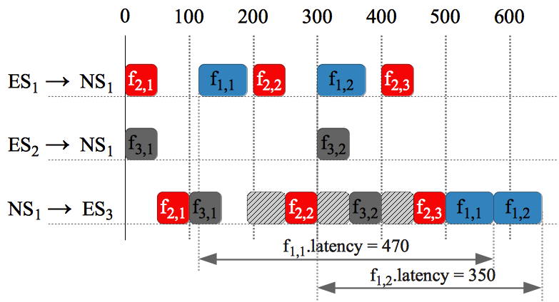
Motivational Example
Initial TT schedule
vl₁
ES₁
 | period (us) | deadline (us) | C_{i} (us) | M
f1 ∈ F^{RC} | 300 | 300 | 75 | vl₁
f2 ∈ F^{TT} | 200 | 200 | 50 | vl₂
f3 ∈ F^{TT} | 300 | 300 | 50 | vl₃
NS₁
vl₂
ES₃
ES₂
vl₃
Notes:
We show how the TT schedule influences the worst-case end-to-end delay of an RC frame.

Slide 44
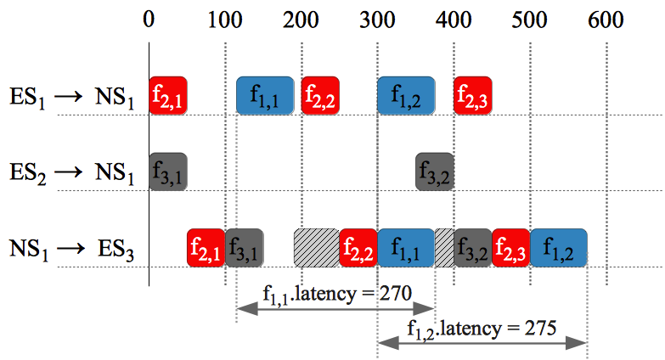
Motivational Example
Optimized TT schedule
vl₁
ES₁
 | period (us) | deadline (us) | C_{i} (us) | M
f1 ∈ F^{RC} | 300 | 300 | 75 | vl₁
f2 ∈ F^{TT} | 200 | 200 | 50 | vl₂
f3 ∈ F^{TT} | 300 | 300 | 50 | vl₃
NS₁
vl₂
ES₃
ES₂
vl₃
Notes:
f3,2 is postponed from ES2->NS1 → f1,1 can be sent earlier

Slide 45
Optimization Strategy
TTEthernet Schedule Optimization (TTESO) strategy:
  Tabu Search meta-heuristic
    The TT schedules S
    Such that:
      TT and RC frames are schedulable
      The end-to-end delay of the RC frames is minimized
Tabu Search
  Minimizes the cost function
  Explores the solution space using design transformations

Slide 46

Optimization Strategy
Degree of schedulability
  Captures the difference between the worst-case delay and deadline
Cost Function

Slide 47
Optimization Strategy: Design Transformations
TT frame moves
  advance frame transmission time
  advance frame predecessors transmission time
  postpone frame transmission time
  postpone frame successors transmission time
RC frame moves
  reserve space for RC frame
  resize reserved space for RC frame
  remove reserved space for RC frame

Slide 48
Frame Representation for Moves
ES₁
ES₃
NS₁
NS₂
ES₂
ES₄
vl₁
[NS₁, NS₂]
f_{1,1}
[ES₁, NS₁]
[NS₁, NS₂]
f_{1,1}
f_{1,1}
[NS₁, NS₂]
f_{1,1}

Slide 49
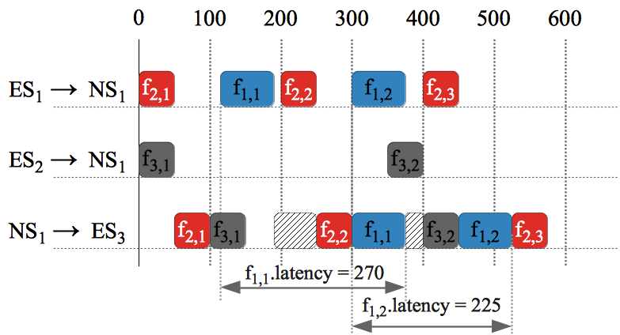
Design transformations: Postpone move

Slide 50
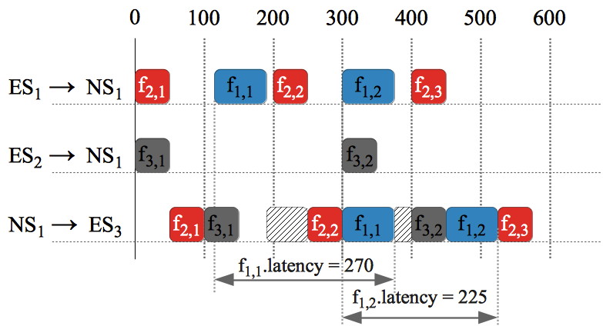
Design transformations: Advance move

Slide 51
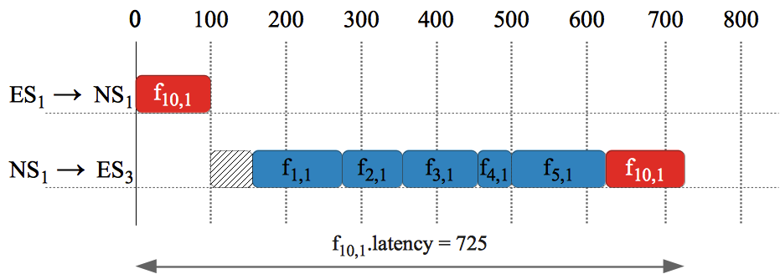
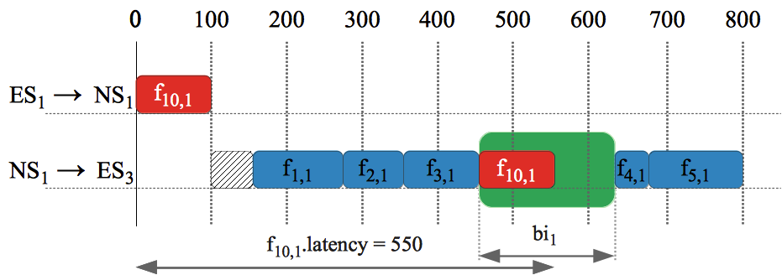
Design transformations: Reserve space for RC

Slide 52
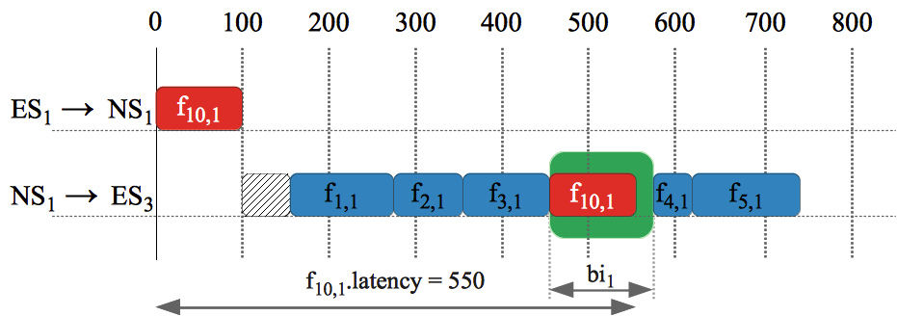
Design transformations: Resize RC reserved space

Slide 53
RC Frame End-to-End Analysis
On a dataflow link, a RC frame can be delayed by:
  scheduled TT frames
  queued RC frames
  technical latency
  policy specific:
    timely block
    pre-emption

Slide 54

RC Frame End-to-End Analysis
0
100
200
300
400
500
600
ES₁ → NS₁
f_{2,1}
f_{1,i}
NS₂ → NS₁
f_{3,j}
NS₃ → NS₁
f_{4,1}
NS₁ → ES₄
f_{2,1}
f_{4,1}
f_{3,j}
f_{1,i}
C
[NS₁, ES₄]
f₁
Q^{TL}
Q^{TT}
Q^{RC}
NS₁
[NS₁, ES₄]
[NS₁, ES₄]
R
vl₂
f₁
ES₁
vl₁
NS₁
ES₄
NS₂
vl₃
vl₄
NS₃

Slide 55
RC Frame End-to-End Analysis
Approaches for analysis of ARINC 644p7 network traffic:
  Network Calculus, (Boyer, 2008)
  Finite State Machine, (Saha, 2007)
  Timed Automata, (Adnan, 2010)
  Trajectory Approach, (Bauer, 2009)
We use the method proposed in (Steiner, 2011)
    it takes into account also the TT traffic
    it is pessimistic:
      does not ignore frames that already delayed a RC frame
      on a previous link
      assumes uniformly distributed intervals of equal length
      reserved for RC traffic

Slide 56
Experimental Results
Benchmarks
  17 synthetic
  1 real life test cases based on the SAE Automotive benchmark
TTESO compared to:
  Straightforward Solution (SS)
    Builds TT schedules with the goal of minimizing the end-to-end delay of TT frames, without considering the RC frames

Slide 57
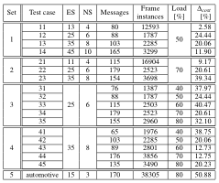
Experimental Results

Slide 58
Experimental Results

Slide 59
Experimental Results

Slide 60
Experimental Results

Slide 61
Experimental Results

Slide 62
Conclusions
TTEthernet is very well suited for mixed-criticality applications
  Predictability is achieved using three classes of traffic: TT, RC and BE
  Spatial separation is achieved trough virtual links
  Temporal separation is enforced by schedule tables for TT traffic and bandwidth allocation for RC traffic
We have addressed the optimization of the TTEthernet protocol
  The TT schedules are determined such that TT and RC frames are schedulable, and the end-to-end delay of the RC frames is minimized
Optimization tools are needed to support the designer in order to obtain schedulable solutions
  We have proposed a Tabu Search-based optimization solution
Notes:
To make more concise!

