Slide 1

Analysis and Optimization of
Mixed-Criticality Applications on
Partitioned Distributed Architectures
Domițian Tămaș-Selicean, Sorin Ovidiu Marinescu and Paul Pop
Technical University of Denmark

Slide 2
Outline
Motivation
Separation of mixed-criticality applications
  At processing element level
  At communication level
Problem formulation and example
Optimization strategy
Experimental results
Conclusions

Slide 3
Motivation
Safety is the property of a system that will not endanger human life or the environment
A safety-related system needs to be certified
A Safety Integrity Level (SIL) is assigned to each safety related function, depending on the required level of risk reduction
There are 4 SILs:
  SIL4 (most critical)
  SIL1 (least critical)
  SIL0 (non-critical) – not covered by standards
SILs dictate the development process and certification procedures

Slide 4
Motivation
Real time applications implemented using distributed systems
Mixed-criticality applications share the same architecture
Federated Architecture
Integrated Architecture
SIL4
SIL1
SIL3
SIL3
SIL2
SIL4
SIL4
SIL1
PE
Application A ₁
Application A ₂
Application A ₃
Solution: partitioned architecture

Slide 5
Separation at PE-level
Partition = virtual dedicated machine
Partitioned architecture
  Spatial partitioning
    protects one application’s memory and access to resources from another application
  Temporal partitioning
    partitions the CPU time among applications

Slide 6
Separation at PE-level
PE 1
PE 2
PE 1
PE 2
PE 3
Partition
Partition
slice
Major Frame
Temporal partitioning
  Static partition table
    Repeated with a period MF
    Partition switch overhead
    Each partition can have its own scheduling policy
    A partition has a certain SIL
Problem: optimize task mapping
and allocation of partitions
PE 3

Slide 7
Separation at Network-level
ES₁
ES₃
NS₁
NS₂
ES₂
ES₄
Network Switch
End System
Full-Duplex Ethernet-based data network for safety-critical applications
Compliant with ARINC 664p7 “Aircraft Data Network”
Notes:
ARINC 664 p7 specifies a full-duplex Ethernet network for aircraft data networks.
It is composed of End – Systems connected by Network Switches and physical connections.

Slide 8
Separation at Network-level
ES₁
ES₃
τ₁
vl₂
τ₂
τ₅
NS₁
NS₂
ES₂
ES₄
vl₁
τ₄
virtual link
τ₃
Highly critical application A ₁: τ₁, τ₂ and τ₃
  τ₁ sends message m₁ to τ₂ and τ₃
Non-critical application A ₂: τ₄ and τ₅
  τ₄ sends message m₂ to τ₅
Notes:
The Ethernet protocol does not offer separation between messages of different criticalities. ARINC 664p7 manages this through the concept of Virtual Links, by emulating point-to-point connectivity over the network. The virtual link is defined as the “logical unidirectional connection from one source system to one or more destination end systems”.
By using virtual links, the highly critical message m1 is separated from the non-critical message m2.
Let’s assume we have 2 applications

Slide 9
Separation at Network-level
ES₁
dataflow link
ES₃
τ₁
dp₁
τ₂
τ₅
l₁
l₃
NS₁
l₂
NS₂
l₄
ES₂
dp₂
ES₄
vl₁
τ₄
τ₃
dataflow path
Highly critical application A ₁: τ₁, τ₂ and τ₃
  τ₁ sends message m₁ to τ₂ and τ₃
Non-critical application A ₂: τ₄ and τ₅
  τ₄ sends message m₂ to τ₅

Slide 10
TTEthernet
Traffic classes
  Time Triggered (TT)
    based on static schedule tables
  Rate Constrained (RC)
    deterministic unsynchronized communication
    ARINC 664p7 traffic
  Best Effort (BE)
    no timing guarantees provided

Slide 11
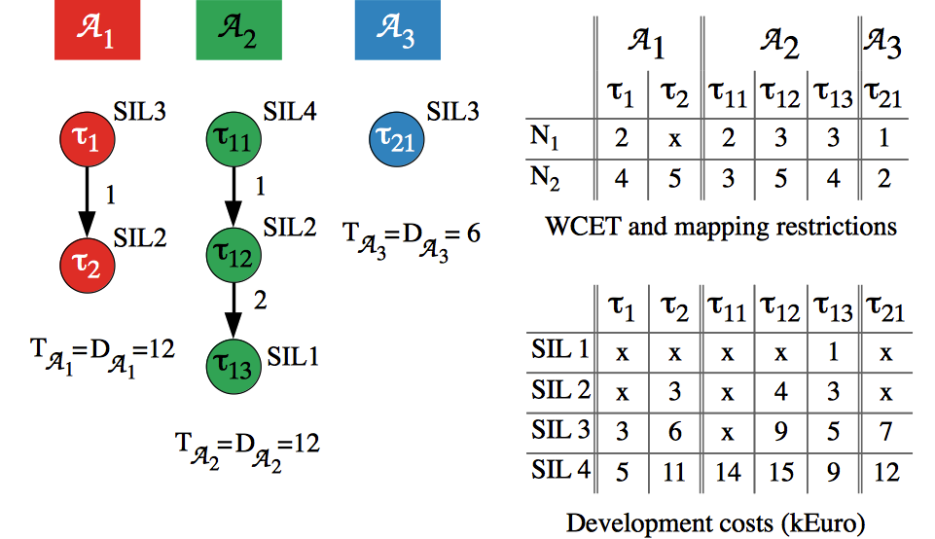
Application Model
SCS apps transmit TT messages
FPS apps transmit RC messages

Slide 12
Problem formulation
Given
    A set of applications
    The criticality level (or SIL) of each task
    A set of N processing elements (PEs) and topology of the network
    The set of TT and RC frames
    The set of virtual links
    The size of the Major Frame and of the Application Cycle
Determine
    The mapping of tasks to PEs
    The sequence and length of partition slices on each processor
    The assignment of tasks to partitions
    The schedule for all the tasks and TT frames in the system
Such that
    All applications meet their deadline
    The response times of the FPS tasks and RC frames is minimized

Slide 13
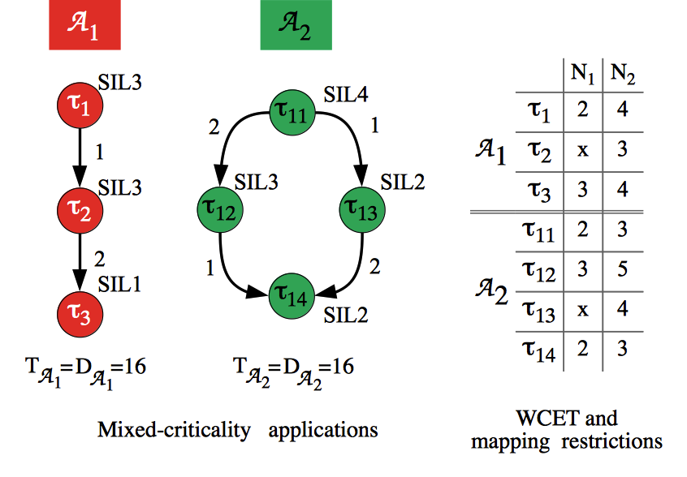
Motivational Example 1
Mapping and partitioning optimization
Notes:
Use the motivational example from Journal!

Slide 14
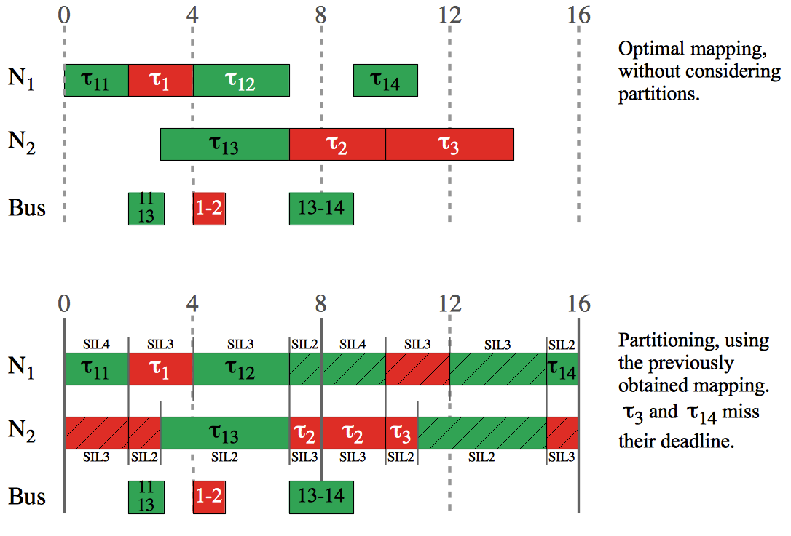
Motivational Example 1

Slide 15
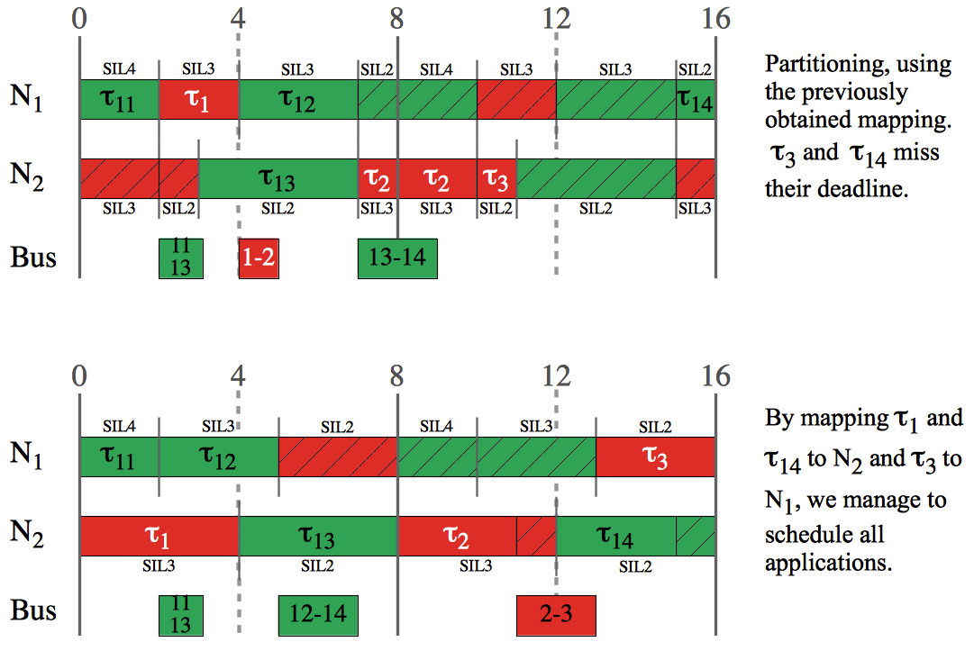
Motivational Example 1

Slide 16
Motivational Example 2
Optimization of TT message schedules
vl₁
ES₁
NS₁
vl₂
ES₃
ES₂
vl₃
 | period (us) | deadline (us) | C_{i} (us) | M
f1 ∈ F^{RC} | 300 | 300 | 75 | vl₁
f2 ∈ F^{TT} | 200 | 200 | 50 | vl₂
f3 ∈ F^{TT} | 300 | 300 | 50 | vl₃

Slide 17
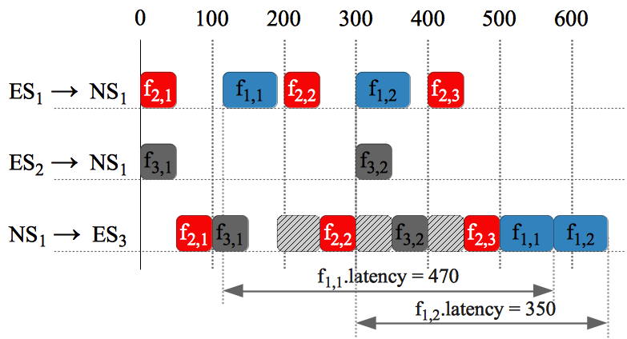
Motivational Example 2
Initial TT schedule
vl₁
ES₁
 | period (us) | deadline (us) | C_{i} (us) | M
f1 ∈ F^{RC} | 300 | 300 | 75 | vl₁
f2 ∈ F^{TT} | 200 | 200 | 50 | vl₂
f3 ∈ F^{TT} | 300 | 300 | 50 | vl₃
NS₁
vl₂
ES₃
ES₂
vl₃
Notes:
We show how the TT schedule influences the worst-case end-to-end delay of an RC frame.

Slide 18
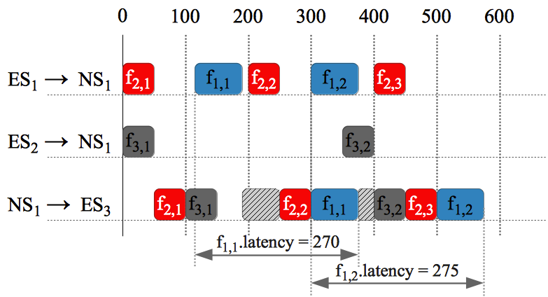
Motivational Example 2
Optimized TT schedule
vl₁
ES₁
 | period (us) | deadline (us) | C_{i} (us) | M
f1 ∈ F^{RC} | 300 | 300 | 75 | vl₁
f2 ∈ F^{TT} | 200 | 200 | 50 | vl₂
f3 ∈ F^{TT} | 300 | 300 | 50 | vl₃
NS₁
vl₂
ES₃
ES₂
vl₃
Notes:
f3,2 is postponed from ES2->NS1 → f1,1 can be sent earlier

Slide 19
Optimization Strategy
Tabu Search meta-heuristic
  Task mapping and partition slice optimization (TO)
    Considering TT frame schedules fixed
  TT frame schedules optimization (TM)
    Considering the task mapping and partition slices fixed
Tabu Search
  Minimizes the cost function
  Explores the solution space using design transformations

Slide 20
Optimization Strategy
Degree of schedulability
  Captures the difference between the worst-case response time and the deadline
Cost Function

Slide 21
Optimization Strategy: Design Transformations
Partition slice moves
  resize partition slice
  swap two partition slices
  join two partition slices
  split partition slice into two
Task moves
  re-assign task to another partition

Slide 22
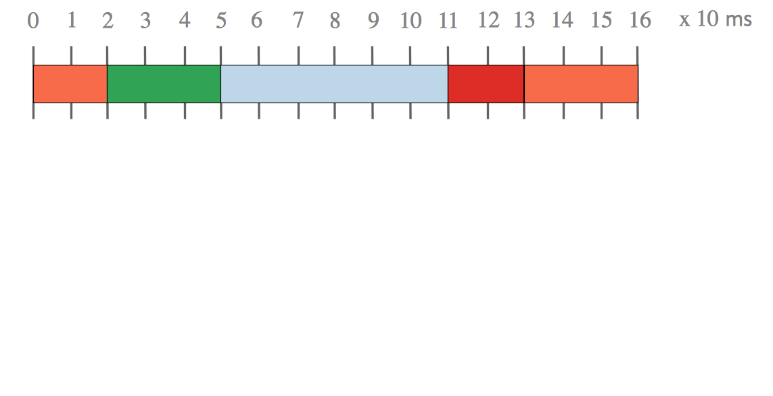
Optimization Strategy: Design Transformations

Slide 23
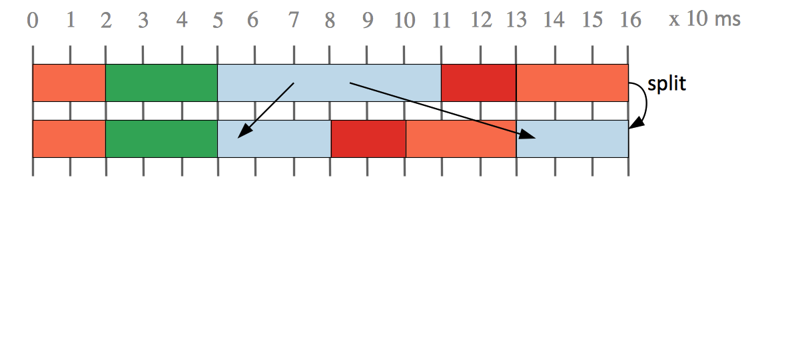
Optimization Strategy: Design Transformations

Slide 24
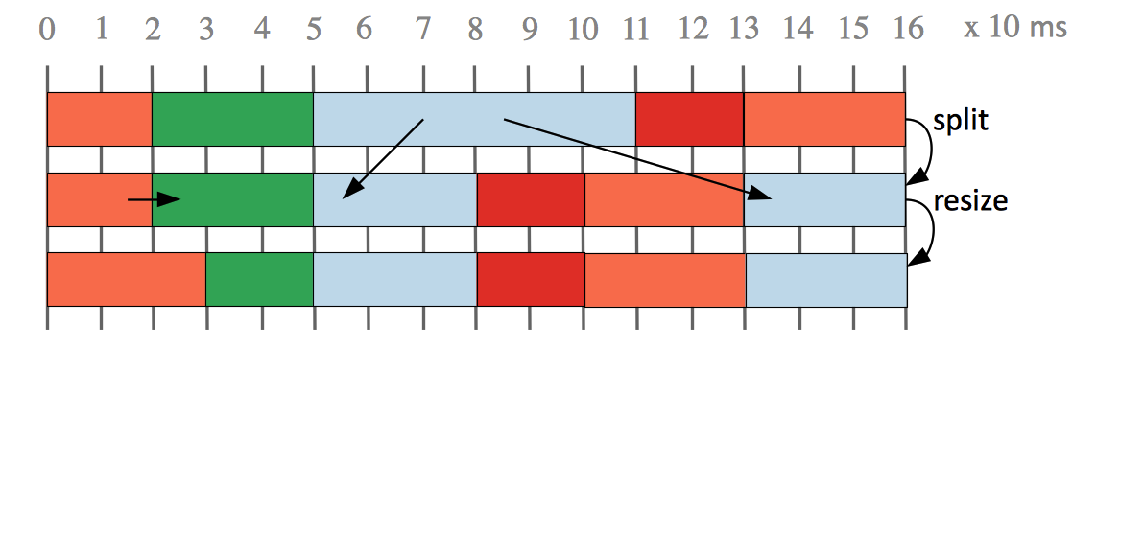
Optimization Strategy: Design Transformations

Slide 25
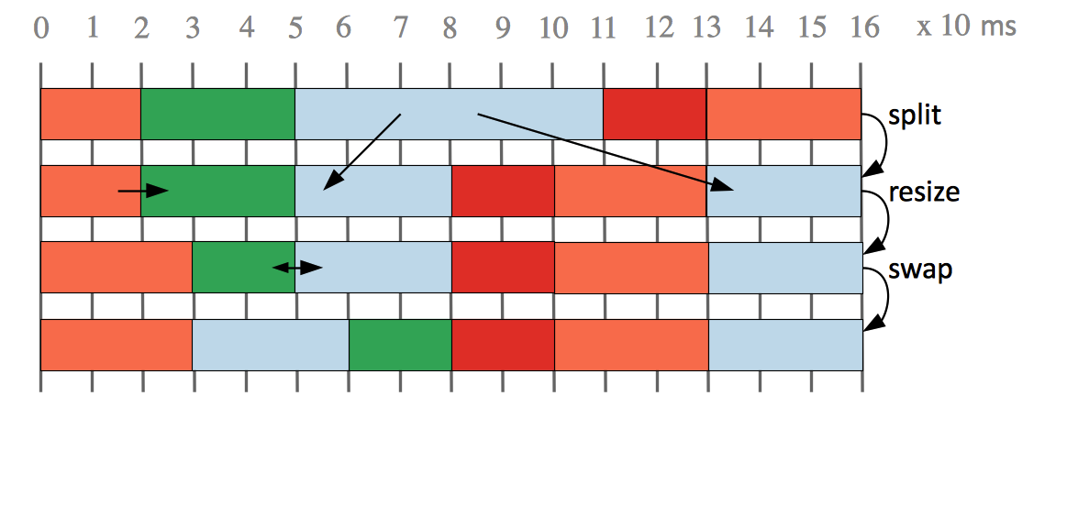
Optimization Strategy: Design Transformations

Slide 26
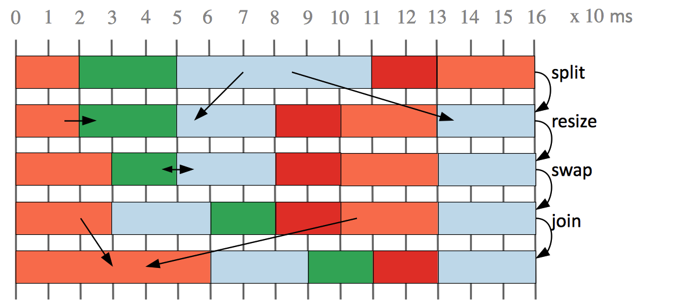
Optimization Strategy: Design Transformations

Slide 27
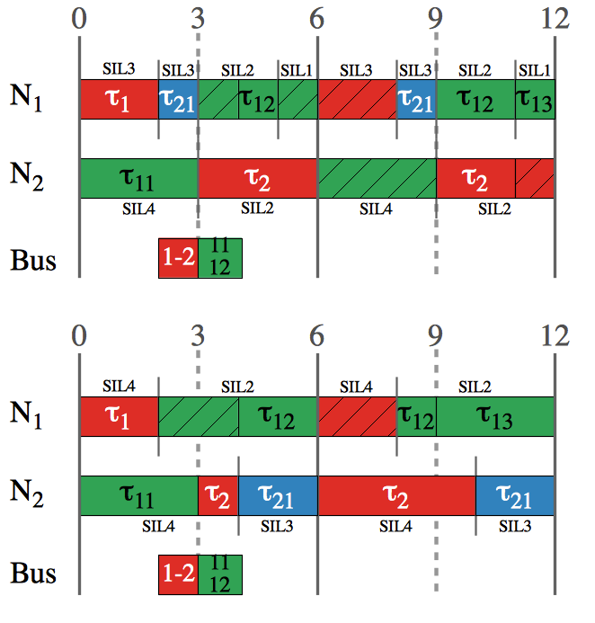
Optimization Strategy: Design Transformation
Task re-assignment move
  To another partition of the same application
  To a partition of another application
  To a newly created partition
  Empty partitions are deleted

Slide 28
Optimization Strategy: Design Transformations
TT frame moves
  advance frame transmission time
  advance frame predecessors transmission time
  postpone frame transmission time
  postpone frame successors transmission time
RC frame moves
  reserve space for RC frame
  resize reserved space for RC frame
  remove reserved space for RC frame

Slide 29
Frame Representation for Moves
ES₁
ES₃
NS₁
NS₂
ES₂
ES₄
vl₁
[NS₁, NS₂]
f_{1,1}
[ES₁, NS₁]
[NS₁, NS₂]
f_{1,1}
f_{1,1}
[NS₁, NS₂]
f_{1,1}

Slide 30
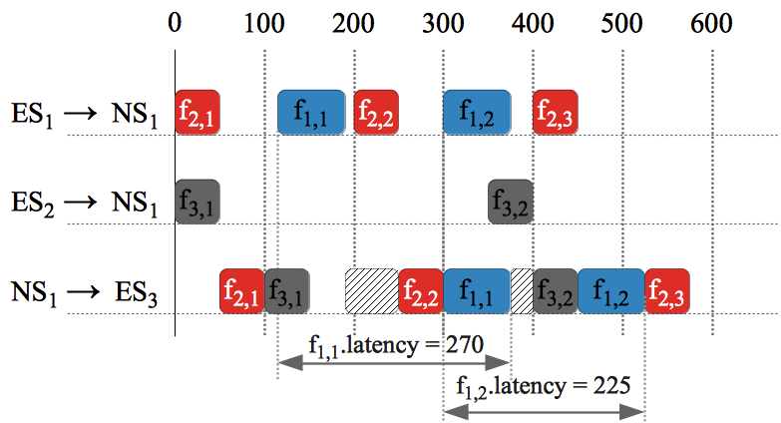
Design transformations: Postpone move

Slide 31
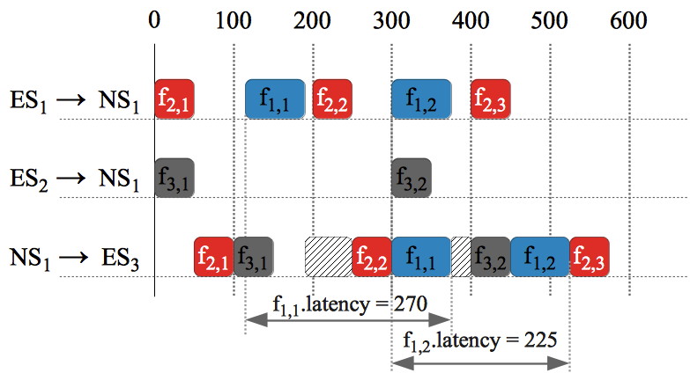
Design transformations: Advance move

Slide 32
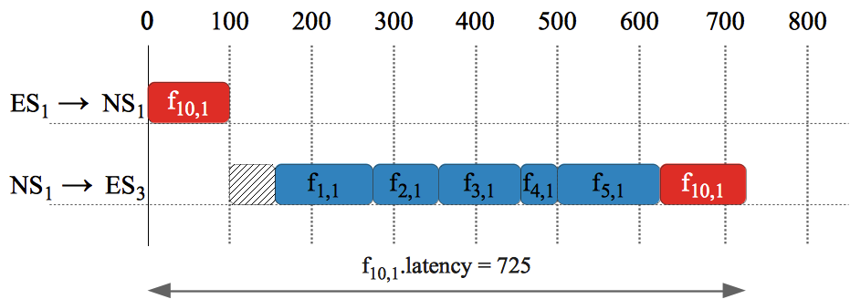
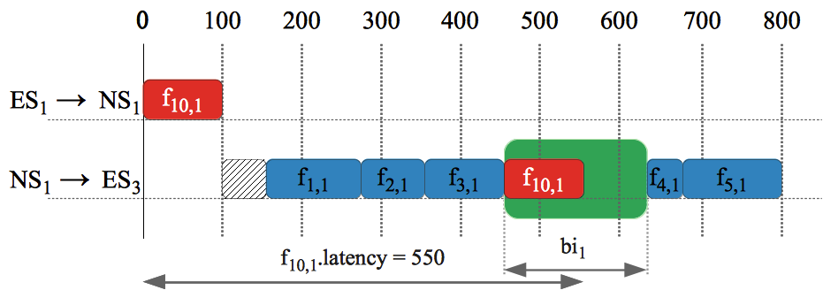
Design transformations: Reserve space for RC

Slide 33
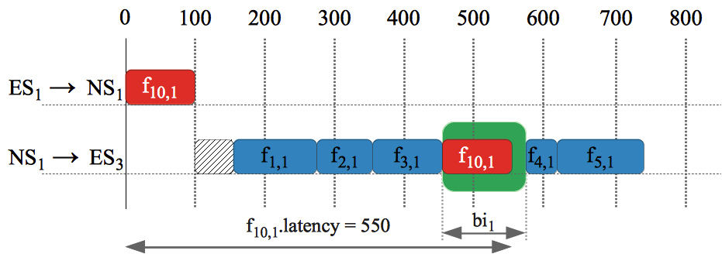
Design transformations: Resize RC reserved space

Slide 34
RC Frame End-to-End Analysis
On a dataflow link, a RC frame can be delayed by:
  scheduled TT frames
  queued RC frames
  technical latency
  policy specific:
    timely block
    pre-emption

Slide 35
RC Frame End-to-End Analysis
0
100
200
300
400
500
600
ES₁ → NS₁
f_{2,1}
f_{1,i}
NS₂ → NS₁
f_{3,j}
NS₃ → NS₁
f_{4,1}
NS₁ → ES₄
f_{2,1}
f_{4,1}
f_{3,j}
f_{1,i}
C
[NS₁, ES₄]
f₁
Q^{TL}
Q^{TT}
Q^{RC}
NS₁
[NS₁, ES₄]
[NS₁, ES₄]
R
vl₂
f₁
ES₁
vl₁
NS₁
ES₄
NS₂
vl₃
vl₄
NS₃

Slide 36
RC Frame End-to-End Analysis
Approaches for analysis of ARINC 644p7 network traffic:
  Network Calculus, (Boyer, 2008)
  Finite State Machine, (Saha, 2007)
  Timed Automata, (Adnan, 2010)
  Trajectory Approach, (Bauer, 2009)
We use the method proposed in (Steiner, 2011)
    it takes into account also the TT traffic
    it is pessimistic:
      does not ignore frames that already delayed a RC frame
      on a previous link
      assumes uniformly distributed intervals of equal length
      reserved for RC traffic

Slide 37
Experimental Results: TO
Benchmarks
  5 synthetic
  2 real life test cases from E3S
TO compared to:
  Straightforward Solution for Tasks (SST)
    Simple partitioning scheme, each application A_{i} is allocated a total time proportional to the utilization of tasks of A_{i} on the processor they are mapped to

Slide 38
Experimental Results: TO

Slide 39
Experimental Results: TO

Slide 40
Experimental Results: TM
Benchmarks
  7 synthetic
  1 real life test case based on the SAE Automotive benchmark
TM compared to:
  Straightforward Solution for Messages (SSM)
    Builds TT schedules with the goal to optimize the end-to-end response time of the TT frames without considering the RC traffic

Slide 41
Experimental Results: TM

Slide 42
Experimental Results: TM

Slide 43
Experimental Results: TM

Slide 44
Conclusions
Applications of different criticality levels can be integrated onto the same architecture only if there is enough separation:
  Separation at PE-level achieved with IMA.
  Separation at network-level using TTEthernet.
We proposed a Tabu Search based optimization of task mapping and allocation to partitions, and of time partitions.
Only by optimizing the implementation of the applications, taking into account the particularities of IMA and TTEthernet, are we able to support the designer in obtaining schedulable implementations.
Notes:
To make more concise!

