Slide 1
Design Optimization of Mixed-Criticality Real-Time Applications on Cost-Constrained Partitioned Architectures
Domițian Tămaș-Selicean and Paul Pop
Technical University of Denmark

Slide 2
Outline
Motivation
System and application models
Problem formulation and example
Optimization strategy
Experimental results
Conclusions

Slide 3
Motivation
Safety is the property of a system that will not endanger human life or the environment
A safety-related system needs to be certified
A Safety Integrity Level (SIL) is assigned to each safety related function, depending on the required level of risk reduction
There are 4 SILs:
  SIL4 (most critical)
  SIL1 (least critical)
  SIL0 (non-critical) – not covered by standards
SILs dictate the development process and certification procedures

Slide 4
Motivation
Real time applications implemented using distributed systems
Mixed-criticality applications share the same architecture
Federated Architecture
Integrated Architecture
SIL4
SIL1
SIL3
SIL3
SIL2
SIL4
SIL4
SIL1
PE
Application A ₁
Application A ₂
Application A ₃
Solution: partitioned architecture

Slide 5
System Model
Partition = virtual dedicated machine
Partitioned architecture
  Spatial partitioning
    protects one application’s memory and access to resources from another application
  Temporal partitioning
    partitions the CPU time among applications

Slide 6
System Model
PE 1
PE 2
PE 1
PE 2
PE 3
Partition
Partition
slice
Major Frame
Temporal partitioning
  Static partition table
    Repeated with a period MF
    Partition switch overhead
    Each partition can have its own scheduling policy
    A partition has a certain SIL
Problem: optimize task mapping
and allocation of partitions
PE 3

Slide 7
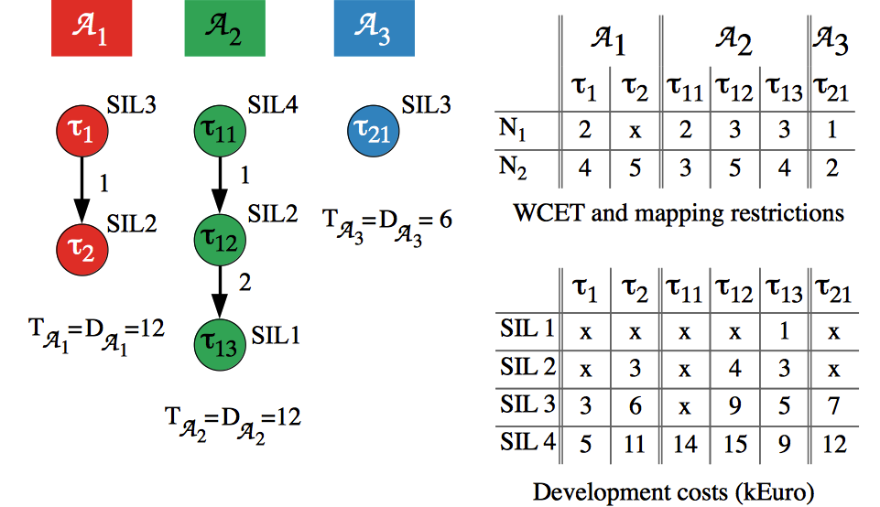
Application Model
Static Cyclic Scheduling

Slide 8
Application Model
Partition sharing
  Tasks from different apps can share a partition if they have the same SIL
  Elevation: increase the SIL of a task to allow partition sharing
Constraints
  No sharing allowed: captured by a “separation requirements” graph
  A task can receive input only from another task with the same or higher SIL
  No communication between applications of different SILs

Slide 9
Problem formulation
Given
    A set of applications
    The criticality level (or SIL) for each task
    The separation requirements between tasks
    A set of N processing elements (PEs)
    The size of the Major Frame and of the Application Cycle
Determine
    The mapping of tasks to PEs
    The sequence and length of partition slices on each processor
    The assignment of tasks to partitions
    The schedule for all the tasks in the system
Such that
    All applications meet their deadline
    The development costs are minimized

Slide 10
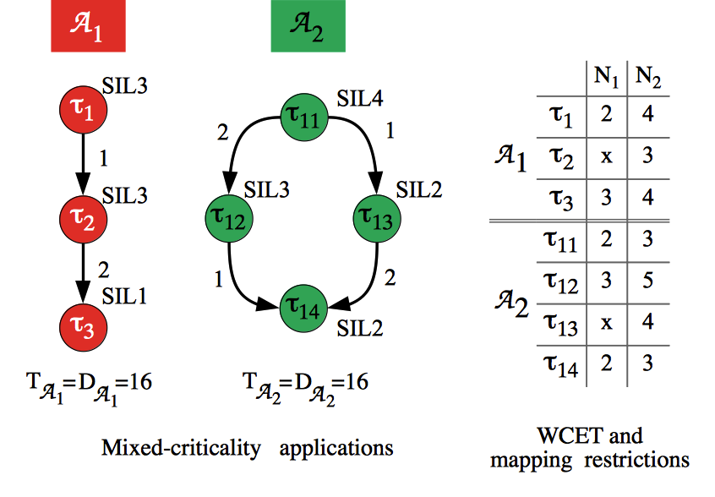
Motivational Example 1
Partition aware mapping optimization
Notes:
Use the motivational example from Journal!

Slide 11
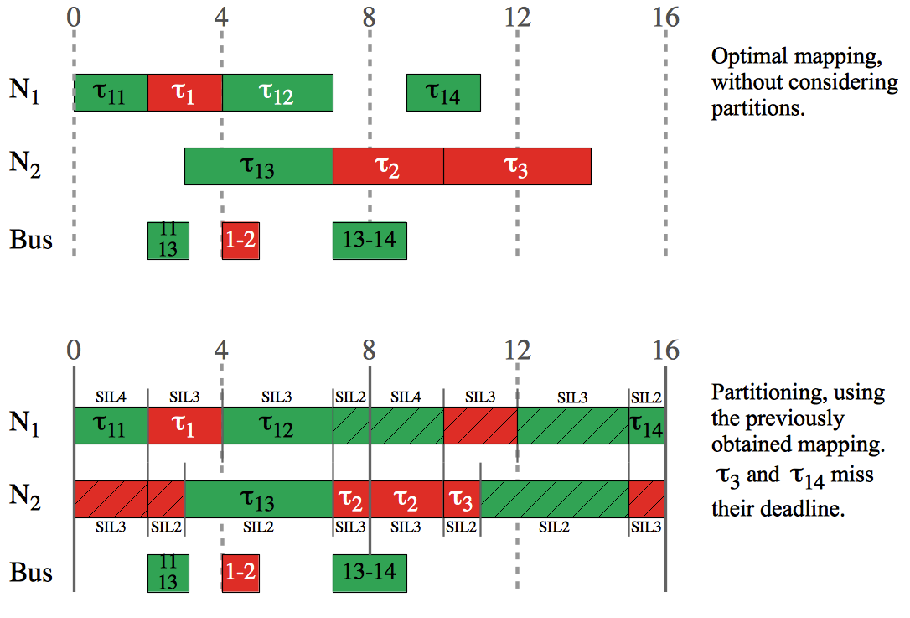
Motivational Example 1

Slide 12
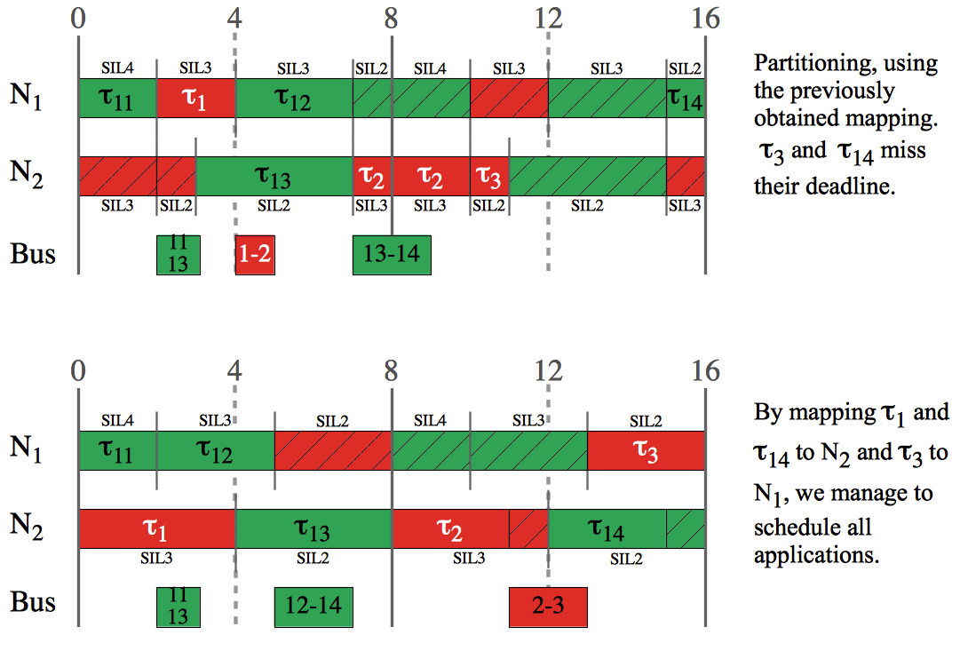
Motivational Example 1

Slide 13
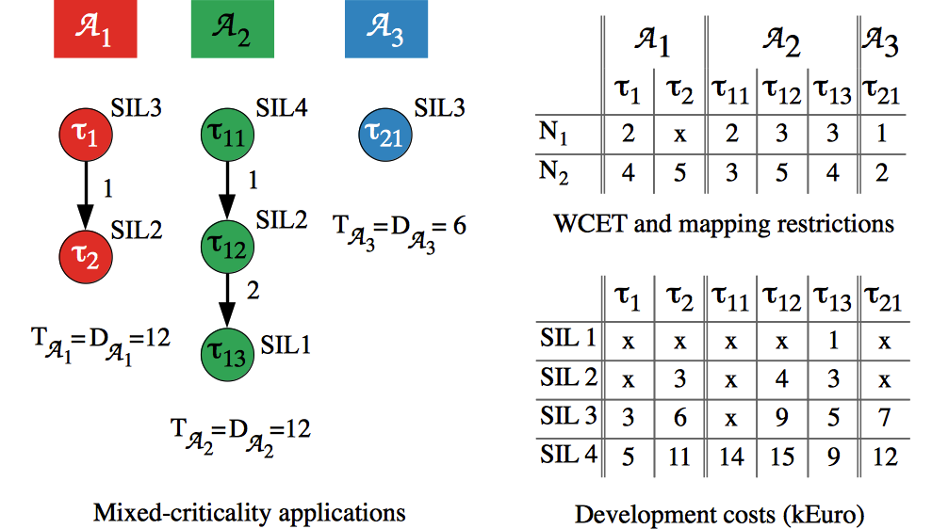
Motivational Example 2
Partition sharing optimization
Notes:
Use the motivational example from Journal!

Slide 14
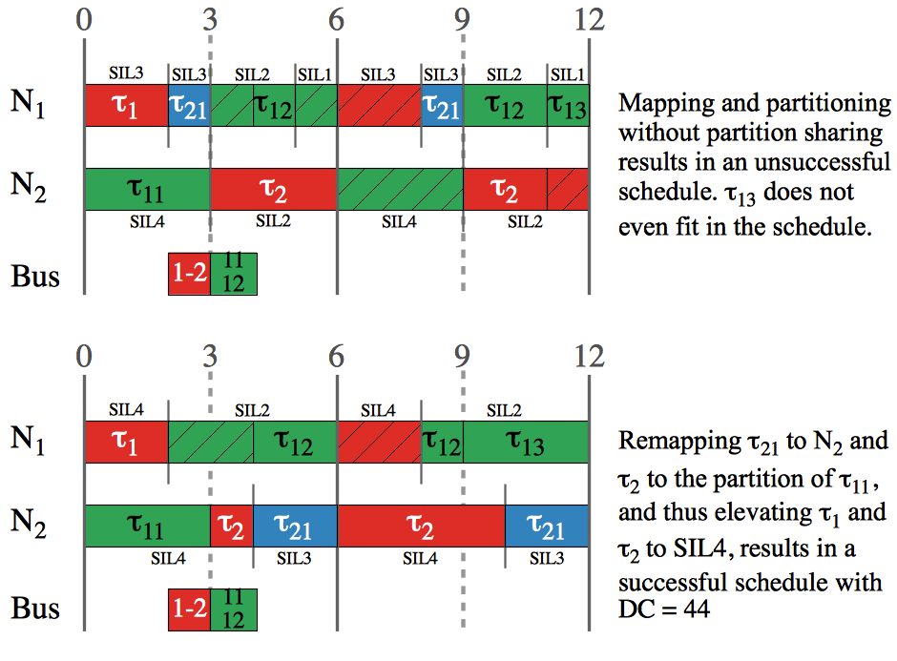
Motivational Example

Slide 15
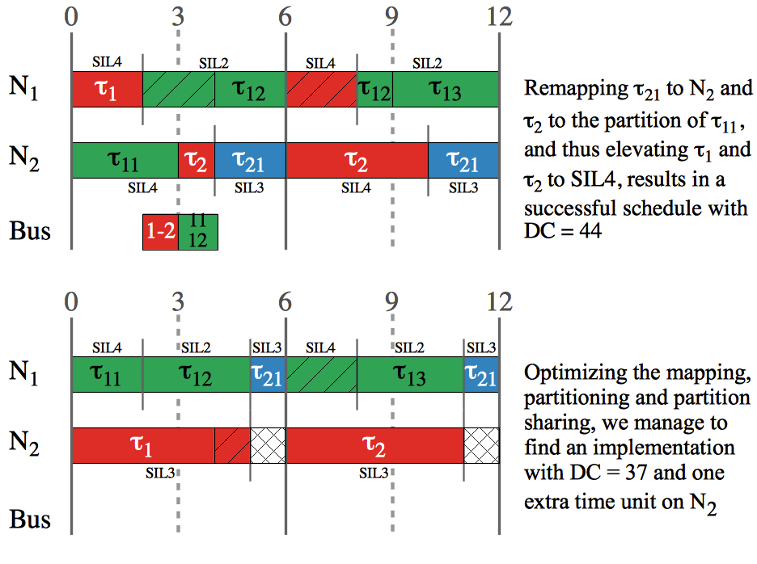
Motivational Example

Slide 16
Optimization Strategy
Mixed-Criticality Design Optimization (MCDO) strategy:
  Tabu Search meta-heuristic
    The mapping of tasks to processors
    The sequence and length of partition slices on each PE
    The assignment of tasks to partitions
  List scheduling
    The schedule for the applications
Tabu Search
  Minimizes the cost function
  Explores the solution space using design transformations

Slide 17

Optimization Strategy
Degree of schedulability
  Captures the difference between the worst-case response time and the deadline
Cost Function

Slide 18
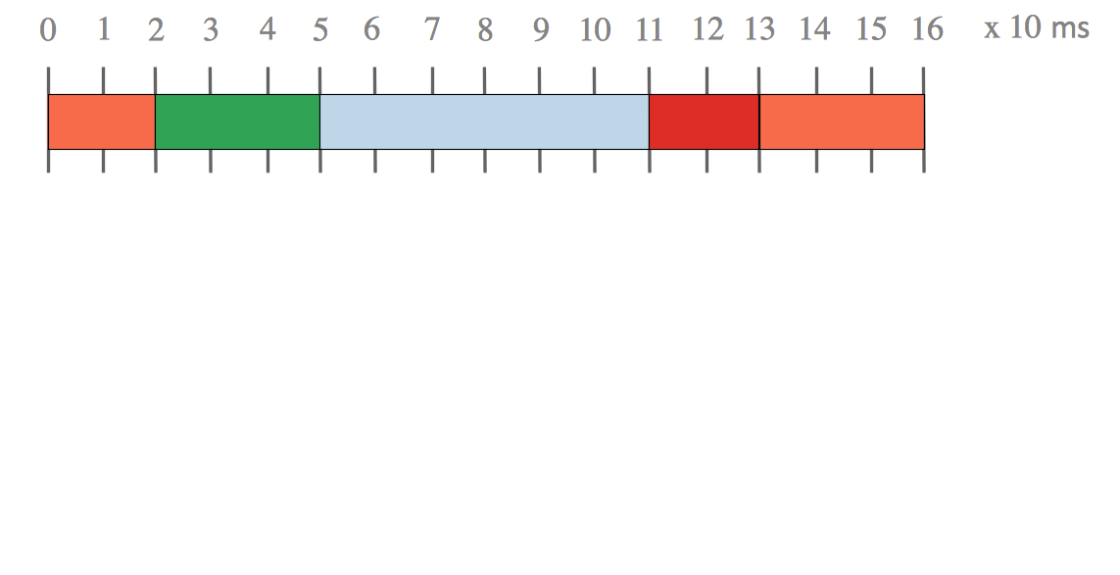
Optimization Strategy: Design Transformations

Slide 19
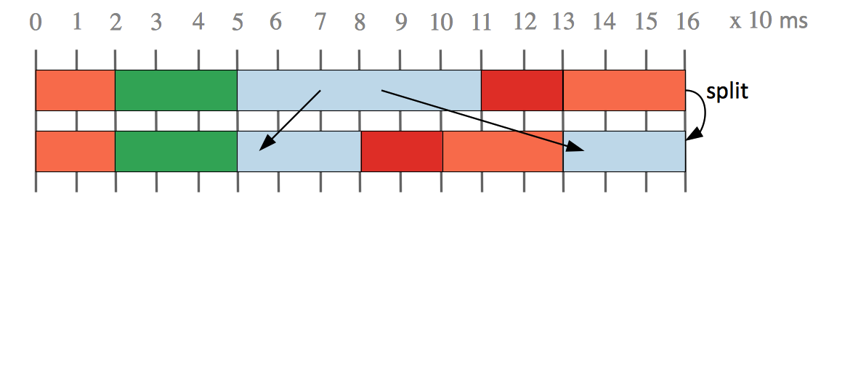
Optimization Strategy: Design Transformations

Slide 20
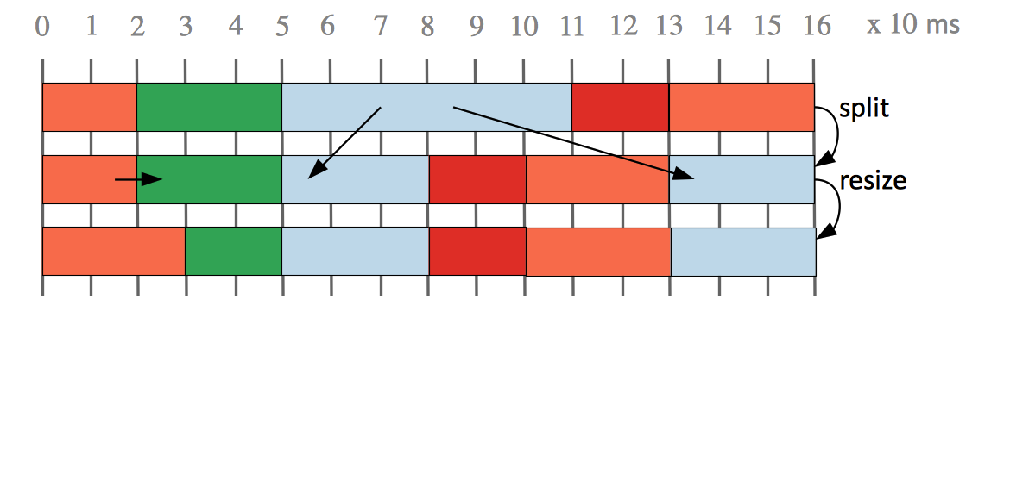
Optimization Strategy: Design Transformations

Slide 21
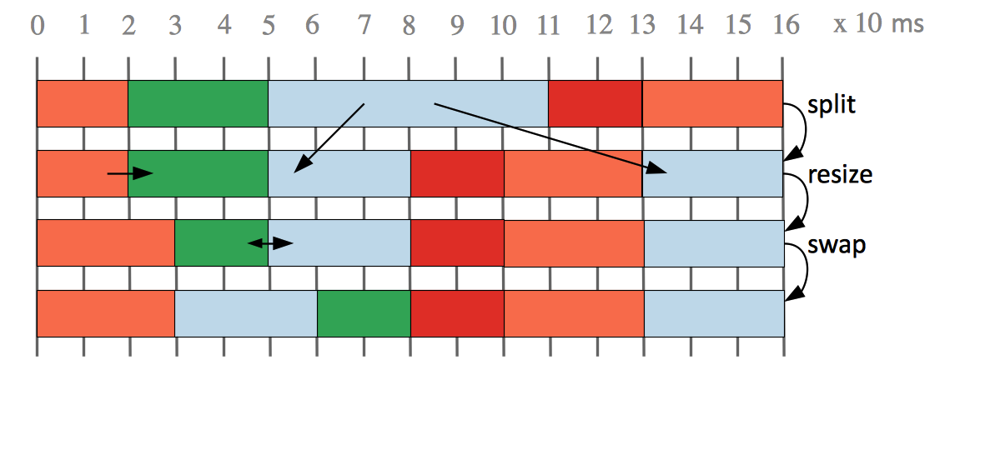
Optimization Strategy: Design Transformations

Slide 22
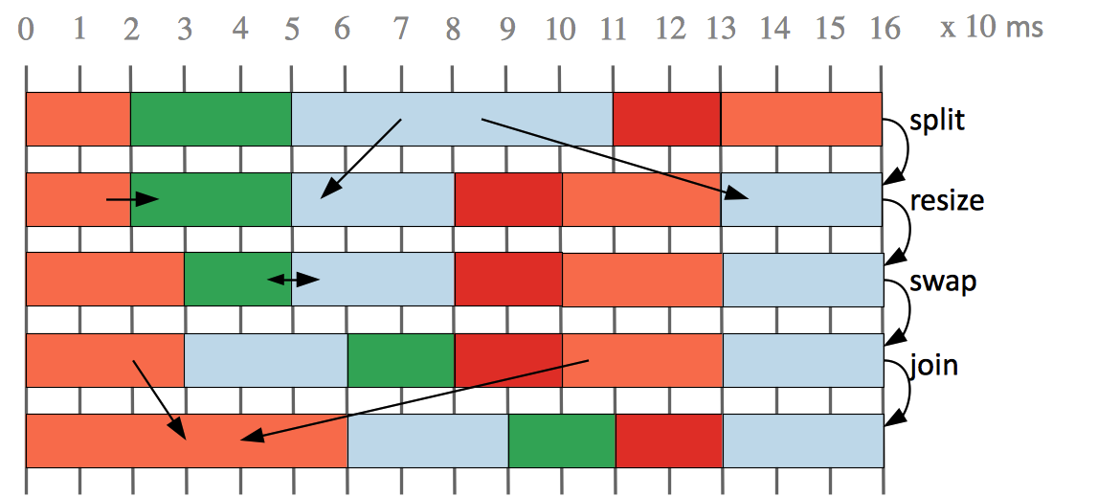
Optimization Strategy: Design Transformations

Slide 23
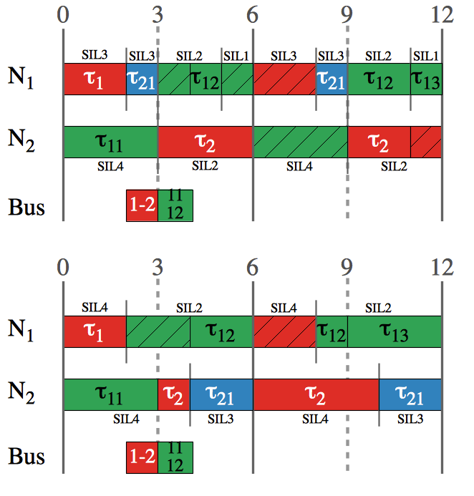
Optimization Strategy: Design Transformation
Task re-assignment move
  To another partition of the same application
  To a partition of another application
  To a newly created partition
  The partition the task was assigned to, before the move, has no other tasks assigned => it is deleted

Slide 24
Experimental Results
Benchmarks
  7 synthetic
  3 real life test cases from E3S
MCDO compared to:
  MO+PO
    Optimization where first we do a mapping optimization, without considering partitioning (MO), and then we perform a partitioning optimization, considering the mapping obtained previously as fixed (PO)
  MPO
    Mapping and partitioning optimization is done at the same time, but without considering partition sharing.
  Cost function

Slide 25


Experimental Results

Slide 26
Conclusions
Partitioning may lead to unused slack in the schedule.
There are situations when finding schedulable implementations on cost-constrained architectures is only possible if the allow tasks of different SILs to share a partition.
We proposed a Tabu Search based optimization of task mapping and allocation to partitions, and of time partitions.
Notes:
To make more concise!

