Slide 1
System-Level Modeling and Synthesis Techniques for Flow-Based Microfluidic Very Large Scale Integration Biochips
Wajid Hassan Minhass
Technical University of Denmark

Slide 2
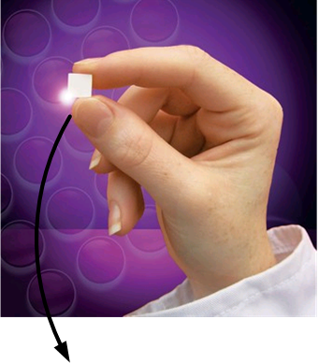
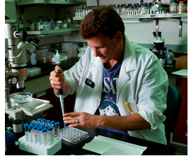
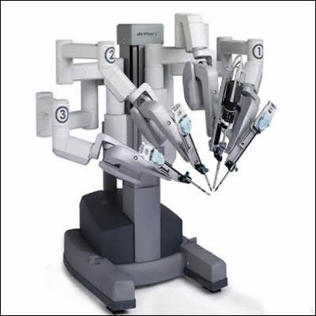
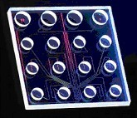
Motivation for biochips

Slide 3

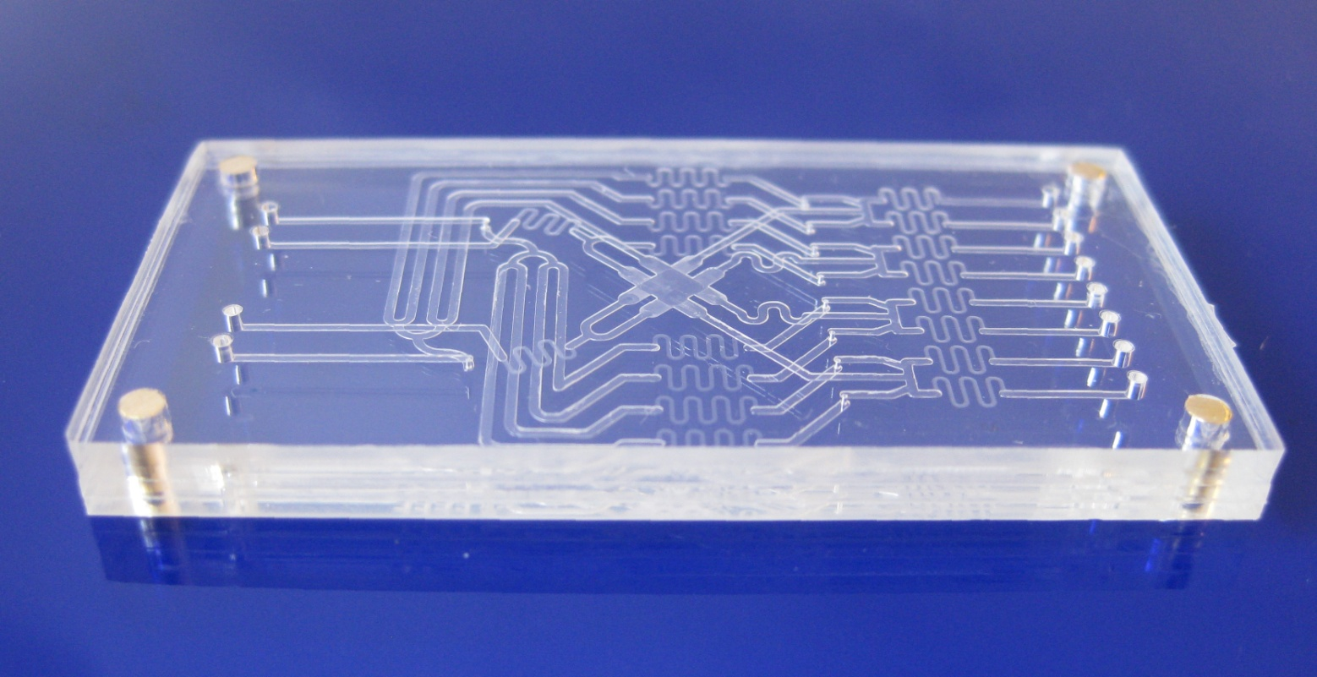
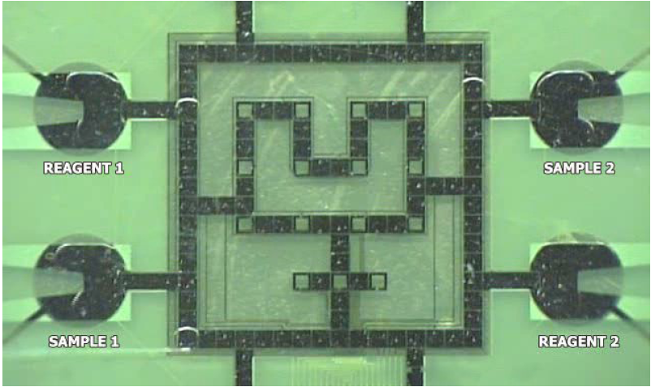
Microfluidic biochips
Flow-based biochips
Manipulation of continuous liquid through permanently-etched micro-channels
Digital biochips
Manipulation of discrete droplets on an array of electrodes
10 mm
Switches
10 mm
Channels
Inlets
Chamber
Outlets
Digital biochip figure source: Duke University

Slide 4


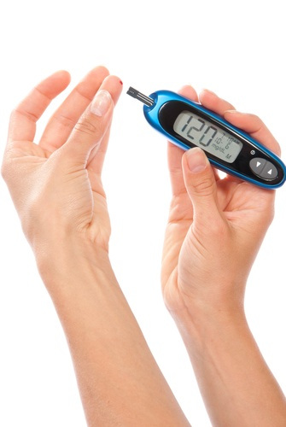
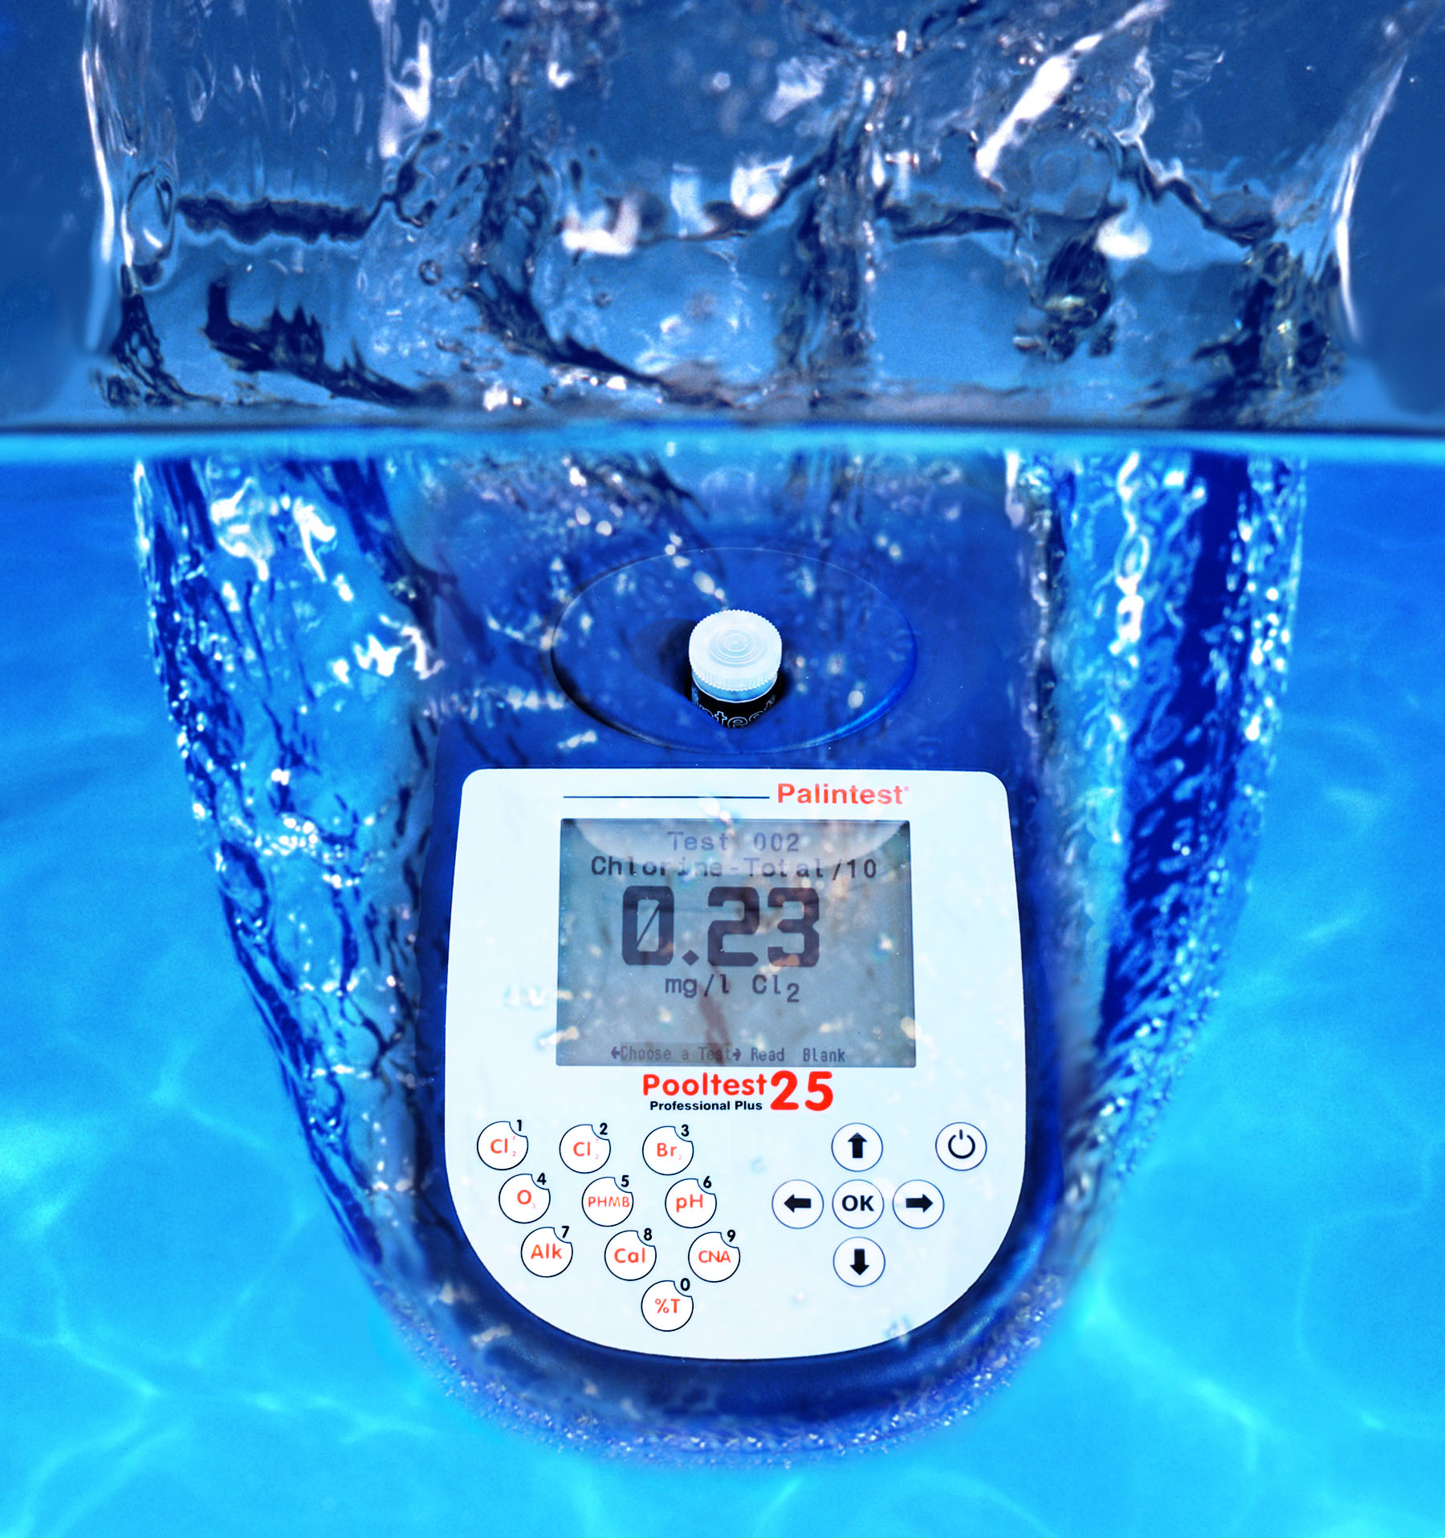
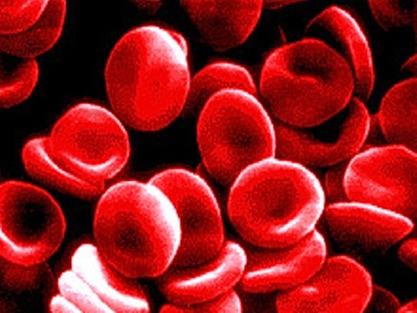
Applications
  Drug discovery
  Point-of-care devices
  Preventive individualized care
  Bio-hazard detection
  DNA sequencing

Slide 5
Advantages and challenges
  Advantages
    High throughput (multiple experiments/ chip)
    Reduced cost (reduced sample/ reagent consumption)
    Reduced size (miniaturization)
    Automation
  Challenges
    High design complexity
    Current design methodologies
      Manual: drawing in AutoCAD
      Bottom-up
      Full-custom

Slide 6
Outline
  Biochip architecture
  Motivation
  Contribution I
    System model and application mapping
  Contribution II
    Architectural synthesis
  Contribution III
    Control synthesis
  Contribution IV
    Cell culture chips – throughput maximization
  Summary and message

Slide 7
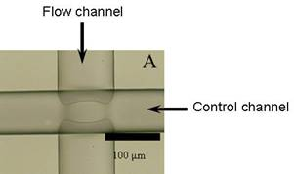
Basic building block: microfluidic valve
Technology:
  Multi-layer soft lithography
  Fabrication substrate –
  elastomers (PDMS)
    Good biocompatibility
    Optical transparency
Pressure
Source
Control Layer
Valve
v_{a}
Valve
v_{a}
Control Pin z₁
a
Flow Layer
Fluidic Input
Glass Plate
3D View
Top View

Slide 8
Components
Microfluidic switch

Slide 9
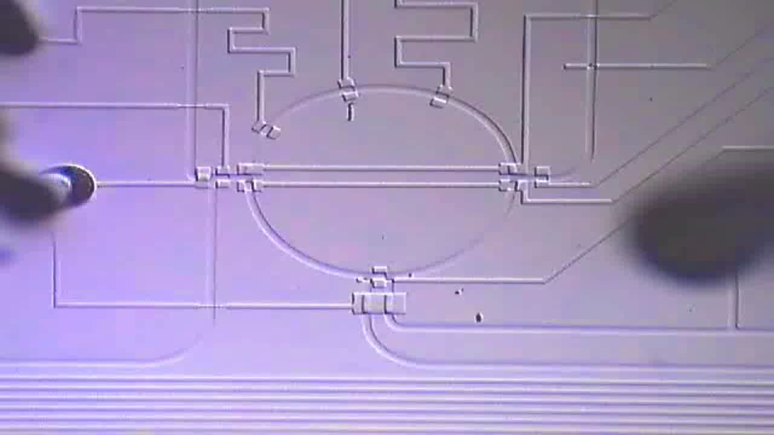
Components
Microfluidic mixer
10x real-time
http://groups.csail.mit.edu/cag/biostream

Slide 10
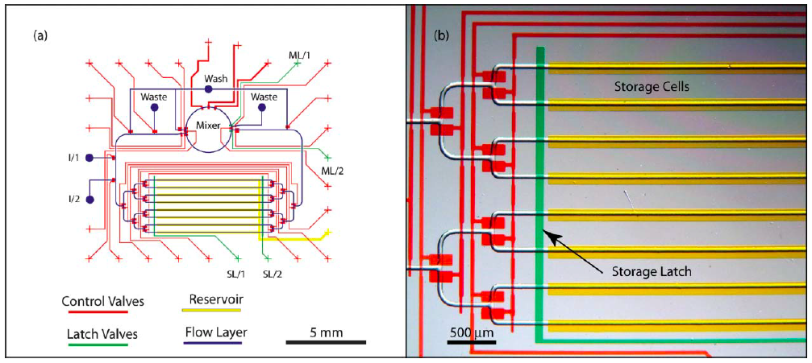
Components
  Mixer
  Detector
  Filter
  Heater
  Separator
  Storage units
[Urbanski et al., Lab-on-a-Chip 2006]

Slide 11
Biochip architecture
Schematic view
Functional view

Slide 12
Motivation
Microfluidic VLSI, or mVLSI
  Term introduced by Quake Group,
  Stanford
  Valve size: 6 × 6 µm²
    possible to have 1 million valves/ cm²
  Increasing design complexity
  (commercial chip with 25,000 valves
  performing 9,216 PCRs in parallel)
Current design methodologies
  Manual
  Tedious and error-prone
  Do not scale
  New top-down design and synthesis
  methodologies are needed

Slide 13
Design tasks: VLSI vs mVLSI
VLSI
mVLSI
System Specifications
System Specifications
Architectural Design
Schematic Design
Functional Design
Physical Design
(Flow Layer)
X = (AB + CD)
Y= (A(B+C))
Logic Design
Application Mapping
t1
t2
t3
...
Circuit Design
Control Synthesis
v1
0
1
0
...
v2
1
0
0
...
...
...
...
...
...
Physical Design
Physical Design
(Control Layer)
Fabrication
Fabrication
Models and algorithms for all mVLSI tasks are proposed here.

Slide 14
  Contribution I
  System model and application mapping
Biochemical Application Model
Component Library
Architectural Synthesis
Biochip Architecture Model
Application Mapping
Binding and Scheduling
Fluid Sample Routing
Control Synthesis
Control Synthesis
Implementation
Platform Controller
Notes:
Facilitates programmability and automation

Slide 15
  Contribution I
  System model and application mapping
Biochemical Application Model
Component Library
Architectural Synthesis
Biochip Architecture Model
Application Mapping
Binding and Scheduling
Fluid Sample Routing
Control Synthesis
Control Synthesis
Implementation
Platform Controller
Notes:
Facilitates programmability and automation

Slide 16
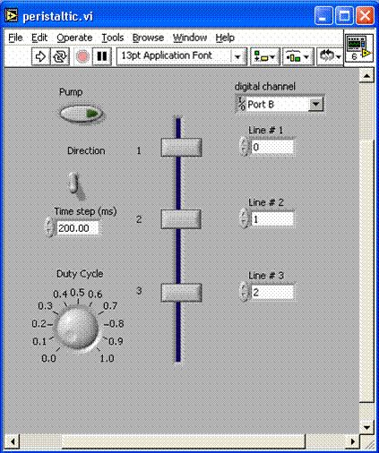
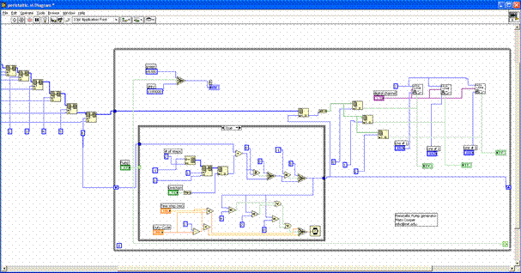
Application mapping: current practice
  Manually map experiments to the valves of the device
    Using Labview or custom C interface
    Given a new device, start over and do mapping again
    With complexity increasing, the method becomes inadequate
  Having gate-level details exposed to the user in VLSI
Slide source: Bill Thies, MIT

Slide 17
Contribution
  System model
    Component model
    Biochip architecture model
  Application mapping framework
    Binding and scheduling biochemical operations
    Fluidic routing
    Satisfying dependency and routing constraints
Notes:
Facilitates programmability and automation

Slide 18
Component model
Microfluidic mixer
Flow layer model:
Operational phases + Execution time
Five phases:
Ip1
Ip2
Mix (0.5 s)
Op1
Op2
Ip1

Slide 19
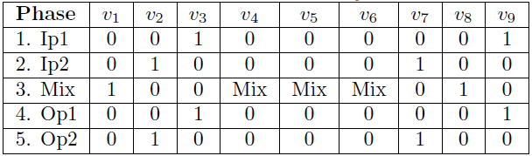
Component model
Input
Waste
Input
Waste
Ip2
Mix
Input
Waste
Input
Waste
open
Op1
closed
Op2
mixing state
Control layer model

Slide 20
Biochip architecture model
Topology graph based model
Notes:
N = All nodes (Switches and Components)
S = Switch nodes only, e.g., S₁
D = Directed edge between 2 nodes, D_{In1, S1}
F = Flow path, i.e., set of two or more directed edges
c = Transport latency

Slide 21
Flow paths in the architecture
Fluid transport latencies are comparable to operation execution times, so handling fluid transport (communication) is important
Enumerate valid flow paths F in the architecture
Routing constraints: A flow path is reserved until completion of the operation, resulting in routing constraints
F₁
F₂

Slide 22
Biochemical application model
Biocoder
[Ananthanarayanan et al., Biological Engineering 2010]
Notes:
Directed, acyclic, polar
Each vertex O_{i} represents an operation
Each vertex has an associated weight denoting the execution time

Slide 23
Problem formulation
Given
  A biochemical application
  A biochip modeled as a topology graph
  Characterized component model library
Determine
  An application mapping, deciding on:
    Binding of operations and edges
    Scheduling of operations and edges
  Such that
    the application completion time is minimized
    the dependency, resource and routing constraints are satisfied

Slide 24
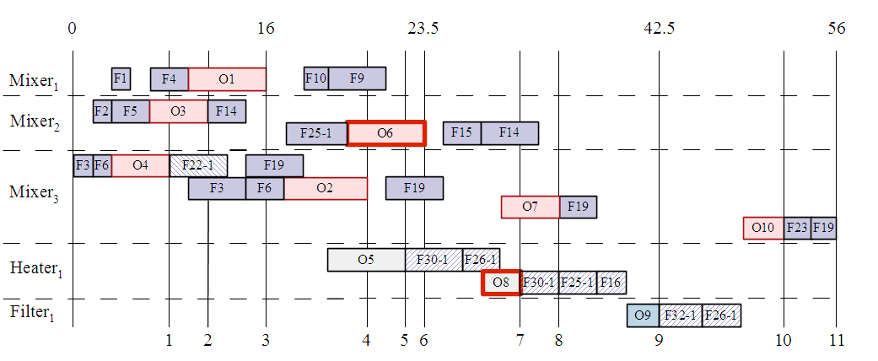
F₁₄
F₁₅

Slide 25
Proposed solution
List Scheduling-based Application Mapping (LSAM)
  Binding
  Scheduling
  Fluidic routing (contention awareness)
  Storage (requirement analysis and assignment)
  Composite route generation
Notes:
Scheduling is NP-complete even in simpler contexts

Slide 26
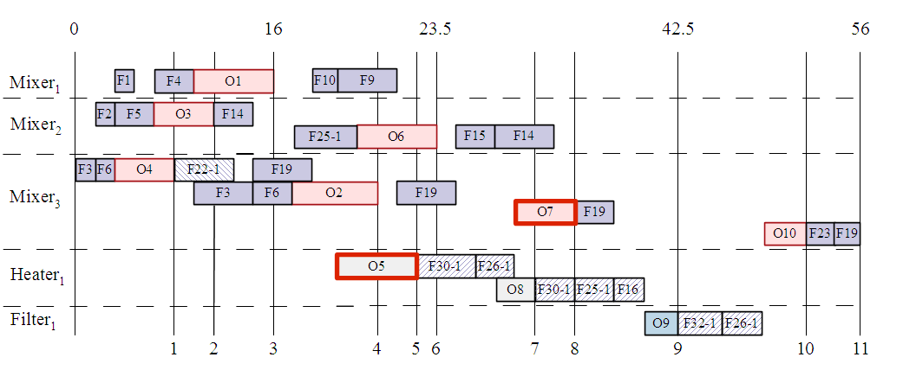
No flow path from Heater1 to Mixer 3!
F₃₀₋₁
F₂₆₋₁
A composite route

Slide 27
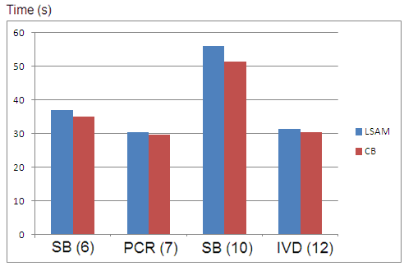
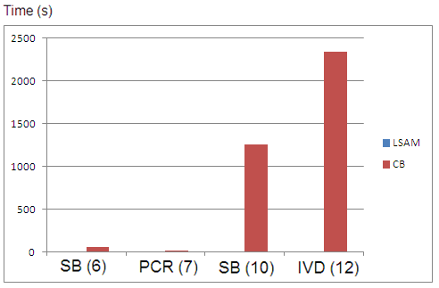
LSAM comparison with optimal
Schedule length
LSAM produces good quality
solutions in short time.
Computation time
CB: Clique based optimal solution
[Dinh et al. ASPDAC, 2013]
SB: Synthetic benchmark
PCR: Polymerase chain reaction –
mixing stage
IVD: In-vitro diagnostics

Slide 28
  Contribution I
  System model and application mapping
Biochemical Application Model
Component Library
Architectural Synthesis
Biochip Architecture Model
Application Mapping
Binding and Scheduling
Fluid Sample Routing
Control Synthesis
Control Synthesis
Implementation
Platform Controller
Notes:
Facilitates programmability and automation

Slide 29
  Contribution II
Biochemical Application Model
Component Library
Architectural Synthesis
Biochip Architecture Model
Application Mapping
Binding and Scheduling
Fluid Sample Routing
Control Synthesis
Control Synthesis
Implementation
Platform Controller
Notes:
Facilitates programmability and automation

Slide 30
  Contribution II
  Architectural synthesis
Biochemical Application Model
Component Library
Architectural Synthesis
Allocation and Schematic Design
Physical Synthesis
Biochip Architecture Model
Control Synthesis
Application Mapping
Control Synthesis
Implementation
Platform Controller
Notes:
Facilitates programmability and automation

Slide 31
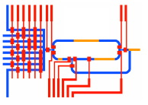
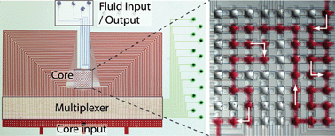
Architectural synthesis: current practice
  CAD tools in their infancy
    Most groups use AutoCAD or Adobe Illustrator
    Every line drawn by hand
    Limited automation:
      Control layer routing tool [Amin et al., ICCD 2009]
  918 valve chip
    Design and physical layout approximately 1 year of postdoc time* [Fidalgo and Maerkl, Lab-on-a-chip, 2010]
  Current practice
    Tedious, time-consuming and error-prone
    Required designer expertise
      Understanding of application requirements
      Knowledge and skills of chip design and fabrication
*Source: Philip Brisk, UCR

Slide 32
Problem formulation
Given
  A biochemical application
  Characterized component model library
Synthesize
  A biochip architecture
  Deciding on:
    Component allocation
    Schematic design and netlist generation
    Physical synthesis
      Placement of components
      Routing of microfluidic channels
  Such that
    the application completion time is minimized
    Satisfying the dependency, resource and routing constraints
Notes:
Facilitates programmability and automation

Slide 33
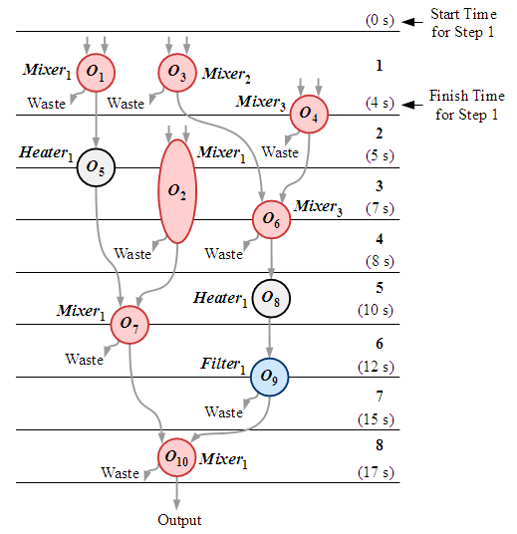
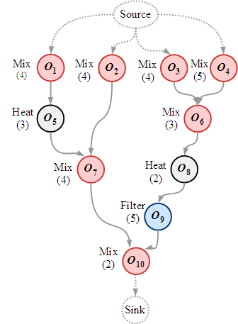
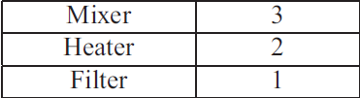
1) Allocation and schematic design
High level synthesis
Notes:
Given an application and some constraints ( the max possible allocation units are given by the user).
We start off by topologically sorting the operations, i.e., we sort them based on dependency contraints (O5 cannot be executed before O1) and the urgency criteria. Urgency criteria is similar to the critical path where we go from the desired node to the end node searching the longest path, for example for )1 the urgency value is 9 but for O2 it is 6, so even though both O1 and O2 are ready at the same time (both have no predecessors) O1 has higher priority than O2. After the priority assignment, we evaluate the operations and find the ready ones. For examples for a start, O1 to O4 are all ready. Then, we pick a highest priority ready op and check if we can allocate a unit of the required type, if yes, then we greedily bind the operation to that unit and schedule it. For example O1 is bound to Mixer1. We continue this until we run out of ready operations. The ready operations that cannot be bound and scheduled yet because there are no more units available to be allocated need to wait until the next schedule step. HLS has the concept of clock cycles, here we have it more asynchronous and have the concept of schedule steps. Every time an operation ends, (O1 ends at 4s) , we reevaluate the operations, find the ready ones and bind and schedule them as well, e.g., O5 is now ready so its bound and scheduled and so is O2. This goes on until the graph is complete.

Slide 34
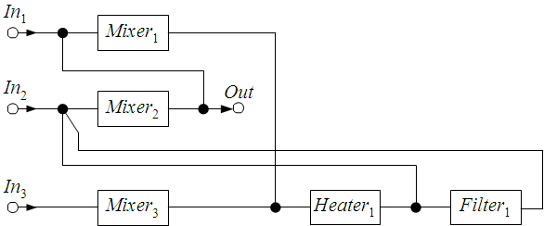
1) Allocation and schematic design
High level synthesis
Notes:
Now is the step to convert this binding and scheduling graph in to the schematic. We scna each schedule and identify the input sources of the components. Using this we generate the whole schematic.

Slide 35
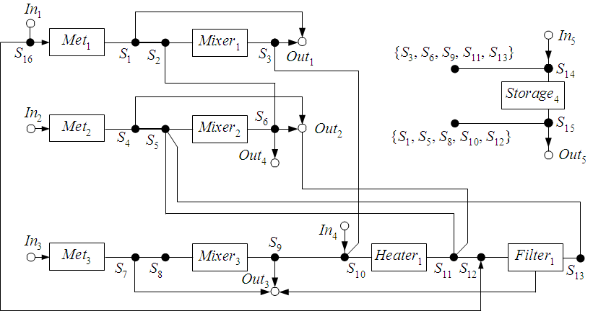
1) Allocation and schematic design
Input/ output ports
Storage units

Slide 36
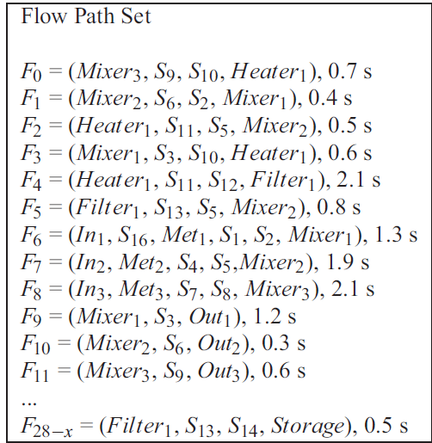
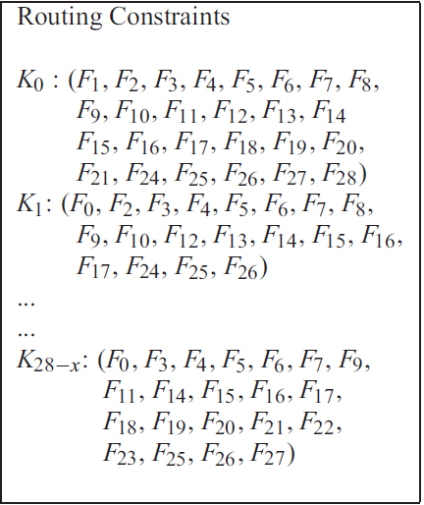
1) Allocation and schematic design
Flow path set and routing constraints

Slide 37
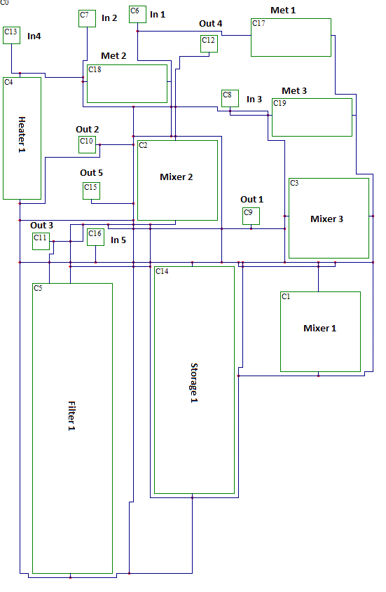
2) Physical synthesis – flow layer
Placement (NP-complete)
  Simulated annealing
Microfluidic channel routing: Hadlock’s algorithm
  Grid model approach
  Finds shortest paths between two vertices
  Faster than other algorithms of this category
  1 Layer: No short-circuit
Extract routing latencies
Control layer routing tool
[Amin et al., ICCD 2009]

Slide 38
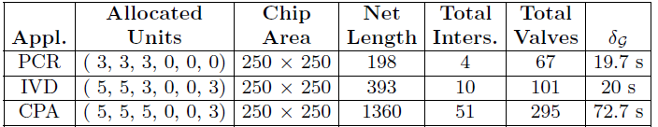
Results – real-life application
PCR: Polymerase Chain Reaction mixing stage
IVD: In-Vitro Diagnostics
CPA: Colorimetric Protein Assay
Allocated units: (Input ports, output ports, Mixers, Heaters,
Filters, Detectors)

Slide 39
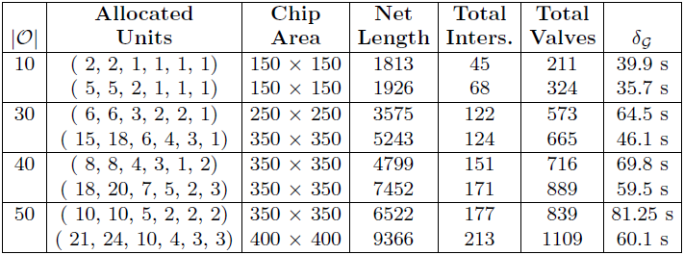
Results – synthetic benchmarks
Constrained vs unconstrained architecture
Model can be used to evaluate design decisions early

Slide 40
Contribution
Proposed
  A top-down architectural synthesis framework for flow-based biochips
    Facilitating programmability and automation
    Decouples application design from chip design
    Minimizing design cycle time

Slide 41
  Contribution III
  Control synthesis
Biochemical Application Model
Component Library
Architectural Synthesis
Biochip Architecture Model
Control Synthesis
Control Synthesis
Application Mapping
Control Logic Generation
Control Pin Minimization
Implementation
Platform Controller
Notes:
Facilitates programmability and automation

Slide 42
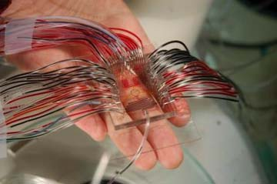
Control synthesis
Perform control synthesis
  Generate the control logic
    Deciding which valves need to be opened or closed, in what sequence and for how long, in order to execute the application on the chip
  Minimize the chip pin count
    Share control pins between valves
    Minimizes macro-assembly around
    the chip and increases scalability
  such that the application completion
  time is minimized and all constraints
  are satisfied
Current practice: Manual

Slide 43
  Contribution IV
  Cell culture biochips – throughput maximization
Notes:
Facilitates programmability and automation

Slide 44
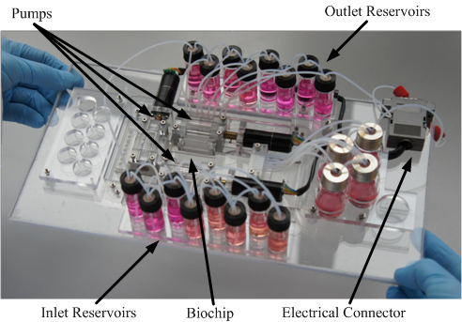
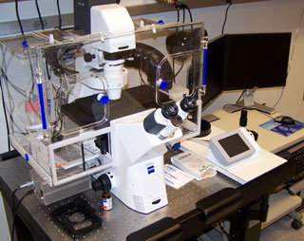
Cell culture biochips
Used for culturing and monitoring living cells in real-time
Applications:
  Stem cell research, drug discovery …
[Peder et al., µTAS 2010]

Slide 45
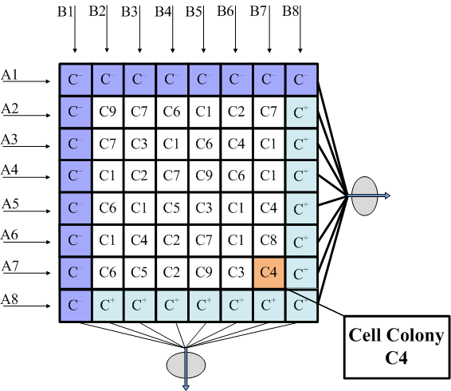
Cell culture experiment
Experiment
  Exposure of a cell colony to a sequence of compounds and response monitoring
  Each element the matrix represents an experiment
  64 simultaneous experiments on 1 cm²
Resources
  Time – Weeks
  Cost – Highly expensive reagents

Slide 46
Experimental design
Deciding on
  Placement pattern P of cell colonies on the chip chamber
  Schedule S of the compound (stimuli) insertion

Slide 47
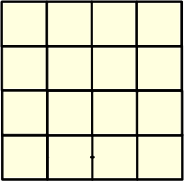
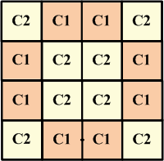
Experimental design
  Given: 4×4 biochip
  No of cell colonies: 2 (C1, C2)
  No of compounds: 3 (F1, F2, F3)
  Task: Expose all colonies to any 3-compound sequence (Placement and Scheduling)
  Row 1:
    C2:
    C1:
    C1:
    C2:

Slide 48
Experimental Design
  Given: 4×4 biochip
  No of cell colonies: 2 (C1, C2)
  No of compounds: 3 (F1, F2, F3)
  Task: Expose all colonies to any 3-compound sequence (Placement and Scheduling)
  Row 1:
    C2:
    C1:
    C1:
    C2:

Slide 49
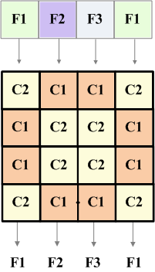
Experimental design
  Expose all colonies to any 3-compound sequence
  Row 1:
    C2: F1
    C1: F2
    C1: F3
    C2: F1

Slide 50
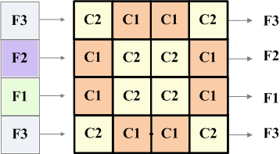
Experimental design
  Expose all colonies to any 3-compound sequence
  Row 1:
    C2: F1 , F3
    C1: F2 , F3
    C1: F3 , F3
    C2: F1 , F3

Slide 51
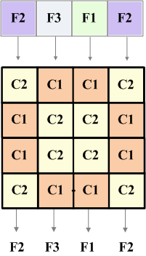
Experimental design
  Expose all colonies to any 3-compound sequence
  Row 1:
    C2: F1 , F3 , F2
    C1: F2 , F3 , F3
    C1: F3 , F3 , F1
    C2: F1 , F3 , F2

Slide 52
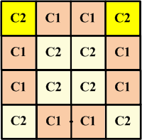
Experimental design
  Row 1:
    C2: F1 , F3 , F2
    C1: F2 , F3 , F3
    C1: F3 , F3 , F1
    C2: F1 , F3 , F2
  Repetition:
    Low throughput (Row 1: 75 % utilized)
    Loss of resources (time in weeks, cost in terms of extremely expensive reagents and valuable cell samples)
  Need optimized experimental design to fully utilize the chip capability and to reduce the resource loss

Slide 53
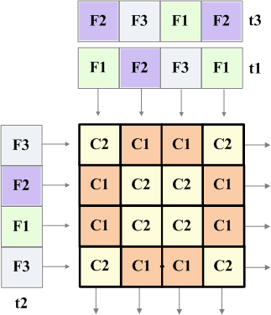
Problem formulation
  Given
    Biochip architecture model N×M Matrix
    Cell colonies set C
    Compounds set X
    Number of compounds per exposure sequence I
    Experimental stages n
  Determine
    Placement P of cell colonies
    Schedule S of compound insertion
    such that the experimental throughput is maximized

Slide 54
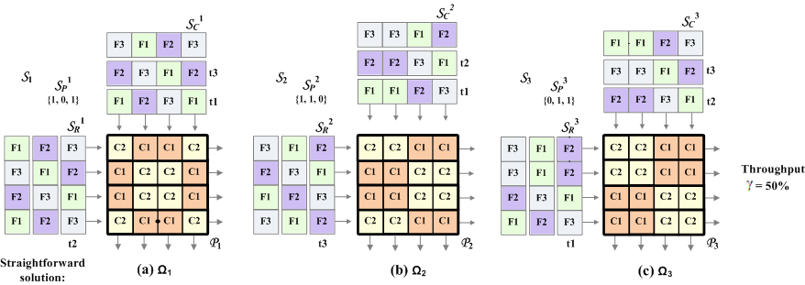
Straight forward solution
  Multiple experimental stages
  Solution: Shift and roll (left-to-right, top-to-bottom)
    Only 50 % chip utilization (i.e., 50 % repetitions)

Slide 55
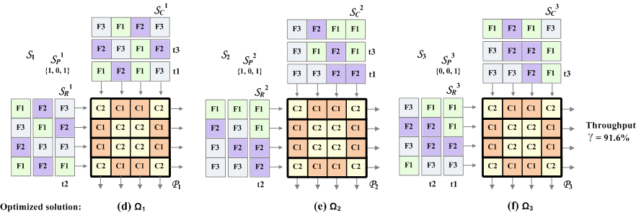
Proposed solution
  NP-complete problem – our approach Simulated Annealing
  Biochip throughput improved from 50% to 91.6% by using our solution

Slide 56
Experimental results
(X, C, n) | SF Throughput (%) | ETO Throughput (%)
6x6 Chip Size
(2, 9, 2) | 50 | 83.3
(3, 7, 6) | 43.9 | 88.4
10x10 Chip Size
(4, 3, 2) | 12.5 | 78.1
(5, 2, 3) | 42.4 | 85.2
14x14 Chip Size
(6, 3, 4) | 44.9 | 76.2
(7, 4, 7) | 22.4 | 68.9

Slide 57
Contributions
System model (component/ biochip) [CASES11]
List Scheduling-based Application Mapping(LSAM) framework [CASES11]
Constraint programming-based optimal application mapping (routing ignored) [DTIP12]
Architectural synthesis framework [CASES12]
Control synthesis framework [ASPDAC13]
Experimental throughput maximization for cell culture biochips [iCBBE11]

Slide 58
Summary and message
Summary
  Models for the biochip and the components
  Top-down synthesis framework and problem formulations
  Expected to
    facilitate programmability and automation
    minimize design cycle time
    enhance chip scalability and throughput
    play a role in emergence of a large biochip market
  Future work
    Contamination awareness
Message
  Biochips have the potential to revolutionize life sciences
  Deign complexity is on the rise
  Top-down CAD tools are needed to support the designer

Slide 59


Slide 60
System Model
  Sample Volume Handling:
    The model considers discretized fluid volumes
    Fluid sample volumes can be precisely controlled (unit sized samples)
    Each sample occupies a certain length on the flow channel (achieved using metering)
12/10/2011
System-Level Modeling and Synthesis of Flow-Based Microfluidic Biochips

Slide 61
Metering – Unit Sized Samples
Metering is done by transporting the sample between two valves that are a fixed length apart
Input
Waste
Input
Waste
To other components
To other components
open
(a)
(b)
closed
Input
Waste
Input
Waste
To other components
To other components
(c)
(d)
12/10/2011
System-Level Modeling and Synthesis of Flow-Based Microfluidic Biochips
Notes:
Microfluidic metering process. Open and closed symbols refer to open and actuated control valves, respectively. (a) Sample of interest flows from an input port through one half of the rotary mixer. (b) Sample is compacted against a valve on the right side of the mixer, ensuring a consistent cross-sectional area. (c) Excess sample is flushed to the waste port. (d) A unit-sized sample results and can be mixed or transported to storage … n the componenta that we use have a sample capcaity of how many units of volume it can hold

Slide 62
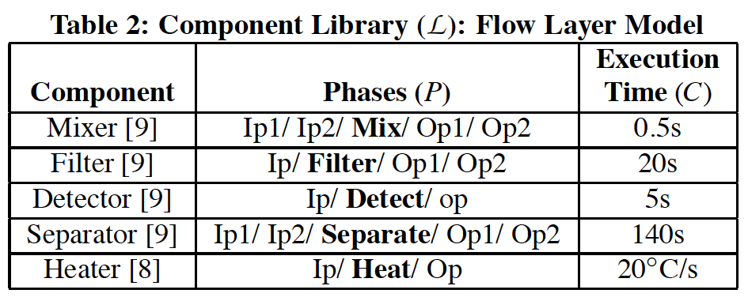
Biochip Architecture Model

Slide 63
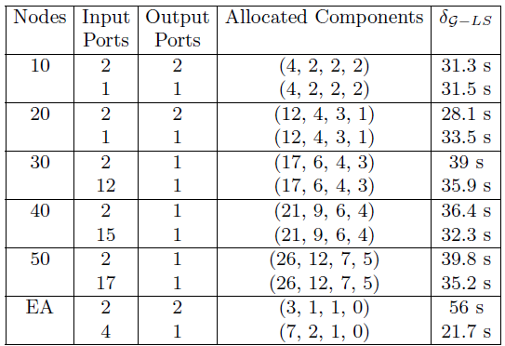
Results – routing considered
EA : Example Application
Allocated Components: (Mixers, Heaters, Filters, Detectors)

Slide 64
Components
MOVE TO BACKUP
Microfluidic mixer

Slide 65
Components
MOVE TO BACKUP
Microfluidic mixer

Slide 66
Experimental evaluation
MOVE TO BACKUP
LSAM algorithm implemented in C++
Benchmarks
  Real-life applications
    Polymerase chain reaction – mixing stage
    In-vitro diagnostics
  Synthetic benchmarks
    5 synthetic benchmarks with 10 to 50 operations
Comparison
  LSAM vs clique-based optimal result
  [Dinh et al. ASPDAC, 2013]

Slide 67
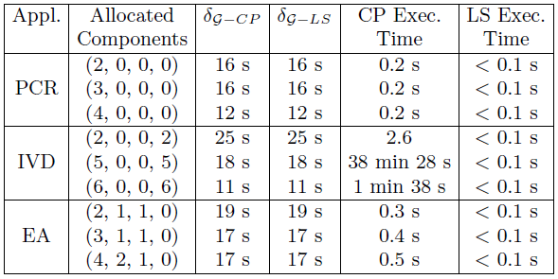
Results – routing ignored
MOVE TO BACKUP
PCR: Polymerase Chain Reaction mixing stage
IVD: In-Vitro Diagnostics
EA: Example Application
Allocated units: (Mixers, Heaters, Filters, Detectors)
CP: Constraint programming
LS: List scheduling
LS produces the same result as CP and is faster.

Slide 68
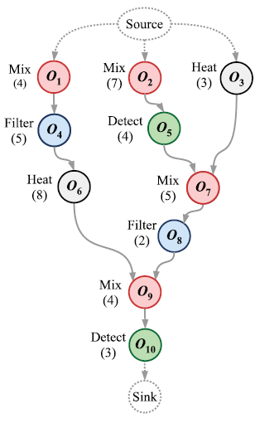
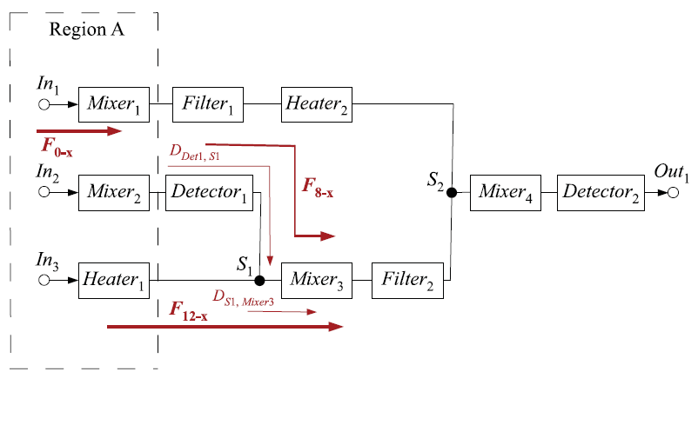
1. Control logic generation
MOVE TO BACKUP
Given the application and architecture models, we perform binding and scheduling to obtain the schedule
Notes:
Schedule

Slide 69
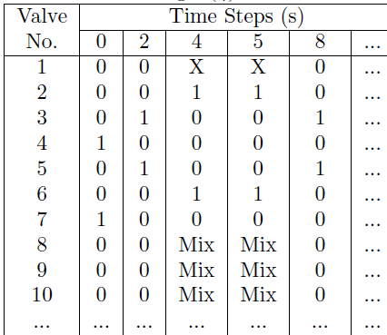
1. Control logic generation
MOVE TO BACKUP
Given the schedule and the component model,
we generate the control logic (we also remove redundant valves)
8
9
10
In₁
2
3
5
6
1
4
7
open
Mixer₁
closed
34
35
36
In₂
28
29
31
32
27
30
33
Mixer₂
In₃
42
43
Heater₁
44
Notes:
Control logic table

Slide 70

2. Control pin count minimization
MOVE TO BACKUP
Control pin sharing: reduced to a graph coloring problem
  Finding the chromatic number: NP-hard problem
  Many heuristic solutions exist, we use a Tabu Search approach
2
3
8
5
4
6
7

Slide 71
Experimental results
MOVE TO BACKUP
PCR: Polymerase Chain Reaction (mixing stage)
IVD: In-Vitro Diagnostics
Allocated units: (Mixers, Heaters, Filters, Detectors)
NR: Non-Redundant
In all cases, pin count reduced by more than 70%.

Slide 72
Experimental evaluation
MOVE TO BACKUP
The algorithm was implemented in C#
Benchmarks
  Real-life applications
    Polymerase chain reaction – mixing stage
    In-vitro diagnostics
    Colorimetric protein assay
  Synthetic benchmarks
    5 synthetic benchmarks with 10 to 50 operations

Slide 73
Architectural synthesis: current practice
MOVE TO BACKUP
  CAD tools in their infancy
    Most groups use AutoCAD or Adobe Illustrator
    Every line drawn by hand
    Limited automation:
      Control layer routing tool [Amin et al., ICCD 2009]
Notes:
Fabrication process is fast but the problem is not having the CAD tools.

Slide 74
Architecture and operation
Each element in the matrix hosts a cell colony
Operation:
1. Cell placement
2. Stimuli insertion

Slide 75

Comparison with optimal solution
  Optimal solution obtained using exhaustive search
(X, C, n) | Chip size | Difference
Case 1
(2, 9, 2) | 6x6 | 1.4 %
Case 2
(4, 3, 2) | 10x10 | 2.1%
Case 3
(6, 3, 4) | 14x14 | 2.3%

