Slide 1
System-Level Modeling and Simulation of the Cell Culture Microfluidic Biochip ProCell
Wajid Hassan Minhass†, Paul Pop†, Jan Madsen†
Mette Hemmingsen‡, Martin Dufva‡
†Department of Informatics and Mathematical Modeling
‡Department of Micro- and Nanotechnology
Technical University of Denmark

Slide 2
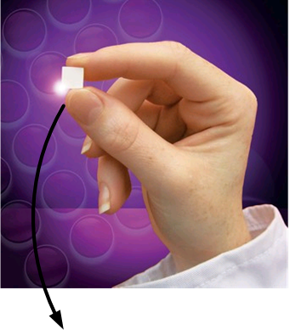
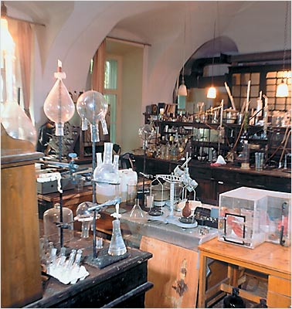
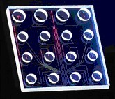
Microfluidic Biochips

Slide 3
Microfluidic Biochips
Micro-components
Channels
Valves
Chambers
Advantages
Cost Efficient
High Throughput
Automated
Higher Precision and Speed
http://groups.csail.mit.edu/cag/biostream/

Slide 4
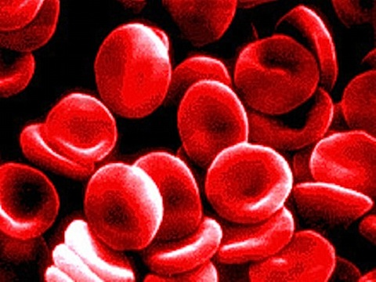
Microfluidic Biochips
Applications
Clinical Diagnostics
DNA Sequencing
Protein Analysis
Molecular Biology
Cell Culturing

Slide 5
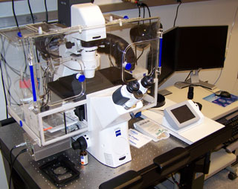
ProCell – Programmable Cell Culture Chip
“A microfluidic device built for culturing and monitoring living cells in real-time”
Real-time feedback provides ground breaking technology for cell
studies by introducing conditional experiments

Slide 6
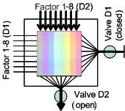
ProCell - Operation
(i) Cell Placement
Laminar Flow:
Parallel flow of liquids in layers without any inter-layer disruption

Slide 7
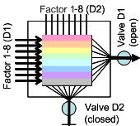
ProCell - Operation
(i) Cell Placement (ii) Compound Perfusion

Slide 8
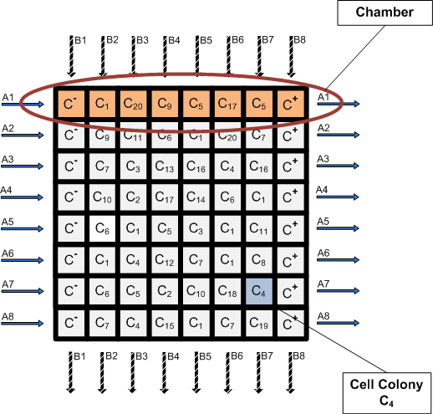
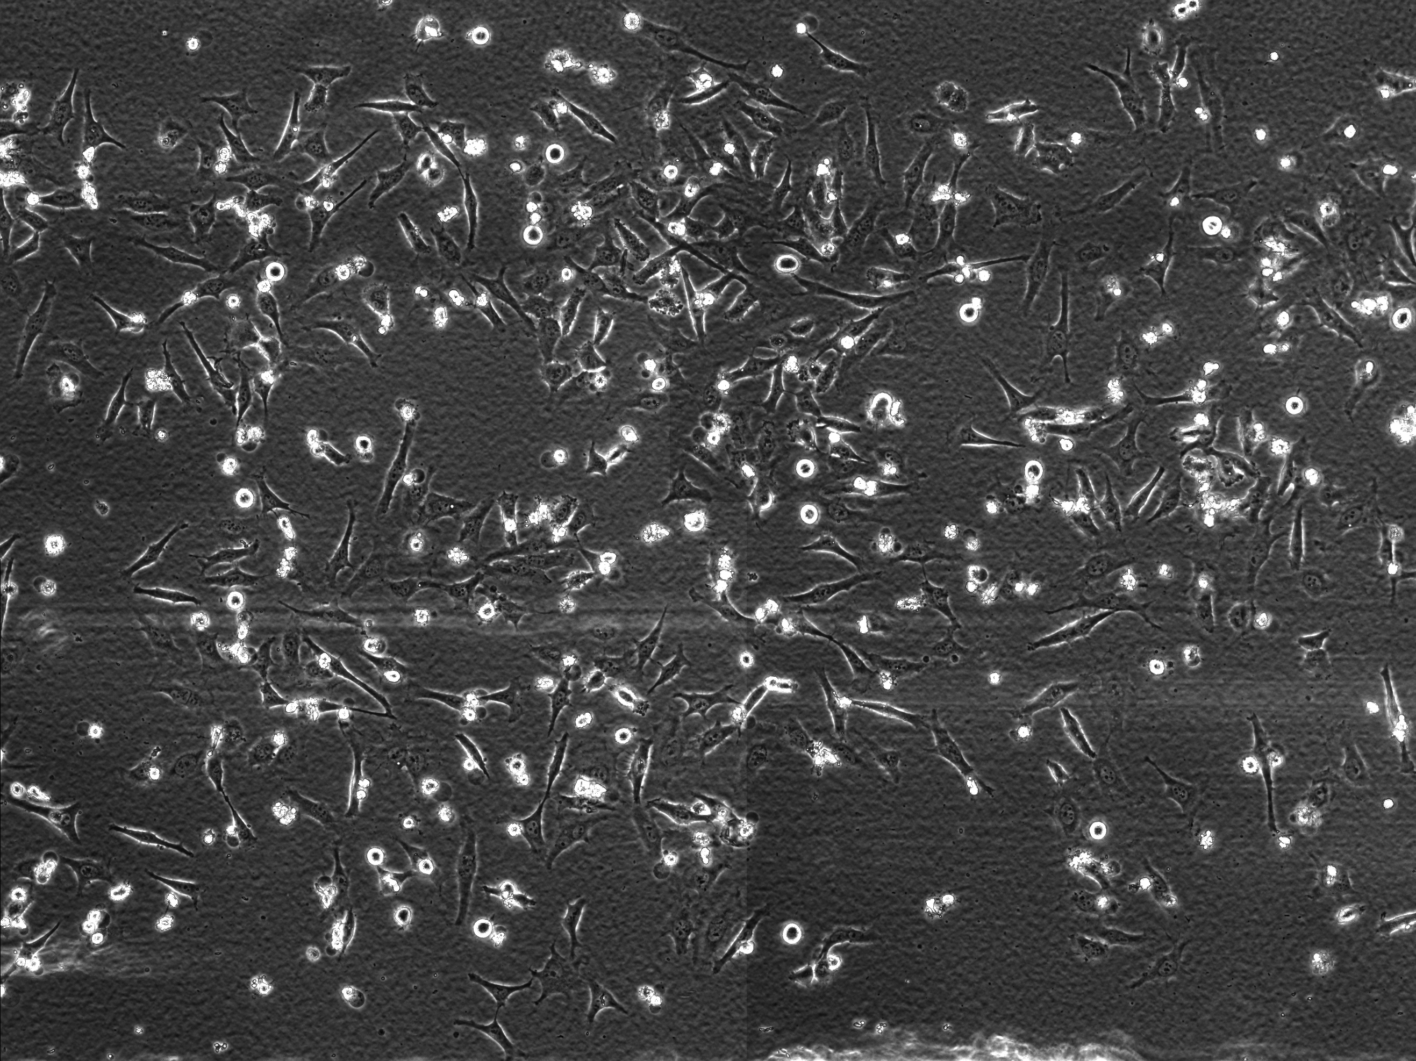
BioChip Architecture Model
8x8 Matrix
Each row represents a chamber
Each element in a row represents an experiment

Slide 9
BioChip Architecture Model
Experiment
Exposure of a cell colony to a sequence of compounds
Response monitoring
Resources
Time – Weeks
Cost – Highly expensive reagents

Slide 10
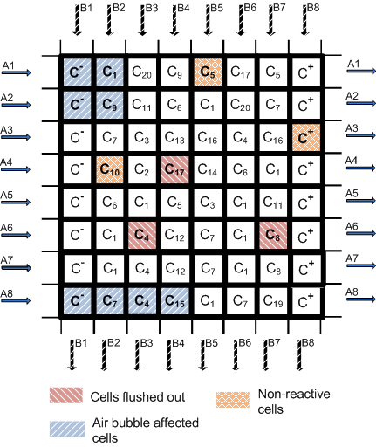
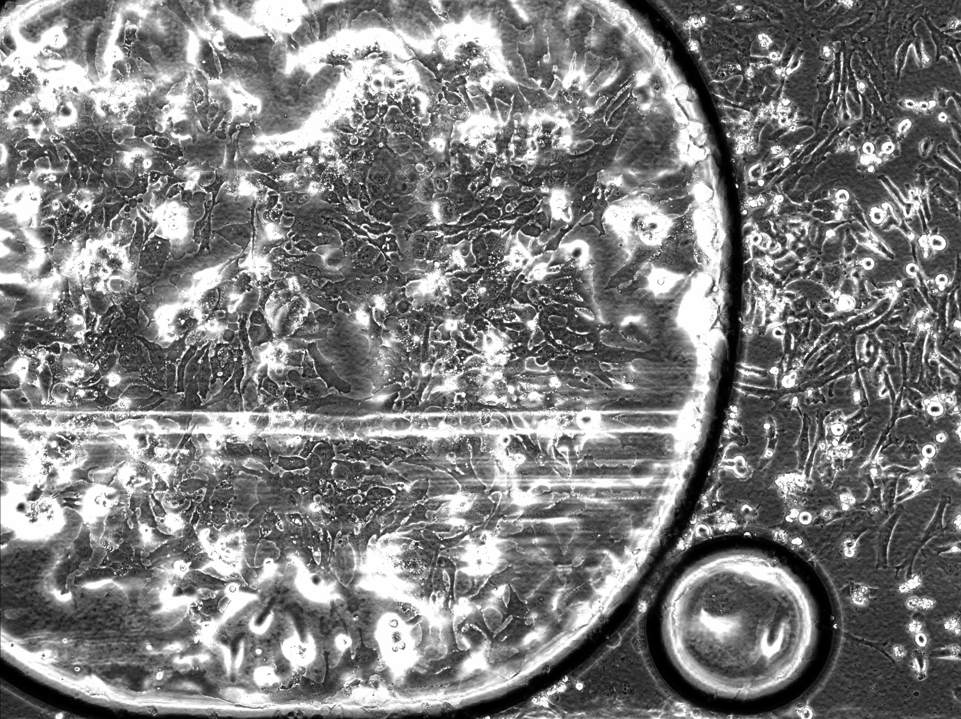
Fault Model
Fault types
Air bubbles
Cell adhesion faults
Overstressed cells

Slide 11
Qualitative Fault Evaluation
Cell Colony Properties
Negative Control (C⁻)
Positive Control (C⁺)
Communicator colonies
High Priority
Low Priority

Slide 12
Qualitative Fault Evaluation
Failure Grade Assignment
Failure Grade | Description
PL | Partial Failure (Low Priority)
PH | Partial Failure (High Priority)
CC | Complete Chamber Failure
FC | Full Chip Failure

Slide 13
Qualitative Fault Evaluation
Failure Index
Failure Index Contribution
Success Metric

Slide 14
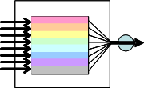
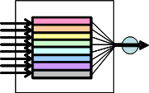
ProCell - Architecture
Types of chambers
Virtual Chambers Isolated Chambers

Slide 15
Outline
ProCell Description and Operation
Biochip Architecture Model
Comprehensive Fault Model
Redundancy Schemes
Simulation Framework
Experimental Results

Slide 16
Redundancy Schemes
Control Redundancy
Notes:
Say how simulation is done (Pb Formulation)

Slide 17
Redundancy Schemes
Control Redundancy
Notes:
Say how simulation is done (Pb Formulation)

Slide 18
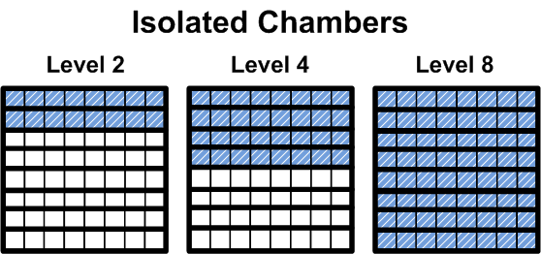
Redundancy Schemes
Control Redundancy
Placement Redundancy
Notes:
Say how simulation is done (Pb Formulation)

Slide 19
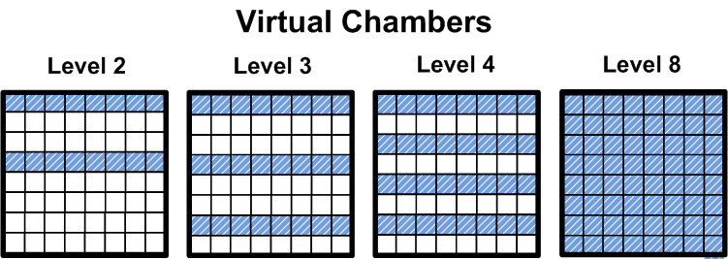
Redundancy Schemes
Control Redundancy
Placement Redundancy
Notes:
Say how simulation is done (Pb Formulation)

Slide 20
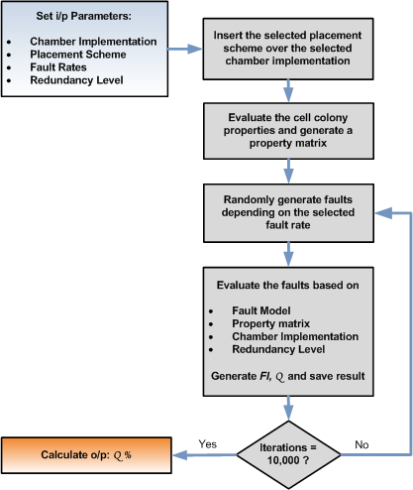
Simulation Framework
Notes:
Say how simulation is done (Pb Formulation)

Slide 21
Experimental Results
Control Redundancy Results
Fault Rate | Placement P2 | Placement P3
8 Isolated chambers
(10,5,5) | 54.19 | 58.53
(20,5,5) | 36.72 | 41.26
8 virtual chambers (Max air bubble radius = 3 chambers)
(10,5,5) | 43.15 | 48.02
(20,5,5) | 21.58 | 25.66
8 virtual chambers (Max air bubble radius = 5 chambers)
(10,5,5) | 34.96 | 39.96
(20,5,5) | 13.93 | 17.52

Slide 22
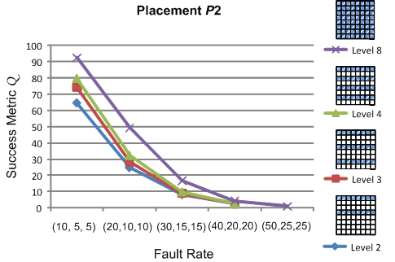
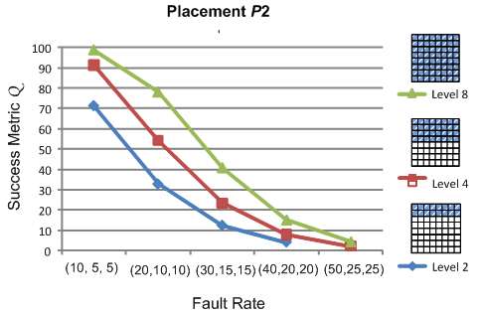
Experimental Results
Placement Redundancy Results
Virtual Chambers
Isolated Chambers

Slide 23
Conclusions
Biochip Architecture Model
Comprehensive Fault Model (modeling permanent faults)
Simulation Framework for architectural-level qualitative biochip performance evaluation for
Isolated Chamber vs Virtual Chamber
Control and Placement redundancy
Aids designer to determine
proper type of chamber
proper type and level of redundancy
to maximize the success rate of an experiment

