Slide 1
Analysis Methods for Mixed-Criticality Applications on TTEthernet-based Distributed Architectures
Sorin Ovidiu Marinescu
Technical University of Denmark

Slide 2
Outline
Motivation
Partitioned Architectures
  At CPU-level
    IMA Analysis
  At network level
    TTEthernet
    TTEthernet Analysis and Simulation
    Trajectory Approach Applied to TTEthernet
Conclusions

Slide 3
Motivation
Real time applications implemented using distributed systems
Mixed-criticality applications share the same architecture
Federated Architecture
Integrated Architecture
SIL4
SIL1
SIL3
SIL3
SIL2
SIL4
SIL4
SIL1
PE
Application A ₁
Application A ₂
Application A ₃
Solution: partitioned architecture

Slide 4
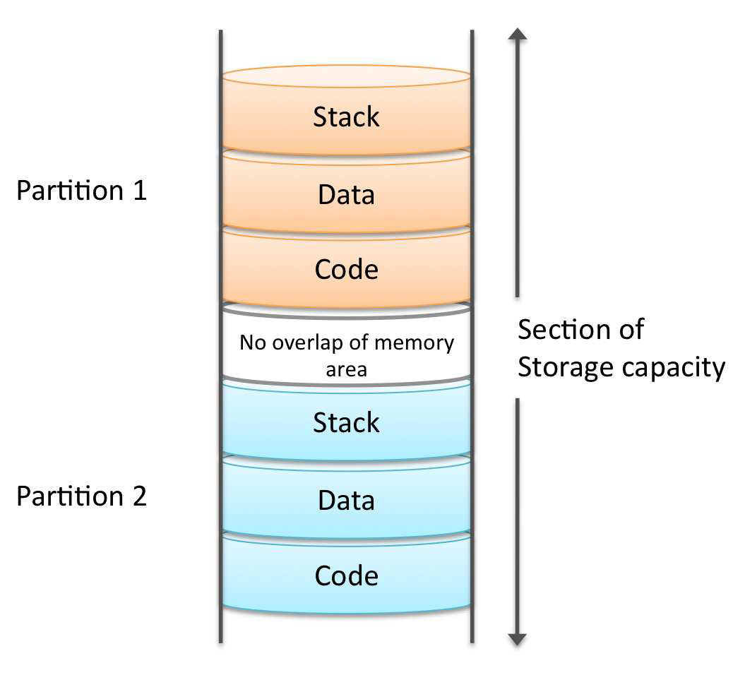
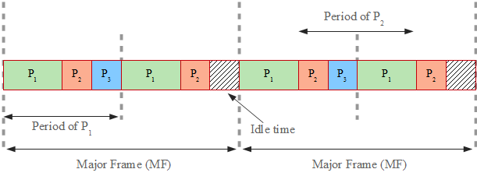
Partitioned Architectures – CPU level
Spatial partitioning
      protects one application’s memory
      and access to resources from another
      application
Temporal partitioning
      partitions the CPU time among applications

Slide 5
System model
Spatial and temporal partitioning scheme similar to IMA (Integrated Modular Avionics)
Applications are allowed to execute only within their assigned partitions.
Each partition can have its own scheduling policy.

Slide 6
Problem formulation
Given
    A set of mixed-criticality applications
    A set of processing elements (PEs)
    The mappings of tasks to the PEs
    The assignments of tasks to partitions
    The size of the Major Frame and of the System Cycle
Determine
    The worst-case response times of tasks scheduled in partitions using fixed-priority preemptive scheduling
Two schedulability analysis methods compared
    SA – existing IMA analysis
    SA+ - our proposed method, an extension of WCDOPS+ to consider IMA

Slide 7
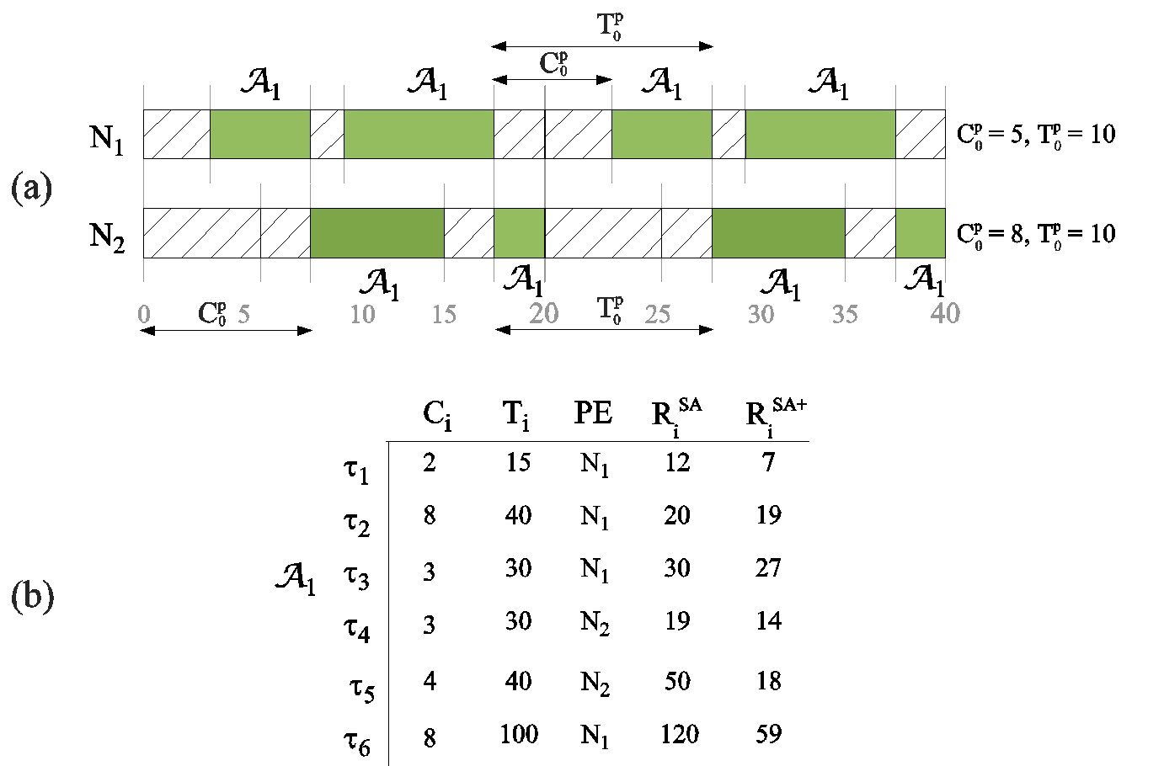
Motivational example

Slide 8
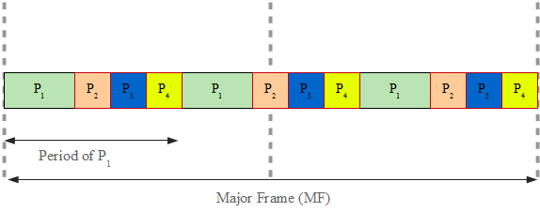
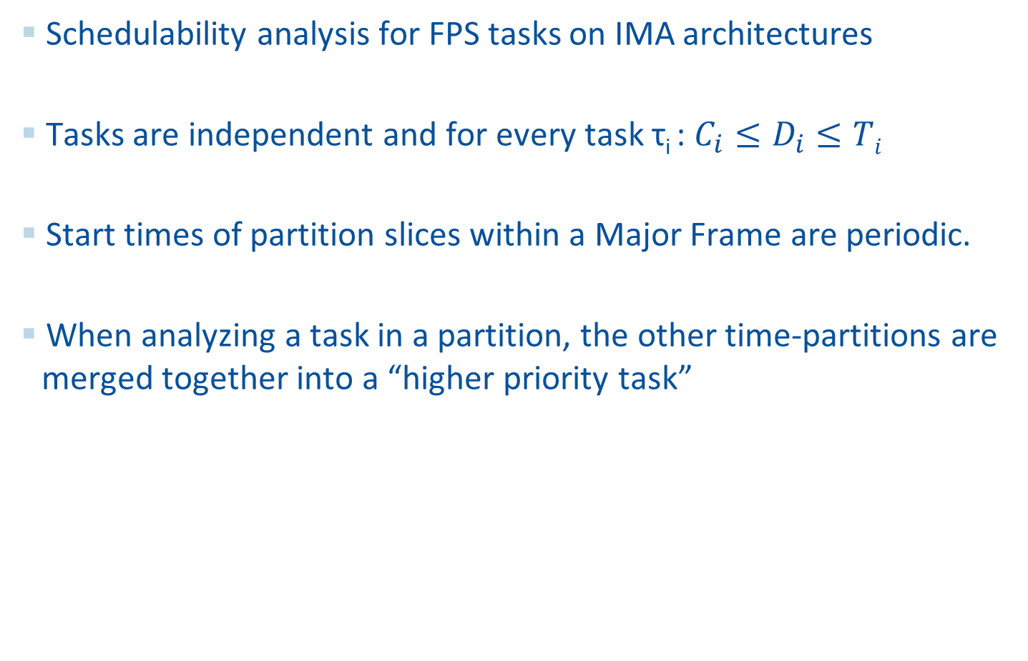
SA (Audsley and Wellings)
Schedulability analysis for FPS tasks on IMA architectures
Tasks are independent and for every task τ_{i} : $C_{i}≤D_{i}≤Ti$
Start times of partition slices within a Major Frame are periodic.
When analyzing a task in a partition, the other time-partitions are merged together into a “higher priority task”

Slide 9
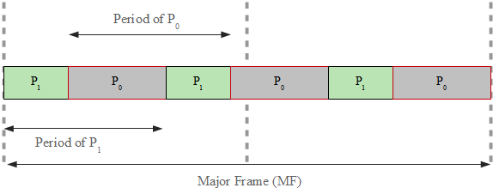
SA (Audsley and Wellings)
Schedulability analysis for FPS tasks on IMA architectures
Tasks are independent and for every task τ_{i} : $C_{i}≤D_{i}≤Ti$
Start times of partition slices within a Major Frame are periodic.
When analyzing a task in a partition, the other time-partitions are merged together into a “higher priority task”

Slide 10

SA+ (extended WCDOPS+)
WCDOPS+ - response time analysis algorithm for FPS tasks disposed in tree shaped transactions.
WCDOPS+ was extended to take into account the partitions.
The concepts of availability and demand were introduced.
SA+ does not assume that the partition slices have to be periodic within a Major Frame.

Slide 11
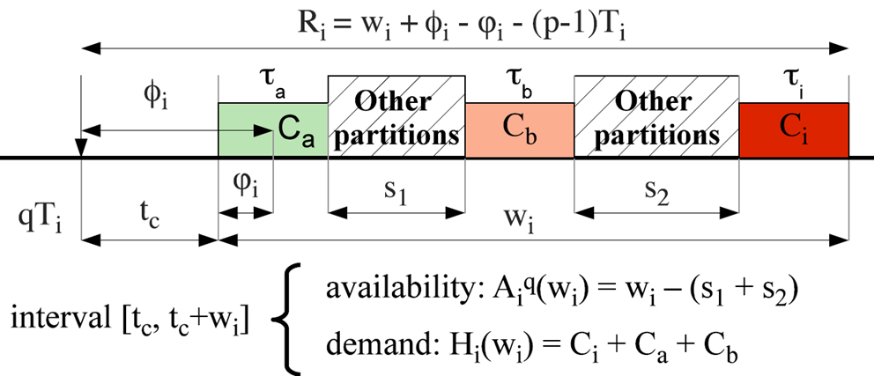
Availability and demand
The availability associated to a task τ_{i} during a time interval t is equal to the processor time that is not used by other partitions during t.
The demand for a task τ_{i} during a time interval t is equal to the sum of the processor times required by τ_{i} and all higher priority tasks mapped to the same processor during t.

Slide 12
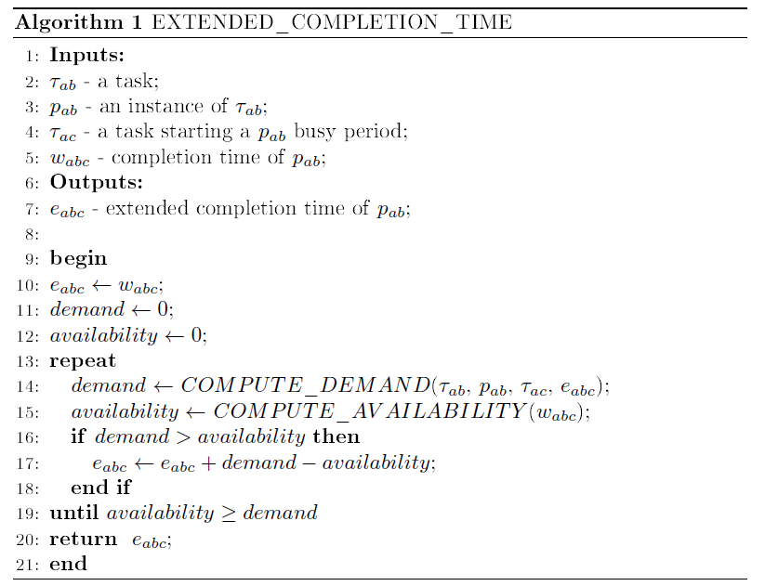
Extended completion time

Slide 13
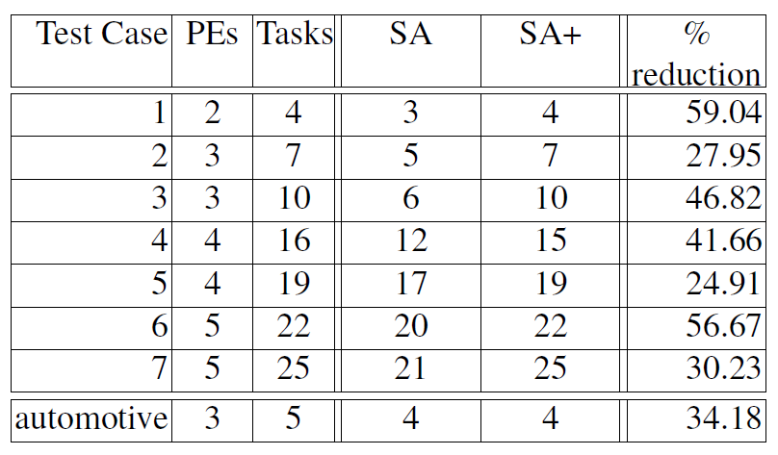
Experimental results
Benchmarks:
  7 synthetic
  1 real-life test case from E3S
Our method provides less pessimistic worst-case response times
Notes:
To make more concise!

Slide 14
Partitioned Architectures – network level
TTEthernet is very well suited for mixed-criticality applications
Traffic classes:
  synchronized communication
    Time Triggered (TT) - based on static schedule tables
  unsynchronized communication
    Rate Constrained (RC) – ARINC 664p7 traffic class
    Best Effort (BE) – no timing guarantees
ARINC 664p7 compliant
Standardized as SAE AS 6802
Notes:
When talking about traffic classes, also mention integration policies:
timely block – the transmission of an RC frame is postponed if it will not terminate before the transmission of a scheduled TT frame
pre-emption – the transmission of an RC frame is pre-empted if a TT frame is scheduled for tranmission
shuffling – if an RC frame is transmitting, the TT frame will be sent only after the transmission finished

Slide 15
TTEthernet network
Full-Duplex Ethernet-based data network for safety-critical applications composed of clusters
Each cluster has a clock synchronization domain
Inter-cluster communication using RC traffic
ES₁
ES₃
ES₅
ES₇
SW₁
SW₂
ES₂
ES₈
ES₄
ES₆
Cluster 1
Cluster 2

Slide 16
Separation at network level
ES₁
ES₃
SW₁
SW₂
ES₂
ES₄
Network Switch
End System
Full-Duplex Ethernet-based data network for safety-critical applications

Slide 17
Separation at network level
ES₁
ES₃
τ₁
vl₂
τ₂
τ₅
SW₁
SW₂
ES₂
ES₄
vl₁
τ₄
virtual link
τ₃
Highly critical application A ₁: τ₁, τ₂ and τ₃
  τ₁ sends message m₁ to τ₂ and τ₃
Non-critical application A ₂: τ₄ and τ₅
  τ₄ sends message m₂ to τ₅
Notes:
The Ethernet protocol does not offer separation between messages of different criticalities. ARINC 664p7 manages this through the concept of Virtual Links, by emulating point-to-point connectivity over the network. The virtual link is defined as the “logical unidirectional connection from one source system to one or more destination end systems”. Thus the virtual link is a directed tree, with the sender as a root, and the receivers as leaf. Each virtual link is composed of a set of dataflow paths, one such dataflow path for each root-leaf connection.
One virtual link is assigned to one message only.
By using virtual links, the highly critical message m1 is separated from the non-critical message m2.
Let’s assume we have 2 applications, A1 and A2.

Slide 18
Separation at network level
ES₁
dataflow link
ES₃
τ₁
dp₁
τ₂
τ₅
l₁
l₃
SW₁
l₂
SW₂
l₄
ES₂
dp₂
ES₄
vl₁
τ₄
τ₃
dataflow path
Highly critical application A ₁: τ₁, τ₂ and τ₃
  τ₁ sends message m₁ to τ₂ and τ₃
Non-critical application A ₂: τ₄ and τ₅
  τ₄ sends message m₂ to τ₅
Notes:
Each virtual link is composed of a set of dataflow paths, one such dataflow path for each root-leaf connection.

Slide 19
Separation at network level
Spatial separation
  achieved through virtual links
Temporal separation
  enforced by schedule tables for TT traffic and bandwidth allocation for RC traffic
Contention problems
  how is the TT and RC traffic integrated?
    preemption
    shuffling
    timely block
Notes:
Let’s recapitulate why is TTEthernet suitable for mixed-criticality applications? Mixed-criticality messages need to be separated spatially and temporally. And TTEthernet provides mechanism for that. Spatial separation is achieved…

Slide 20
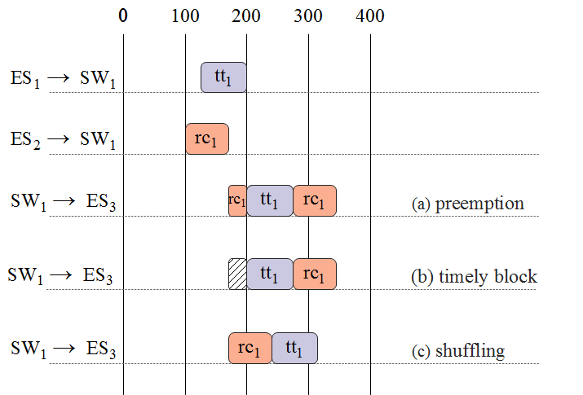
Dataflow integration
ES₁
vl₁
tt₁ – TT frame
rc₁ – RC frame
SW₁
vl₂
ES₃
ES₂
vl₃

Slide 21
TT Transmission
ES₁
SW₁
ES₂
CPU
k
l
CPU
P_{1,1}
P_{2,1}
FU
f
FU
B_{2,Rx}
m
τ₁
e
TT
h
τ₄
b
d
TT_{R}
B_{1,Tx}
i
TT_{S}
B_{1,Rx}
P_{1,2}
b
TT_{S}
P_{2,2}
τ₂
a
B_{1,Tx}
B_{2,Tx}
j
τ₃
P_{1,3}
f₂
B_{2,Tx}
g
P_{2,3}
S_{S}
c
S_{R}
S_{S}
f₃
SW₂
f₄
A₁: τ₁ à m₁ à τ₃, RC
SW₃
A₂: τ₂ à m₂ à τ₄, TT

Slide 22
TT Transmission
ES₁
SW₁
ES₂
CPU
k
l
CPU
P_{1,1}
P_{2,1}
FU
f
FU
B_{2,Rx}
m
τ₁
e
TT
h
τ₄
b
d
TT_{R}
B_{1,Tx}
i
TT_{S}
B_{1,Rx}
P_{1,2}
b
TT_{S}
P_{2,2}
τ₂
a
B_{1,Tx}
B_{2,Tx}
j
τ₃
P_{1,3}
f₂
B_{2,Tx}
g
P_{2,3}
S_{S}
c
S_{R}
S_{S}
f₃
SW₂
f₄
A₁: τ₁ à m₁ à τ₃, RC
SW₃
A₂: τ₂ à m₂ à τ₄, TT
a
Packing message m₂ into frame f₂
h
TT_{R} checks if f₂ arrives according to schedule
b
Place f₂ in buffer B_{1,Tx} for transmission
i
Place f₂ in buffer B_{1,Tx} for transmission
c
Send time specified in send schedule S_{S}
j
Send time specified in send schedule S_{S}
d
TT_{S} sends f₂ to NS₁
k
FU checks f₂
e
f₂ is sent on the dataflow link to NS₁
l
Store the frame into receive buffer B_{2,Rx}
f
The Filtering Unit (FU) checks the frame f₂
m
Task τ₄ reads f₂ from buffer
g
Expected receive time specified in receive schedule S_{R}

Slide 23
TT Transmission
ES₁
SW₁
ES₂
CPU
k
l
CPU
P_{1,1}
P_{2,1}
FU
f
FU
B_{2,Rx}
m
τ₁
e
TT
h
τ₄
b
d
TT_{R}
B_{1,Tx}
i
TT_{S}
B_{1,Rx}
P_{1,2}
b
TT_{S}
P_{2,2}
τ₂
a
B_{1,Tx}
B_{2,Tx}
j
τ₃
P_{1,3}
f₂
B_{2,Tx}
g
P_{2,3}
S_{S}
c
S_{R}
S_{S}
f₃
SW₂
f₄
A₁: τ₁ à m₁ à τ₃, RC
SW₃
A₂: τ₂ à m₂ à τ₄, TT
a
Packing message m₂ into frame f₂
h
TT_{R} checks if f₂ arrives according to schedule
b
Place f₂ in buffer B_{1,Tx} for transmission
i
Place f₂ in buffer B_{1,Tx} for transmission
c
Send time specified in send schedule S_{S}
j
Send time specified in send schedule S_{S}
d
TT_{S} sends f₂ to NS₁
k
FU checks f₂
e
f₂ is sent on the dataflow link to NS₁
l
Store the frame into receive buffer B_{2,Rx}
f
The Filtering Unit (FU) checks the frame f₂
m
Task τ₄ reads f₂ from buffer
g
Expected receive time specified in receive schedule S_{R}

Slide 24
TT Transmission
ES₁
SW₁
ES₂
CPU
k
l
CPU
P_{1,1}
P_{2,1}
FU
f
FU
B_{2,Rx}
m
τ₁
e
TT
h
τ₄
b
d
TT_{R}
B_{1,Tx}
i
TT_{S}
B_{1,Rx}
P_{1,2}
b
TT_{S}
P_{2,2}
τ₂
a
B_{1,Tx}
B_{2,Tx}
j
τ₃
P_{1,3}
f₂
B_{2,Tx}
g
P_{2,3}
S_{S}
c
S_{R}
S_{S}
f₃
SW₂
f₄
A₁: τ₁ à m₁ à τ₃, RC
SW₃
A₂: τ₂ à m₂ à τ₄, TT
a
Packing message m₂ into frame f₂
h
TT_{R} checks if f₂ arrives according to schedule
b
Place f₂ in buffer B_{1,Tx} for transmission
i
Place f₂ in buffer B_{1,Tx} for transmission
c
Send time specified in send schedule S_{S}
j
Send time specified in send schedule S_{S}
d
TT_{S} sends f₂ to NS₁
k
FU checks f₂
e
f₂ is sent on the dataflow link to NS₁
l
Store the frame into receive buffer B_{2,Rx}
f
The Filtering Unit (FU) checks the frame f₂
m
Task τ₄ reads f₂ from buffer
g
Expected receive time specified in receive schedule S_{R}

Slide 25
TT Transmission
ES₁
SW₁
ES₂
CPU
k
l
CPU
P_{1,1}
P_{2,1}
FU
f
FU
B_{2,Rx}
m
τ₁
e
TT
h
τ₄
b
d
TT_{R}
B_{1,Tx}
i
TT_{S}
B_{1,Rx}
P_{1,2}
b
TT_{S}
P_{2,2}
τ₂
a
B_{1,Tx}
B_{2,Tx}
j
τ₃
P_{1,3}
f₂
B_{2,Tx}
g
P_{2,3}
S_{S}
c
S_{R}
S_{S}
f₃
SW₂
f₄
A₁: τ₁ à m₁ à τ₃, RC
SW₃
A₂: τ₂ à m₂ à τ₄, TT
a
Packing message m₂ into frame f₂
h
TT_{R} checks if f₂ arrives according to schedule
b
Place f₂ in buffer B_{1,Tx} for transmission
i
Place f₂ in buffer B_{1,Tx} for transmission
c
Send time specified in send schedule S_{S}
j
Send time specified in send schedule S_{S}
d
TT_{S} sends f₂ to NS₁
k
FU checks f₂
e
f₂ is sent on the dataflow link to NS₁
l
Store the frame into receive buffer B_{2,Rx}
f
The Filtering Unit (FU) checks the frame f₂
m
Task τ₄ reads f₂ from buffer
g
Expected receive time specified in receive schedule S_{R}

Slide 26
TT Transmission
ES₁
SW₁
ES₂
CPU
k
l
CPU
P_{1,1}
P_{2,1}
FU
f
FU
B_{2,Rx}
m
τ₁
e
TT
h
τ₄
b
d
TT_{R}
B_{1,Tx}
i
TT_{S}
B_{1,Rx}
P_{1,2}
b
TT_{S}
P_{2,2}
τ₂
a
B_{1,Tx}
B_{2,Tx}
j
τ₃
P_{1,3}
f₂
B_{2,Tx}
g
P_{2,3}
S_{S}
c
S_{R}
S_{S}
f₃
SW₂
f₄
A₁: τ₁ à m₁ à τ₃, RC
SW₃
A₂: τ₂ à m₂ à τ₄, TT
a
Packing message m₂ into frame f₂
h
TT_{R} checks if f₂ arrives according to schedule
b
Place f₂ in buffer B_{1,Tx} for transmission
i
Place f₂ in buffer B_{1,Tx} for transmission
c
Send time specified in send schedule S_{S}
j
Send time specified in send schedule S_{S}
d
TT_{S} sends f₂ to NS₁
k
FU checks f₂
e
f₂ is sent on the dataflow link to NS₁
l
Store the frame into receive buffer B_{2,Rx}
f
The Filtering Unit (FU) checks the frame f₂
m
Task τ₄ reads f₂ from buffer
g
Expected receive time specified in receive schedule S_{R}

Slide 27
TT Transmission
ES₁
SW₁
ES₂
CPU
k
l
CPU
P_{1,1}
P_{2,1}
FU
f
FU
B_{2,Rx}
m
τ₁
e
TT
h
τ₄
b
d
TT_{R}
B_{1,Tx}
i
TT_{S}
B_{1,Rx}
P_{1,2}
b
TT_{S}
P_{2,2}
τ₂
a
B_{1,Tx}
B_{2,Tx}
j
τ₃
P_{1,3}
f₂
B_{2,Tx}
g
P_{2,3}
S_{S}
c
S_{R}
S_{S}
f₃
SW₂
f₄
A₁: τ₁ à m₁ à τ₃, RC
SW₃
A₂: τ₂ à m₂ à τ₄, TT
a
Packing message m₂ into frame f₂
h
TT_{R} checks if f₂ arrives according to schedule
b
Place f₂ in buffer B_{1,Tx} for transmission
i
Place f₂ in buffer B_{1,Tx} for transmission
c
Send time specified in send schedule S_{S}
j
Send time specified in send schedule S_{S}
d
TT_{S} sends f₂ to NS₁
k
FU checks f₂
e
f₂ is sent on the dataflow link to NS₁
l
Store the frame into receive buffer B_{2,Rx}
f
The Filtering Unit (FU) checks the frame f₂
m
Task τ₄ reads f₂ from buffer
g
Expected receive time specified in receive schedule S_{R}

Slide 28
TT Transmission
ES₁
SW₁
ES₂
CPU
k
l
CPU
P_{1,1}
P_{2,1}
FU
f
FU
B_{2,Rx}
m
τ₁
e
TT
h
τ₄
b
d
TT_{R}
B_{1,Tx}
i
TT_{S}
B_{1,Rx}
P_{1,2}
b
TT_{S}
P_{2,2}
τ₂
a
B_{1,Tx}
B_{2,Tx}
j
τ₃
P_{1,3}
f₂
B_{2,Tx}
g
P_{2,3}
S_{S}
c
S_{R}
S_{S}
f₃
SW₂
f₄
A₁: τ₁ à m₁ à τ₃, RC
SW₃
A₂: τ₂ à m₂ à τ₄, TT
a
Packing message m₂ into frame f₂
h
TT_{R} checks if f₂ arrives according to schedule
b
Place f₂ in buffer B_{1,Tx} for transmission
i
Place f₂ in buffer B_{1,Tx} for transmission
c
Send time specified in send schedule S_{S}
j
Send time specified in send schedule S_{S}
d
TT_{S} sends f₂ to NS₁
k
FU checks f₂
e
f₂ is sent on the dataflow link to NS₁
l
Store the frame into receive buffer B_{2,Rx}
f
The Filtering Unit (FU) checks the frame f₂
m
Task τ₄ reads f₂ from buffer
g
Expected receive time specified in receive schedule S_{R}

Slide 29
TT Transmission
ES₁
NS₁
ES₂
CPU
k
l
CPU
P_{1,1}
P_{2,1}
FU
f
FU
B_{2,Rx}
m
τ₁
e
TT
h
τ₄
b
d
TT_{R}
B_{1,Tx}
i
TT_{S}
B_{1,Rx}
P_{1,2}
b
TT_{S}
P_{2,2}
τ₂
a
B_{1,Tx}
B_{2,Tx}
j
τ₃
P_{1,3}
f₂
B_{2,Tx}
g
P_{2,3}
S_{S}
c
S_{R}
S_{S}
f₃
NS₂
f₄
A₁: τ₁ à m₁ à τ₃, RC
NS₃
A₂: τ₂ à m₂ à τ₄, TT
a
Packing message m₂ into frame f₂
h
TT_{R} checks if f₂ arrives according to schedule
b
Place f₂ in buffer B_{1,Tx} for transmission
i
Place f₂ in buffer B_{1,Tx} for transmission
c
Send time specified in send schedule S_{S}
j
Send time specified in send schedule S_{S}
d
TT_{S} sends f₂ to NS₁
k
FU checks f₂
e
f₂ is sent on the dataflow link to NS₁
l
Store the frame into receive buffer B_{2,Rx}
f
The Filtering Unit (FU) checks the frame f₂
m
Task τ₄ reads f₂ from buffer
g
Expected receive time specified in receive schedule S_{R}

Slide 30
TT Transmission
ES₁
NS₁
ES₂
CPU
k
l
CPU
P_{1,1}
P_{2,1}
FU
f
FU
B_{2,Rx}
m
τ₁
e
TT
h
τ₄
b
d
TT_{R}
B_{1,Tx}
i
TT_{S}
B_{1,Rx}
P_{1,2}
b
TT_{S}
P_{2,2}
τ₂
a
B_{1,Tx}
B_{2,Tx}
j
τ₃
P_{1,3}
f₂
B_{2,Tx}
g
P_{2,3}
S_{S}
c
S_{R}
S_{S}
f₃
NS₂
f₄
A₁: τ₁ à m₁ à τ₃, RC
NS₃
A₂: τ₂ à m₂ à τ₄, TT
a
Packing message m₂ into frame f₂
h
TT_{R} checks if f₂ arrives according to schedule
b
Place f₂ in buffer B_{1,Tx} for transmission
i
Place f₂ in buffer B_{1,Tx} for transmission
c
Send time specified in send schedule S_{S}
j
Send time specified in send schedule S_{S}
d
TT_{S} sends f₂ to NS₁
k
FU checks f₂
e
f₂ is sent on the dataflow link to NS₁
l
Store the frame into receive buffer B_{2,Rx}
f
The Filtering Unit (FU) checks the frame f₂
m
Task τ₄ reads f₂ from buffer
g
Expected receive time specified in receive schedule S_{R}

Slide 31
TT Transmission
ES₁
SW₁
ES₂
CPU
k
l
CPU
P_{1,1}
P_{2,1}
FU
f
FU
B_{2,Rx}
m
τ₁
e
TT
h
τ₄
b
d
TT_{R}
B_{1,Tx}
i
TT_{S}
B_{1,Rx}
P_{1,2}
b
TT_{S}
P_{2,2}
τ₂
a
B_{1,Tx}
B_{2,Tx}
j
τ₃
P_{1,3}
f₂
B_{2,Tx}
g
P_{2,3}
S_{S}
c
S_{R}
S_{S}
f₃
SW₂
f₄
A₁: τ₁ à m₁ à τ₃, RC
SW₃
A₂: τ₂ à m₂ à τ₄, TT
a
Packing message m₂ into frame f₂
h
TT_{R} checks if f₂ arrives according to schedule
b
Place f₂ in buffer B_{1,Tx} for transmission
i
Place f₂ in buffer B_{1,Tx} for transmission
c
Send time specified in send schedule S_{S}
j
Send time specified in send schedule S_{S}
d
TT_{S} sends f₂ to NS₁
k
FU checks f₂
e
f₂ is sent on the dataflow link to NS₁
l
Store the frame into receive buffer B_{2,Rx}
f
The Filtering Unit (FU) checks the frame f₂
m
Task τ₄ reads f₂ from buffer
g
Expected receive time specified in receive schedule S_{R}

Slide 32
TT Transmission
ES₁
SW₁
ES₂
CPU
k
l
CPU
P_{1,1}
P_{2,1}
FU
f
FU
B_{2,Rx}
m
τ₁
e
TT
h
τ₄
b
d
TT_{R}
B_{1,Tx}
i
TT_{S}
B_{1,Rx}
P_{1,2}
b
TT_{S}
P_{2,2}
τ₂
a
B_{1,Tx}
B_{2,Tx}
j
τ₃
P_{1,3}
f₂
B_{2,Tx}
g
P_{2,3}
S_{S}
c
S_{R}
S_{S}
f₃
SW₂
f₄
A₁: τ₁ à m₁ à τ₃, RC
SW₃
A₂: τ₂ à m₂ à τ₄, TT
a
Packing message m₂ into frame f₂
h
TT_{R} checks if f₂ arrives according to schedule
b
Place f₂ in buffer B_{1,Tx} for transmission
i
Place f₂ in buffer B_{1,Tx} for transmission
c
Send time specified in send schedule S_{S}
j
Send time specified in send schedule S_{S}
d
TT_{S} sends f₂ to NS₁
k
FU checks f₂
e
f₂ is sent on the dataflow link to NS₁
l
Store the frame into receive buffer B_{2,Rx}
f
The Filtering Unit (FU) checks the frame f₂
m
Task τ₄ reads f₂ from buffer
g
Expected receive time specified in receive schedule S_{R}

Slide 33
TT Transmission
ES₁
SW₁
ES₂
CPU
k
l
CPU
P_{1,1}
P_{2,1}
FU
f
FU
B_{2,Rx}
m
τ₁
e
TT
h
τ₄
b
d
TT_{R}
B_{1,Tx}
i
TT_{S}
B_{1,Rx}
P_{1,2}
b
TT_{S}
P_{2,2}
τ₂
a
B_{1,Tx}
B_{2,Tx}
j
τ₃
P_{1,3}
f₂
B_{2,Tx}
g
P_{2,3}
S_{S}
c
S_{R}
S_{S}
f₃
SW₂
f₄
A₁: τ₁ à m₁ à τ₃, RC
SW₃
A₂: τ₂ à m₂ à τ₄, TT
a
Packing message m₂ into frame f₂
h
TT_{R} checks if f₂ arrives according to schedule
b
Place f₂ in buffer B_{1,Tx} for transmission
i
Place f₂ in buffer B_{1,Tx} for transmission
c
Send time specified in send schedule S_{S}
j
Send time specified in send schedule S_{S}
d
TT_{S} sends f₂ to NS₁
k
FU checks f₂
e
f₂ is sent on the dataflow link to NS₁
l
Store the frame into receive buffer B_{2,Rx}
f
The Filtering Unit (FU) checks the frame f₂
m
Task τ₄ reads f₂ from buffer
g
Expected receive time specified in receive schedule S_{R}

Slide 34
TT Transmission
ES₁
SW₁
ES₂
CPU
k
l
CPU
P_{1,1}
P_{2,1}
FU
f
FU
B_{2,Rx}
m
τ₁
e
TT
h
τ₄
b
d
TT_{R}
B_{1,Tx}
i
TT_{S}
B_{1,Rx}
P_{1,2}
b
TT_{S}
P_{2,2}
τ₂
a
B_{1,Tx}
B_{2,Tx}
j
τ₃
P_{1,3}
f₂
B_{2,Tx}
g
P_{2,3}
S_{S}
c
S_{R}
S_{S}
f₃
SW₂
f₄
A₁: τ₁ à m₁ à τ₃, RC
SW₃
A₂: τ₂ à m₂ à τ₄, TT
a
Packing message m₂ into frame f₂
h
TT_{R} checks if f₂ arrives according to schedule
b
Place f₂ in buffer B_{1,Tx} for transmission
i
Place f₂ in buffer B_{1,Tx} for transmission
c
Send time specified in send schedule S_{S}
j
Send time specified in send schedule S_{S}
d
TT_{S} sends f₂ to NS₁
k
FU checks f₂
e
f₂ is sent on the dataflow link to NS₁
l
Store the frame into receive buffer B_{2,Rx}
f
The Filtering Unit (FU) checks the frame f₂
m
Task τ₄ reads f₂ from buffer
g
Expected receive time specified in receive schedule S_{R}

Slide 35
RC Transmission
ES₁
f₁
SW₁
8
9
ES₂
CPU
2
3
RC
TP
Q_{Tx}
11
CPU
P_{1,1}
Q_{1,Tx}
TR₁
4
7
P_{2,1}
τ₁
1
TR₂
RC_{S}
6
FU
FU
B_{2,Rx}
τ₄
Q_{2,Tx}
5
TT
10
P_{1,2}
TT_{R}
B_{1,Tx}
TT_{S}
12
B_{1,Rx}
P_{2,2}
B_{1,Tx}
TT_{S}
Q_{2,Rx}
13
τ₂
B_{2,Tx}
τ₃
P_{1,3}
f₂
B_{2,Tx}
Q_{1,Rx}
P_{2,3}
S_{S}
S_{R}
S_{S}
f₃
SW₂
f₄
A₁: τ₁ à m₁ à τ₃, RC
SW₃
A₂: τ₂ à m₂ à τ₄, TT
1
Packing message m₁ into frame f₁
8
Traffic Policing (TP) checks that f₁ arrives
according to the BAG
2
Insert it in queue Q_{1,Tx}
3
Traffic Regulator (TR) ensures bandwidth for each VL
9
Copy f₁ to outgoing queue Q_{Tx}
4
RC scheduler RC multiplexes frames coming from TRs
10
Send f₁ when there is no TT traffic
5
TT_{S} transmits f₁ when there is no TT traffic
11
FU checks f₁
6
f₁ is sent on the dataflow link to NS₁
12
Copy to receiving Q_{2,Rx}
7
FU checks the validity of the frame
13
Task τ₃ reads f₁ from the queue

Slide 36
RC Transmission
ES₁
f₁
SW₁
8
9
ES₂
CPU
2
3
RC
TP
Q_{Tx}
11
CPU
P_{1,1}
Q_{1,Tx}
TR₁
4
7
P_{2,1}
τ₁
1
TR₂
RC_{S}
6
FU
FU
B_{2,Rx}
τ₄
Q_{2,Tx}
5
TT
10
P_{1,2}
TT_{R}
B_{1,Tx}
TT_{S}
12
B_{1,Rx}
P_{2,2}
B_{1,Tx}
TT_{S}
Q_{2,Rx}
13
τ₂
B_{2,Tx}
τ₃
P_{1,3}
f₂
B_{2,Tx}
Q_{1,Rx}
P_{2,3}
S_{S}
S_{R}
S_{S}
f₃
SW₂
f₄
A₁: τ₁ à m₁ à τ₃, RC
SW₃
A₂: τ₂ à m₂ à τ₄, TT
1
Packing message m₁ into frame f₁
8
Traffic Policing (TP) checks that f₁ arrives
according to the BAG
2
Insert it in queue Q_{1,Tx}
3
Traffic Regulator (TR) ensures bandwidth for each VL
9
Copy f₁ to outgoing queue Q_{Tx}
4
RC scheduler RC multiplexes frames coming from TRs
10
Send f₁ when there is no TT traffic
5
TT_{S} transmits f₁ when there is no TT traffic
11
FU checks f₁
6
f₁ is sent on the dataflow link to NS₁
12
Copy to receiving Q_{2,Rx}
7
FU checks the validity of the frame
13
Task τ₃ reads f₁ from the queue

Slide 37
RC Transmission
ES₁
f₁
SW₁
8
9
ES₂
CPU
2
3
RC
TP
Q_{Tx}
11
CPU
P_{1,1}
Q_{1,Tx}
TR₁
4
7
P_{2,1}
τ₁
1
TR₂
RC_{S}
6
FU
FU
B_{2,Rx}
τ₄
Q_{2,Tx}
5
TT
10
P_{1,2}
TT_{R}
B_{1,Tx}
TT_{S}
12
B_{1,Rx}
P_{2,2}
B_{1,Tx}
TT_{S}
Q_{2,Rx}
13
τ₂
B_{2,Tx}
τ₃
P_{1,3}
f₂
B_{2,Tx}
Q_{1,Rx}
P_{2,3}
S_{S}
S_{R}
S_{S}
f₃
SW₂
f₄
A₁: τ₁ à m₁ à τ₃, RC
SW₃
A₂: τ₂ à m₂ à τ₄, TT
1
Packing message m₁ into frame f₁
8
Traffic Policing (TP) checks that f₁ arrives
according to the BAG
2
Insert it in queue Q_{1,Tx}
3
Traffic Regulator (TR) ensures bandwidth for each VL
9
Copy f₁ to outgoing queue Q_{Tx}
4
RC scheduler RC multiplexes frames coming from TRs
10
Send f₁ when there is no TT traffic
5
TT_{S} transmits f₁ when there is no TT traffic
11
FU checks f₁
6
f₁ is sent on the dataflow link to NS₁
12
Copy to receiving Q_{2,Rx}
7
FU checks the validity of the frame
13
Task τ₃ reads f₁ from the queue

Slide 38
RC Transmission
ES₁
f₁
SW₁
8
9
ES₂
CPU
2
3
RC
TP
Q_{Tx}
11
CPU
P_{1,1}
Q_{1,Tx}
TR₁
4
7
P_{2,1}
τ₁
1
TR₂
RC_{S}
6
FU
FU
B_{2,Rx}
τ₄
Q_{2,Tx}
5
TT
10
P_{1,2}
TT_{R}
B_{1,Tx}
TT_{S}
12
B_{1,Rx}
P_{2,2}
B_{1,Tx}
TT_{S}
Q_{2,Rx}
13
τ₂
B_{2,Tx}
τ₃
P_{1,3}
f₂
B_{2,Tx}
Q_{1,Rx}
P_{2,3}
S_{S}
S_{R}
S_{S}
f₃
SW₂
f₄
A₁: τ₁ à m₁ à τ₃, RC
SW₃
A₂: τ₂ à m₂ à τ₄, TT
1
Packing message m₁ into frame f₁
8
Traffic Policing (TP) checks that f₁ arrives
according to the BAG
2
Insert it in queue Q_{1,Tx}
3
Traffic Regulator (TR) ensures bandwidth for each VL
9
Copy f₁ to outgoing queue Q_{Tx}
4
RC scheduler RC multiplexes frames coming from TRs
10
Send f₁ when there is no TT traffic
5
TT_{S} transmits f₁ when there is no TT traffic
11
FU checks f₁
6
f₁ is sent on the dataflow link to NS₁
12
Copy to receiving Q_{2,Rx}
7
FU checks the validity of the frame
13
Task τ₃ reads f₁ from the queue

Slide 39
RC Transmission
ES₁
f₁
SW₁
8
9
ES₂
CPU
2
3
RC
TP
Q_{Tx}
11
CPU
P_{1,1}
Q_{1,Tx}
TR₁
4
7
P_{2,1}
τ₁
1
TR₂
RC_{S}
6
FU
FU
B_{2,Rx}
τ₄
Q_{2,Tx}
5
TT
10
P_{1,2}
TT_{R}
B_{1,Tx}
TT_{S}
12
B_{1,Rx}
P_{2,2}
B_{1,Tx}
TT_{S}
Q_{2,Rx}
13
τ₂
B_{2,Tx}
τ₃
P_{1,3}
f₂
B_{2,Tx}
Q_{1,Rx}
P_{2,3}
S_{S}
S_{R}
S_{S}
f₃
SW₂
f₄
A₁: τ₁ à m₁ à τ₃, RC
SW₃
A₂: τ₂ à m₂ à τ₄, TT
1
Packing message m₁ into frame f₁
8
Traffic Policing (TP) checks that f₁ arrives
according to the BAG
2
Insert it in queue Q_{1,Tx}
3
Traffic Regulator (TR) ensures bandwidth for each VL
9
Copy f₁ to outgoing queue Q_{Tx}
4
RC scheduler RC multiplexes frames coming from TRs
10
Send f₁ when there is no TT traffic
5
TT_{S} transmits f₁ when there is no TT traffic
11
FU checks f₁
6
f₁ is sent on the dataflow link to NS₁
12
Copy to receiving Q_{2,Rx}
7
FU checks the validity of the frame
13
Task τ₃ reads f₁ from the queue

Slide 40
RC Transmission
ES₁
f₁
SW₁
8
9
ES₂
CPU
2
3
RC
TP
Q_{Tx}
11
CPU
P_{1,1}
Q_{1,Tx}
TR₁
4
7
P_{2,1}
τ₁
1
TR₂
RC_{S}
6
FU
FU
B_{2,Rx}
τ₄
Q_{2,Tx}
5
TT
10
P_{1,2}
TT_{R}
B_{1,Tx}
TT_{S}
12
B_{1,Rx}
P_{2,2}
B_{1,Tx}
TT_{S}
Q_{2,Rx}
13
τ₂
B_{2,Tx}
τ₃
P_{1,3}
f₂
B_{2,Tx}
Q_{1,Rx}
P_{2,3}
S_{S}
S_{R}
S_{S}
f₃
SW₂
f₄
A₁: τ₁ à m₁ à τ₃, RC
SW₃
A₂: τ₂ à m₂ à τ₄, TT
1
Packing message m₁ into frame f₁
8
Traffic Policing (TP) checks that f₁ arrives
according to the BAG
2
Insert it in queue Q_{1,Tx}
3
Traffic Regulator (TR) ensures bandwidth for each VL
9
Copy f₁ to outgoing queue Q_{Tx}
4
RC scheduler RC multiplexes frames coming from TRs
10
Send f₁ when there is no TT traffic
5
TT_{S} transmits f₁ when there is no TT traffic
11
FU checks f₁
6
f₁ is sent on the dataflow link to NS₁
12
Copy to receiving Q_{2,Rx}
7
FU checks the validity of the frame
13
Task τ₃ reads f₁ from the queue

Slide 41
RC Transmission
ES₁
f₁
SW₁
8
9
ES₂
CPU
2
3
RC
TP
Q_{Tx}
11
CPU
P_{1,1}
Q_{1,Tx}
TR₁
4
7
P_{2,1}
τ₁
1
TR₂
RC_{S}
6
FU
FU
B_{2,Rx}
τ₄
Q_{2,Tx}
5
TT
10
P_{1,2}
TT_{R}
B_{1,Tx}
TT_{S}
12
B_{1,Rx}
P_{2,2}
B_{1,Tx}
TT_{S}
Q_{2,Rx}
13
τ₂
B_{2,Tx}
τ₃
P_{1,3}
f₂
B_{2,Tx}
Q_{1,Rx}
P_{2,3}
S_{S}
S_{R}
S_{S}
f₃
SW₂
f₄
A₁: τ₁ à m₁ à τ₃, RC
SW₃
A₂: τ₂ à m₂ à τ₄, TT
1
Packing message m₁ into frame f₁
8
Traffic Policing (TP) checks that f₁ arrives
according to the BAG
2
Insert it in queue Q_{1,Tx}
3
Traffic Regulator (TR) ensures bandwidth for each VL
9
Copy f₁ to outgoing queue Q_{Tx}
4
RC scheduler RC multiplexes frames coming from TRs
10
Send f₁ when there is no TT traffic
5
TT_{S} transmits f₁ when there is no TT traffic
11
FU checks f₁
6
f₁ is sent on the dataflow link to NS₁
12
Copy to receiving Q_{2,Rx}
7
FU checks the validity of the frame
13
Task τ₃ reads f₁ from the queue

Slide 42
RC Transmission
ES₁
f₁
SW₁
8
9
ES₂
CPU
2
3
RC
TP
Q_{Tx}
11
CPU
P_{1,1}
Q_{1,Tx}
TR₁
4
7
P_{2,1}
τ₁
1
TR₂
RC_{S}
6
FU
FU
B_{2,Rx}
τ₄
Q_{2,Tx}
5
TT
10
P_{1,2}
TT_{R}
B_{1,Tx}
TT_{S}
12
B_{1,Rx}
P_{2,2}
B_{1,Tx}
TT_{S}
Q_{2,Rx}
13
τ₂
B_{2,Tx}
τ₃
P_{1,3}
f₂
B_{2,Tx}
Q_{1,Rx}
P_{2,3}
S_{S}
S_{R}
S_{S}
f₃
SW₂
f₄
A₁: τ₁ à m₁ à τ₃, RC
SW₃
A₂: τ₂ à m₂ à τ₄, TT
1
Packing message m₁ into frame f₁
8
Traffic Policing (TP) checks that f₁ arrives
according to the BAG
2
Insert it in queue Q_{1,Tx}
3
Traffic Regulator (TR) ensures bandwidth for each VL
9
Copy f₁ to outgoing queue Q_{Tx}
4
RC scheduler RC multiplexes frames coming from TRs
10
Send f₁ when there is no TT traffic
5
TT_{S} transmits f₁ when there is no TT traffic
11
FU checks f₁
6
f₁ is sent on the dataflow link to NS₁
12
Copy to receiving Q_{2,Rx}
7
FU checks the validity of the frame
13
Task τ₃ reads f₁ from the queue

Slide 43
RC Transmission
ES₁
f₁
SW₁
8
9
ES₂
CPU
2
3
RC
TP
Q_{Tx}
11
CPU
P_{1,1}
Q_{1,Tx}
TR₁
4
7
P_{2,1}
τ₁
1
TR₂
RC_{S}
6
FU
FU
B_{2,Rx}
τ₄
Q_{2,Tx}
5
TT
10
P_{1,2}
TT_{R}
B_{1,Tx}
TT_{S}
12
B_{1,Rx}
P_{2,2}
B_{1,Tx}
TT_{S}
Q_{2,Rx}
13
τ₂
B_{2,Tx}
τ₃
P_{1,3}
f₂
B_{2,Tx}
Q_{1,Rx}
P_{2,3}
S_{S}
S_{R}
S_{S}
f₃
SW₂
f₄
A₁: τ₁ à m₁ à τ₃, RC
SW₃
A₂: τ₂ à m₂ à τ₄, TT
1
Packing message m₁ into frame f₁
8
Traffic Policing (TP) checks that f₁ arrives
according to the BAG
2
Insert it in queue Q_{1,Tx}
3
Traffic Regulator (TR) ensures bandwidth for each VL
9
Copy f₁ to outgoing queue Q_{Tx}
4
RC scheduler RC multiplexes frames coming from TRs
10
Send f₁ when there is no TT traffic
5
TT_{S} transmits f₁ when there is no TT traffic
11
FU checks f₁
6
f₁ is sent on the dataflow link to NS₁
12
Copy to receiving Q_{2,Rx}
7
FU checks the validity of the frame
13
Task τ₃ reads f₁ from the queue

Slide 44
RC Transmission
ES₁
f₁
SW₁
8
9
ES₂
CPU
2
3
RC
TP
Q_{Tx}
11
CPU
P_{1,1}
Q_{1,Tx}
TR₁
4
7
P_{2,1}
τ₁
1
TR₂
RC_{S}
6
FU
FU
B_{2,Rx}
τ₄
Q_{2,Tx}
5
TT
10
P_{1,2}
TT_{R}
B_{1,Tx}
TT_{S}
12
B_{1,Rx}
P_{2,2}
B_{1,Tx}
TT_{S}
Q_{2,Rx}
13
τ₂
B_{2,Tx}
τ₃
P_{1,3}
f₂
B_{2,Tx}
Q_{1,Rx}
P_{2,3}
S_{S}
S_{R}
S_{S}
f₃
SW₂
f₄
A₁: τ₁ à m₁ à τ₃, RC
SW₃
A₂: τ₂ à m₂ à τ₄, TT
1
Packing message m₁ into frame f₁
8
Traffic Policing (TP) checks that f₁ arrives
according to the BAG
2
Insert it in queue Q_{1,Tx}
3
Traffic Regulator (TR) ensures bandwidth for each VL
9
Copy f₁ to outgoing queue Q_{Tx}
4
RC scheduler RC multiplexes frames coming from TRs
10
Send f₁ when there is no TT traffic
5
TT_{S} transmits f₁ when there is no TT traffic
11
FU checks f₁
6
f₁ is sent on the dataflow link to NS₁
12
Copy to receiving Q_{2,Rx}
7
FU checks the validity of the frame
13
Task τ₃ reads f₁ from the queue

Slide 45
RC Transmission
ES₁
f₁
SW₁
8
9
ES₂
CPU
2
3
RC
TP
Q_{Tx}
11
CPU
P_{1,1}
Q_{1,Tx}
TR₁
4
7
P_{2,1}
τ₁
1
TR₂
RC_{S}
6
FU
FU
B_{2,Rx}
τ₄
Q_{2,Tx}
5
TT
10
P_{1,2}
TT_{R}
B_{1,Tx}
TT_{S}
12
B_{1,Rx}
P_{2,2}
B_{1,Tx}
TT_{S}
Q_{2,Rx}
13
τ₂
B_{2,Tx}
τ₃
P_{1,3}
f₂
B_{2,Tx}
Q_{1,Rx}
P_{2,3}
S_{S}
S_{R}
S_{S}
f₃
SW₂
f₄
A₁: τ₁ à m₁ à τ₃, RC
SW₃
A₂: τ₂ à m₂ à τ₄, TT
1
Packing message m₁ into frame f₁
8
Traffic Policing (TP) checks that f₁ arrives
according to the BAG
2
Insert it in queue Q_{1,Tx}
3
Traffic Regulator (TR) ensures bandwidth for each VL
9
Copy f₁ to outgoing queue Q_{Tx}
4
RC scheduler RC multiplexes frames coming from TRs
10
Send f₁ when there is no TT traffic
5
TT_{S} transmits f₁ when there is no TT traffic
11
FU checks f₁
6
f₁ is sent on the dataflow link to NS₁
12
Copy to receiving Q_{2,Rx}
7
FU checks the validity of the frame
13
Task τ₃ reads f₁ from the queue

Slide 46
RC Transmission
ES₁
f₁
SW₁
8
9
ES₂
CPU
2
3
RC
TP
Q_{Tx}
11
CPU
P_{1,1}
Q_{1,Tx}
TR₁
4
7
P_{2,1}
τ₁
1
TR₂
RC_{S}
6
FU
FU
B_{2,Rx}
τ₄
Q_{2,Tx}
5
TT
10
P_{1,2}
TT_{R}
B_{1,Tx}
TT_{S}
12
B_{1,Rx}
P_{2,2}
B_{1,Tx}
TT_{S}
Q_{2,Rx}
13
τ₂
B_{2,Tx}
τ₃
P_{1,3}
f₂
B_{2,Tx}
Q_{1,Rx}
P_{2,3}
S_{S}
S_{R}
S_{S}
f₃
SW₂
f₄
A₁: τ₁ à m₁ à τ₃, RC
SW₃
A₂: τ₂ à m₂ à τ₄, TT
1
Packing message m₁ into frame f₁
8
Traffic Policing (TP) checks that f₁ arrives
according to the BAG
2
Insert it in queue Q_{1,Tx}
3
Traffic Regulator (TR) ensures bandwidth for each VL
9
Copy f₁ to outgoing queue Q_{Tx}
4
RC scheduler RC multiplexes frames coming from TRs
10
Send f₁ when there is no TT traffic
5
TT_{S} transmits f₁ when there is no TT traffic
11
FU checks f₁
6
f₁ is sent on the dataflow link to NS₁
12
Copy to receiving Q_{2,Rx}
7
FU checks the validity of the frame
13
Task τ₃ reads f₁ from the queue

Slide 47
RC Transmission
ES₁
f₁
SW₁
8
9
ES₂
CPU
2
3
RC
TP
Q_{Tx}
11
CPU
P_{1,1}
Q_{1,Tx}
TR₁
4
7
P_{2,1}
τ₁
1
TR₂
RC_{S}
6
FU
FU
B_{2,Rx}
τ₄
Q_{2,Tx}
5
TT
10
P_{1,2}
TT_{R}
B_{1,Tx}
TT_{S}
12
B_{1,Rx}
P_{2,2}
B_{1,Tx}
TT_{S}
Q_{2,Rx}
13
τ₂
B_{2,Tx}
τ₃
P_{1,3}
f₂
B_{2,Tx}
Q_{1,Rx}
P_{2,3}
S_{S}
S_{R}
S_{S}
f₃
SW₂
f₄
A₁: τ₁ à m₁ à τ₃, RC
SW₃
A₂: τ₂ à m₂ à τ₄, TT
1
Packing message m₁ into frame f₁
8
Traffic Policing (TP) checks that f₁ arrives
according to the BAG
2
Insert it in queue Q_{1,Tx}
3
Traffic Regulator (TR) ensures bandwidth for each VL
9
Copy f₁ to outgoing queue Q_{Tx}
4
RC scheduler RC multiplexes frames coming from TRs
10
Send f₁ when there is no TT traffic
5
TT_{S} transmits f₁ when there is no TT traffic
11
FU checks f₁
6
f₁ is sent on the dataflow link to NS₁
12
Copy to receiving Q_{2,Rx}
7
FU checks the validity of the frame
13
Task τ₃ reads f₁ from the queue

Slide 48
Problem formulation
Given
    The network topology G
    The set of TT and RC frames (F^{TT} and F^{RC})
    The TT schedule tables
    The set of virtual links
    The assignment of frames to virtual links
    For each frame the size, the deadline and the period/rate
    The size of the application cycle T_{cycle}
Determine
    The worst-case end-to-end delays of the RC frames
Two worst-case end-to-end analyses for RC traffic compared
    The analysis proposed by Steiner (2011)
    Our TTEthernet simulator

Slide 49
Steiner’s Analysis
Schedule porosity is obtained by:
  TT slots of length l_{TT} alternated with blank slots of length l_{blank} for RC
Max. backlog: the difference between max. ingress dataflow and the egress dataflow
Is pessimistic:
    does not ignore frames that already delayed a RC frame on a previous link
    assumes the l_{blank} intervals are uniformly distributed
v_{x}
k
v_{y}
[v_{x}, k]
[k, v_{y}]

Slide 50


RC Frame End-to-End Delay Analysis
Before being sent of a dataflow link, a RC frame can be delayed by:
  scheduled TT frames
  queued RC frames
  technical latency
  policy specific

Slide 51
RC Frame End-to-End Analysis
vl₂
ES₁
vl₁
f₂, f₄– TT frames
f₁, f₃ – RC frames
SW₁
ES₂
SW₂
vl₃
vl₄
SW₃
0
100
200
300
400
500
600
ES₁ → SW₁
f_{2,1}
f_{1,1}
SW₂ → SW₁
f_{3,1}
SW₃ → SW₁
f_{4,1}
SW₁ → ES₂
f_{2,1}
f_{3,1}
f_{4,1}
f_{3,1}
f_{1,1}
C
[SW₁, ES₂]
f₁
Q^{TL}
Q^{TT}
Q^{RC}
SW₁
[SW₁, ES₂]
[SW₁, ES₂]
R
f₁

Slide 52
TTEthernet simulator
RC traffic is simulated based on the given network arch. and known TT static schedules
1 TTEthernet cluster, 1 clock synchronization domain
RC traffic is asynchronous
  we assigned random arrival times to the RC frame instances at their source end-systems
The obtained worst-case end-to-end delays are not exact
  we can’t say that a RC frame is schedulable, but we may find out that it’s not

Slide 53
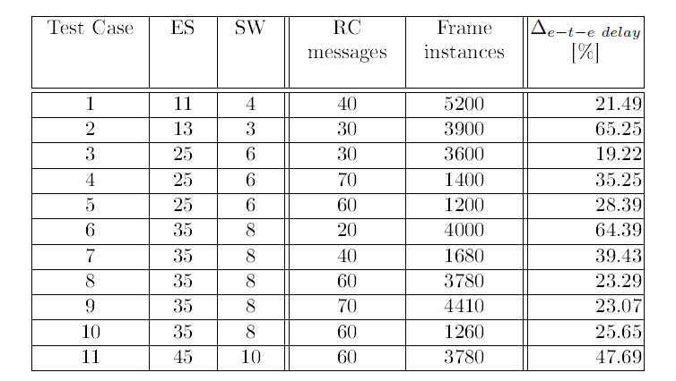
Experimental results
11 synthetic benchmarks from [TSP12]
[TSP12] Domitian Tamas-Selicean and Paul Pop. Synthesis of communication schedules for TTEthernet-based mixed-criticality systems. In Proceedings of the International Conference on Hardware/Software Codesign and System Synthesis, 2012.

Slide 54
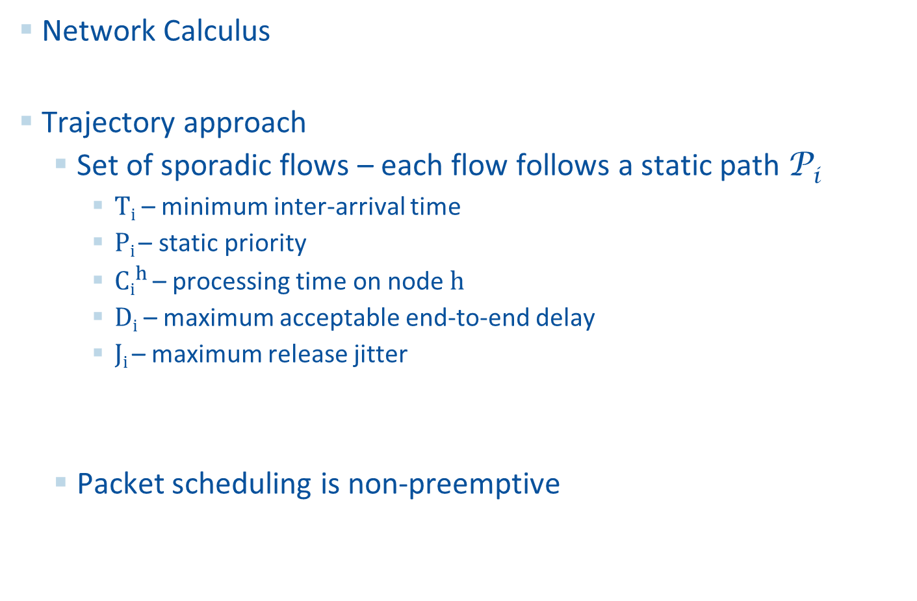
End-to-End Delay Analysis Methods
Network Calculus
Trajectory approach
  Set of sporadic flows – each flow follows a static path P_{i}
    T_{i} – minimum inter-arrival time
    P_{i} – static priority
    ${Ci}_{}^{h }$– processing time on node h
    D_{i} – maximum acceptable end-to-end delay
    J_{i} – maximum release jitter
  Packet scheduling is non-preemptive

Slide 55
Trajectory Approach Principle
Once a packet started to be processed on the last node of its trajectory it can not be interrupted
It makes sense then to determine “only” the latest starting time on the last node in the trajectory
Move backwards through the sequence of visited nodes
Identify the preceding packets and busy periods that ultimately affect the delay of m (the packet under study)

Slide 56
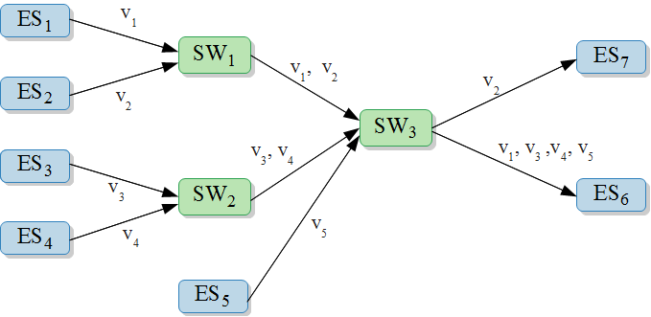
Trajectory Approach Applied to AFDX
The AFDX configuration on which trajectory approach is applied:
AFDX virtual link paths define trajectory approach flows
The flows have the same static priority, same T_{i}

Slide 57
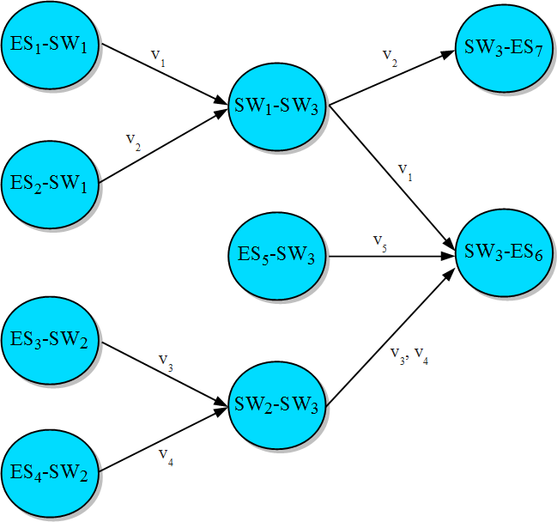
Trajectory Approach Applied to AFDX
The equivalent trajectory approach system:

Slide 58
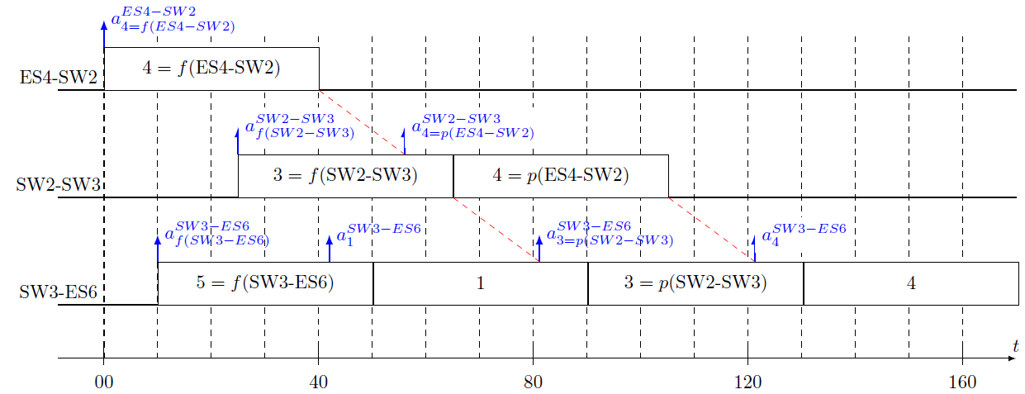
Example Scheduling of Packets
We are interested in the starting time of packet 4 on node SW3-ES6

Slide 59
Trajectory Approach Applied to TTEthernet
The TT and RC frames are modeled as trajectory approach flows
TTEthernet TT frames offsets
How is the trajectory approach applied to TTEthernet depends on the TT/RC integration policy
  Shuffling
    FP/FIFO non-preemptive scheduling policy
  Timely block and preemption
    FP/FIFO scheduling of packets
    Trajectory approach needs to be extended to permit preemption

Slide 60
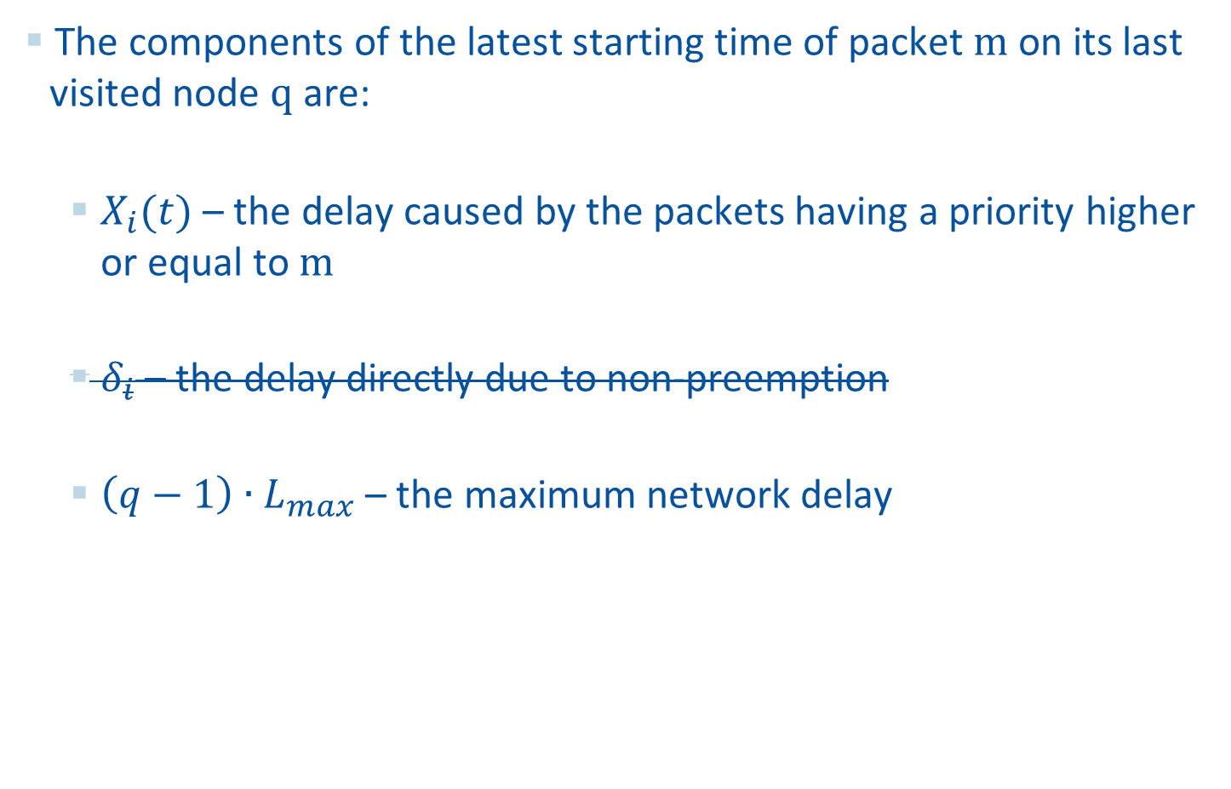
End-to-End Delay Components
The components of the latest starting time of packet m on its last visited node q are:
  $X_{i}(t)$ – the delay caused by the packets having a priority higher or equal to m
  $δ_{i}$ – the delay directly due to non-preemption
  $\left(q−1\right)∙L_{max}$ – the maximum network delay

Slide 61
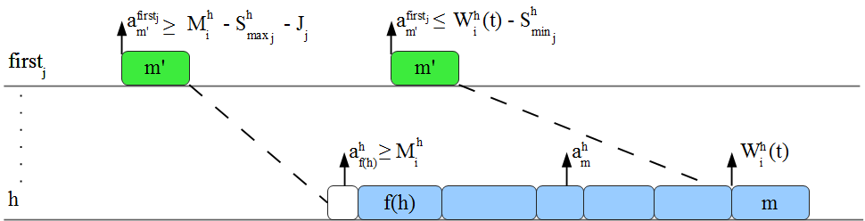
Allowing preemption
The generation interval for packets with higher or equal priority than m

Slide 62
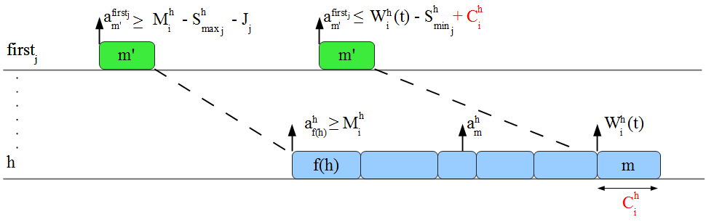
Allowing preemption
The generation interval for packets with higher or equal priority than m when preemption is allowed

Slide 63
Future work
A holistic analysis to integrate our analyses done at the CPU-level and at the network level
Optimal design of virtual links
Study of the influence of different frame parameters on the end-to-end delays
Multi-cluster TTEthernet networks
Notes:
To make more concise!

Slide 64
Conclusions
Functions with different criticalities can share the same computing platform only if there is enough spatial and temporal separation between them
Separation at CPU-level achieved through an IMA-like partitioning
Schedulability analysis of FPS tasks that takes into account the partitions
We have extended a state-of-the-art RTA algorithm to consider a non-periodic partitioning system
Notes:
To make more concise!

Slide 65
Conclusions
Separation at network level provided by TTEthernet
  Predictability is achieved using three classes of traffic: TT, RC and BE
  Spatial separation is achieved trough virtual links
  Temporal separation is enforced by schedule tables for TT traffic and bandwidth allocation for RC traffic
End-to-end delay analysis of RC messages
  We compared the results obtained by the previously proposed TTEthernet analysis and by our TTEthernet simulator
  We proposed an extension of the trajectory approach
Analysis tools are needed to support the designer in order to obtain schedulable implementation of mixed-criticality applications on partitioned architectures
Notes:
To make more concise!

