Slide 1
Timing Analysis of Mixed-Criticality Hard Real-Time Applications Implemented on Distributed Partitioned Architectures
Sorin Ovidiu Marinescu, Domițian Tămaș-Selicean,
Vlad Acrețoaie and Paul Pop
Technical University of Denmark

Slide 2
Motivation
Real time applications implemented using distributed systems
Mixed-criticality applications share the same architecture
Federated Architecture
Integrated Architecture
SIL4
SIL1
SIL3
SIL3
SIL2
SIL4
SIL4
SIL1
PE
Application A ₁
Application A ₂
Application A ₃
Solution: partitioned architecture

Slide 3
Motivation
Spatial and temporal partitioning scheme similar to IMA
Applications run in separate partitions. Each partition can have its own scheduling policy and is allocated several time slots on a processor.
Worst-case response time of tasks scheduled in partitions using fixed-priority preemptive scheduling

Slide 4
Problem formulation
Given
    A set of mixed-criticality applications
    A set of N processing elements (PEs)
    The mappings of tasks to the processing elements (PEs)
    The assignments of tasks to partitions
    The size of the Major Frame and of the Application Cycle
Determine
    The worst-case response times of tasks scheduled in partitions using fixed-priority preemptive scheduling
Schedulability analysis methods
    SA – used in the timing analysis of APEX applications
    SA+ - extension of WCDOPS+

Slide 5
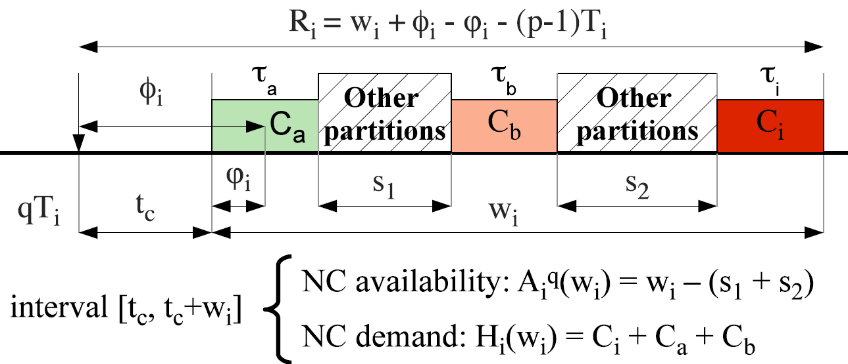
Extending WCDOPS+
WCDOPS+ - response time analysis algorithm for fixed priority scheduled tasks disposed in tree shaped transactions.
WCDOPS+ was extended to take into account the partitions.
The concepts of availability and demand were introduced.
Notes:
To make more concise!

