Slide 1

Routing-Based Synthesis of
Digital Microfluidic Biochips
Elena Maftei, Paul Pop, Jan Madsen
Technical University of Denmark
Notes:
Leave the droplet picture
Hello everybody, and thank for your introduction.
The paper I am presenting is about the design optimization of multi-cluster systems implementing hard-real time applications.
<click>
What is a multi-cluster?

Slide 2
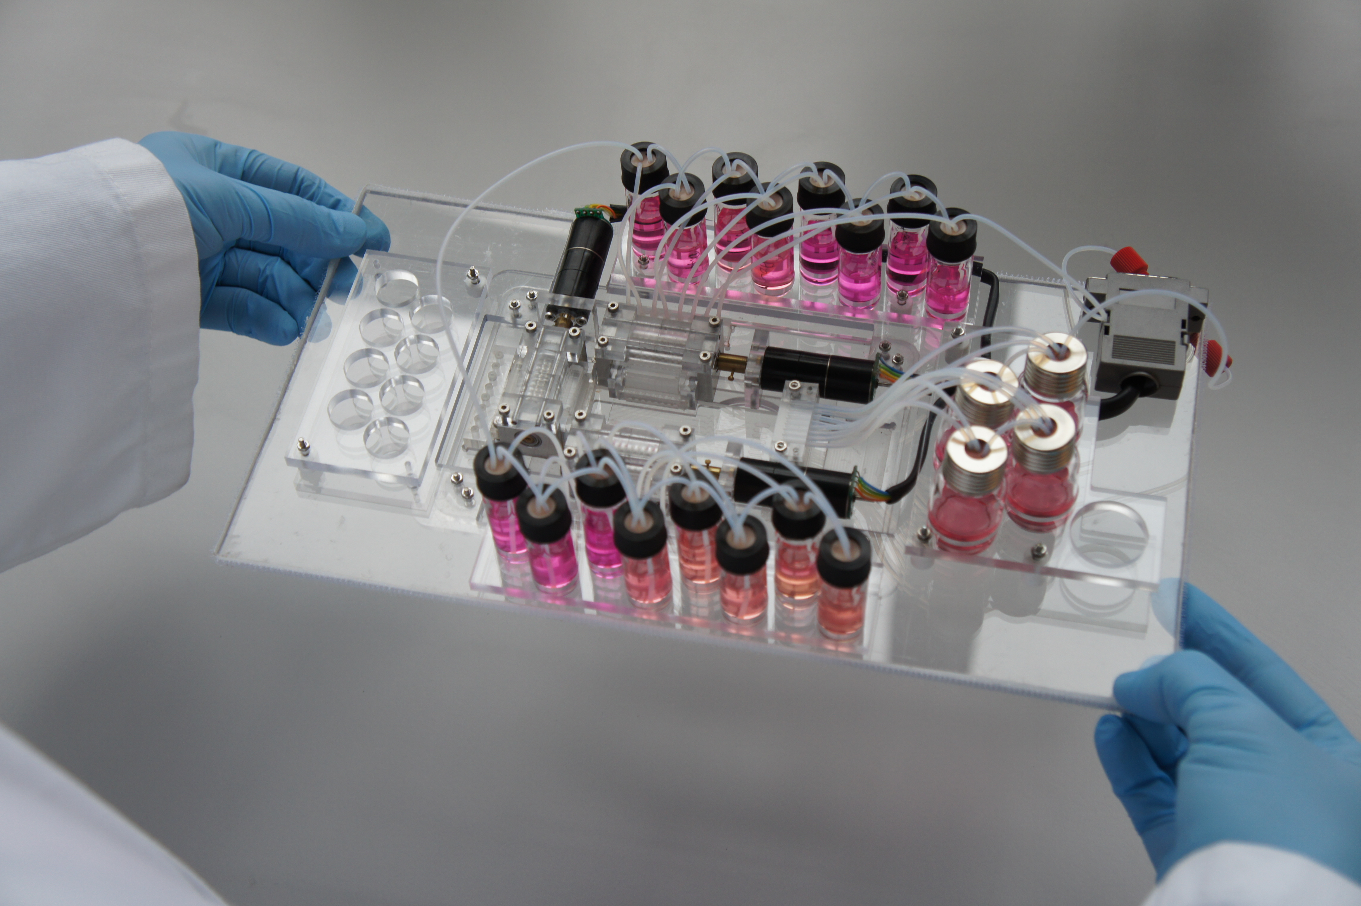
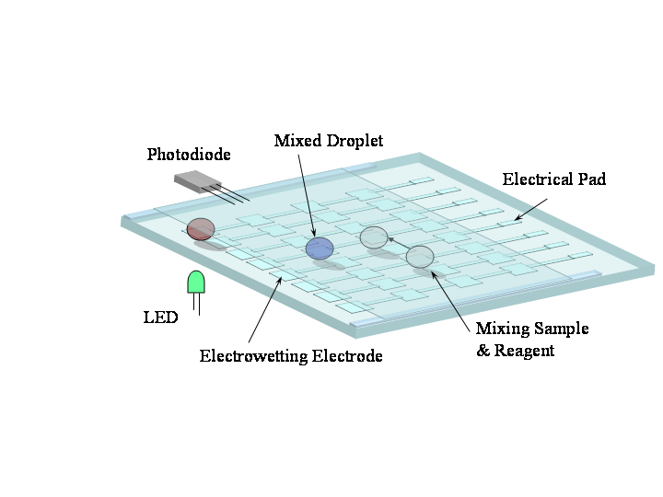
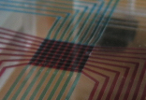
Microfluidic Biochips
Continuous-flow biochips
Droplet-based biochips
Technical Univ. of Denmark
2010
Duke University
2002

Slide 3
Microfluidic Biochips
Applications
  Sampling and real time testing of air/water for biochemical toxins
  Detection of adverse atmospheric conditions
  DNA analysis and sequencing
  Clinical diagnosis
  Point of care devices
Advantages:
  High throughput (reduced sample / reagent consumption)‏
  Space (miniaturization)‏
  Time (parallelism)‏
  Automation (minimal human intervention)‏
Notes:
Ok

Slide 4
Outline
Motivation
Architecture
Typical Design Tasks
Problem Formulation
Proposed Solution
  GRASP-Based Synthesis
Experimental Evaluation
Conclusions

Slide 5
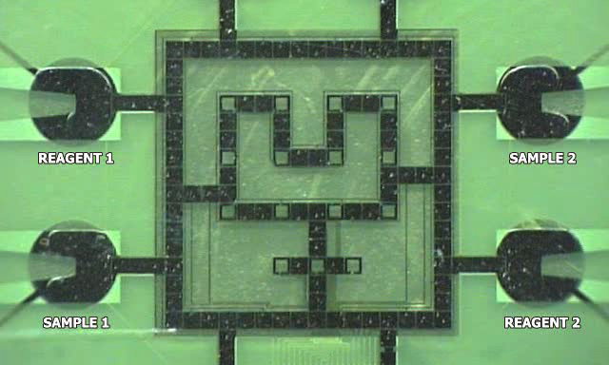
Biochip Architecture
Biochip created at Duke University

Slide 6
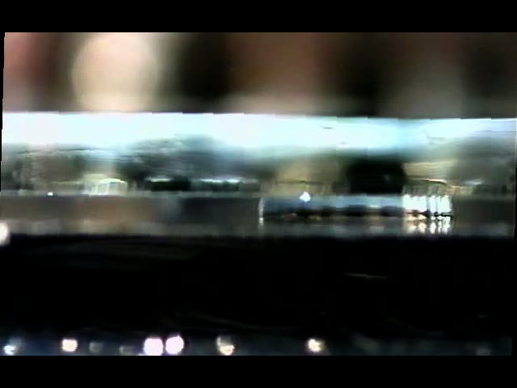
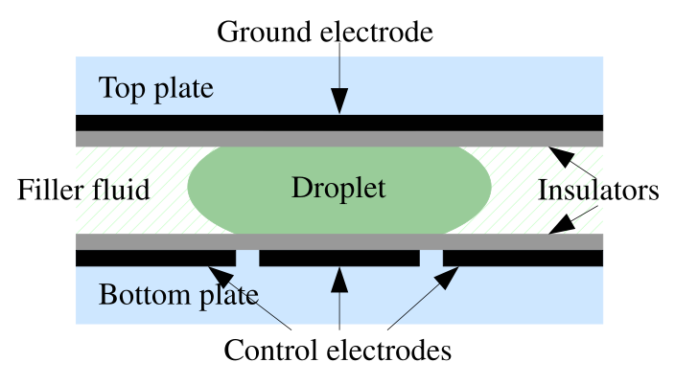
Electrowetting on Dielectric

Slide 7
Module-Based Synthesis: Design Tasks
Allocation
Binding
Placement
Scheduling

Slide 8
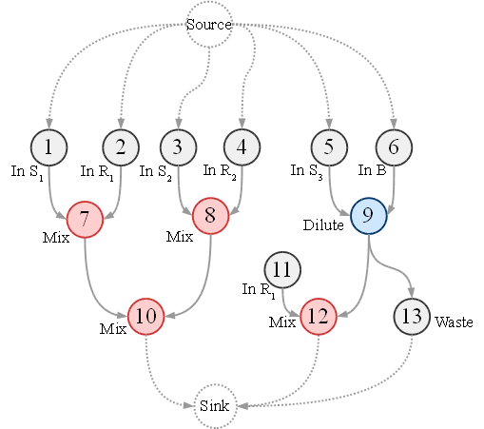
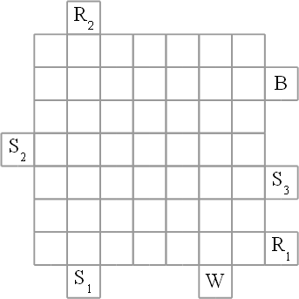
Module-Based Synthesis

Slide 9
Module-Based Synthesis
O7
O8
O9

Slide 10
Module-Based Synthesis
O7
O8
O9

Slide 11
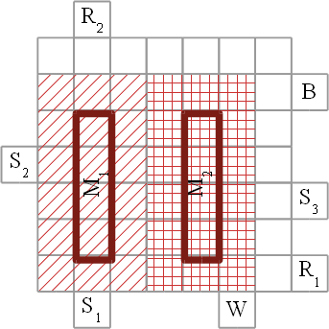
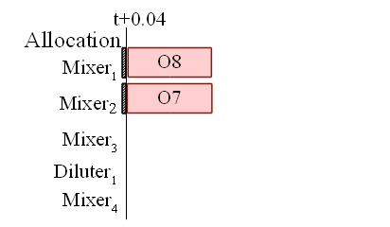
Module-Based Synthesis
O7 | 1x4
O8 | 1x4

Slide 12
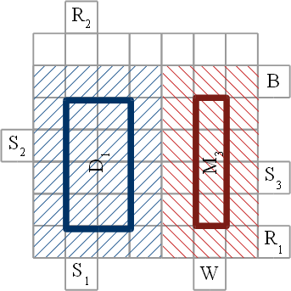
Module-Based Synthesis
O9 | 2x4
O10 | 1x4

Slide 13
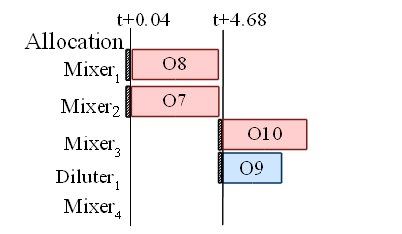
Module-Based Synthesis
O9 | 2x4
O10 | 1x4

Slide 14
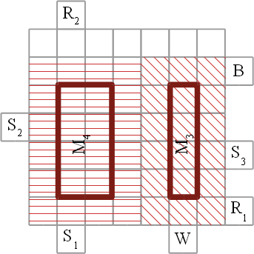
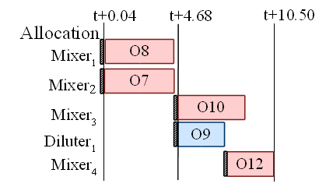
Module-Based Synthesis

Slide 15
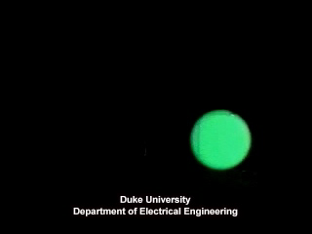
Mixing
Droplets can move anywhere
Fixed area:
module-based synthesis
Unconstrained:
routing-based
synthesis

Slide 16
Routing-Based Synthesis

Slide 17
Routing-Based Synthesis
O7
O8
O9

Slide 18
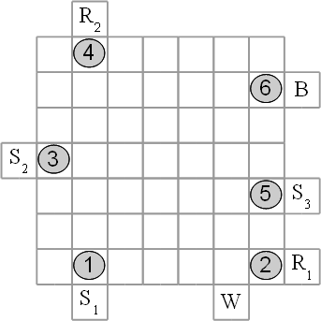
Routing-Based Synthesis

Slide 19
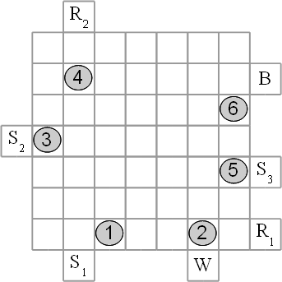
Routing-Based Synthesis

Slide 20
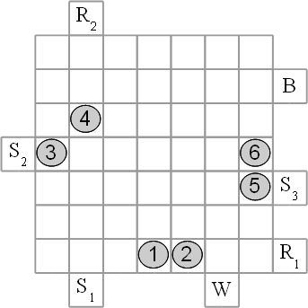
Routing-Based Synthesis

Slide 21
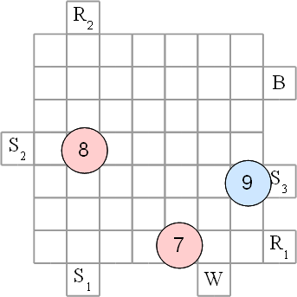
Routing-Based Synthesis

Slide 22
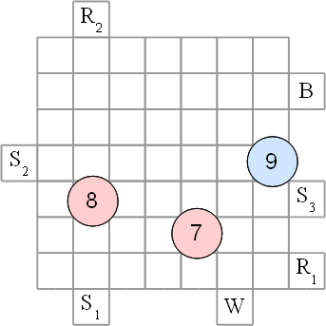
Routing-Based Synthesis

Slide 23
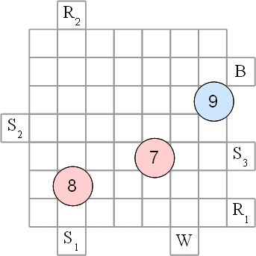
Routing-Based Synthesis

Slide 24
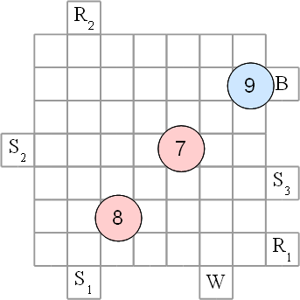
Routing-Based Synthesis

Slide 25
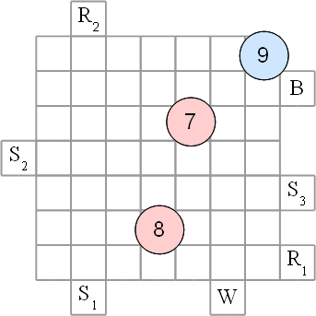
Routing-Based Synthesis

Slide 26
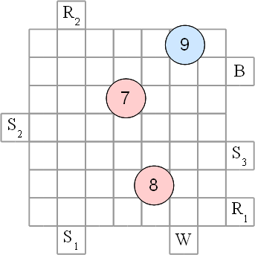
Routing-Based Synthesis

Slide 27
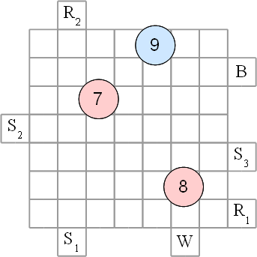
Routing-Based Synthesis

Slide 28
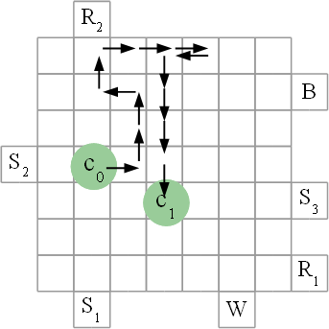
When will the operations complete?
For module-based synthesis we know the completion time from the module library.
But now there are no modules, the droplets can move anywhere.
  How can we find out the
  operation completion times?

Slide 29
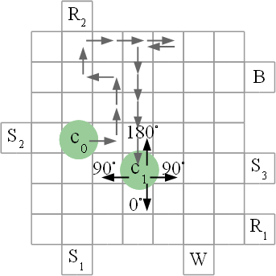
Characterizing operations
If the droplet does not move: very slow mixing by diffusion
If the droplet moves, how long does it take to complete?
Mixing percentages:
p⁰, p⁹⁰, p¹⁸⁰ ?

Slide 30
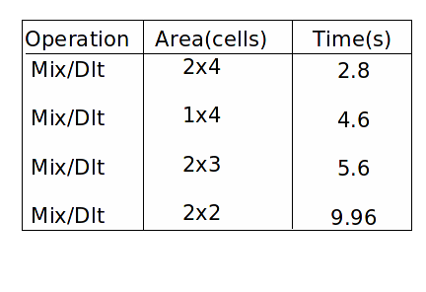
Characterizing operations
We know how long an operation takes on modules
Starting from this, can determine the percentages?

Slide 31




Decomposing modules
Safe, conservative estimates
p⁹⁰ = 0.1%, p¹⁸⁰ = -0.5%,
p⁰ = 0.29% and 0.58%
Moving a droplet one cell takes 0.01 s.

Slide 32
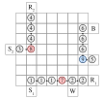
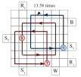
Routing-Based Synthesis

Slide 33
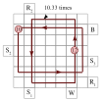
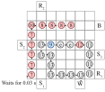
Routing-Based Synthesis

Slide 34
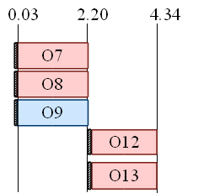
Droplet- vs. Module-Based Synthesis
Routing-Based Synthesis
Module-Based Synthesis

Slide 35
Problem Formulation
Input
  Application graph
  Architecture (matrix of electrodes)
  Library of non-reconfigurable devices
Output
  Implementation which minimizes application execution time
    Droplet routes for all reconfigurable operations
    Allocation and binding of non-reconfigurable modules from a library
    Scheduling of operations

Slide 36
Proposed Solution

Slide 37
Proposed Solution
Meet
Execute

Slide 38
Proposed Solution
Meet
Minimize the time
until the droplet(s)
arrive at destination
Execute
Minimize the completion
time for the operation

Slide 39
GRASP-Based Heuristic
Greedy Randomized Adaptive Search Procedure

Slide 40
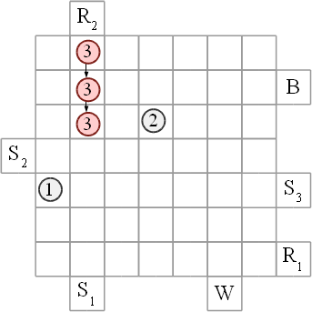
GRASP-Based Heuristic
Greedy Randomized Adaptive Search Procedure

Slide 41
GRASP-Based Heuristic
Greedy Randomized Adaptive Search Procedure
For each droplet:
  Determine possible moves
  Evaluate possible moves
  Make a list of
  best N possible moves
  Perform a randomly
  chosen possible move

Slide 42
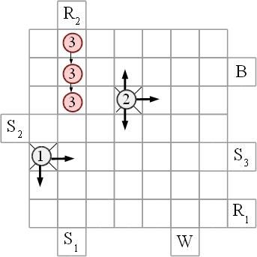
GRASP-Based Heuristic
Greedy Randomized Adaptive Search Procedure
For each droplet:
  Determine possible moves
  Evaluate possible moves
  Make a list of
  best N possible moves
  Perform a randomly
  chosen possible move

Slide 43
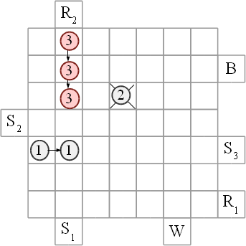
GRASP-Based Heuristic
Greedy Randomized Adaptive Search Procedure
For each droplet:
  Determine possible moves
  Evaluate possible moves
  Make a list of
  best N possible moves
  Perform a randomly
  chosen possible move

Slide 44
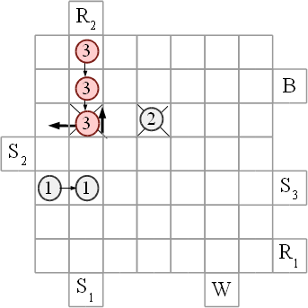
GRASP-Based Heuristic
Greedy Randomized Adaptive Search Procedure
For each droplet:
  Determine possible moves
  Evaluate possible moves
  Make a list of
  best N possible moves
  Perform a randomly
  chosen possible move

Slide 45
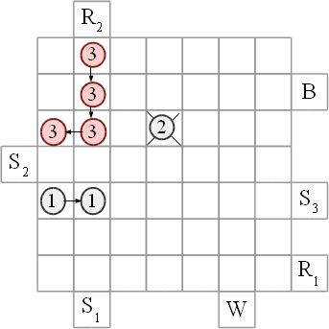
GRASP-Based Heuristic
Greedy Randomized Adaptive Search Procedure
For each droplet:
  Determine possible moves
  Evaluate possible moves
  Make a list of
  best N possible moves
  Perform a randomly
  chosen possible move

Slide 46

Experimental Evaluation
Routing-Based Synthesis (RBS) vs. to Module-Based Synthesis* (MBS)
  Two real-life applications (the table below)
  Ten synthetic benchmarks (see the paper)
(*) E. Maftei at al.: Tabu Search-Based Synthesis of Dynamically Reconfigurable
Digital Microfluidic Biochips. CASES, 2009 (best paper award)

Slide 47
Contributions and Message
Message
  Labs-on-a-chip can be implemented with microfluidics
  CAD tools are essential for the design of biochips
Contributions
  Eliminated the concept of “virtual modules” and proposed a routing-based synthesis approach
  Proposed a GRASP-based algorithm for showing that routing-based synthesis leads to significant improvements compared to module-based synthesis

Slide 48
Discussion
Module-based vs. routing-based
  Module-based needs an extra routing step between the modules;
  Routing-based performs unified synthesis and routing
  Module-based wastes space: only one module-cell is used;
  Routing-based exploits better the application parallelism
  Module-base can contain the contamination to a fixed area;
  We are extending routing-based to consider contamination
  Module-based: nice, useful abstraction?
  Routing based: too much spaghetti?

