Slide 1




Paul Pop, Technical University of Denmark, Denmark
Tsung-Yi Ho, National Cheng Kung University, Taiwan
Juinn-Dar Huang, National Chiao Tung University, Taiwan
Digital Microfluidic Biochips: Towards Hardware/Software Co-Design and Cyberphysical Integration

Slide 2






Acknowledgments
Students: Tsung-Wei Huang, Yi-Ling Hsieh, Jia-Wen Chang, Sheng-Han Yeh
Collaborators: Prof. Krishnendu Chakrabarty (Duke Univ.), Prof. Shigeru Yamashita (Ritsumeikan Univ.)
Duke University’s Microfluidics Research Lab
Advanced Liquid Logic (http://www.liquid-logic.com/): Start-up company spun out off Duke University’s microfluidics research project

Slide 3

Acknowledgments
Prof. Jan Madsen
Dr. Elena Maftei, Dr. Wajid Hassan Minhass
PhD student Mirela Alistar
Master students: Morten Foged Schmidt, Maciej Piotr Lukas, Felician S. Blaga
Bachelor students: Martin Simonsen Hørslev-Petersen, Thomas Onstrup Risager
The Danish Council for Strategic Research

Slide 4
Acknowledgments
Students: Chia-Hung Liu, Huei-Shen Lin, Ting-Wei Chiang
Prof. Tsung-Yi Ho, National Cheng Kung University, Taiwan
Ministry of Education (MoE), Taiwan
National Science Council (NSC), Taiwan

Slide 5
Outline
Microfluidic platforms
  Digital microfluidic biochips
System-level design
  Modeling
  Typical design tasks
  Cyberphysical system integration
Physical synthesis
Sample preparation

Slide 6

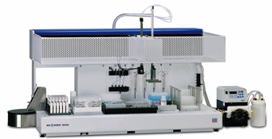
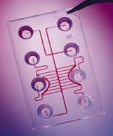

Motivation for biochips
Automation
Test tubes
Integration
Miniaturization
⬇
Automation
Robotics
Integration
Miniaturization
⬇
Microfluidic Biochips
Automation
Integration
Miniaturization
Slide source: Prof. Krishneddu Chakrabarty, Duke Universtiy

Slide 7
Microfluidics field evolution
From: Engineers are from PDMS-land, Biologists are from Polystyrenia, Lab Chip, 2012, 12, 1224

Slide 8
Microfluidics on the “slope of enlightenment”
From: Microfluidics: On the Slope of Enlightenment, Anal. Chem., May 2009

Slide 9
Microfluidic platforms
A microfluidic platform provides a set of fluidic unit operations, which are designed for easy combination within a well-defined fabrication technology.
From: Microfluidic lab-on-a-chip platforms: requirements, characteristics and applications, Chem. Soc. Rev., 2010, 39, 1153–1182

Slide 10
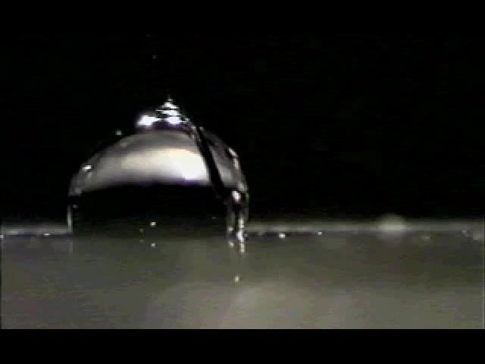
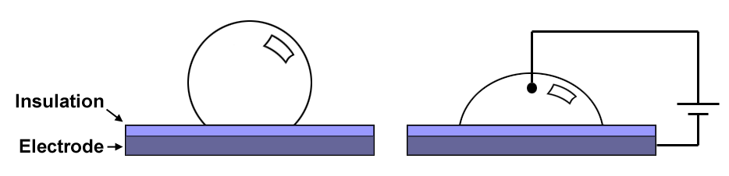
Electrowetting
Novel microfluidic platform invented at Duke University
Droplet actuation is achieved through an effect called electrowetting
No Potential
A droplet on a hydrophobic surface originally has a large contact angle.
Applied Potential
The droplet’s surface energy increases, which results in a reduced contact angle. The droplet now wets the surface.
Slide source: Prof. Krishneddu Chakrabarty, Duke Universtiy
Notes:
This digital microfluidic biochips invented at Duke University is based the principle of electrowetting. Electrowetting is to apply the electrical field to modulate the solid-liquid interfacial tension. As shown in this figure, we put a droplet on a hydrophobic surface. it has a large contact angle. If an electrical field is applied between the droplet and the solid surface, the contact angle is reduced. So, the interfacial surface tension is changed. if we apply an electric field to only one side of the droplet, it will create an imbalance of surface tensions. Then, It will drive the droplet to move. This the working principle of our biochips.

Slide 11
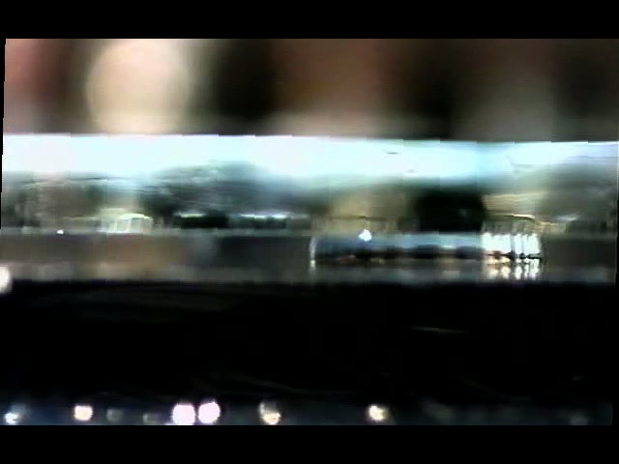
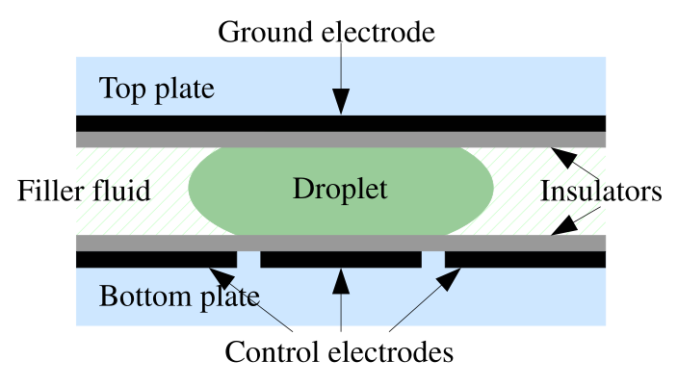
Operations: droplet movement

Slide 12
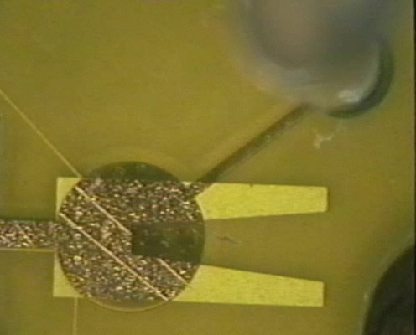
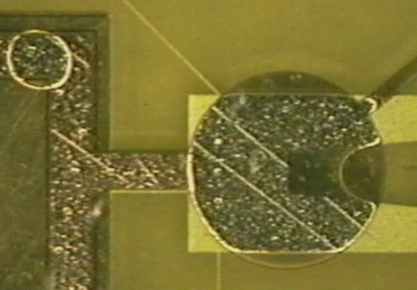
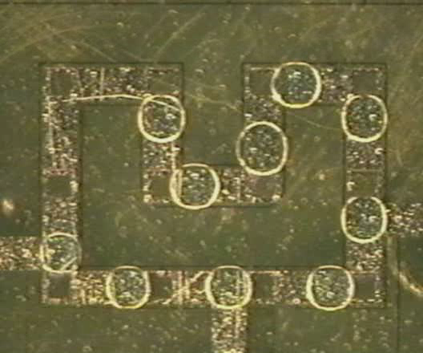
Operations, cont.
Reservoir loading
Droplet dispensing
Transport

Slide 13
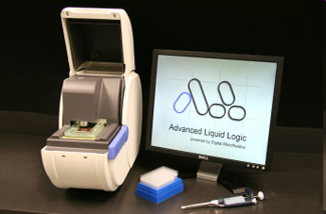
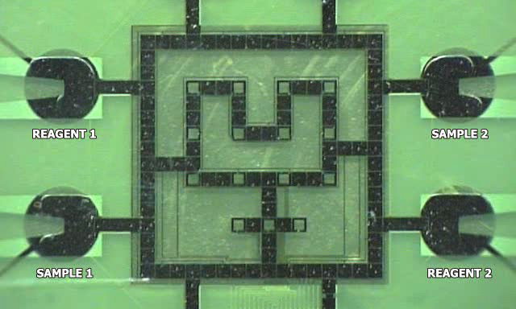
Droplet-based microfluidic biochips
Commercial application: Newborn screening
Biochip from Duke University
Current design practice: full-custom bottom-up
As the complexity increases (there are architectures with thousands of electrodes), top-down design methods are needed

Slide 14
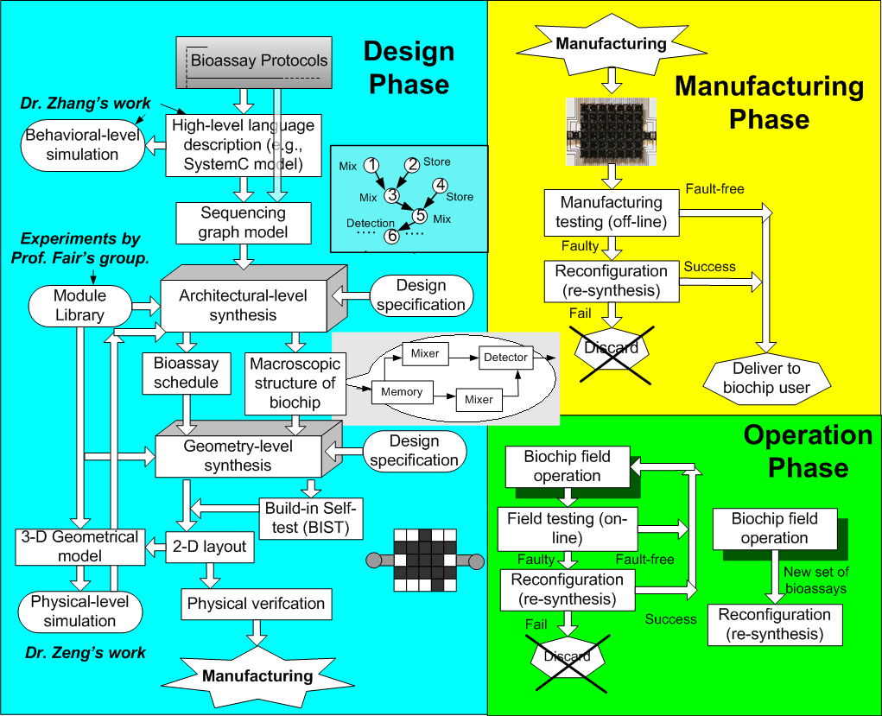
Biochip Design Automation Overview
Slide source: Prof. Krishneddu Chakrabarty, Duke Universtiy
Notes:
In my thesis research, I propose a top-down methodology to support system-level design-automation for digital microfluidic biochips. This automation tool can be used in biochip design phase, manufacturing phase and operation phase. This figure illustrates the flow of the proposed method. First we can obtain a behavioral graph model for a bioassay from its protocol directly. Or we can use a high-level language such as SystemC to describe the bioassay, then we generate a graph model from SystemC model. This systemC model can also be used for behavioral-level simulation. This work has been done by Dr. Tianhao Zhang. Next, architectural-level synthesis is used to generate a macroscopic structure of the biochip; this structure is analogous to a structural RTL model in electronic CAD. In this phase, bioassay operations are binding to functional resources and also then scheduled. Then, geometry-level synthesis creates a physical representation at a 2-D geometrical level. This 2-D layout of the biochip consist of the configuration of the microfluidic array, locations of reservoirs and dispensing ports, and other geometric details. To support self test, we can also design test hardware and generate a test plan in this phase. Note that a microfluidic module library will be provided to synthesis procedures. They have information on appropriate modules and components. We can build and update this library by using experimental data from Prof. Fair and his students. And also, we can generate a 3-D geometrical model from this 2-D layout to support physical-level simulation. This simulation work is being invesitgated by Dr. Jun Zeng at Coventor. After the physical verification, this biochip design will be sent to be fabricated. In the manufacturing phase, we will use testing techniques to the fabricated biochip just after its fabrication. If this biochip is fault-free, it will be delivered to the biochip user. If not, we try to apply reconfiguration techniques to bypass the faulty cells. Synthesis techniques will be used to re-schedule the bioassay and re-place modules. If this reconfiguration succeed, this faulty biochip can still be used. Otherwise, it will be discarded. Clearly this reconfiguration technique increase the yield of biochip. Finally, in operation phase, in order to ensure high reliability, we need to perform field testing. If some cells become faulty during the operation, we try to use dynamic reconfiguration technique to avoid them to keep the right functionality. This will increase the life-time of biochip. The key issues in the proposed synthesis, testing and reconfiguration techniques form my thesis research work.

Slide 15
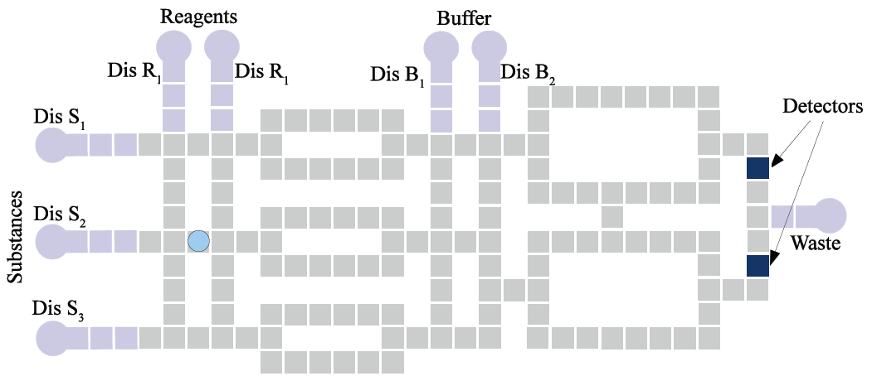
Architecture modeling

Slide 16
Operation execution modeling
Non-reconfigurable
R₂
Dispensing
Detection
Splitting/Merging
Storage
Mixing/Dilution
B
S₂
Reconfigurable
S₃
R₁
S₁
W

Slide 17
Operation execution: “modules”
R₂
Module library
Operation | Area (cells) | Time (s)
Mix | 2 x 4 | 3
Mix | 2 x 2 | 4
Dilution | 2 x 4 | 4
Dilution | 2 x 2 | 5
B
2 x 4
module
S₂
S₃
R₁
S₁
W

Slide 18
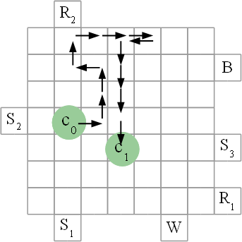
Operation execution: “routes”
Droplets can move anywhere
No need to consider fixed “modules”, operations are executed on a “route”

Slide 19
Biochemical application model
  “in-vitro diagnostics”
  application
See also: BioCoder [Ananthanarayanan et al., Biological Engineering 2010]

Slide 20
System-level design tasks
Allocation
Binding
Placement & routing
Scheduling

Slide 21
Example system-level synthesis problem
Given
  Application: graph
  Biochip: array of electrodes
  Library of modules
Determine
  Allocation of modules from modules library
  Binding of modules to operations in the graph
  Scheduling of operations
  Placement of modules on the array
Such that
  the application execution time is minimized

Slide 22
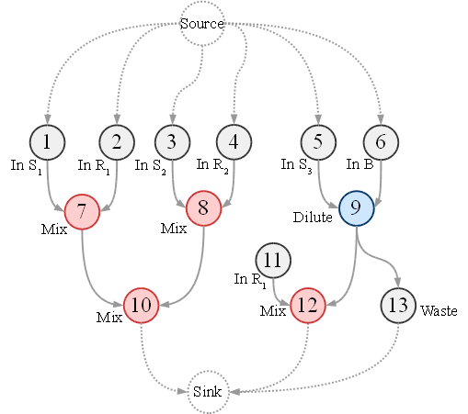
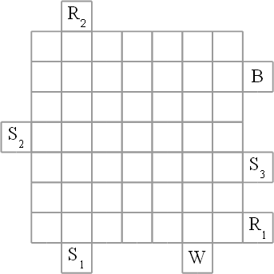
System-level synthesis example

Slide 23
System-level synthesis example
O7
O8
O9

Slide 24
System-level synthesis example
O7
O8
O9

Slide 25
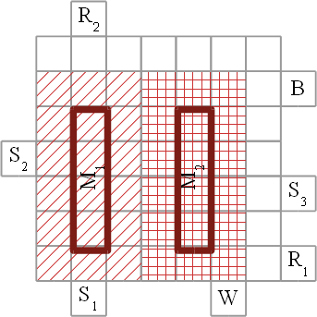
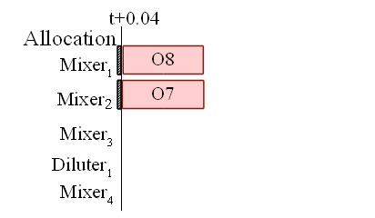
System-level synthesis example
O7 | 1x4
O8 | 1x4

Slide 26
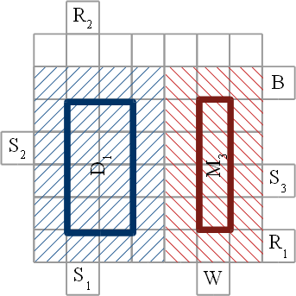
System-level synthesis example
O9 | 2x4
O10 | 1x4

Slide 27
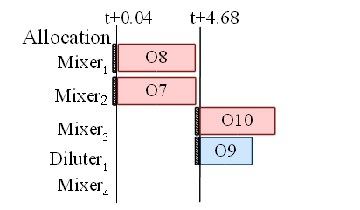
System-level synthesis example
O9 | 2x4
O10 | 1x4

Slide 28
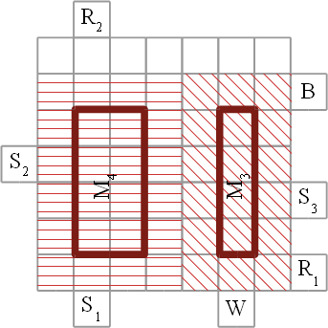
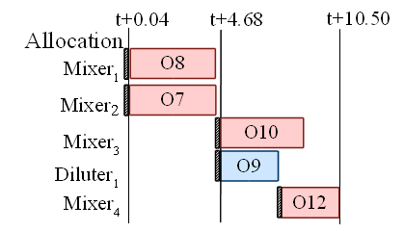
System-level synthesis example

Slide 29
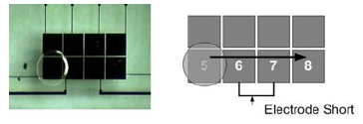
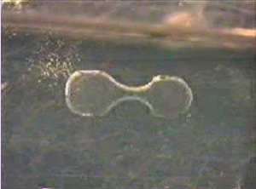
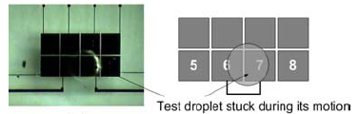
Synthesis Challenges: faults, variability
Electrode short
Electrode degradation
Imperfect splitting
Hindered transportation

Slide 30
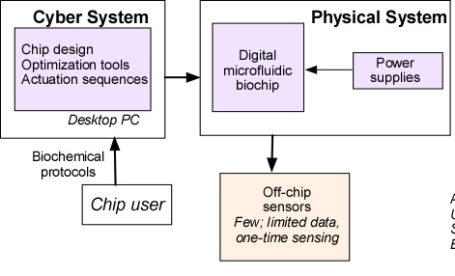
Today’s Digital Microfluidic Biochips
Slide source: Prof. Krishneddu Chakrabarty, Duke Universtiy

Slide 31
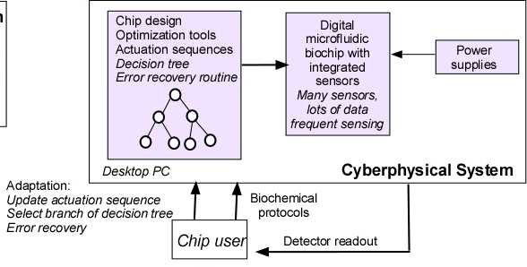
Cyberphysical system integration
Slide source: Prof. Krishneddu Chakrabarty, Duke Universtiy

Slide 32
Runtime (online) synthesis for error recovery

