Slide 1
System-Level Design of
Digital Microfluidic Biochips
Paul Pop
Technical University of Denmark
Acknowledgements:
Elena Maftei, Mirela Alistar, Jan Madsen (DTU)
Krishnendu Chakrabarty (Duke Univ.)
All of today’s slides:
cl.lk/tutorial2011

Slide 2
Outline
Digital microfluidic biochips
  Architecture model: module vs. routing-based
  Application model
Top-level design flow
  Design tasks
  Module-based synthesis
  Routing-based synthesis
  Fault-tolerant applications

Slide 3
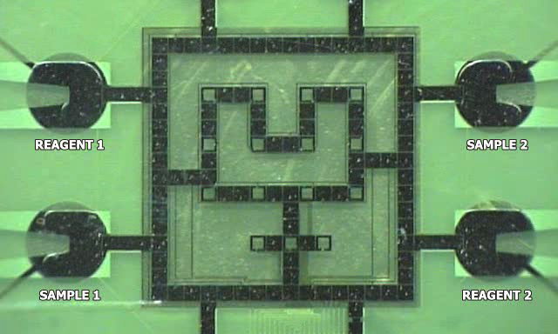
Architecture model
Biochip from Duke University

Slide 4
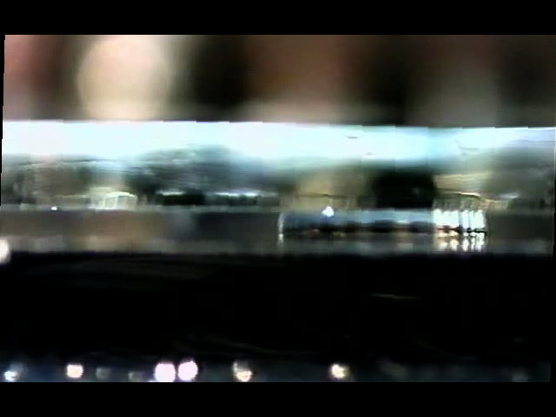
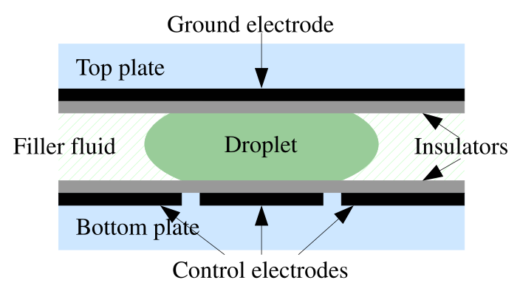
Electrowetting on Dielectric

Slide 5
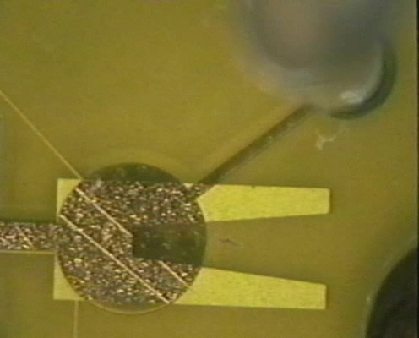
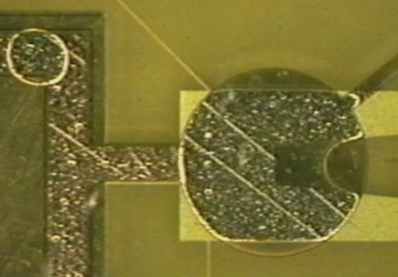
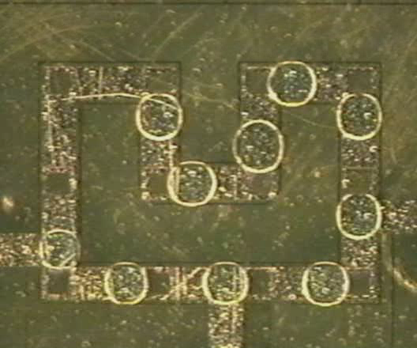
Operations, cont.
Reservoir loading
(0.1M KCL with dye)
Transport on 3-phase inner bus
Droplet dispensing

Slide 6
Reconfigurability
Non-reconfigurable
R₂
Dispensing
Detection
Splitting/Merging
Storage
Mixing/Dilution
B
S₂
Reconfigurable
S₃
R₁
S₁
W

Slide 7
Operation execution: Module based
R₂
Module library
Operation | Area (cells) | Time (s)
Mix | 2 x 4 | 3
Mix | 2 x 2 | 4
Dilution | 2 x 4 | 4
Dilution | 2 x 2 | 5
B
2 x 4
module
S₂
S₃
R₁
S₁
W

Slide 8
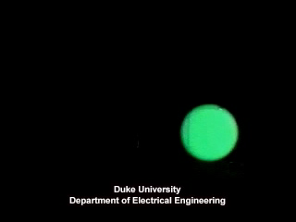
Operations: Mixing
Droplets can move anywhere
Fixed area:
module-based
operation execution
Unconstrained:
routing-based
operation execution

Slide 9
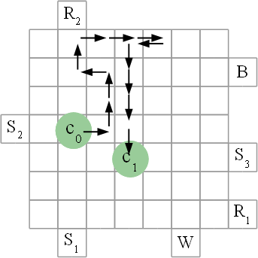
Operation execution: Routing based
Droplets can move anywhere
Constrained to a module
  We know the completion time from the module library.
Unconstrained, any route
  How can we find out the
  operation completion times?

Slide 10
Application model: from this…
  Trinder’s reaction, a colorimetric enzyme-based method
  Glucose assay steps on the biochip
  Several such reactions assays in parallel:
  “in-vitro diagnostics” application
  Reconfigurable architecture

Slide 11
Application model:
…to this—an acyclic directed graph
  “in-vitro diagnostics”
  application

Slide 12
Another application example:
“Colorimetric protein assay”

Slide 13
System-level design tasks
Allocation
Binding
Placement & routing
Scheduling

Slide 14
My motivation: adapt familiar design methods to a new area
FPGA
Digital biochip
Transistors
Net Wires
Clock lines
Control electrodes
Reservoirs
Transparent cells
Basic Devices
RAM
Multiplexer
CLBs
Mixers
Transport bus
Optical detectors
Tiles
Systems
Configured FPGA
Configured biochip

Slide 15
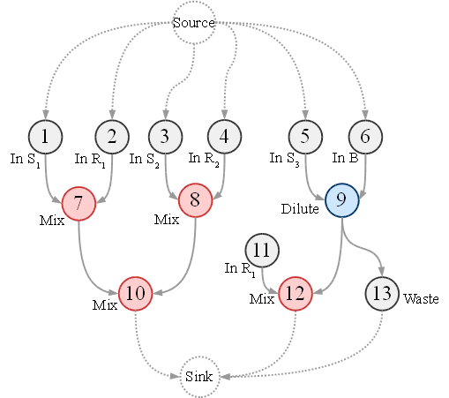
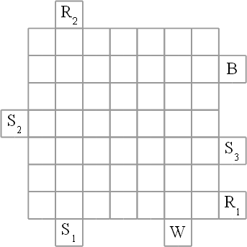
Module-Based Synthesis

Slide 16
Module-Based Synthesis
O7
O8
O9

Slide 17
Module-Based Synthesis
O7
O8
O9

Slide 18
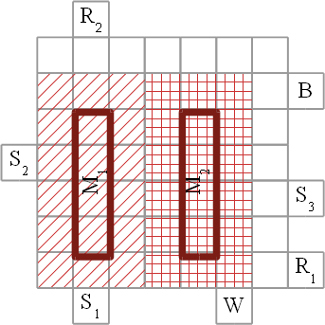
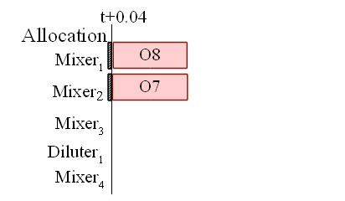
Module-Based Synthesis
O7 | 1x4
O8 | 1x4

Slide 19
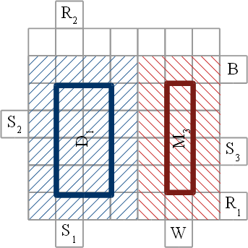
Module-Based Synthesis
O9 | 2x4
O10 | 1x4

Slide 20
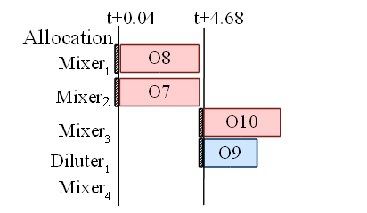
Module-Based Synthesis
O9 | 2x4
O10 | 1x4

Slide 21
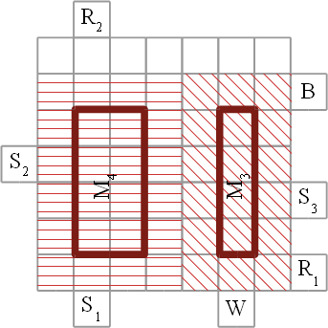
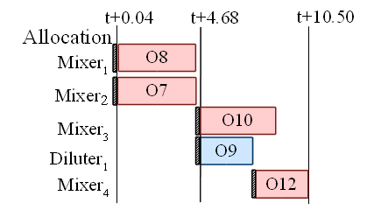
Module-Based Synthesis

Slide 22
Problem Formulation
Given
  Application: graph
  Biochip: array of electrodes
  Library of modules
Determine
  Allocation of modules from modules library
  Binding of modules to operations in the graph
  Scheduling of operations
  Placement of modules on the array
Such that
  the application execution time is minimized

Slide 23
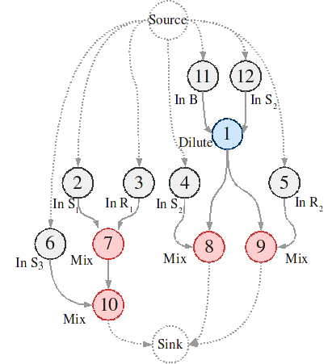
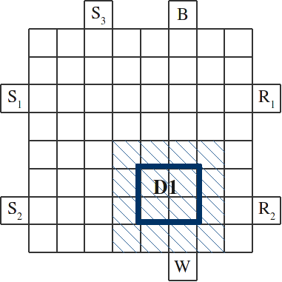
Reconfigurability

Slide 24
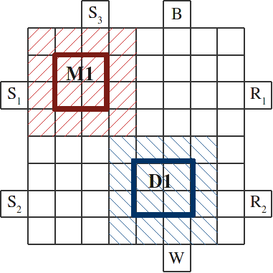
Reconfigurability

Slide 25
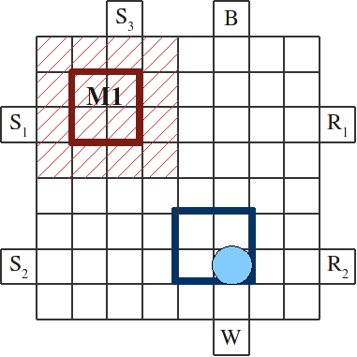
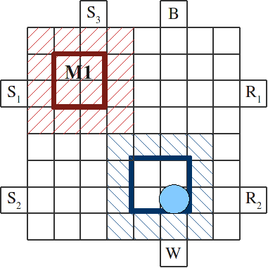
Reconfigurability

Slide 26
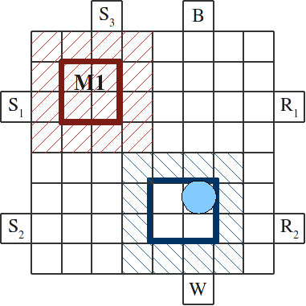
Reconfigurability

Slide 27
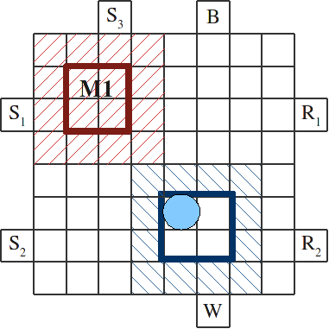
Reconfigurability

Slide 28
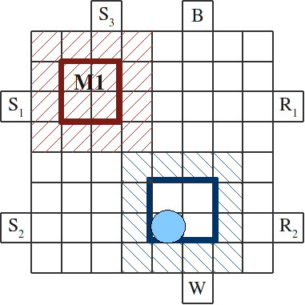
Reconfigurability

Slide 29
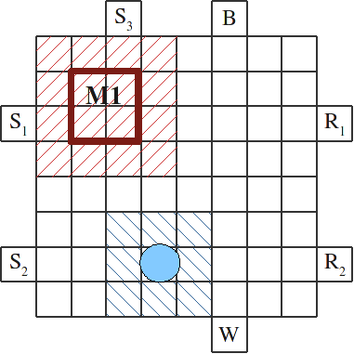
Reconfigurability

Slide 30
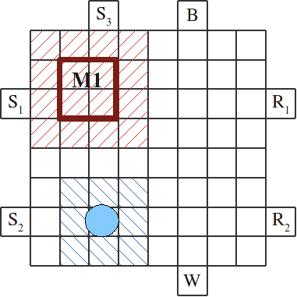
Reconfigurability

Slide 31
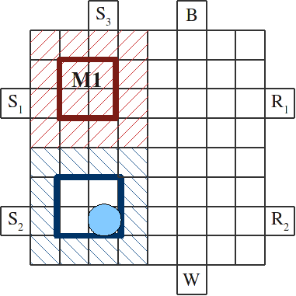
Reconfigurability

Slide 32
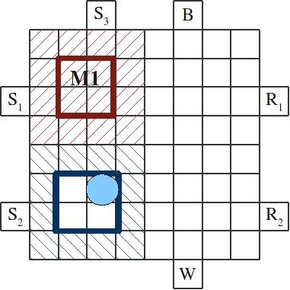
Reconfigurability

Slide 33
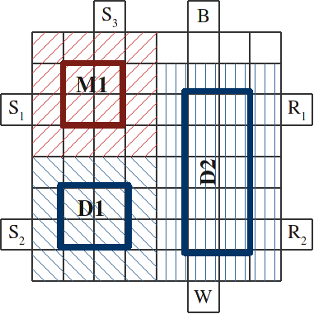
Reconfigurability

Slide 34
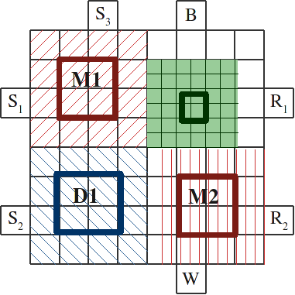
Reconfigurability

Slide 35
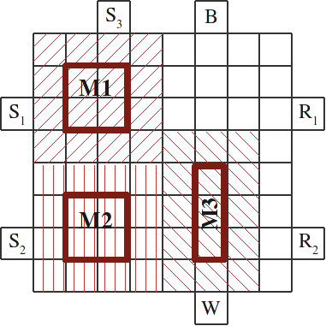
Reconfigurability

Slide 36
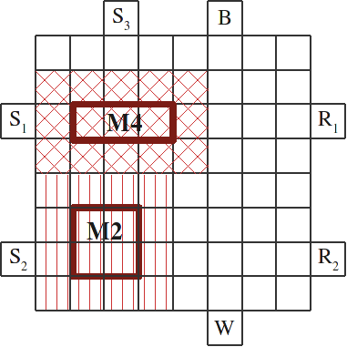
Reconfigurability

Slide 37
Reconfigurability
Without dynamic
reconfiguration: t+18

Slide 38
Solution
Binding of modules to operations
Schedule of the operations
  Placement of modules performed
  inside scheduling
Placement of the modules
  Free space manager based on
  [Bazargan et al. 2000]
Other solutions proposed in the literature:
  Integer Linear Programming
  Simulated Annealing
Tabu Search
List Scheduling
Maximal Empty Rectangles

Slide 39
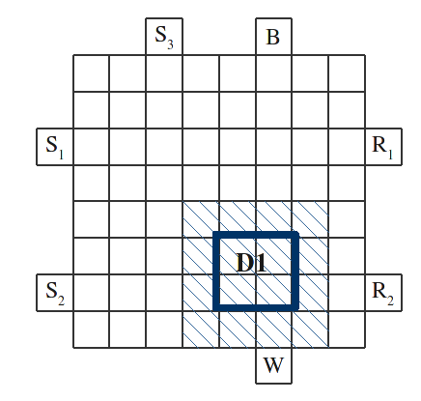
Dynamic Placement Algorithm
Operation
Module
O₇ (mix)
M₁ (2x2)
O₁ (diluter)
D₂ (2x5)

Slide 40
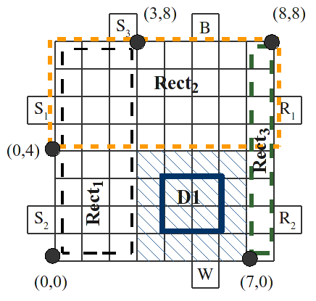
Dynamic Placement Algorithm
[Bazargan et al. 2000]
Free space manager: divides free space into a list of overlapping rectangles
Search engine:
selects the best empty rectangle from the list using “best fit”

Slide 41
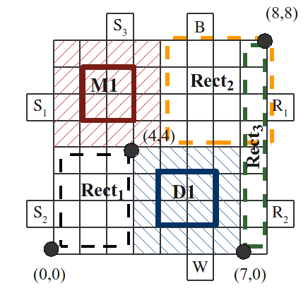
Dynamic Placement Algorithm
Modified [Bazargan et al. 2000]: use a Greedy approach to try to move each device (under a routing constraint) in order to reduce the free space fragmentation.

Slide 42
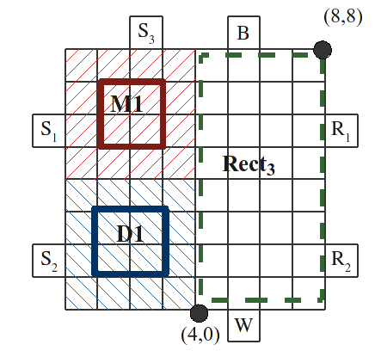
Dynamic Placement Algorithm

Slide 43
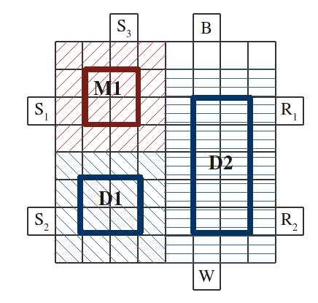
Dynamic Placement Algorithm

Slide 44
Routing-Based Synthesis

Slide 45
Routing-Based Synthesis
O7
O8
O9

Slide 46
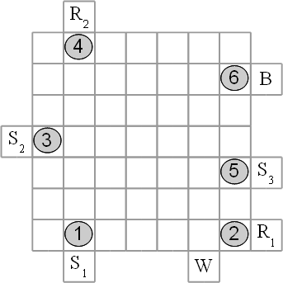
Routing-Based Synthesis

Slide 47
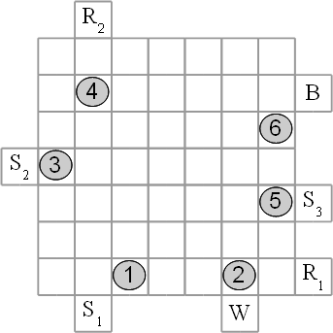
Routing-Based Synthesis

Slide 48
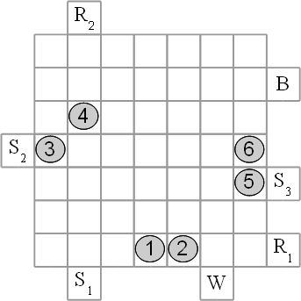
Routing-Based Synthesis

Slide 49
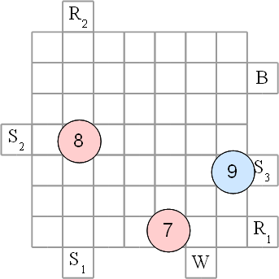
Routing-Based Synthesis

Slide 50
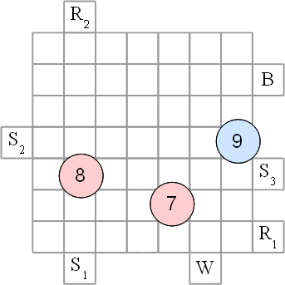
Routing-Based Synthesis

Slide 51
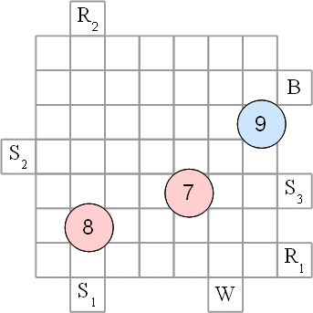
Routing-Based Synthesis

Slide 52
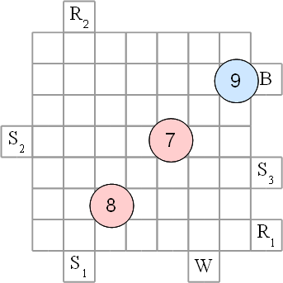
Routing-Based Synthesis

Slide 53
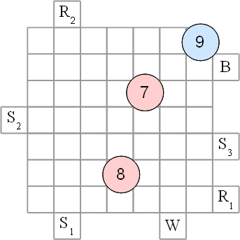
Routing-Based Synthesis

Slide 54
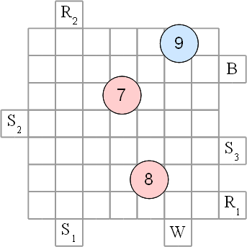
Routing-Based Synthesis

Slide 55
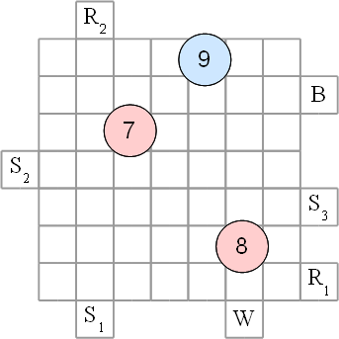
Routing-Based Synthesis

Slide 56
When will the operations complete?
For module-based synthesis we know the completion time from the module library.
But now there are no modules,
the droplets can move anywhere:
  How can we find out the
  operation completion times?

Slide 57
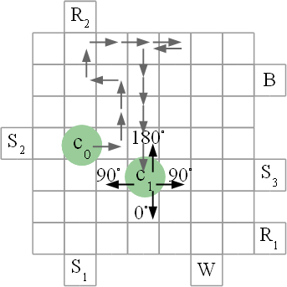
Characterizing operations
If the droplet does not move:
very slow mixing by diffusion
If the droplet moves, how long does it take to complete?
Mixing percentages:
p⁰, p⁹⁰, p¹⁸⁰ ?

Slide 58
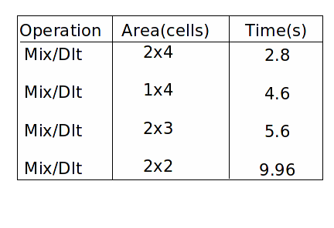
Characterizing operations
We know how long an operation takes on modules
Starting from this, can determine the percentages?

Slide 59




Decomposing modules
Safe, conservative estimates
p⁹⁰ = 0.1%, p¹⁸⁰ = -0.5%,
p⁰ = 0.29% and 0.58%
Moving a droplet one cell takes 0.01 s.

Slide 60
Routing-Based Synthesis

Slide 61
Routing-Based Synthesis

Slide 62
Routing- vs. Module-Based Synthesis

Slide 63
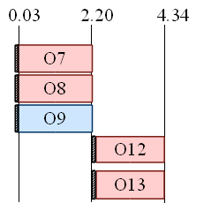
Routing- vs. Module-Based Synthesis
Routing-Based Synthesis
Module-Based Synthesis

Slide 64
Problem Formulation
Given
  Application: graph
  Biochip: array of electrodes
  Library of non-reconfigurable devices
Determine
  Droplet routes for all reconfigurable operations
  Allocation and binding of non-reconfigurable modules from a library
  Scheduling of operations
Such that
  the application completion time is minimized

Slide 65
Proposed Solution

Slide 66
Proposed Solution
Meet
Execute

Slide 67
Proposed Solution
Meet
Minimize the time
until the droplet(s)
arrive at destination
Execute
Minimize the completion
time for the operation

Slide 68

GRASP-Based Heuristic
Greedy Randomized Adaptive Search Procedure
For each droplet:
  Determine possible moves
  Evaluate possible moves
  Make a list of
  best N possible moves
  Perform a randomly
  chosen possible move

Slide 69

GRASP-Based Heuristic
Greedy Randomized Adaptive Search Procedure
For each droplet:
  Determine possible moves
  Evaluate possible moves
  Make a list of
  best N possible moves
  Perform a randomly
  chosen possible move

Slide 70

GRASP-Based Heuristic
Greedy Randomized Adaptive Search Procedure
For each droplet:
  Determine possible moves
  Evaluate possible moves
  Make a list of
  best N possible moves
  Perform a randomly
  chosen possible move

Slide 71

GRASP-Based Heuristic
Greedy Randomized Adaptive Search Procedure
For each droplet:
  Determine possible moves
  Evaluate possible moves
  Make a list of
  best N possible moves
  Perform a randomly
  chosen possible move

Slide 72

GRASP-Based Heuristic
Greedy Randomized Adaptive Search Procedure
For each droplet:
  Determine possible moves
  Evaluate possible moves
  Make a list of
  best N possible moves
  Perform a randomly
  chosen possible move

Slide 73
Experimental Evaluation
Routing-Based Synthesis (RBS) vs. to Module-Based Synthesis (MBS)

Slide 74
Discussion
Module-based vs. routing-based
  Module-based needs an extra routing step between the modules;
  Routing-based performs unified synthesis and routing
  Module-based wastes space: only one module-cell is used;
  Routing-based exploits better the application parallelism
  Module-based can contain the contamination to a fixed area;
  We have extended routing-based to address contamination
Hybrid approaches are also possible
  Non-rectangular modules
  Droplet-aware module-based synthesis
  Area-constrained routing-based synthesis

Slide 75

1. Non-rectangular modules

Slide 76
2. Droplet-Aware Operation Execution

Slide 77

2. Droplet-Aware Operation Execution, cont.

Slide 78

2. Droplet-Aware Operation Execution, cont.

Slide 79
3. Area-constrained routing-based synthesis

Slide 80

3. Area-constrained routing-based synthesis, cont.

Slide 81



Synthesis Challenges: Faults
Electrode short
Electrode degradation
Imperfect splitting
Hindered transportation

Slide 82
Motivation for Error Recovery
Verify correctness of fluidic operations in bioassay
  Monitor bioassay status to find errors
  Parameters for monitoring: volume of product droplet, sample concentration
Correct errors as soon as possible
  Re-execute only the erroneous part of bioassay
Drawback of current synthesis tools
  Only provide a “data path”, no control or feedback mechanism
  Monitor bioassay result at the end and re-execute the entire assay to correct errors
Error detected
Need control-path design for error detection and recovery
O₁
No error
O₀
No error
O₂
Notes:
82

Slide 83

Droplet Detection Mechanisms
Capacitive-sensing circuit for volumetric test
Optical detection for concentration test
Thin-film MSM detector (S.-W. Seo, PhD Thesis 2003)
Capacitive-sensing circuit
(M. G. Pollack, PhD Thesis 2001)
Photo-diode detector (Srinivasan et al., MicroTAS’03)
Notes:
83
We here introduce the electrical detection mechanism for digital microfluidic biochips. We use the capacitive sensing circuits, and photo diode detector for the detection of outcome droplet.
We use the capacitive sensing circuits for the detection of outcome droplet.
Principle: It reflects the capacitive changes in electrical signals. After reading outcome droplets serially in the sink electrode, the capacitive
sensing circuit generates a periodic square-waveform corresponding to the detection of these droplets.
Two Drawbacks:
(1) The reading of test outcomes and the analysis of pulse sequences increase test time;
(2) The latter procedure is especially prone to errors arising from inaccuracies in sensor calibration.
2. We also use the photo-diode detector
composed of a photo-diode and LED, that is easy to setup;
produce a pulse corresponding to the detection of the outcome droplet.
One Drawback: long detection time: 30 secs.

Slide 84
Fault-tolerant graph: captures fault scenarios due to split operations
A sensing operation is introduced after each split
If the split was OK, the graph continues
If the split was NOT OK, we retry: insert a merge operation followed by another split
Assumption: at most two consecutive errors

Slide 85
Straightforward scheduling
Adding worst-case slack after each split to allow for recovery

Slide 86
Scheduling the fault-tolerant graph: backup schedules for fault scenarios
Fault-tolerant schedule for two faults in O7

Slide 87
Scheduling the fault-tolerant graph: backup schedules for fault scenarios
Fault-tolerant schedule for faults in O4 and O7

Slide 88

Another approach: Control-Path Design
Add checkpoints to monitor outcomes of fluidic operations
  Checkpoint: storage of the intermediate product droplet
  Add checkpoints based on error-propagation estimates
Assign each checkpoint a re-execution subroutine
  Subroutine: fluidic operations between checkpoints
  Correct the detected error by re-executing the subroutine
Status at checkpoints
  C₁: Pass
  C₂: Fail
  C₃: Pass
Re-execution subroutine for C₂
  Operations O₁
  and O₂
Notes:
88

Slide 89
Control-Path Design
Error detection at the checkpoint
  Performed for intermediate product droplet at the checkpoint
  Concentration test (using photo-detector)
  Volumetric test (using capacitive-sensing circuit)
Droplet preparation for re-execution subroutine
  Copy droplets are consumed during re-execution of a subroutine
  Output droplets of operations (O₀, O₅) feeding inputs of subroutine
O₀
copy droplets
O₅
Notes:
89

Slide 90
Control-Path Design
Implementation flow for error recovery at checkpoint C₂
Input: product droplet from operation O₂
Store product droplet at on-chip storage unit at checkpoint C₂
Move to on-chip detector
for error-detection
Yes (Fail)
No (Pass)
Error ?
Trigger
rollback recovery
(re-execute O₁ and O₂)
Implement
successive operation O₄
90
Notes:
90

Slide 91
Time Cost for Control Path Design
Part 1: time cost for the storage of the intermediate product droplet at the checkpoint (can be omitted)
Part 2: time cost for transporting the intermediate product droplet to an on-chip detector (can be omitted)
Part 3: time cost for error-detection
  Typically 5 seconds for an LED-photodiode detector
  Capacitive-sensing circuit operates at relatively high frequency (15 kHz)
Part 4: time cost for implementing the re-execution subroutine
  Sub-part 1: time cost for retrieving stored copy droplets and bringing to inputs of fluidic operations in the subroutine
  Sub-part 2: time cost for re-executing the subroutine (e.g., operations O₁ and O₂ for checkpoint C₂)
Notes:
91

Slide 92
Area Cost of Control Path Design
Type 1: reconfigurable fluidic devices (no space cost)
  Include storage units for the product droplets and copy droplets
  Dynamically created using available electrodes
Type 2: non-reconfigurable fluidic devices
  Mainly include photo-detectors
  Space cost: a photo-detector occupies one electrode, and the adjacent eight electrodes are used as the guard ring
Type 1: storage units
  Intermediate droplets for O₀, O₂ and O₅
  Copy droplets for O₀ and O₅
Type 2: photo-detectors
  For checkpoints C₁, C₂ and C₃
92
Notes:
92

Slide 93
Error-Propagation Estimates
Add checkpoints based on error-propagation estimates
  Add a checkpoint when output error-limit exceeds E_{threshold}
Dispensing operation (Intrinsic error limit: E_{Ds})
  Output volume:
Transportation (Intrinsic error limit: E_{Tran})
  Volume loss due to adsorption at electrode surface
  Input volume:
  Output volume:
Assumption: Intrinsic errors are independent Gaussian random variables
J. R. Taylor, An Introduction to Error Analysis: the Study of Uncertainties of Physical Measurements, 1982
Notes:
93

Slide 94
Error-Propagation Estimates
Mix operation (Intrinsic error limit: E_{Mix})
  Volume loss due to evaporation and adsorption
  Input volume: and
  Output volume:
Split operation (Intrinsic error limit: E_{Slt})
  Unevenly split due to difference in applied voltages
  Input volume:
  Output volume:
Dilution (Intrinsic error limit: E_{Dlt})
  Output volume:
Notes:
94

Slide 95
Control-Path Synthesis
Map a checkpoint to a storage operation and a subsequent detection
Apply PRSA-based synthesis to modified sequencing graph
Incorporation of a checkpoint in a sequencing graph
(Det. refers to detection operation)
Notes:
95

Slide 96
Software for Rollback Recovery
Map bioassay synthesis results to software in micro-controller memory
A re-execution subroutine corresponds to a fragment of program (subprogram)
Address | Fluidic operation | Duration (seconds) | Resource | Module placement
0083 | O₀ | 0-6 | 4-electrode mixer | (2,2)
0084 | C₁ | 7-12 | Detector 1 | (1,1)
0085 | O₁ | 13-21 | 2x3-array dilutor | (3,3)
0086 | O₂ | 22-27 | 2x4-array dilutor | (2,4)
0087 | C₂ | 28-33 | Detector 1 | (1,1)
0088 | O₅ | 7-15 | 2x3-array dilutor | (5,6)
0089 | C₃ | 16-21 | Detector 2 | (10,1)
0090 | O₃ | 30-35 | 2x4-array dilutor | (6,2)
0091 | O₄ | 36-42 | 4-electrode mixer | (4,6)
Subprogram for checkpoint C₂
Software corresponding to the bioassay synthesis result
Notes:
96

Slide 97

Implementation for Rollback Recovery at Checkpoint C₂
Bioassay Instructions
Micro-controller
(software programs)
Bioassay Results
Microfluidic Array
Time: clock cycle 28
Instruction: start 0087 (C₂)
Time: clock cycle 33
Result: error detected at C₂
Time: clock cycle 33
Instruction:
(1) stop 0090 (O₃)
(2) stop time counter
(3) start 0085(O₁) to 0087(C₂)
Time: clock cycle 33
Result: no error at C₂
Time: clock cycle 33
Instruction:
(1) resume following bioassay
(2) resume time counter
Notes:
97

Slide 98

Evaluation Results – Protein Assay
A large-scale protein assay
103 fluidic operations
  Buffer dispensing: DsB₁₋₃₉
  Reagent dispensing: DsR₁₋₈
  Binary dilution: Dlt₁₋₃₉
  Mixing operation: Mix₁₋₈
  Optical detection: Opt₁₋₈
Error-limit threshold
  E_{threshold} = 15%
Checkpoint assignment
  From sample dilution C
  to sample dilution C/64
V. Srinivasan et al., Proc. SPIE 2004
98
Notes:
98

Slide 99
Control Software for Protein Assay
Map control-path-based protein assay synthesis results to software program in micro-controller memory
C₄ to C₇ are checkpoints for operations Dlt₄ to Dlt₇
Address | Fluidic operation | Duration (seconds) | Resource | Module placement
0011 | Dlt₄ | 46-53 | 4-electrode dilutor | (3,1)
0012 | C₄ | 54-59 | Detector 1 | (1,1)
0013 | Dlt₅ | 76-81 | 2x4-array dilutor | (5,3)
0014 | C₅ | 82-87 | Detector 3 | (5,1)
0015 | Dlt₆ | 56-61 | 2x4-array dilutor | (1,5)
0016 | C₆ | 62-67 | Detector 1 | (1,1)
0017 | Dlt₇ | 58-70 | 2x2-array dilutor | (5,3)
0018 | C₇ | 71-76 | Detector 2 | (1,10)
Subprogram for checkpoint C₅
Software corresponding to the bioassay synthesis
Notes:
99

Slide 100

Assay Completion Time (No Error)
Completion time for control-path-based protein assay when no error occurs during bioassay
  4-detector case and 3-detector case
  Completion time = assay time + checkpointing time
Notes:
100

Slide 101
Assay Completion Time (With Error)
Completion time for the scheduled protein assay protocol with and without control paths
  Errors appear at intermediate points (sample concentrations)
  Completion time = assay time + checkpointing time + recovery time
101
Notes:
101

Slide 102
Droplet Consumption (With Error)
No. of droplets consumed for the scheduled protein assay protocol with and without control paths
  Errors appear at intermediate points (sample concentrations)
Notes:
102

Slide 103
Assay Completion Time for Randomly Injected Errors
Average assay completion time for the scheduled protein assay protocol
  Different numbers of errors are injected at randomly chosen dilutions
  Results for various error-limit thresholds: 15%, 23%, 25%, 30%
Notes:
103

Slide 104
Droplet Consumption for Randomly Injected Errors
Average number of consumed droplets for the scheduled protein assay protocol
  Different numbers of errors are injected at randomly chosen dilutions
  Results for various error-limit thresholds: 15%, 23%, 25%, 30%
Notes:
104

Slide 105

Evaluation Result – Interpolating Mixing Architecture
71 fluidic operations
  Buffer dispensing: DsB₁₋₃₁
  Dilution operation: Dlt₁₋₃₅
  Optical detection: Opt₁₋₄
Error-limit threshold
  E_{threshold} = 18%
Checkpoint assignment
  From sample dilutions C/2^{N},
  C/10.67, C/21.33, C/42.67, and C/85.33
H. Ren et al., Transducers 2003
Notes:
105

Slide 106
Assay Completion Time (No Error)
Completion time for control-path-based interpolating mixing architecture when no error occurs during bioassay
  Completion time = assay time + checkpointing time
Notes:
106

Slide 107
Assay Completion Time (With Error)
Completion time for the scheduled interpolating mixing architecture with and without control paths
  Errors appear at intermediate points (sample concentrations)
  Completion time = assay time + checkpointing time + recovery time
Notes:
107

Slide 108

System-Level Design of Microfluidic Biochips

Slide 109
Another design task: architecture selection
Biochip from Duke University

Slide 110

Biochip Design Automation Overview
Notes:
In my thesis research, I propose a top-down methodology to support system-level design-automation for digital microfluidic biochips. This automation tool can be used in biochip design phase, manufacturing phase and operation phase. This figure illustrates the flow of the proposed method. First we can obtain a behavioral graph model for a bioassay from its protocol directly. Or we can use a high-level language such as SystemC to describe the bioassay, then we generate a graph model from SystemC model. This systemC model can also be used for behavioral-level simulation. This work has been done by Dr. Tianhao Zhang. Next, architectural-level synthesis is used to generate a macroscopic structure of the biochip; this structure is analogous to a structural RTL model in electronic CAD. In this phase, bioassay operations are binding to functional resources and also then scheduled. Then, geometry-level synthesis creates a physical representation at a 2-D geometrical level. This 2-D layout of the biochip consist of the configuration of the microfluidic array, locations of reservoirs and dispensing ports, and other geometric details. To support self test, we can also design test hardware and generate a test plan in this phase. Note that a microfluidic module library will be provided to synthesis procedures. They have information on appropriate modules and components. We can build and update this library by using experimental data from Prof. Fair and his students. And also, we can generate a 3-D geometrical model from this 2-D layout to support physical-level simulation. This simulation work is being invesitgated by Dr. Jun Zeng at Coventor. After the physical verification, this biochip design will be sent to be fabricated. In the manufacturing phase, we will use testing techniques to the fabricated biochip just after its fabrication. If this biochip is fault-free, it will be delivered to the biochip user. If not, we try to apply reconfiguration techniques to bypass the faulty cells. Synthesis techniques will be used to re-schedule the bioassay and re-place modules. If this reconfiguration succeed, this faulty biochip can still be used. Otherwise, it will be discarded. Clearly this reconfiguration technique increase the yield of biochip. Finally, in operation phase, in order to ensure high reliability, we need to perform field testing. If some cells become faulty during the operation, we try to use dynamic reconfiguration technique to avoid them to keep the right functionality. This will increase the life-time of biochip. The key issues in the proposed synthesis, testing and reconfiguration techniques form my thesis research work.

