Slide 1

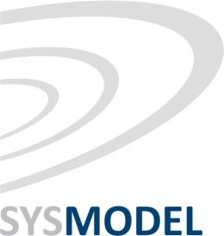
Robust and Flexible Mapping for
Real-time Distributed Applications during the Early Design Phases
Junhe Gan¹, Paul Pop¹, Flavius Gruian² and Jan Madsen¹
¹Technical University of Denmark, Denmark
²Lund University, Sweden

Slide 2
Motivation
Example life-cycle phases
Early design decisions have a high impact
  More effort should be spent during the early design phases
Challenge: uncertainties

Slide 3
Early phases: uncertainties
Uncertainties:
Functionality requirements
Worst-case execution times
Application
model
System platform model
Hard real-time applications
Distributed heterogeneous platforms
System-level
design tasks
Architecture selection
Mapping
Scheduling
Model of system implementation
Analysis
Software
synthesis
Hardware synthesis
Schedulability
Flexibility

Slide 4
Outline
Early design phases
  Design decisions and uncertainties
Modeling uncertainties
  Worst-case execution time
  Functionality requirements
Problem formulation: mapping optimization
  Motivational examples
Multi-objective optimization strategy
  Robustness vs. flexibility
  Genetic Algorithm approach
  Experimental results
Conclusions and message

Slide 5
WCET uncertainties
Details of the PE not fully known
Full implemen-tation not yet available
PE
PE
τ_{i}
τ_{i}
“Percentile method”
  50th percentile: 30 ms
  90th percentile: 60 ms
Execution time e_{i} varies because of architectural features of the PE, input data, etc.
The uncertainty in the worst-case execution time (WCET) c_{i}
is due to lack of information

Slide 6
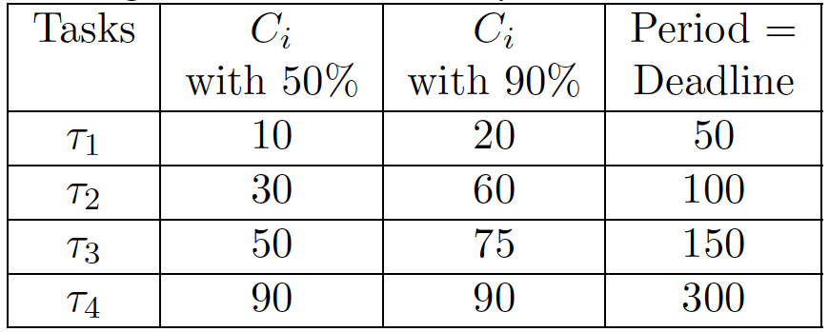
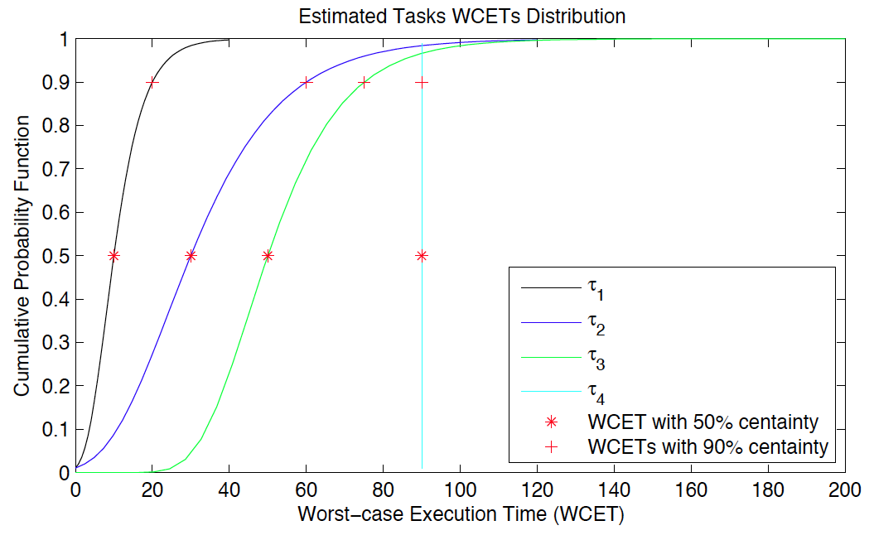
Example WCET modeling
Hard real-time applications
Knowing the 50th and 90th percentiles, we can determine the cumulative distribution function of the WCET c_{i}

Slide 7
Uncertainty in functionality requirements
Changes in requirements
New version of a product
Evolution of a product line
We capture the functionality
as a set of tasks, baseline S₀
We capture the changes in functionality as scenarios
S₁ is a functionality update, replaces τ₁ with τ₅
S₂ adds τ₆ to
increase performance
S₃ adds a new application,
with tasks τ₇ and 8
S₄ is a combination of
S₁ and S₂

Slide 8
Mapping problem formulation
Given
  Number of processing elements (PE) in the architecture
  Baseline functionality S₀
  Set of future scenarios S_{i}
Determine
  Mapping M₀ of the tasks in S₀ such that
  the robustness and flexibility of M₀ is maximized
    Robustness the tasks in S₀ have a high chance to be schedulable
    Flexibility M₀ has a high chance to successfully accommodate S_{i}
Notes
  This problem is especially relevant for system integrators
  Changing the mapping is costly, especially in areas such as safety-critical

Slide 9
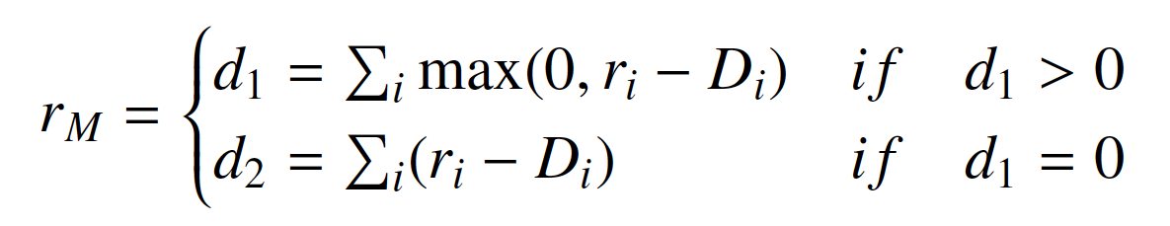
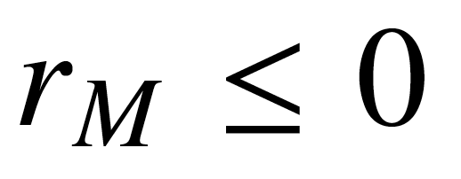

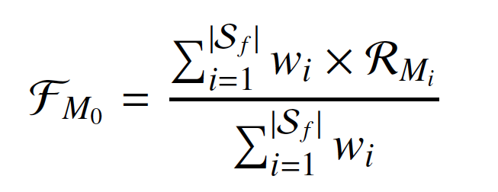
Robustness and flexibility
Given a mapping alternative M,
the degree of schedulability is
means the mapping M is schedulable
A larger negative value indicates the
mapping is “more schedulable”
Robustness
  Tasks in S₀ have a high chance to be schedulable
    For a mapping M_{k} for a task set S_{k},
    it’s the probability that all tasks in S_{k}
    are schedulable
Flexibility
  M₀ has a high chance to accommodate all S_{i}
    M_{i} is the mapping for a future scenario S_{i}
    on top of S₀, such that R_{Mi} is maximized

Slide 10
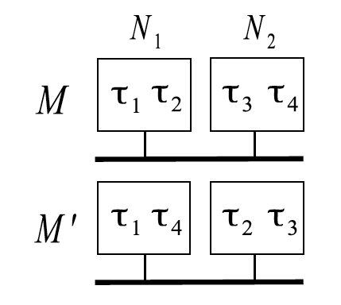
Motivational example: robustness
MRF our proposed solution, Mapping for Robustness and Flexibility
SFM Straightforward Mapping
uses the expected value of the WCET probability density function
ignores the future scenarios S_{i}
Let’s use MRF vs. SFM to compare the robustness of M and M’

Slide 11
Motivational example: flexibility
Baseline functionality
Future scenarios
(×) Exhaustive search
Pareto-optimal solutions
(+) Straightforward Mapping, SFM
ignores uncertainties

Slide 12
Calculating the robustness
Monte Carlo Simulation: repeat 100,000 times
For each τ_{i}, randomly generate c_{i} from the pdf of the WCET
robustness
c_{i}
M_{k}
Schedulability analysis
r_{i}
Calculate and record the sch. degree r_{Mk}
(r_{i} – D_{i})
  Stochastic schedulability analysis is used when the execution
  time e_{i} varies and assumes that each job has a different e_{i}
  We are interested in the uncertainty in the WCET c_{i},
  and in our case each job is assumed to have the same c_{i}
  We are not interested in schedulability guarantees, but only in guiding the search. The guarantees will come at the later stages, when more information is available.

Slide 13
Kernel Smoothing Density Estimate (KSDE)
Monte Carlo Simulation (MCS) is too slow to be used inside
design space exploration (100,000 iterations)
Instead, we use KSDE to approximate the robustness (1,000 samples)

Slide 14
Mapping for Robustness and Flexibility (MRF)
Multi-objective optimization strategy
  Pareto-front (×) of non-dominated solutions
Genetic algorithm for determining M₀
of the baseline functionality S₀
Non-dominated Sorting Genetic Algorithm-II
  For each candidate solution M_{k}
    We calculate the robustness using KSDE
    We calculate the flexibility based on the robustness of each M_{i}
      We have to know the mapping M_{i} of each future scenarios S_{i} on top of M_{k}
      We use a Greedy mapping approach to determine the
  Greedy mapping M_{i} of each future scenarios S_{i} on top of M_{k}
    Only the tasks which are not in S₀ have to be mapped
    Greedy: tasks are sorted on utilization; mapped on the lowest utilized PE

Slide 15
Experimental setup
Baseline scenario
  We have varied the size of the system from 22 tasks (S₀) and 3 PEs
  to 84 tasks (S₀) and 10 PEs
    4 real-life case studies from Embedded System Synthesis Benchmark Suite
    8 eight synthetic benchmarks generated using Task Graphs For Free
Future scenarios
  For each benchmark, we have four future scenarios
Implementation
  Matlab 2010 and run on an Intel Core i7 CPU 920 (2.67 GHz)
  NSGA-II parameters are tuned such that no improvements were seen
  after a very long runtime

Slide 16
Experimental results: synthetic benchmarks
synthetic 1
(×) Mapping for Robustness and Flexibility MRF, Pareto-front
(+) Straightforward Mapping, SFM
uses the expected value of the WCET probability density function
ignores the future scenarios S_{i}

Slide 17
Experimental results: real-life case studies
consumer
(×) MRF, Pareto-front
(+) Straightforward Mapping, SFM

Slide 18
Conclusions and message
Early design phases: high impact, but many uncertainties
We have modeled the following uncertainties
  Worst-case execution time robustness
  Functionality (scenarios) flexibility
Problem: mapping of hard real-time applications on distributed heterogeneous architectures during the early design phases
Genetic Algorithm-based multi-objective optimization heuristic
  More effort should be spent on the early design phases
  It is very important to model the uncertainties and
  to take them into account during design space exploration

