Slide 1
Energy/Reliability Trade-offs in Fault-Tolerant Event-Triggered Distributed Embedded Systems
Junhe Gan, Flavius Gruian, Paul Pop, Jan Madsen

Slide 2
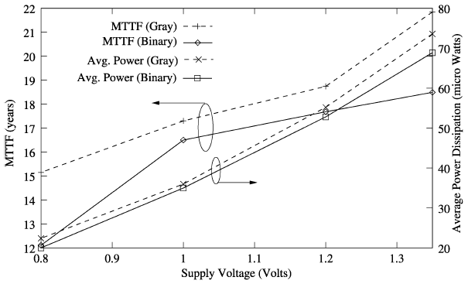
Motivation
The impact of power supply scaling
on fault-tolerance (MTTF) and power dissipation
Maheshwari, A. et al., Trading off transient fault tolerance and power consumption in deep submicron (DSM) VLSI circuits , VLSI Systems, pp. 299-311, 12(3), 2004.
Notes:
First we would like to introduce our motivation of this paper. The trends in CMOS technology, applications, and operating conditions are resulting in circuits with higher power consumption and higher affected to transient faults. Bus systems like mobile phones, wearable computes must be designed for not only fault tolerance but also low-power consumption due to limited battery life.
However, the objectives between high fault tolerance for transient faults and low power consumption are conflicting. The figure here show a simulation result. When the supply voltage is scaled down, the power consumed is reduced, but the MTTF is reduced as well.
Therefore, we want to derive the energy/reliability design, which eliminate the negative impact of energy minimization on reliability with minimal decrease in energy saving.

Slide 3
Outline
Architecture, Application and Energy Models
  Reliability model
  Energy/reliability trade-off model
  Schedulability analysis
Problem Formulation
  Example
Optimization Strategy
  TABU search-based algorithm
Experiment Results
Conclusion and Contributions

Slide 4

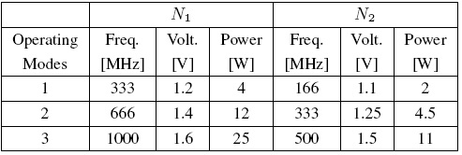
Architecture Model
  A set of heterogeneous Processing Elements
  interconnected by a communication channel.
  Each PE has a set of operating mode
  Each operating mode, we know
Notes:
We start talking with architecture model. We consider a set of heterogeneous processing elements interconnected by a communication channel. Each PE is characterized by a set of operating mode, and for each operating mode, we know the corresponding operating frequency, voltage and power dissipation.
A simple architecture example is shown in the right-upper-corner. Two PEs are connected by a bus. The operating modes of each PE are described in the bottom figure.
For an instant, if we execute a task in the highest operating mode of PE N1, the operating frequency is 1000 megahertz, the supply voltage is 1.6 volts, and the power dissipation is 25 watts.

Slide 5
Reliability Model
K = 2
N₁
τ₁
τ₁
τ₁
τ₁
N₂
τ₁
N₃
τ₁
Re-execution:
Transient faults
Replication:
Transient faults /
Permanent faults
Notes:
An PE may experience different kinds of faults during its execution. For example, permanent faults and transient faults. We could have many ways to tolerate faults. For an instance, we could re-execute the task twice for tolerating 2 transient faults within one PE, or we could replicate the task twice to tolerating 2 transient or permanent faults.
The reliability of executing a task, \tau_i, is defined as the probability of its successful execution, and expressed as the first equation. The \lambda is the average fault rate, and c is the execution time of the task.
The second and the third equations are calculating the reliability when tolerating the faults by re-execution and replication. The last equation is calculating the reliability of an application, which actually multiplies the reliability of every task.
In this paper, we consider to tolerate faults through task replication.

Slide 6
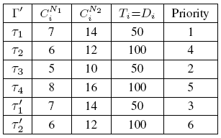
Energy and Application Model
Application Model:
  A set of periodic tasks
  for each task, we know
    Unique priority
    Critical/non-critical task
Energy Model:
Sum of
mode-switching overheads
Notes:
We model applications as a set of periodic tasks. For each task, we know CiNj, the WCETs when the task be mapped on Nj and executed in the maximum operating mode, the period Ti, and the deadline Di. In this paper, we assume that the deadlines are smaller or equal to the periods, and each task is assigned a unique priority.
There are two kinds of tasks, critical or non-critical. For each critical task, we assume the designer will specify a desired redundancy level, that is, how many replicas of the task will be introduced. The redundancy level depends on the functionality and implementation of the task.
An application tasks set example is given in the table. Tasks are going to map on two PEs which described in the previous slides. \tau_1 and \tau_2 are critical tasks and \tau’_1 and \tau’_2 are their replicas. That means, the redundancy level of \tau_1 and \tau_2 are 1.
In this paper, we address the energy consumption in PE, which is a major component of the system-level energy consumption. Since we know directly how much Watts are consumed when the PE runs in a chosen operating mode from the architecture model, by multiplying the task execution time, we obtain the power consumption for running the task. We could also consider the overheads due to the mode-switch among tasks if needed.

Slide 7
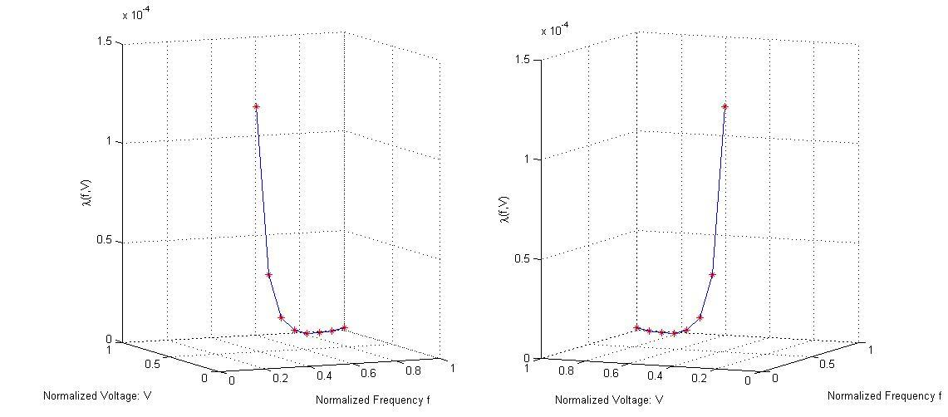
Energy/reliability Trade-off Model
  The average failure rate of a system increases exponentially
  when the supply voltage and the operating frequency decreases
Notes:
The energy consumption is not only linked to performance, but also reliability. Because switching operating modes has an impact on the average failure rate. When the supply voltage and the operating frequency are scaling down, the fault rate increases exponentially.
In this paper, we assume that when PE runs in the minimum voltage and frequency level, the fault rate increases 100 times compared to that of PE running in the maximum voltage and frequency level. The two figures show the fault rate changes with respect to the normalized operating frequency and normalized supply voltage, which are calculated by the proposed fault rate equation.

Slide 8
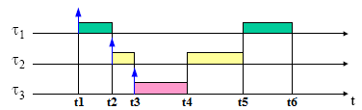
Schedulability Analysis
Fixed-Priority
Preemptive Scheduling
Response Time Analysis
Degree of Schedulability
Notes:
In this paper, we consider tasks are scheduled using fixed-priority preemptive scheduling. In the figure, we show an example of fixed-priority preemptive scheduling. At any given time, the PE executes the highest priority task of all those tasks that are currently ready to execute. For instance, at time t2, \tau_2 releases, since its priority higher than \tau_1’s priority, the preemption happens. At time t4, \tau_3 finish, since \tau_2 has higher priority, the PE resume\tau_2 first.
Our focus in this paper is exploring the trade-off between energy and reliability. Hence, we consider the basic response time analysis for the schedulability analysis. In order to tell which of the design alternatives is more schedulable than the others, we use degree of schedulability, which is expressed in the last equation. Instead of only comparing the response times with the deadlines, the degree of schedulability basically counts for the still available slacks.

Slide 9
Problem Formulation
Given:
  Application
  Architecture
  Reliability Goal
  Tolerate k-faults for each task
We are interested to determine:
  the mapping for allocating each task
  the operating mode for executing each task
Such that:
  all tasks meet their timing requirements
  the application reliability meets the given reliability goal
  the energy consumption of system is minimized
Notes:
Now we are ready to draw the problem formulation.

Slide 10
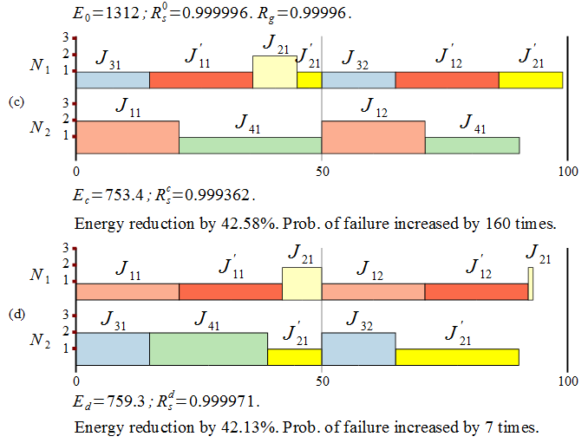
Motivational Example
Notes:
We continue with a motivational example. The application model and architecture model are already shown as example in the previous slides.
We use a reference as initial solution, which runs all the tasks in the maximum speed operating mode and attempts to reduce the energy consumption by mapping the tasks on the low power consumed PEs, without missing the deadlines. The result is calculated in the first row.
Then we perform the typical approach for energy minimization, which decide the mapping and the operating mode for each task such that the energy consumed is minimized and the deadlines are satisfied. The result is shown in the first picture. The implementation meets all tasks’ deadlines and reduces the energy by 42.58%, compared to the initial solution, but its probability of failure is 160 times greater than that of the initial solution.
We consider the reliability impact in another implementation. By carefully deciding the mapping and operating modes as shown in second picture, the implementation fulfills all timing and reliability requirements, with only 0.45% loss in energy saving while comparing with the energy reduction result between these two implementations.
Therefore, it is possible to reduce the negative impact on reliability without a significant loss of energy savings.

Slide 11
Optimization Strategy
NP-hard problem:
  ways of allocating tasks to PEs.
  ways of executing tasks at operating modes of an PE.
Search the optimal solution by heuristic algorithm.
Minimize the cost function:
Energy
Consumption
Timing
Requirement
Reliability
Goal

Slide 12
Tabu Search-based Algorithm
Searching Loop:
Mapping (M-moves)
Move a task from an PE to another PE
Or Swap two tasks between PEs
Operating Mode (L-moves)
Change a task’s operating mode
Select New Solution
Save Best Solution (if it is)
First attempt: An improved solution
Otherwise: Randomly select
a non-improved & not-tabu solution
Design Transformations
Use and Maintenance of
Tabu-list

Slide 13
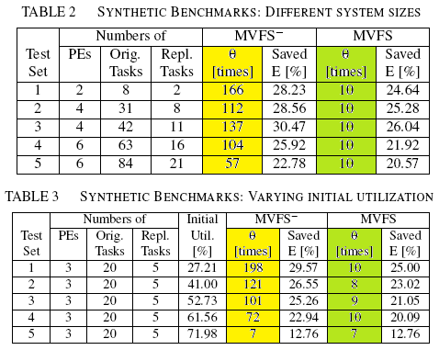
Experimental Results
Notes:
For the evaluation of our approach, we used ten synthetic benchmarks and five real-life case studies to perform three experiments.
The first experiment we evaluate the quality of our proposed algorithm as the systems become larger. We could see in table 2 that five synthetic benchmarks of 10 to 105 tasks mapped on 2 to 6 difference kinds of PEs.
The second experiment we determine the ability of our proposed algorithm to find good quality solutions as the utilization of the system increases. We could see in table 3 we varied the execution times resulting in five cases corresponding to various initial utilization, from 27.21% to 71.98%.

Slide 14
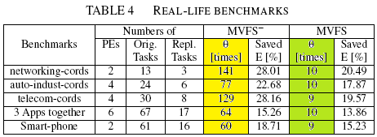
Experimental Results
Notes:
The third experiment we evaluated our proposed algorithm in real-life case studies.
All the experiment results show that minimizing the energy without considering reliability leads to a dramatic increase in the probability of failure, which increases more than 100 times in most cases. However, using our proposed algorithm is able to keep the system reliability within the specified reliability goal, without a significant loss in energy savings.

Slide 15
Conclusion and Contributions
  Conclusion:
Contributions:
  Energy/reliability model
  Combine deciding mapping and operating mode assignment
    Optimization algorithms for this energy/reliability trade-offs problem
It is possible to eliminate the negative impact of energy minimization on reliability
by carefully considering the energy/reliability trade-offs during optimization.
Notes:
In conclusion, It is possible to eliminate the negative impact of energy minimization on reliability by carefully considering the energy/reliability trade-offs during optimization.
Our contributions, as this paper, are including deriving a reasonable energy/reliability model, combining the decision of mapping and operating mode assignment, and proposing the optimization algorithm for this energy/reliability trade-off problem.

