Slide 1
Fault-Tolerant Architecture Design for Flow-Based Biochips
Morten Chabert Eskesen

Slide 2
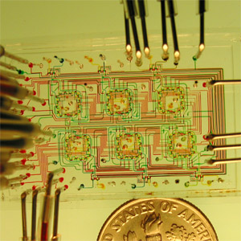
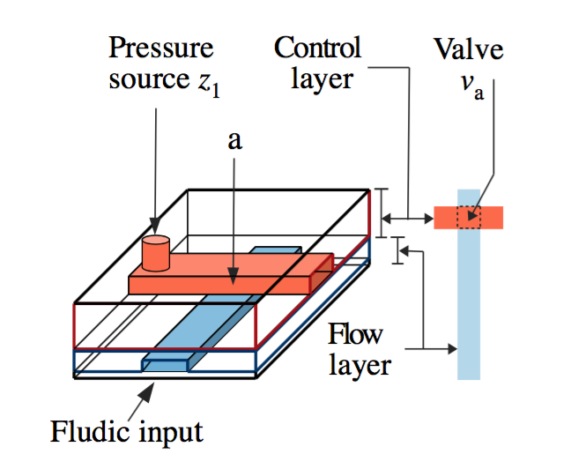
Flow-Based Biochips
Can run biochemical applications
Microreaction Technology
Cell Biology
Diagnosis Testing
Basic building block

Slide 3
Outline
Components
Faults, Causes and Fault Modeling
Component Library Extension
Fault-tolerant components
Problem Formulation
Motivational Example
Architecture Evaluation
Architecture Synthesis
Design Transformations
Proposed Solutions
Experimental Evaluation
Conclusions

Slide 4
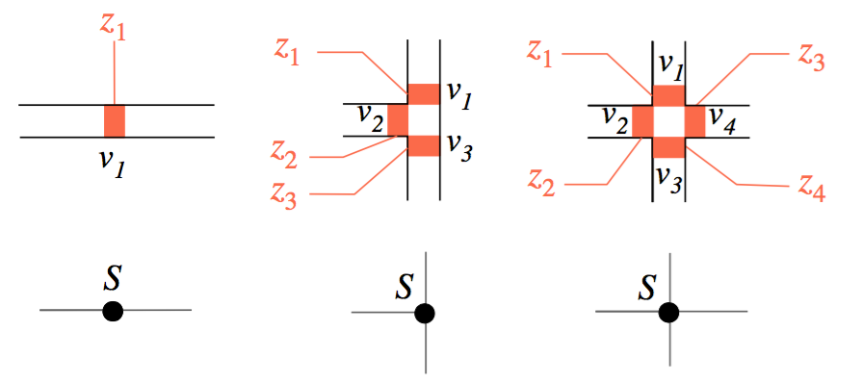
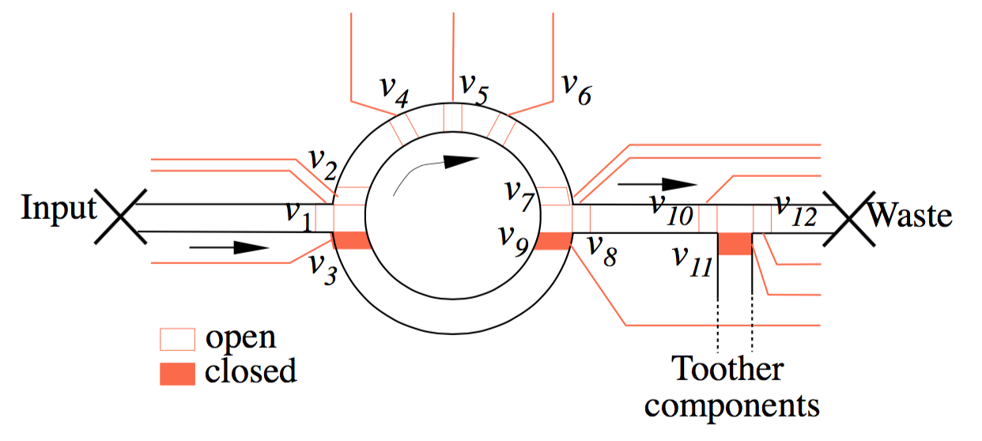
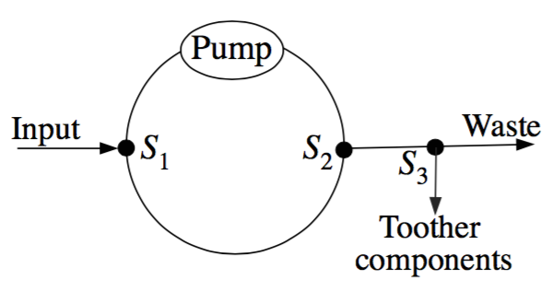
Components
Valves combine to form more complex units
Microfluidic Switch
Microfluidic Mixer

Slide 5
Video of Mixer
Microfluidic Mixer
http://groups.csail.mit.edu/cag/biostream/

Slide 6
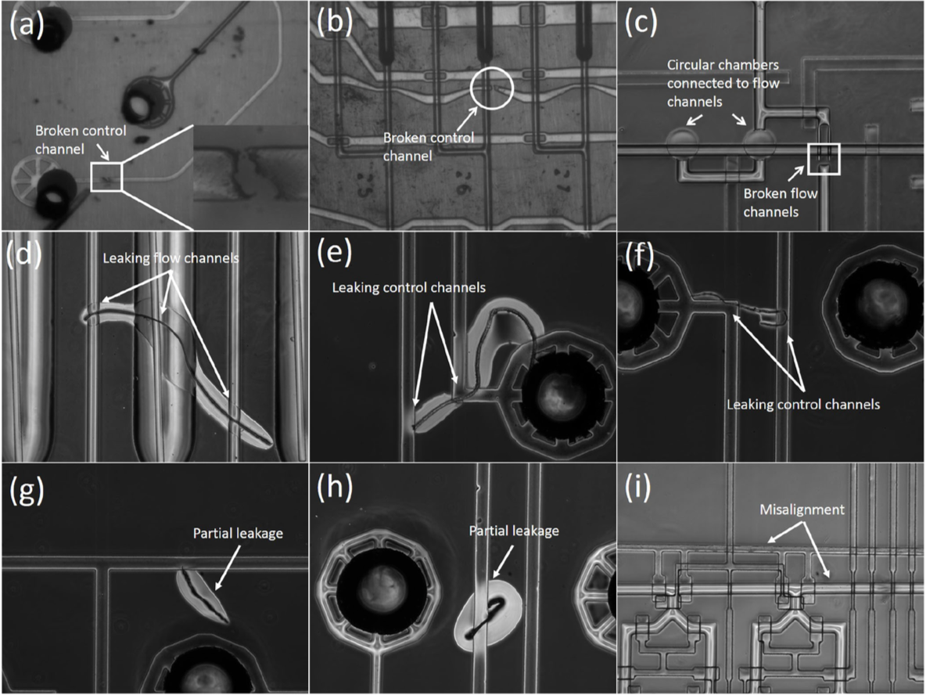
Faults, Causes and Fault Modeling
Block (a)-(c)
Leak (d)-(f)
Partial leak (g)-(h)
Misalignment (i)
Faulty pumps
Degradation of valves
Dimensional errors

Slide 7
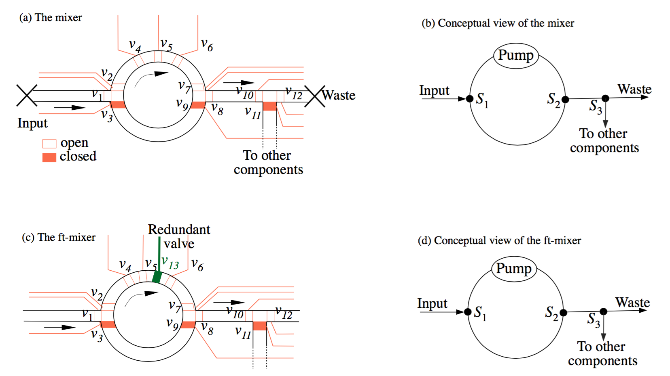
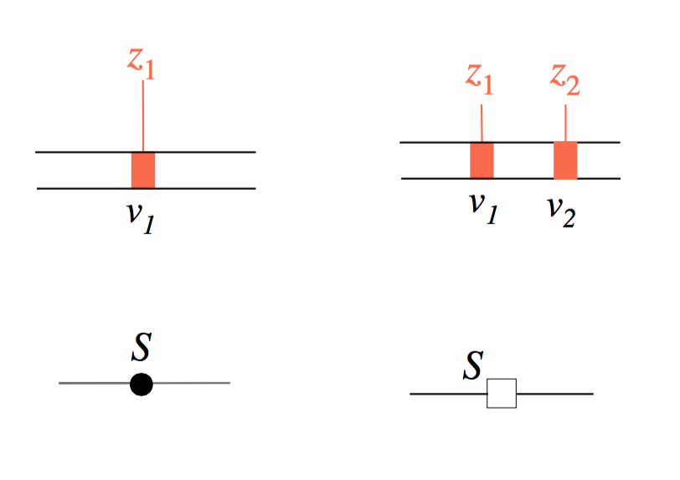
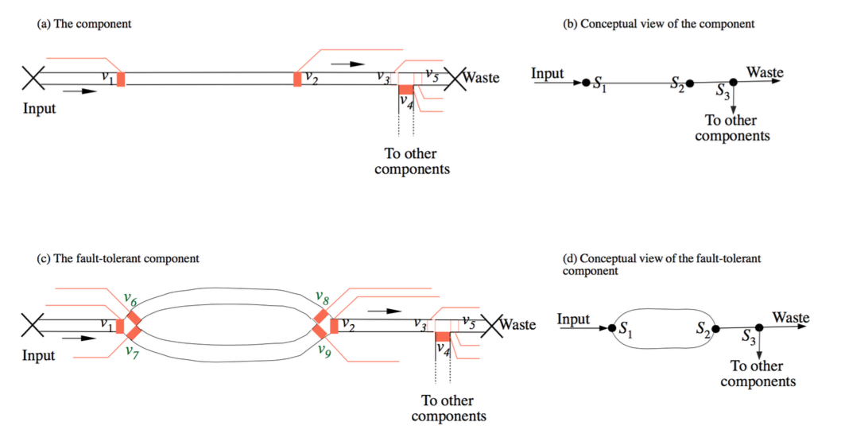
Component Library - Extension
Switch
Mixer
Heater
Detector
Filter
Separator

Slide 8
Problem Formulation
Given
A netlist (components and their interconnections)
A component library L
An application graph G with a deadline
A fault model Z
Determine
A fault-tolerant netlist
Such that
The biochip is fault-tolerant and
It minimises the cost of the architecture

Slide 9
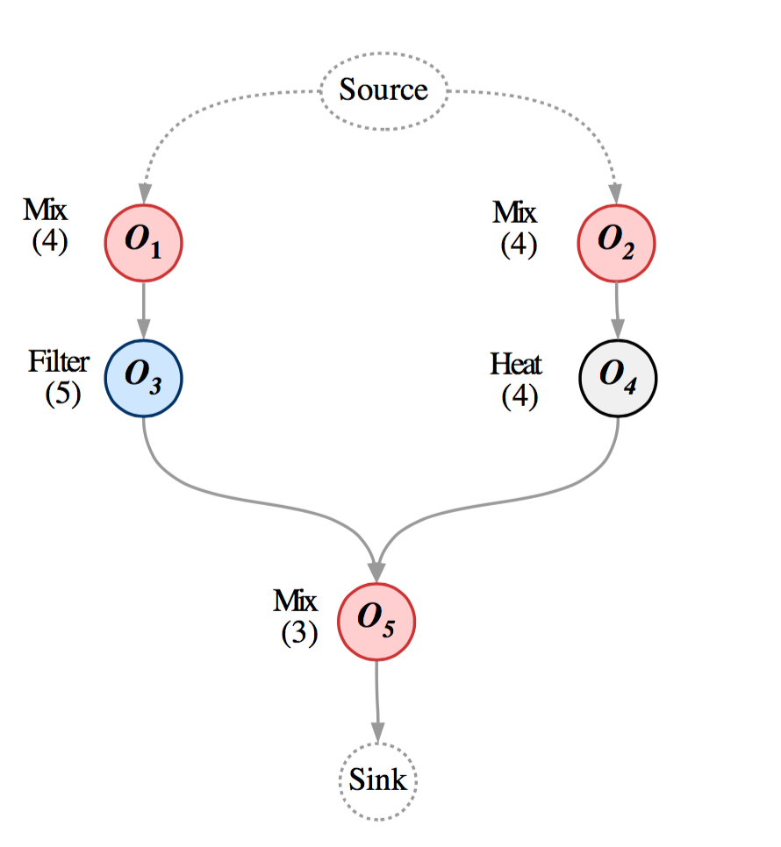
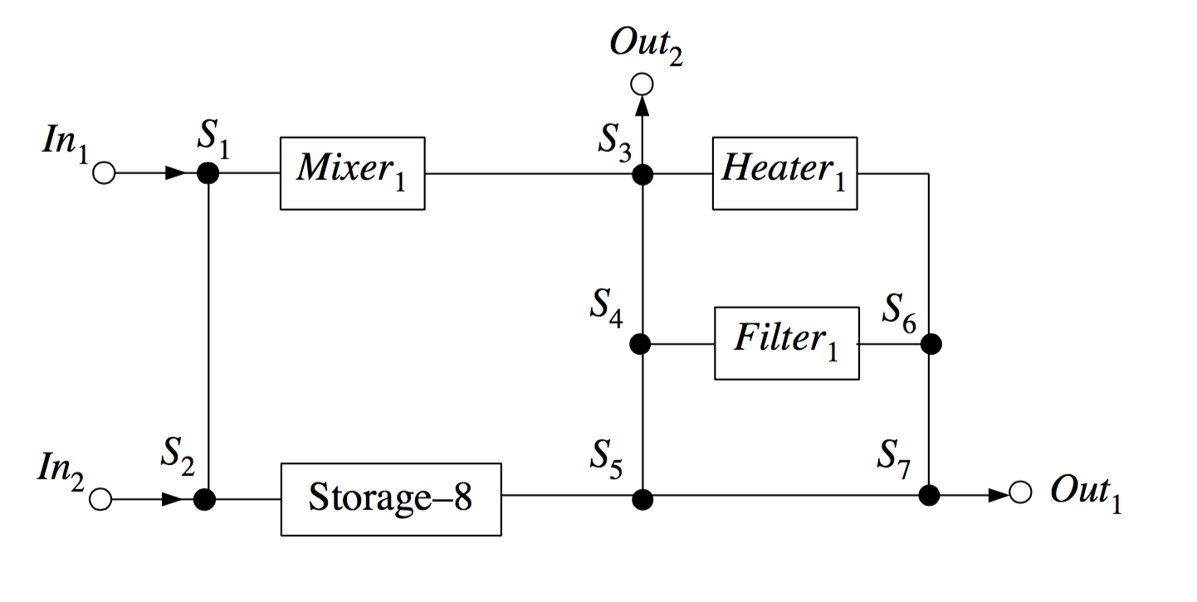
Motivational Example - Setup
Initial architecture
Application Graph

Slide 10
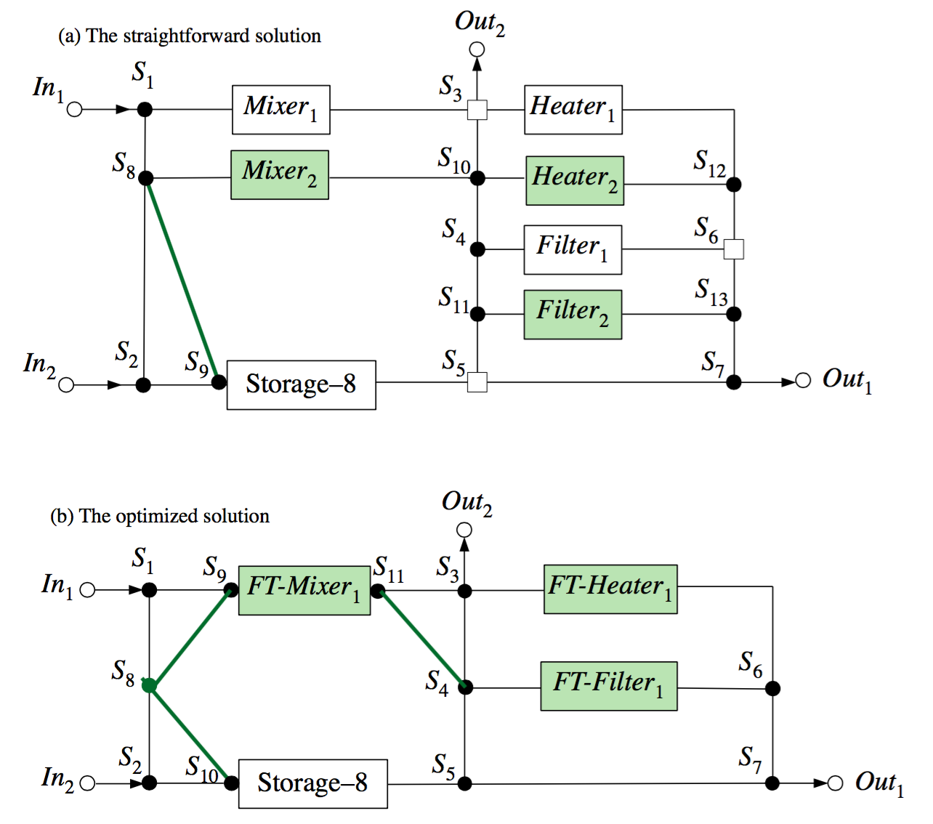
Motivational Example - Solution
Straightforward solution
Redundant components
Cost: 129
Optimised solution
Fault-tolerant components
Cost: 96

Slide 11
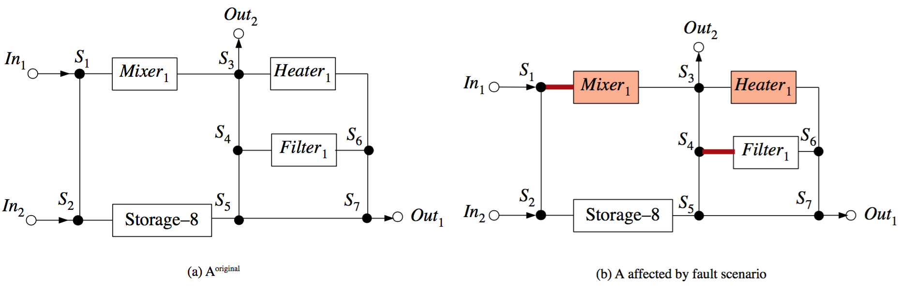
Architecture Evaluation
Fault scenario generation
Each iteration
Applies a fault scenario
Determines connectivity
Finish time, δ, of the application
Channel S₁ → Mixer₁ is blocked, Channel of Heater₁ suffers from a block defect.
A valve in the pump of Mixer₁ and the valves controlling the channel towards S₃ and the channel towards S₅ of S₄ are stuck open
Connectivity
1 if connected, 0 otherwise
Determined by Breadth First Search
Considers blocked route and valve faults on switches
Scheduling
Maximum of 0 or δ - application deadline
Determined by List Scheduling
Routes determined by Breadth First Search
Physical constraints
Sum of
Total number of valves
Total number of connections

Slide 12
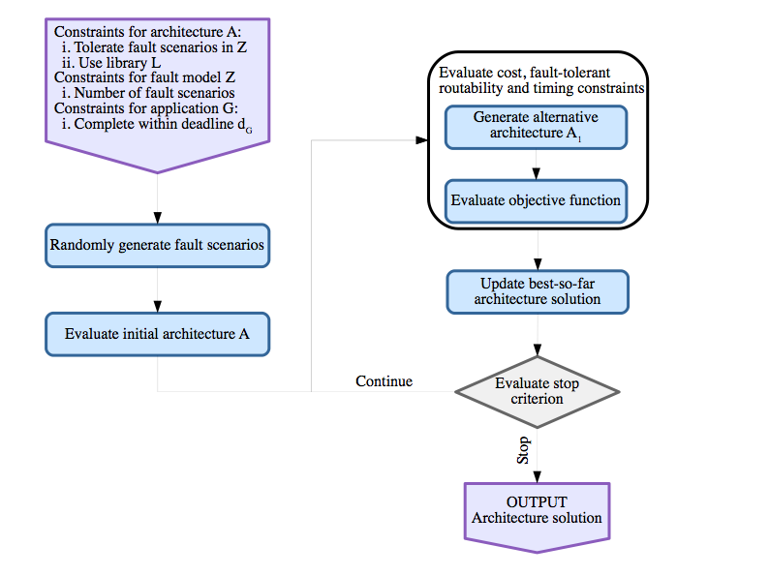
Architecture Synthesis
Two metaheuristics:
Simulated Annealing
GRASP

Slide 13
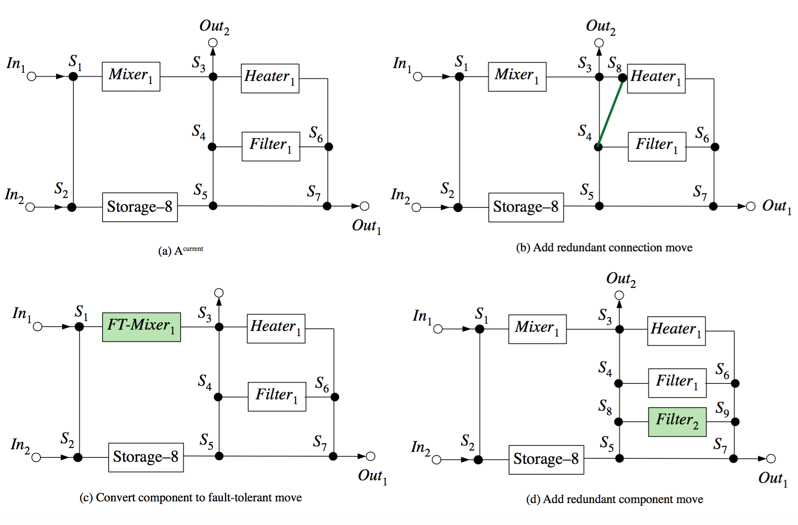
Design Transformations
Add redundant component
Make component fault-tolerant
Add redundant connection
Remove redundant component
Make component non fault-tolerant
Remove redundant connection

Slide 14
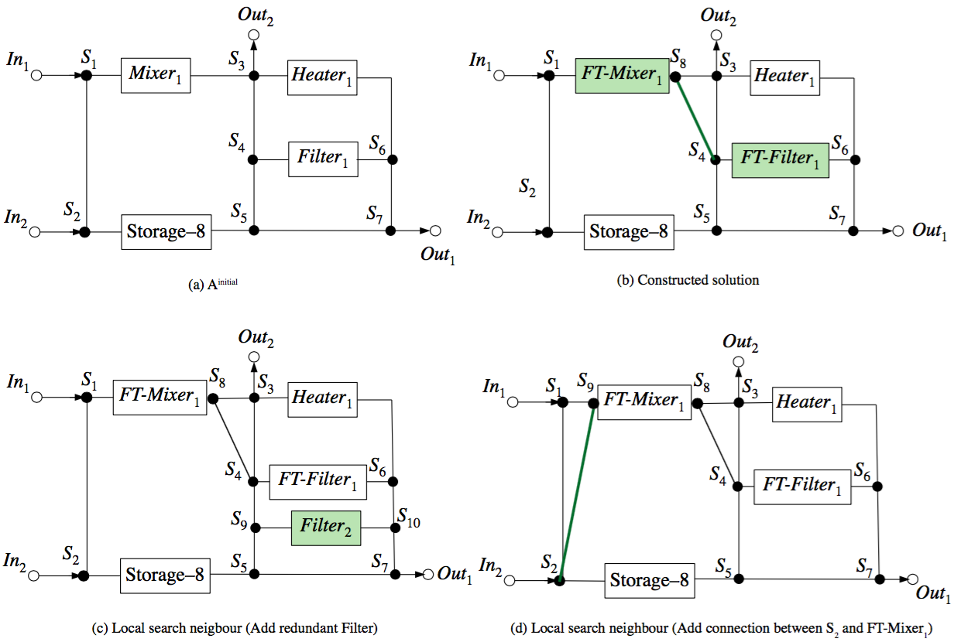
Greedily Randomized Adaptive Search Procedure
Two phases
Construction phase
Local search phase
Candidate list
Ranking of components
RCL
Moves

Slide 15
Methodology
Steps in the methodology:
Architecture design
Fault-tolerant architecture synthesis
Considering an application and a fault model
Physical architecture synthesis
Fabrication
Testing
If a fault is present and not in the fault model or it is not tolerated, discard the chip
Or if the application is not schedulable, the chip is discarded

Slide 16
Experimental Evaluation
Objective function evaluation
Initial features of benchmarks
The resulting netlists of the benchmarks

Slide 17
Experimental Evaluation
Yield evaluation
Initial features of benchmarks
Only benchmark S-1 used and GRASP was the algorithm
The result of yield evaluation

Slide 18
Conclusions
Extended the component library with fault-tolerant components
Proposed a fault-model for flow-based biochips
Synthesising a fault-tolerant architecture
Both algorithms produce fault-tolerant netlists for all benchmarks
GRASP provided better results in terms of solution quality and performance
The yield evaluation proved that even generating a fraction of the possible fault scenario can lead to good fault-tolerance on all fault scenarios

Slide 19
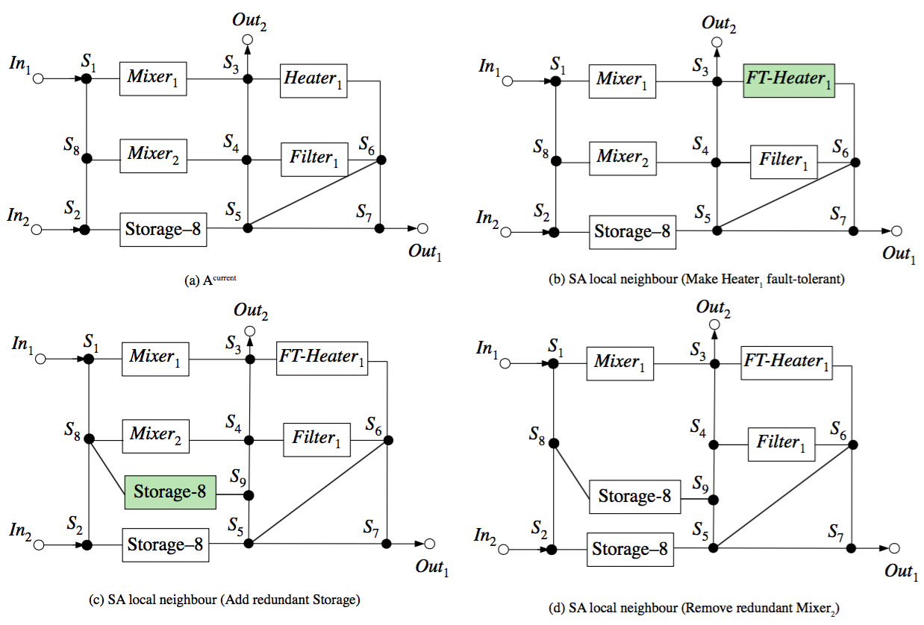
Simulated Annealing
Initial solution
Solution acceptance
Temperature cooling
Moves

Slide 20
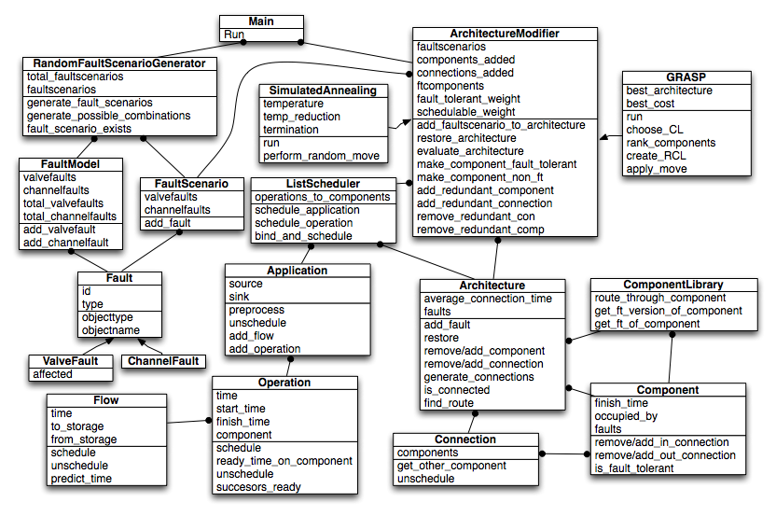
Class Diagram

