Slide 1
Compilation and Synthesis for
Fault-Tolerant
Digital Microfluidic Biochips
Mirela Alistar

Slide 2
Biochips
Can run biochemical applications
  In-vitro diagnostics
  Drug discovery
  Biotech
  Ecology
Digital microfluidic biochip

Slide 3
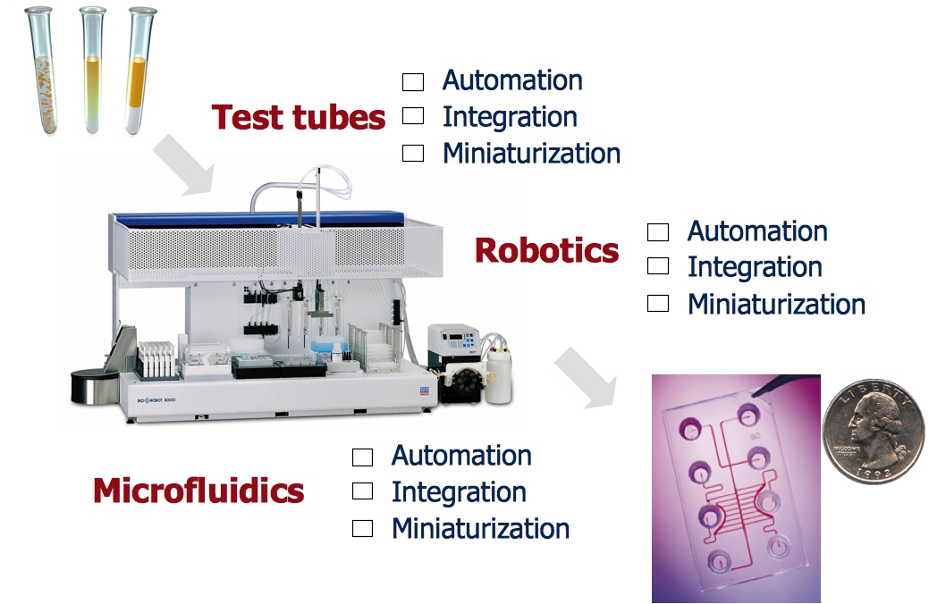
Motivation for biochips
Note: show a continuous flow biochip
Automation
Integration
Miniaturization
✔
Automation
Integration
Miniaturization
✔
✔
Automation
Integration
Miniaturization
✔
✔
*This slide was created by prof. K. Chakrabarty, Duke University. Used with permission.

Slide 4
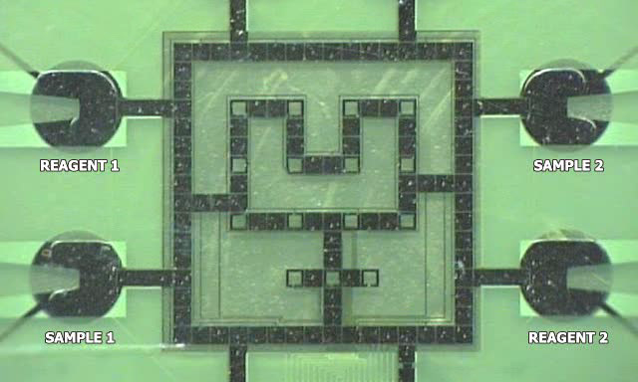
Digital Microfluidic Biochip (DMB) example
Moving droplets -> Biochemical application

Slide 5
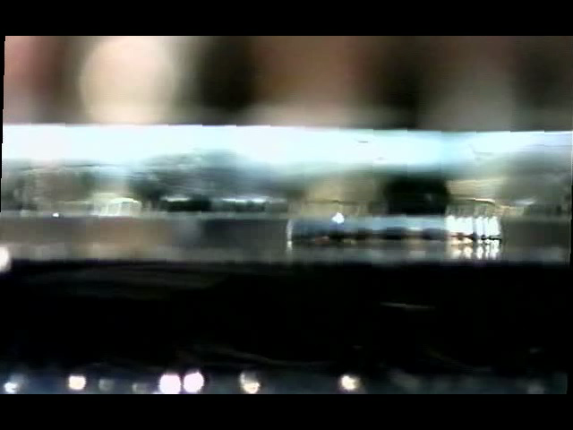
Electrowetting on dielectric

Slide 6
Biochip architecture model

Slide 7
Biochemical application model
In-vitro diagnostics application

Slide 8
Design methodology
  The architecture of the biochip is decided
  assuming maximum k permanent faults
Architecture design
  The biochip is fabricated
Biochip fabrication
  The biochip is tested for permanent faults
  If more faults than k, then the biochip
  is discarded
Biochip testing
  If application does not complete within deadline, then the biochip is discarded
Application compilation
  The application is executed on the biochip
Operation
  The DMB is discarded or stored
  if the results are needed later
Disposal

Slide 9
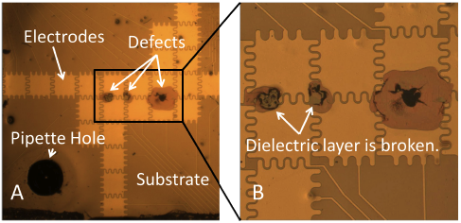
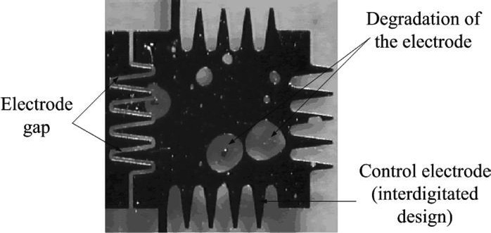
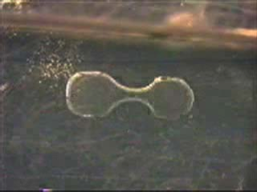
Motivation: faults
Permanent faults
Transient faults
Application failure
Unbalanced split [3]
Dielectric breakdown [1]
Insulator degradation [2]
It is imperative to develop fault-tolerant strategies.
[1] Hu et. al, Fault detection, real-time error recovery, and experimental demonstration for DMBs
[2] Su et. al, Ensuring the operational health of droplet-based microelectrofluidic biosensor systems
[3] R.B. Fair, University Lecture on Biochip Engineering

Slide 10
Outline
Background and motivation
System models
Compilation for error recovery
  Problem formulation and example
  Redundancy Optimization Strategy
  Experimental results
Synthesis of application-specific architectures
  Problem formulation and example
  Tabu-Search synthesis strategy
  Fault-tolerant architecture evaluation
  Experimental results
Contributions
Conclusions

Slide 11
Online compilation for error recovery
Transient faults?

Slide 12
Error propagation model
8%
8%
11.4%
8%
Threshold ≤
17.4%
Error propagation model [4]
0%
Detection
[4] Zhao et. al Integrated control-path design and error recovery in the synthesis of digital microfluidic lab-on-chip

Slide 13
Time vs. Space redundancy
Time redundancy
  The recovery operations are executed after the error is detected
  In case of no error, no delays are introduced
  In case of error, the recovery time delays the execution of the application
Space redundancy
  The recovery operations are executed before the error is detected
  In case of error, the recovery time is minimized
  In case of no error, it may delay the execution of regular operations
Recovery subgraph

Slide 14
Time redundancy graph model
Next
operation

Slide 15
Space redundancy graph model
Next
operation

Slide 16
Problem formulation
Given
  Biochip architecture
  Biochemical application (deadline)
  Module library containing the area and execution time for each operation
Determine
  Online the necessary recovery actions
  Such that
    The number of tolerated faults is maximized
    The application deadline is satisfied

Slide 17
Motivational example
Application graph
Biochip architecture
Placement of modules on biochip
Application graph with detection operations
Allocation of modules
Binding and schedule of operations

Slide 18
Motivational example
Deadline: 25 s
Scenario | Detected by | (a) Only Time redundancy | (b) Only Space redundancy | (c) Time in D₆ Space in D₈ | (d) Time in D₈ Space in D₆
1 | No faults | 18 | 18 | 18 | 18
2 | {D₆} | 36 | 26 | 30 | 22
3 | {D₈} | 28 | 24 | 23 | 23
4 | {D₆, D₈} | 46 | 36 | 30 | 25
A combination of time and space redundancy is the best solution
Schedule of operations for case 3a

Slide 19
Online Recovery Strategy
Redundancy assignment
Recovery
Redundancy Optimization Strategy
Compilation
Compilation

Slide 20
Online error recovery strategy
Redundancy Optimization Strategy (ROS)
  Determine the detection operations
  Prioritize the detection operations
  Assign space redundancy
  Assign time redundancy
Redundancy assignment
Recovery
Redundancy assignment
Redundancy Optimization Strategy
Redundancy Optimization Strategy
Compilation
Compilation
Compilation

Slide 21
Online error recovery strategy
Redundancy assignment
Recovery
Redundancy Optimization Strategy
Redundancy Optimization Strategy
Compilation
Compilation
Compilation

Slide 22
ROS example
Recovery
Recovery
Redundancy assignment
Recovery
Redundancy assignment
Redundancy assignment
Redundancy Optimization Strategy
Redundancy Optimization Strategy
Redundancy Optimization Strategy
Compilation
Compilation
Compilation
Compilation
Compilation
Compilation

Slide 23
Experimental results
ROS results for q = 1, 2 and 3 faults
App. (ops.) | Deadline (s) | Arch. | Time (s) q = 1 | Time (s) q = 2 | Time (s) q = 3
PDNA (19) | 60 | 7x7 | 37.25 | 37.25 | 37.4
IDP (71) | 200 | 9x9 | 166.63 | 177.61 | 182.66
CPA (103) | 300 | 11x11 | 219.78 | 219.93 | 244.95
PDNA Interpolation for plasmid DNA
IDP Interpolation dilution of a protein
CPA Colorimetric protein assay
ROS can tolerate faults within the deadline

Slide 24
Contributions
Compilation for error recovery
  Offline compilation
    Fault-tolerant compilation strategy
  Online compilation
    Generalized fault-tolerant application model
    List Scheduling compilation strategy
    Redundancy optimization strategy
      For sensor and CCD-camera
Our online strategy obtains better quality results

Slide 25
Outline
Background and motivation
System models
Compilation for error recovery
  Problem formulation and example
  Redundancy Optimization Strategy
  Experimental results
Synthesis of application-specific architectures
  Problem formulation and example
  Tabu-Search synthesis strategy
  Fault-tolerant architecture evaluation
  Experimental results
Contributions
Conclusions

Slide 26
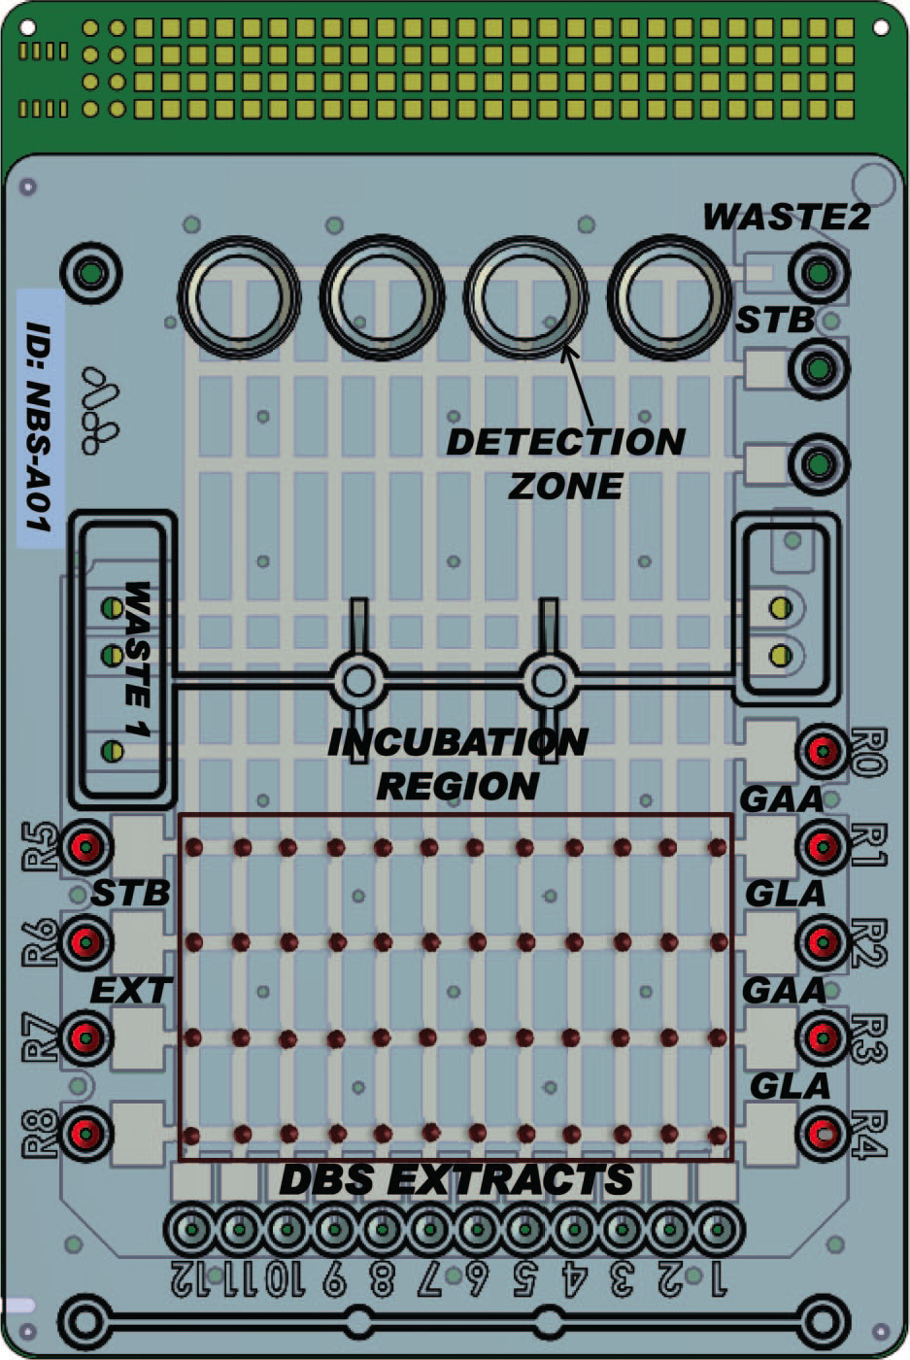
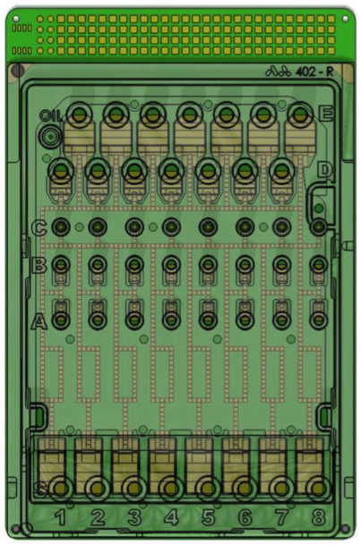
Application-specific biochips
Biochip for newborn screening
(Advanced Liquid Logics, Inc.)
Biochip for sample preparation
(Nugen Technlogies, Inc.)

Slide 27
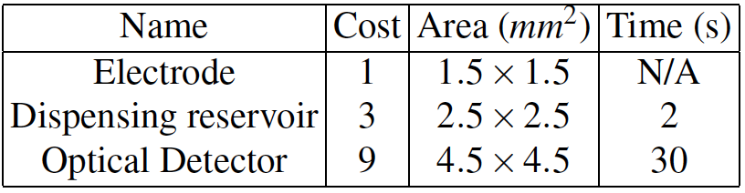
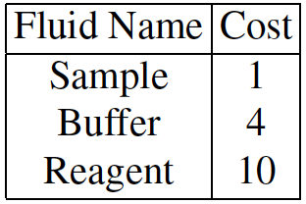
Application-specific architecture models
Component library
Fluidic library
Total Cost = Cost of components + Cost of fluids
Circular-Route Module (CRM)

Slide 28
Motivational Example
Application-specific architecture
Application obtained by repeating 3 times the graph
Rectangular architecture
Cost: 128 units
Cost: 168 units
The application-specific architecture is cheaper

Slide 29
Design methodology
  Location of faults not known
Architecture design
Biochip fabrication
  Location of faults known
Biochip testing
Application compilation
Operation
Disposal

Slide 30
Problem Formulation
Given
  Biochemical application (deadline)
  Maximum number of faults k to be tolerated
  Input libraries
Determine
  A minimum cost application-specific architecture such that
  The deadline is satisfied even for k permanent faults

Slide 31
Tabu-Search (TS) metaheuristic
TS uses moves to explore

Slide 32
Tabu Search
Neighborhood of architecture solutions
Tabu list
Evaluate architectures
Diversification
Add a row of electrodes
Add a reservoir
Initial architecture
Re-place the detector

Slide 33
Tabu-Search (TS) metaheuristic
Check if the application completes
within deadline even in the case of
k permanent faults
Algorithm to test the k-vertex connectivity
in a graph, S. Even, 1975

Slide 34
Compilation for estimation under k faults
Estimation of the application completion time for the currently evaluated architecture under the worst-case scenario
Challenge: fault scenario not known
Our approach:
  List Scheduling (fast and good quality results)
  Guess the worst-case scenario: distribute the faults
  Estimate the impact of faults on the operation execution time

Slide 35
FA-LSR example

Slide 36
Library build
Input
  Biochip architecture
Output
  A library of CRMs
Incremental library build algorithm
  Determine the CRMs impacted by the last move
  Adjust the CRMs
  Estimate the operation execution time for k faults

Slide 37
Experimental results
Application-specific architectures obtained by TS
App. (ops.) | d (s) | k = 0 Arch. C_{RECT} C_{TS} |  |  | k = 1 Arch. C_{RECT} C_{TS} |  |  | k = 2 Arch. C_{RECT} C_{TS}
PCR (7) | 10 | 5x5 | 53 | 47 | 7x6 | 66 | 54 | 8x6 (1,1,1,0) | 72 | 61
PDNA (19) | 60 | 5x5 | 49 | 38 | 6x5 | 54 | 40 | 6x5 (1,1,1,0) | 54 | 49
IDP (71) | 200 | 5x5 | 85 | 74 | 5x5 | 90 | 84 | 5x5 (1,1,1,4) | 90 | 84
25.9 %
PCR Polymerase chain reaction
PDNA Interpolation for plasmid DNA
IDP Interpolation dilution of a protein
TS produces cheaper application-specific architectures

Slide 38
Contributions
Synthesis of application-specific architectures
  Simulated Annealing metaheuristic
    Rectangular modules
    Worst-case operation execution overhead in case of k faults
  Tabu-Search metaheuristic
    Circular-route modules
    Estimation of operation execution overhead in case of k faults
    Incremental library build algorithm

Slide 39
Conclusions
Compilation for error recovery
  Offline compilation
    Errors during split operations
    Considers all possible fault scenarios
    Good quality fault-tolerant schedules
  Online compilation
    Fault-tolerant general application model
    Online redundancy optimization
    Shorter application completion times
Synthesis of application-specific architectures
  Simulated Annealing metaheuristic
  Tabu-Search metaheuristic
  Fault-tolerant compilation
  Operation placement strategy
  Fault-tolerant low-cost architectures

